Slide 1
NASA Living With a Star Annual Briefing
Hilton Parc 55, San Francisco, CA
December 8, 2019
Notes:
STILL

Slide 2
Agenda
Item | Time | Agenda Item | Presenter
1 | 6:30 PM | Welcome | Nicky Fox
2 | 6:35 PM | LWS Program Status | Jeff Morrill / Simon Plunkett
3 | 6:55 PM | LPAG Status | Anthea Coster / Mark Linton / Sabrina Savage
4 | 7:15 PM | Van Allen Probes | Sasha Ukhorskiy
5 | 7:30 PM | GDC Status | Jared Leisner
6 | 7:45 PM | Space Weather Activities | Jim Spann
7 | 8:00 PM | Frontier Development Lab & Jack Eddy Fellowships | Lika Guhathakurtha
8 | 8:15 PM | ADJOURN

Slide 3
LWS Program Status

Slide 4
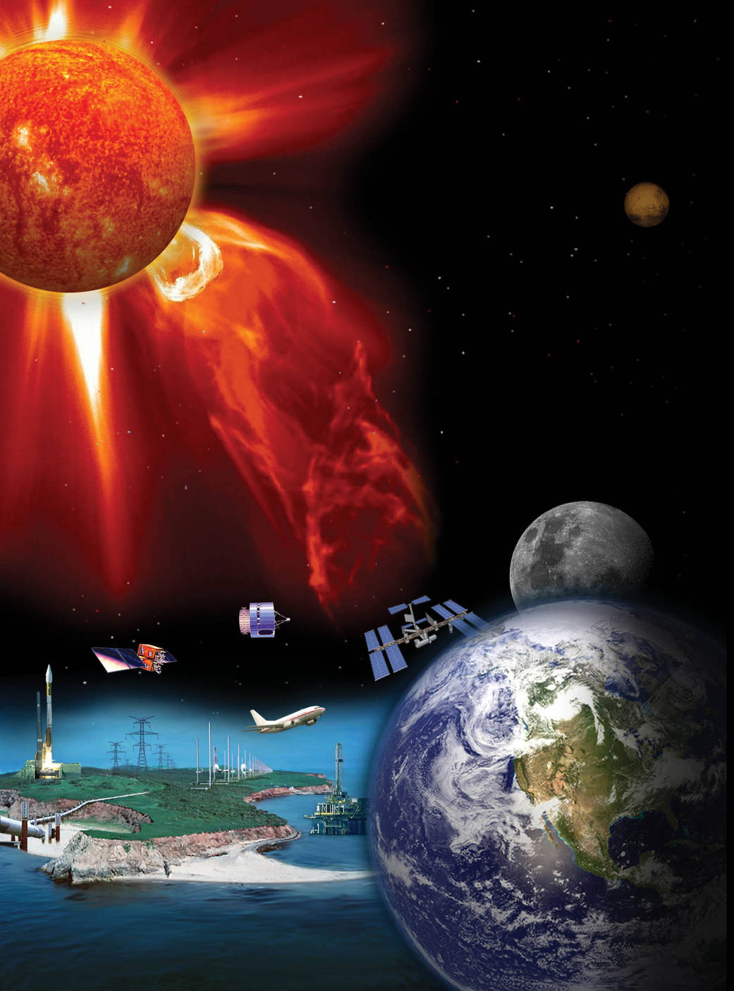
Living With a Star (LWS)
LWS program emphasizes the science necessary to understand those aspects of the Sun and Earth’s space environment that affect life and society and that enable human and robotic exploration of the solar system.
LWS goal is to provide a scientific understanding of the system that leads to predictive capability of the space environment conditions at Earth, other planetary systems, and in the interplanetary medium.
LWS objectives:
Understand how the Sun varies and what drives solar variability;
Understand how the Earth and planetary systems respond to dynamic external and internal drivers;
Understand how and in what ways dynamic space environments affect human and robotic exploration activities.

Slide 5
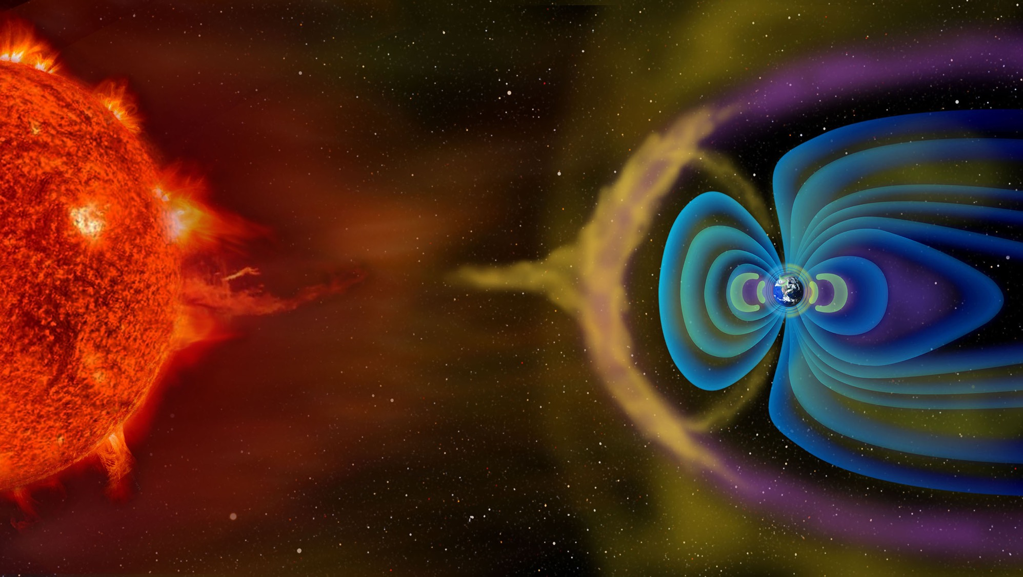
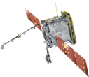
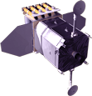
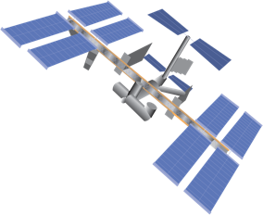
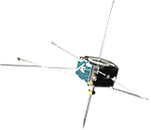
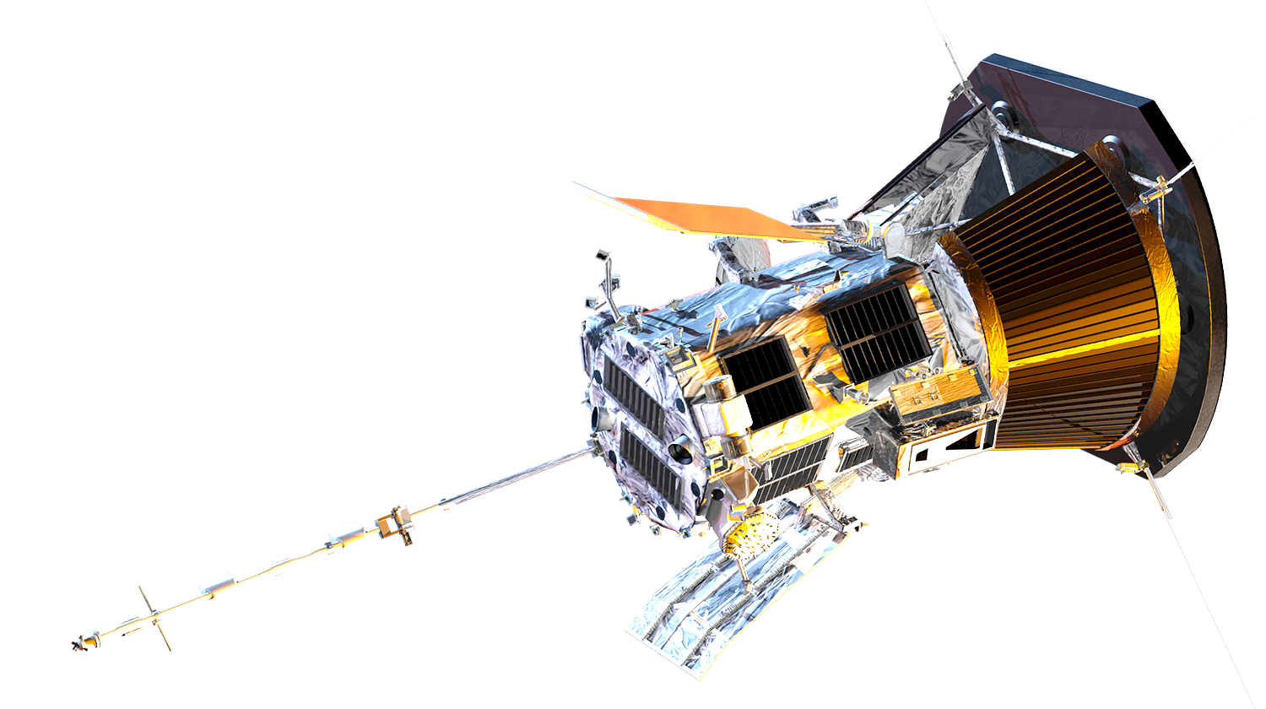
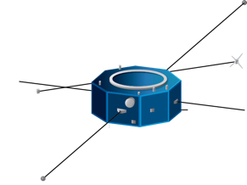
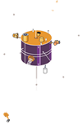
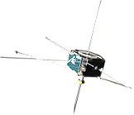
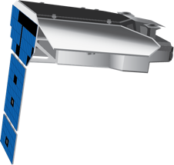
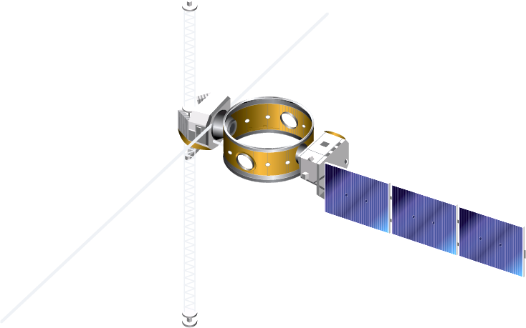
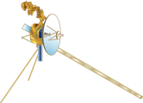
Heliophysics System Observatory
FORMULATION
IMPLEMENTATION
19 Operating Missions with 27 Spacecraft
2 Missions in Implementation
4 Missions in Formulation
PRIMARY OPS
EXTENDED OPS
Solar Orbiter (ESA)
SOHO (ESA)
IMAP
AIM
IBEX
Parker Solar Probe
ACE
SDO
AWE (ISS)
ICON
THEMIS (3)
GOLD
(SES)
TRACERS (2)
TIMED
Van Allen Probes (2)
WIND
THEMIS-ARTEMIS (2)
Hinode (JAXA)
PUNCH (4)
STEREO
MMS (4)
IRIS
SET-1 (USAF)
Geotail (JAXA)
Voyager (2)

Slide 6
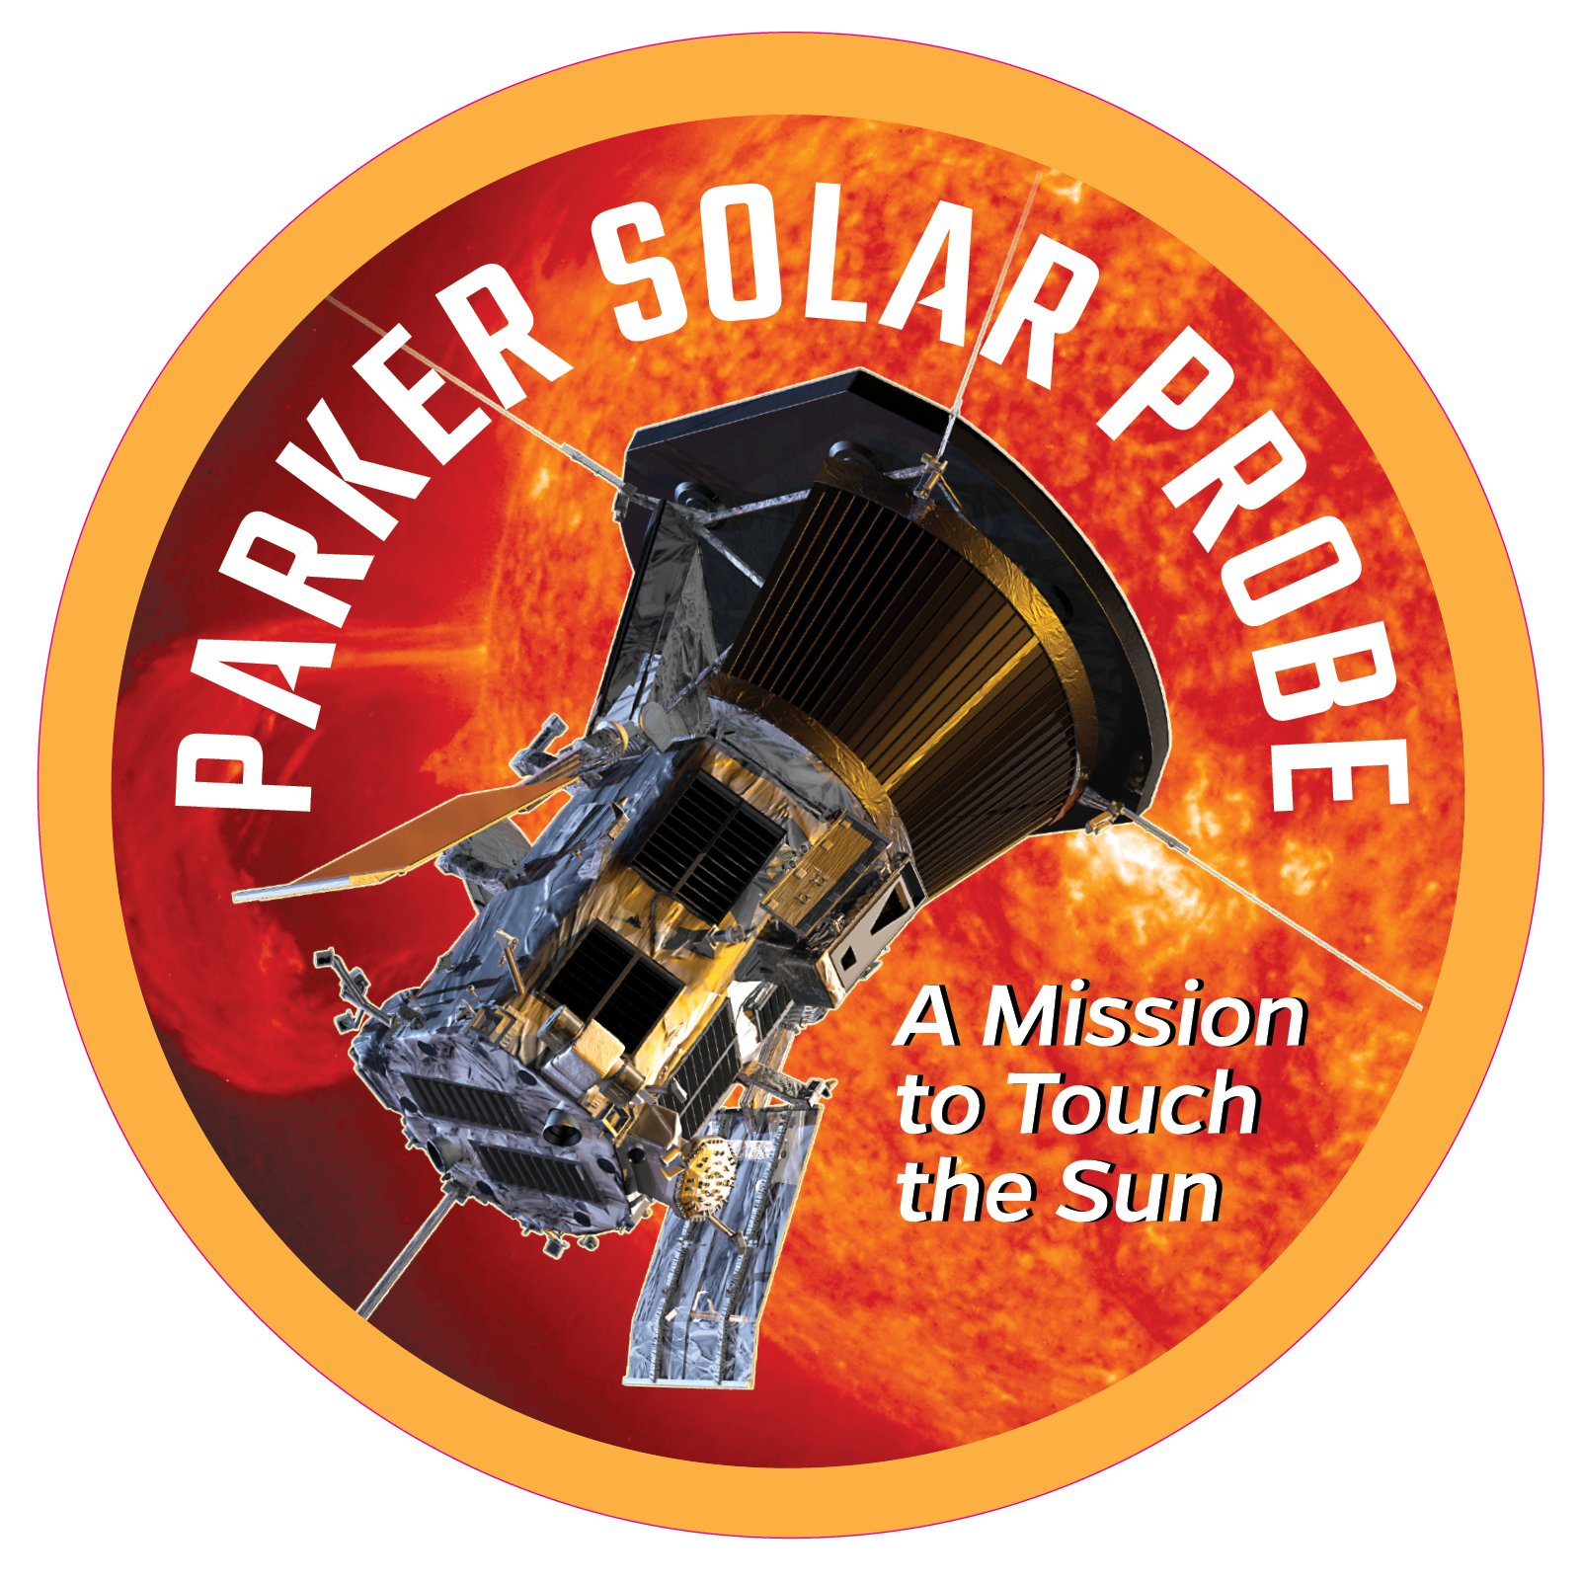
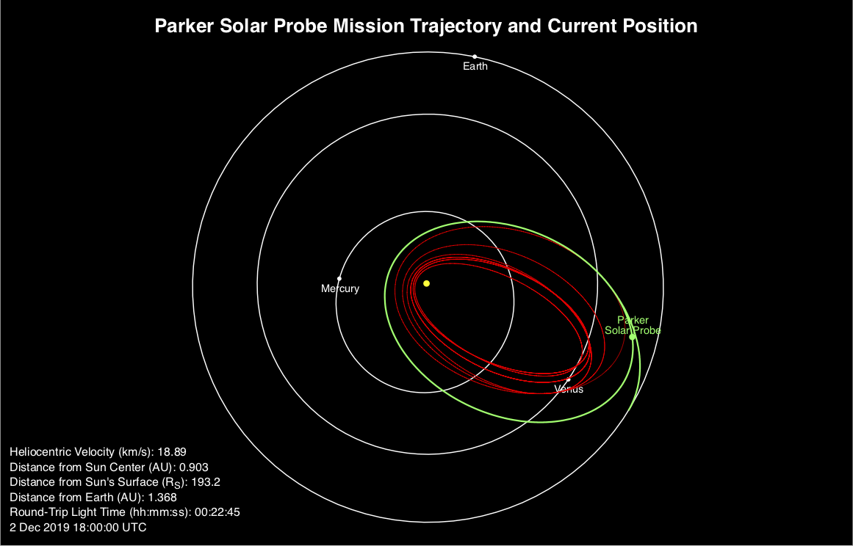
Parker Solar Probe
Launch Vehicle: Delta IV-Heavy with Upper Stage
Launch Site: Cape Canaveral, FL
Launch: August 12, 2018
Recent Highlights and Upcoming Events:
First, second, and third solar encounters complete
Perihelion #3 occurred on September 1, 2019.
Data from the first two solar encounters released to the public on November 12, 2019.
First results papers published in a special edition of Nature on December 12, 2019 (papers available online on December 4)
Also see sessions SH11A, SH12A, SH13C, SH21C and SH23A.
Venus Flyby #2: December 26, 2019
Will lower perihelion to 27.9 Rs for subsequent solar encounters.
Perihelion #4: January 29, 2020
Solar Encounter #4 occurs January 23 – February 4, 2020.
Above: Combined images from the WISPR inner and outer telescopes revealing faint solar wind structures in November 2018.
Credit: Naval Research Laboratory/Parker Solar Probe

Slide 7
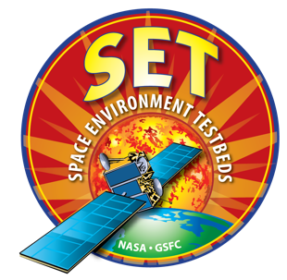
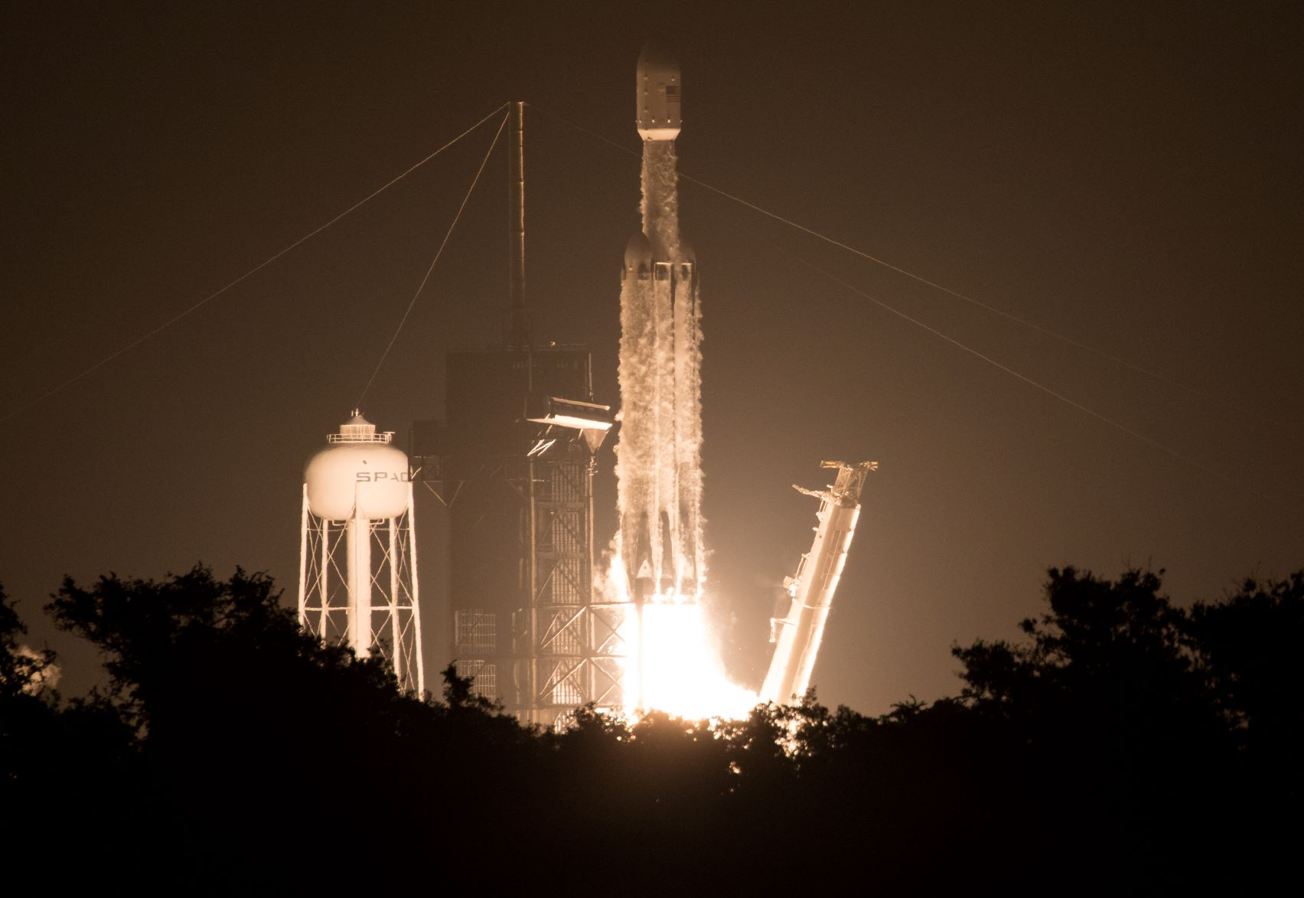
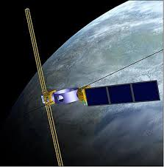
Space Environment Testbeds (SET-1)
Launch Vehicle: Falcon Heavy
Launch Site: Cape Canaveral, FL
Launch: June 25, 2019
Observatory: SET-1 hosted payload on Air Force Research Laboratory (AFRL) Demonstration and Science Experiments (DSX) spacecraft.
Description:
Define the mechanisms for induced space environment and effects;
Reduce uncertainties in the definitions of the induced environment and effects on spacecraft and their payloads;
Improve design and operations guidelines and test protocols so that spacecraft anomalies and failures due to environmental effects during operations are reduced.
Above: SpaceX Falcon Heavy rocket carrying 24 satellites as part of the Department of Defense's Space Test Program-2 (STP-2) mission launches from Launch Complex 39A at NASA's Kennedy Space Center in Florida Tuesday, June 25, 2019.

Slide 8
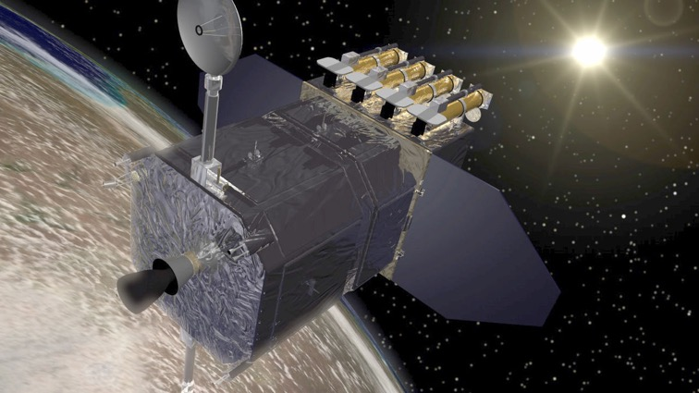
Solar Dynamics Observatory
Launch Vehicle: Atlas V-401
Launch Site: Cape Canaveral, FL
Launched: February 11, 2010
Recent Science Highlight:
Mason et al. (2019) discovered that coronal rain happens in special places on the Sun.
The region must be just the right size (not too big and not too small) and in the right location (near the edge of a coronal hole).
Coronal rain can last for several days. Impulsive coronal heating cannot keep heating the region and flares are not frequent enough.
Heating mechanism for these regions must bring hot material with it to refresh the ever-depleting upper parts of the coronal rain region – not just heat the material already present.
Time
Processed time-difference frames of AIA 171 Å, with two black arrows pointing out white, distinct blob intensifications. As time progresses, the blobs fall and are replaced with dark tracks in the later difference images. The arrows point at the same locations in all three images to ease viewing. (Credit to Nathalia Alzate.)
Mason, E. I., S. K. Antiochos, and N. M. Viall (2019), Observations of Solar Coronal Rain in Null Point Topologies, Ap. J. Lett., 874, L33, 10pp.

Slide 9
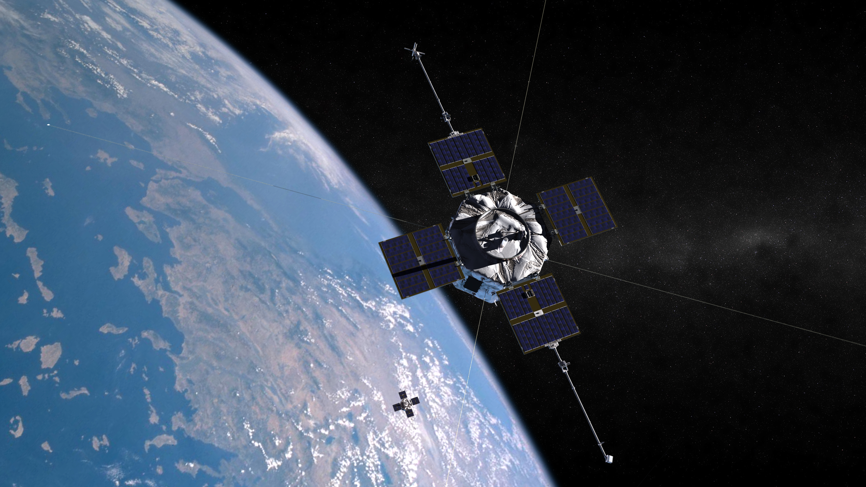
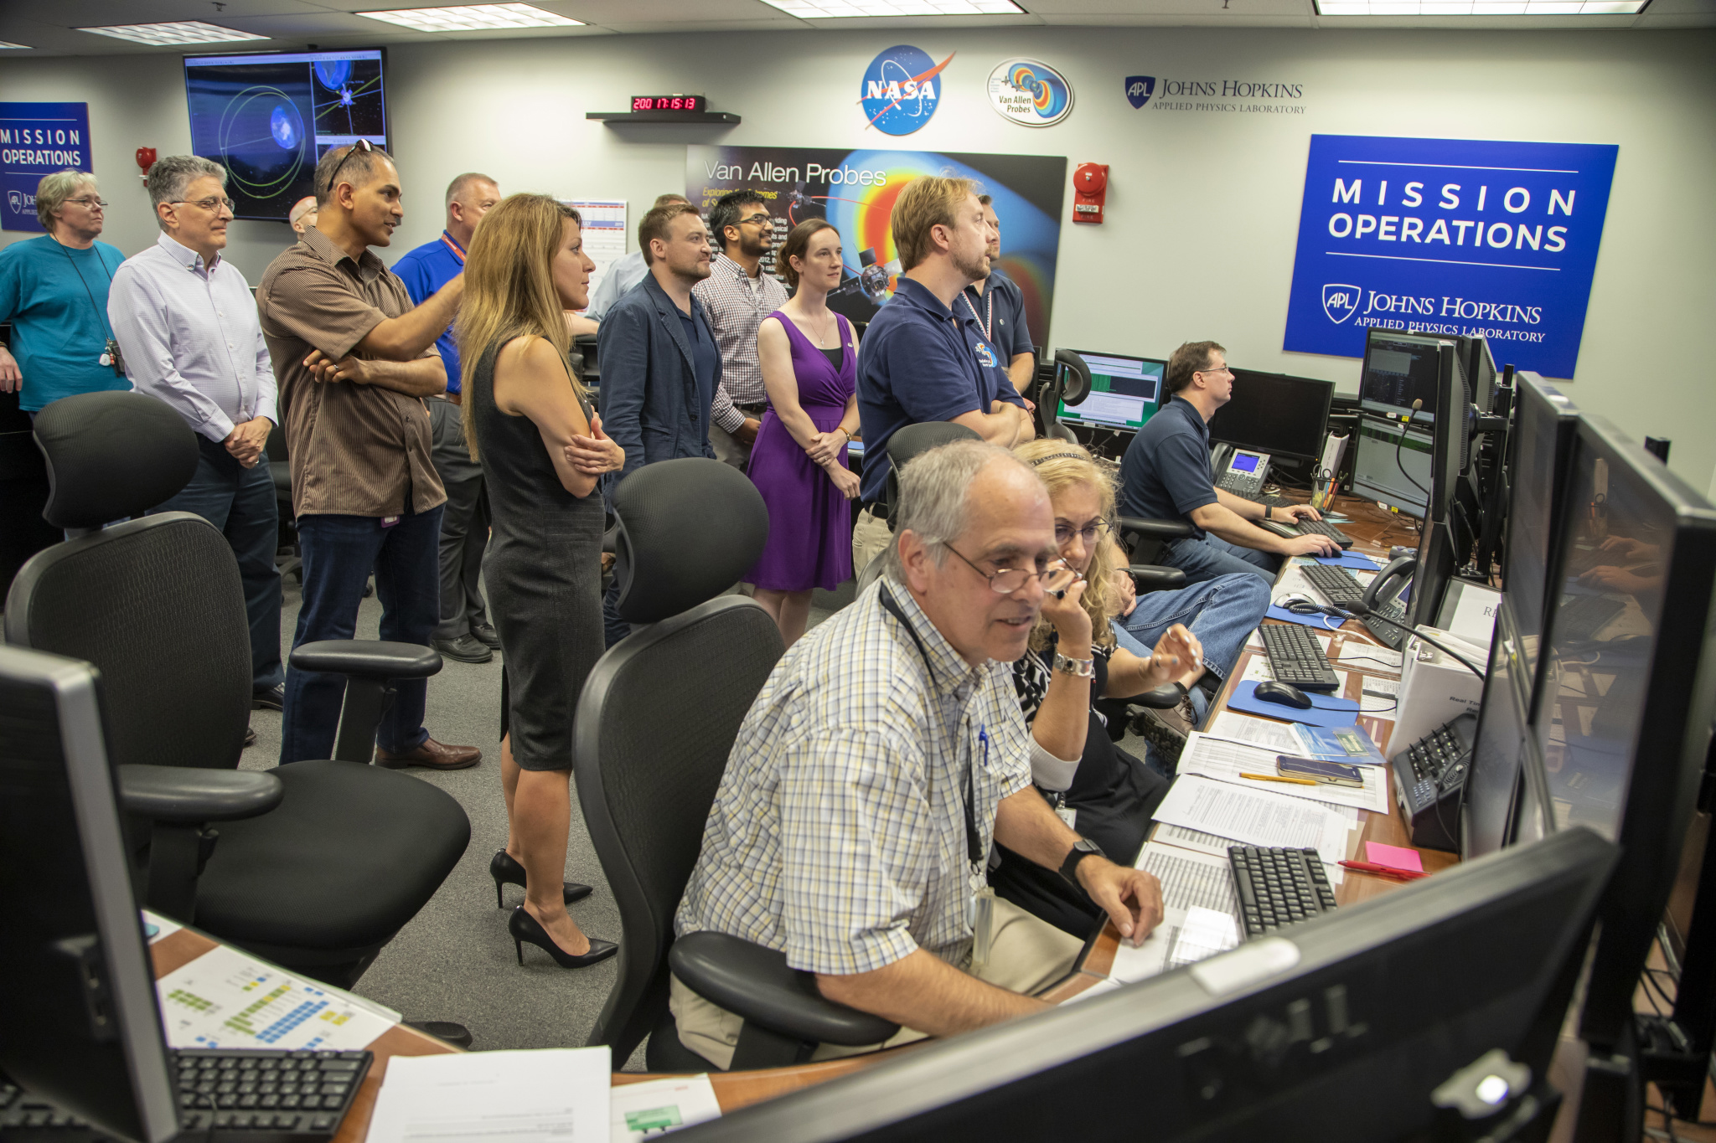
Van Allen Probes
Launch Vehicle: Atlas V-401
Launch Site: Cape Canaveral, FL
Launch: August 30, 2012
Description:
The Van Allen Probes study two extreme and dynamic regions of space known as the Van Allen Radiation Belts that surround Earth. Named for their discoverer, James Van Allen, these two concentric, donut-shaped rings are filled with high-energy particles that gyrate, bounce, and drift through the region, sometimes shooting down to Earth's atmosphere, sometimes escaping out into space.
Decommissioned in 2019 after more than 7 years of highly successful operations.
Spacecraft A ceased operations on October 18, 2019
Spacecraft B ceased operations on July 19, 2019.
See presentation by Sasha Ukhorskiy.
Top: Artist’s rendering of the twin Van Allen Probes in orbit around the Earth.
Bottom: Mission controllers prepare to send the command to spacecraft B that will end its operations after seven years of scientific discovery.
Credit: NASA/Johns Hopkins APL

Slide 10
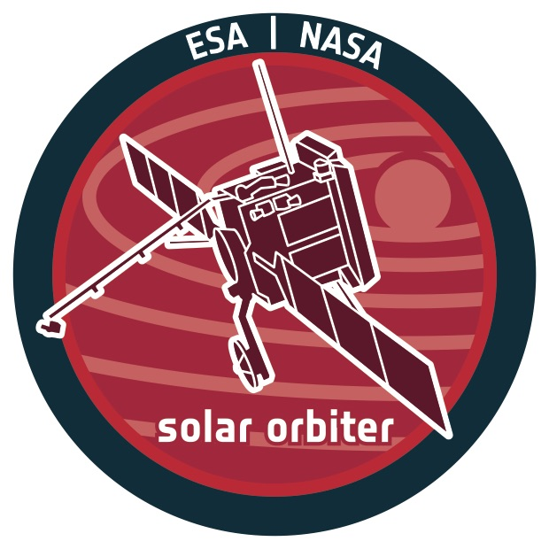
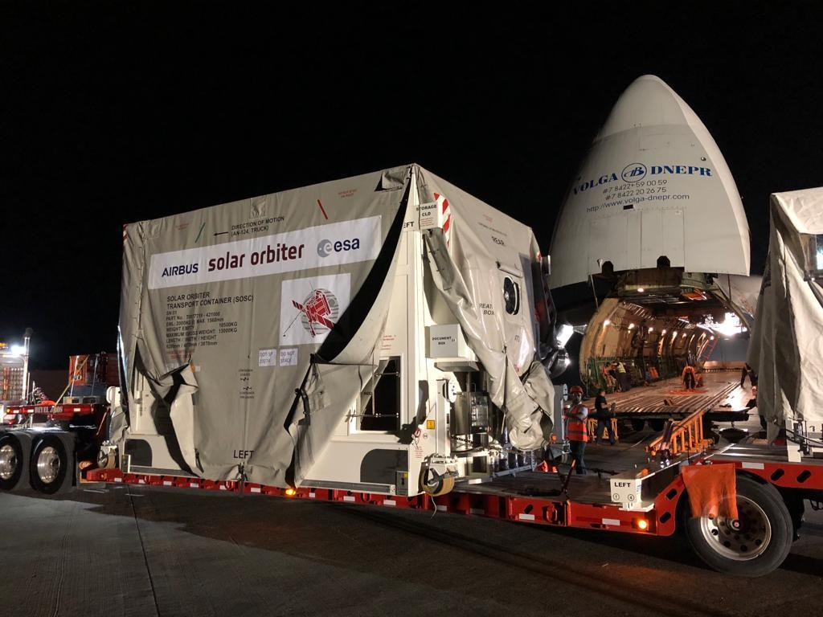
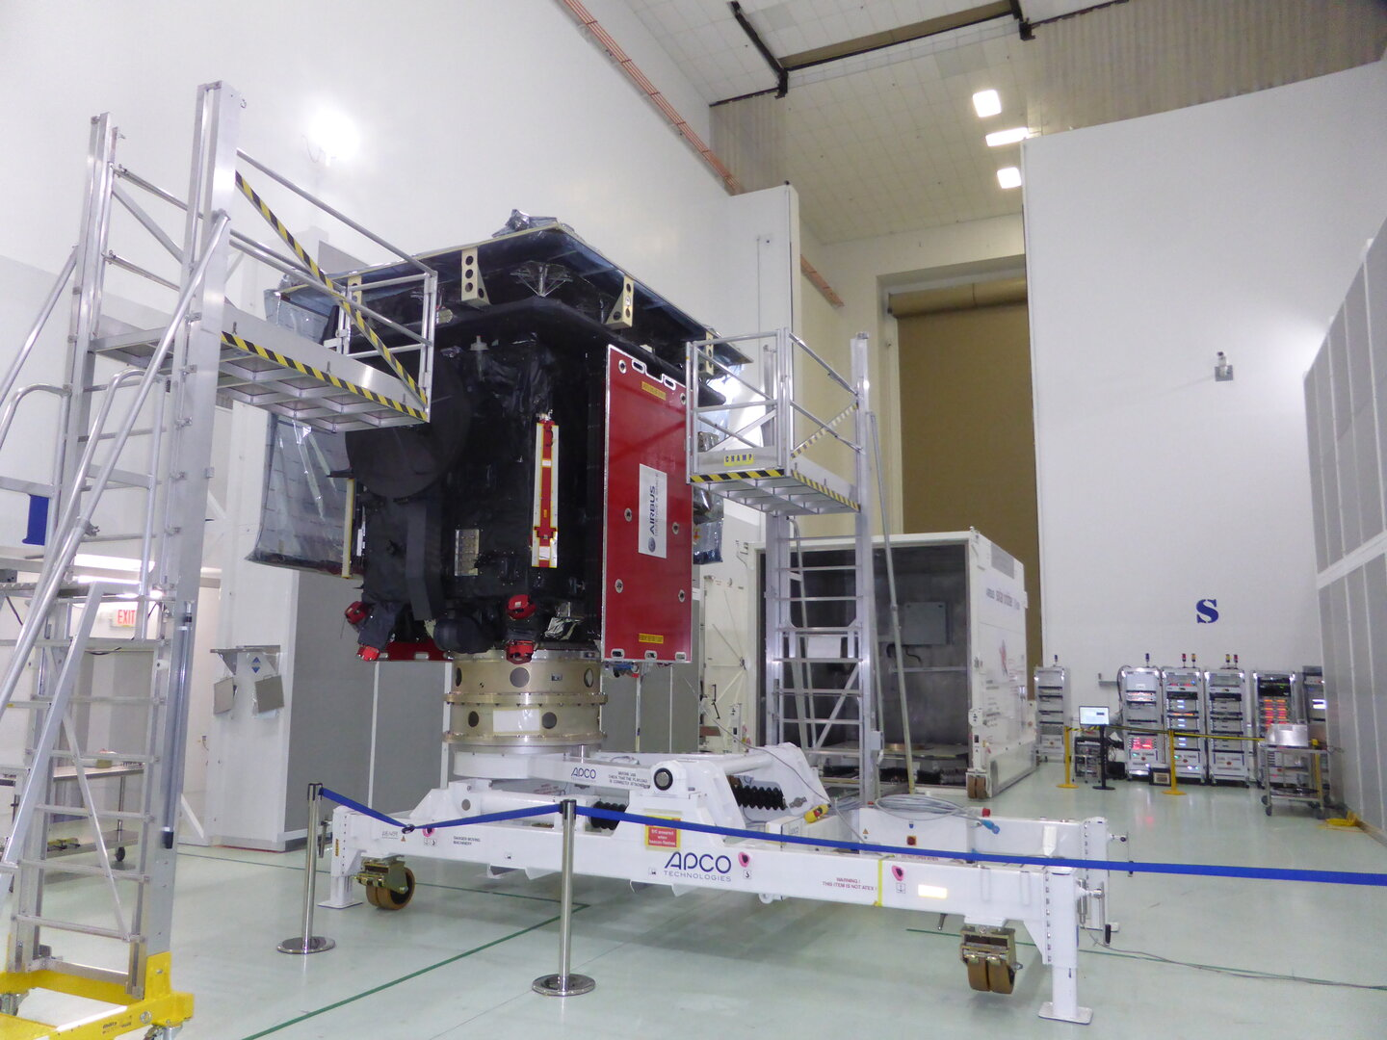
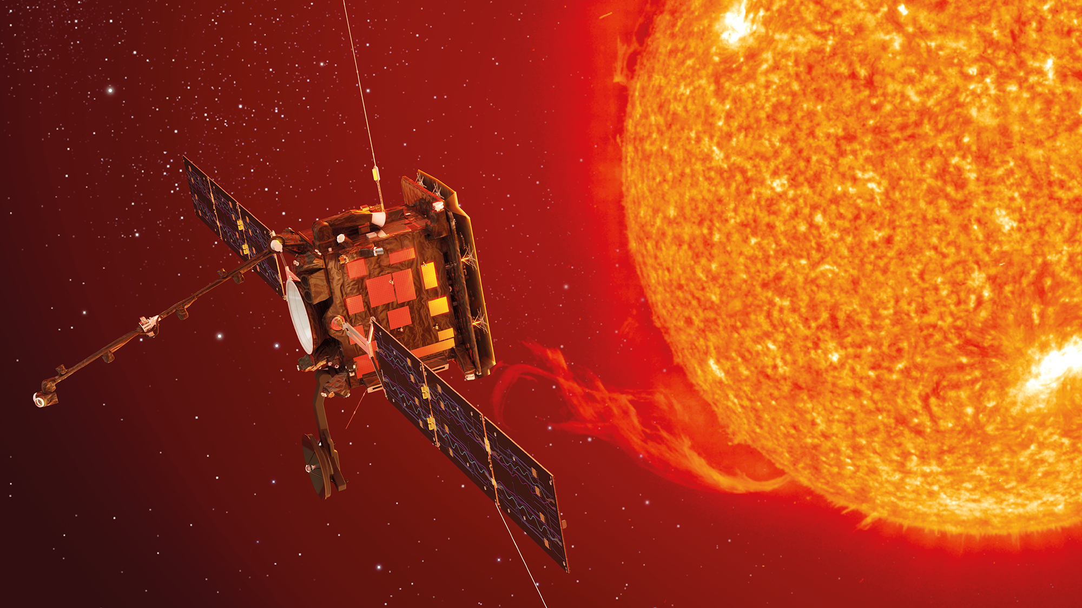
Solar Orbiter Collaboration (with ESA)
Launch Vehicle: U.S.-provided Atlas V-411
Launch Site: Cape Canaveral, FL
LRD: February 5, 2020
U.S. Provided Instruments:
HIS (Heavy Ion Sensor, part of Solar Wind Analyzer) and SoloHI (Heliospheric Imager)
Description:
Aims to make significant breakthroughs in our understanding both of how the inner heliosphere works, and of the effects of solar activity on it.
Will take a unique combination of measurements: in situ measurements will be used alongside remote sensing close to the Sun to relate these measurements back to their source regions and structures on the Sun's surface.
See sessions SH21D and SH24A
Credit: ESA

Slide 11
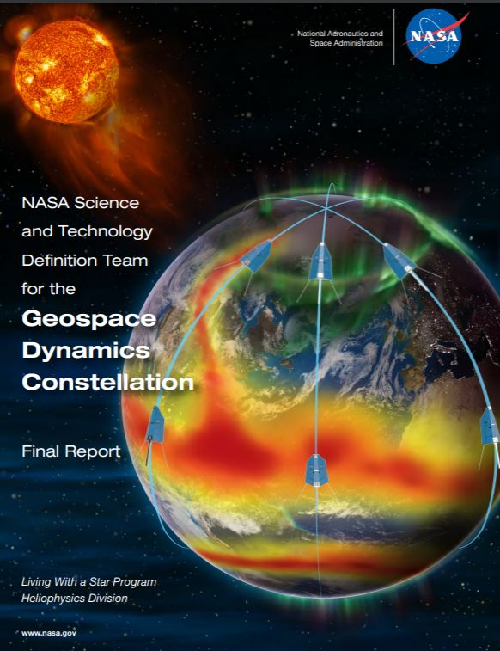
Geospace Dynamics Constellation
Decadal Survey identified GDC as the next LWS large strategic mission:
“…provide the first simultaneous, multipoint observations of how the ionosphere-thermosphere system responds to, and regulates, magnetospheric forcing over local and global scales…”.
Science and Technology Definition Team:
Convened in May 2018
Final report delivered to HPAC October 2019 and available at https://science.nasa.gov/heliophysics/resources/stdts/geospace-dynamics-constellation/documents-and-reports
GSFC initiating mission formulation phase.
Heliophysics Division targeting LRD no earlier than 2026.
See presentation by Jared Leisner.

Slide 12
Increased Science Return through Rideshare Workshop
The purpose of the Agile Access 2 Space workshop is to obtain community inputs on how NASA's Science Mission Directorate's (SMD) can embrace ESPA class missions for transformative science, in light of SMD's new policy for Rideshare and provide inputs on the creation, population, and management of a secondary payload pipeline to support (SMD) future Rideshare missions.
When: 25-27 February, 2020 Where: Johns Hopkins University Applied Physics Laboratory (JHU/APL)
Registration and abstract deadline:
10 January, 2020
https://civspace.jhuapl.edu/News-and-Events/events/Access2Space/

Slide 13
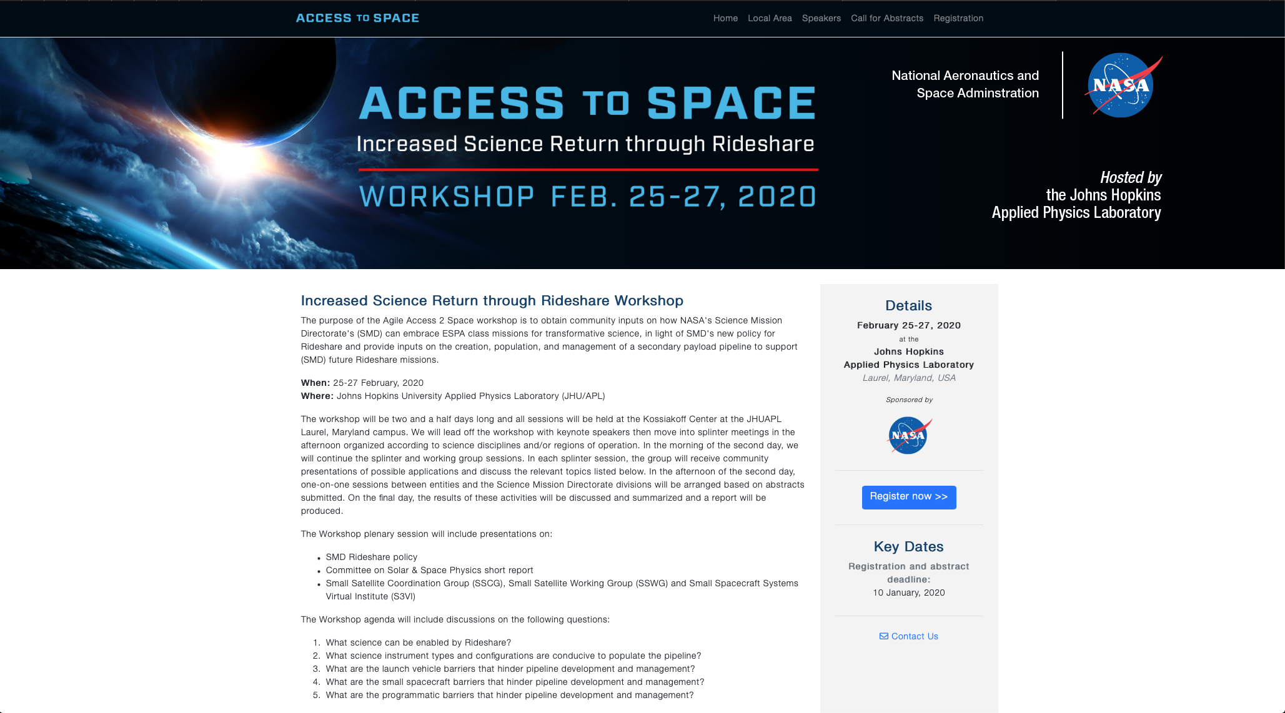
https://civspace.jhuapl.edu/News-and-Events/events/Access2Space/

Slide 14
LWS Science Selections – ROSES 2018
Proposals were solicited for 4 FSTs:
Mid-Latitude and Equatorial Dynamics of the Ionosphere – Thermosphere System;
Origins, Acceleration and Evolution of the Solar Wind;
Understanding the Response of Magnetospheric Plasma Populations to Solar Wind Structures;
Understanding Global-Scale Solar Processes and their Implications for the Solar Interior.
Proposals were due in May 2019
A total of 104 Step 2 proposals were received.
Selections were announced in October 2019
28 proposals (27%) were selected for funding and organized into 4 FST teams (see next slide).

Slide 15
New FST Teams – ROSES 2018
FST #1: Mid-Latitude and Equatorial Dynamics of the Ionosphere – Thermosphere System | FST #2: Origins, Acceleration and Evolution of the Solar Wind | FST #3: Understanding the Response of Magnetospheric Plasma Populations to Solar Wind Structures | FST #4: Understanding Global-Scale Solar Processes and their Implications for the Solar Interior
Huang (AFRL) – LEAD | Jian (GSFC) – LEAD | Ganushkina (U. Michigan) – LEAD | Dikpati (UCAR) - LEAD
Anderson (UT Dallas) Dhadly (NRL) Qian (UCAR) Scherliess (USU) Wu (UCAR) Zou (U. Michigan) | Fu (NMC, Inc.) Hahn (Columbia U.) Landi (U. Michigan) Lionello (Pred. Sci. Inc.) Nitta (LMSAL) Parashar (U. Delaware) | Agapitov (UC Berkeley) Berchem (UCLA) Dombeck (U. Minnesota) Li (UCLA) Lugaz (UNH) Ma (Boston U.) | Braun (NWRA Inc.) Featherstone (U. Colorado) Komm (AURA) Scherrer (Stanford U.) Upton (SSRC) Wang (NJIT)

Slide 16
Enhancing the Effectiveness of Team Science
Identify a shared overarching goal or set of goals that is central to the FST, is compelling to all participants, and may be attainable within the timeframe of the project.
Identify roles and responsibilities for each team and team member.
Develop team charters that lay out the scope of work for each team and achieve consensus on the approach.
Be aware of the characteristics of effective teams (and teams of teams), and the challenges of working in teams (particularly diverse, geographically separated virtual teams).
See the 2015 NRC Report on Enhancing the Effectiveness of Team Science.

Slide 17
FST Development and Selection Process
Community are LPAG members
Acts as Executive Committee
Community Input
LWS Program Analysis Group (LPAG)
NASA HPD
Selected FSTs
Past FSTs
(5-6 years)
Available Budget

Slide 18
FSTs and Dates – ROSES 2019
ROSES 2019 FSTs
The Variable Radiation Environment in the Dynamical Solar and Heliospheric System;
Fast Reconnection Onset;
Magnetospheric and Ionospheric Processes Responsible for Rapid Geomagnetic Changes;
Causes and Consequences of Hemispherical Asymmetries in Magnetosphere – Ionosphere – Thermosphere System.
Important Dates
ROSES 2019 LWS Amendment: June 2019, amended November 2019.
Step 1 Proposals: December 12, 2019 (NOTE THE CHANGE IN DATE).
Step 2 Proposals: February 27, 2020.

Slide 19
Draft FSTs and Dates – ROSES 2020
ROSES 2020 Draft FSTs
Modeling and Validation of Ionospheric Irregularities and Scintillations;
Understanding and Predicting Radiation Belt Loss in the Coupled Magnetosphere;
The Origin and Consequences of Suprathermal Particles that Seed Solar Energetic Particles;
Long Term Variability and Predictability of the Sun-Climate System.
Important Dates
ROSES 2020 LWS Amendment: February 2020.
Step 1 Proposals: ~ August 2020.
Step 2 Proposals: ~ November 2020.

Slide 20
Strategic Capabilities
Strategic Capabilities (SCs) are large-scale models and tools that can test understanding and serve as prototypes for prediction schemes.
SCs were last competed as a NASA – NSF Partnership for Space Weather Modeling in ROSES 2011 (successful proposals funded in CY 2013).
ROSES 2020 will include a call for SC proposals.
Potential topics for investigation may include
Develop a model, or coupled set of models, to specify the global ion and neutral density in the thermosphere, ionosphere and plasmasphere and its variation over time under varying geomagnetic conditions;
Develop a global model of the magnetosphere that extends beyond single-fluid MHD;
Derive a model, or coupled set of models, of CME eruption, CME propagation, SEP acceleration and transport within the context of realistic models of the corona and inner heliosphere.

