Slide 1
LWS TR&T Town Hall Meeting Fall AGU 2010
Brief summary of LWS TR&T Program Status Lika Guhathakurta, Chuck Goodrich, Bob Leamon from NASA HQ
Comments on current Focus Team and Strategic Capability activities (Team leads)
Open discussion of LWS TR&T Program and next Focus Topics
AGENDA

Slide 2
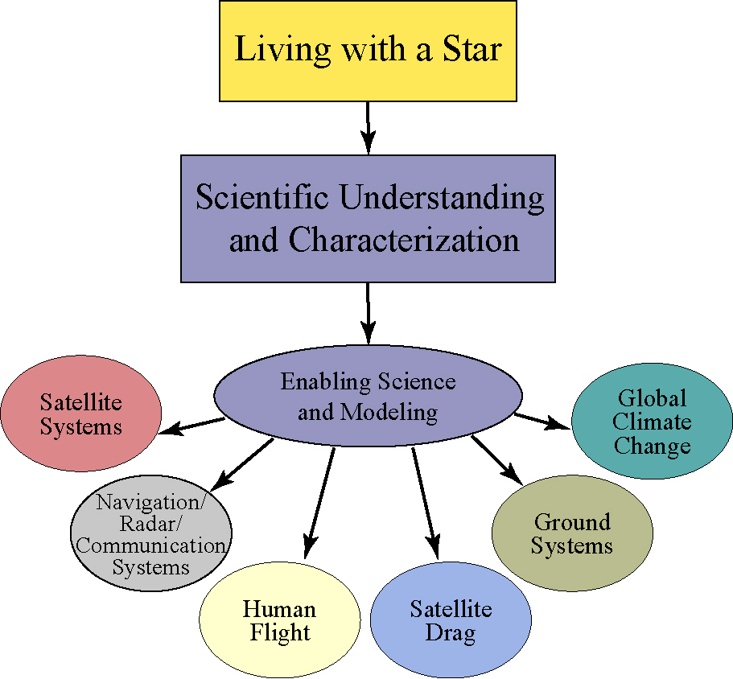
Science Application as the Focus
The primary goal of the LWS Program is to develop the understanding necessary to enable the U.S. to effectively address those aspects of the Connected Sun-Solar system that directly affect life and society.
Space Weather
Space Climate
Sun-Climate Connection

Slide 3
LWS TR&T Strategic Plan
Based on the LWS TR&T Science Definition Team report of November 2003
LWS is a systematic, goal-oriented research program targeting those aspects of the Sun-Earth system that affect life and society.
The TR&T component of LWS is to provide the theory, modeling, and data analysis necessary to enable an integrated, system-wide approach to LWS science.
Focused Science Teams
Strategic Capabilities
Cross-cutting Workshops
Summer Schools
Heliophysics Postdoctoral Fellows
TR&T Supports:

Slide 4
LWS TR&T Strategic Plan
Vision for TR&T depends on successful implementation of an approach that:
Encourages and enables teamwork toward solving specific LWS science and applications problems through the creation of Focused Science Topic working groups and substantial Strategic Capability development efforts;
Supports data analysis and the development of theories and models in TR&T target areas that clearly have potential societal benefits;
Requires deliverables with clear relevance to the program's goals;
Gives particular emphasis to cross-disciplinary research;
Supports synergistic activities such as workshops and summer schools to facilitate cross-disciplinary activities and to foster an infrastructure for mentoring and developing careers in LWS science areas;
Supports the development of selected strategic capabilities that lead directly to LWS science applications;
Supports model testing and validation using available data and
Supports the development of tools and data environments that better enable the achievement of LWS goals and objectives.

Slide 5
TR&T Steering Committee
New Membership for 2011 establised
Establishing and continually updating targets and top-level priorities;
Measuring the progress of the program in meeting science goals and objectives;
Providing mechanisms for monitoring how well products that result from the program are transferred into societal benefits.
SC has broad science and application community representation and rotating membership, who will support NASA Headquarters in:
Agency Liasion:
NOAA (Terry Onsager)
NSF (Farzad Kamlabadi)
AFSOR (Casandra Fessen)
CCMC (Michael Hesse)
Neal Zapp NASA (SRAG/JSC)

Slide 6
Amitava Bhattacharjee, Chair, Amitava.bhattacharjee@unh.edu UNH Bruce T Tsurutani, bruce.t.tsurutani@jpl.nasa.gov, JPL Pontus C.Brandt, Pontus.Brandt@jhuapl.edu, JHU/APL Michael Wiltberger, wiltbemj@ucar.edu, NCAR Phil Erikson, pje@haystack.mit.edu , MIT/Haystack Dolores Knipp Delores.Knipp@gmail.com , CIRES Stan Solomon, stans@ucar.edu , NCAR Peter Schuck, peter.schuck@nasa.gov, GSFC Peter Pilewskie , peter.pilewskie@lasp.colorado.edu, CUB Peter Foukal, pvfoukal@comcast.net, SC Hugh Hudson, hhudson@ssl.berkeley.edu, Berkeley Gang Li, ganli.uah@gmail.com, UAH, Yuan-Kuen Ko, yuan-kuen.ko@nrl.navy.mil, NRL Alexei Pevtsov, pevtsov@email.noao.edu, NOAO, Edward DeLuca, edeluca@cfa.harvard.edu, Harvard/SAO Liason to TR&T SC: Terry Onsager, NOAA SWPC F. Kamalabadi, NSF Casandra, Fessen, AFOSR Michael Hesse, GSFC Neal Zapp SRAG/JSC Ex Officio: Lika Guhathakurta, Lead Program Scientist, NASA HQ Mona Kessel, RBSP Program Scientist Bob Leamon, NASA HQ Chuck Goodrich, NASA HQ
New Steering Committee Members

Slide 7
Proposals and Awards
Selection for 2009
135 proposals submitted, but 6 noncompliant
Of 124 proposals reviewed, 31 were selected (success ratio: 1/4)
3 workshop proposals selected
ROSES 2010
New SDO analysis opportunity
No Tools and Methods
Many proposals submitted for TR&T, very few are non-compliant,
No Strategic Capability
Proposal selection March/April 2011,
TR&T email: lws.trt@nasa.gov

Slide 8
4 New Focus Teams in 2009
Behavior of the Plasmasphere and its Influence on the Ionosphere and Magnetosphere. 24 proposals, 5 funded, average $128 K
Predict Onset and Space Weather Effects of Fast CMEs/Eruptive Flares, 21 proposals, 4 funded, average $101 K
Plasma – Neutral Gas Interactions, 15 proposals, 6 funded, average $127 K
Origin and Nature of the Slow Solar Wind, Interplanetary Structures, and SEP Transport. 13 proposals, 5 funded, average $108 K
Sun-Climate Theme
20 proposals, 4 funded, average $128 K
Workshops
26 proposals, 4 funded, average $109 K
Tools and Methods
26 proposals, 4 funded, average $109 K

Slide 9
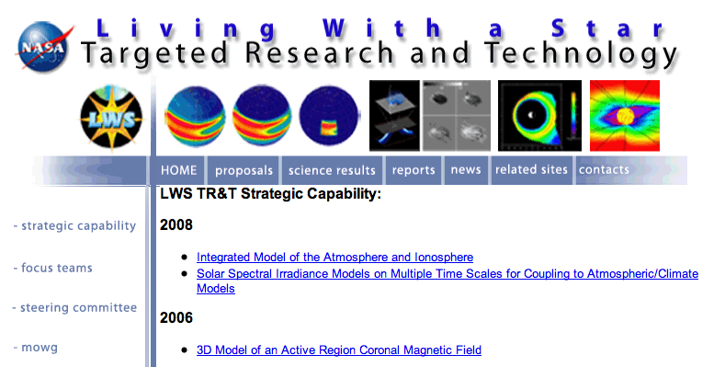
TR&T website: http://lws-trt.gsfc.nasa.gov

Slide 10
LWS TR&T Focus Topics
2004 | 2005 | 2006 | 2007 | 2008 | 2009
Solar origins of the plasma and magnetic flux of observed ICMEs | Shock acceleration of SEPs by interplanetary CMEs | Predict emergence of solar active regions before visible | Magnetic Connection of Photosphere and Low Corona | Properties of the Solar Dynamo that affect Irradiance and Active Regions | Behavior of the Plasmasphere and its Influence on the Iono-/Magnetosphere
Topology and impact of the magnetic field through the photosphere, corona and heliosp. | Mechanism for solar wind heating and acceleration | Understand how flares accelerate particles near the Sun and contribution to large SEP events | Modulation of Galactic Cosmic Rays,… due to Long-term Solar Activity | Use Inner Heliosphere Obs. to Better Constrain CME and SEP Models | Origin and Nature of the Slow Solar Wind, and its effect on Helio Structures, and SEP Transport
Origin of solar-energetic particles at the sun and inner heliosphere | Solar wind plasma entry and transport in the magnetosphere | Plasma redistribution during storms in the ITM system | Daily Variability in the Thermosphere and Ionosphere | Integrate Non-MHD/Kinetic Effects into Global Models | Predict the Onset and Space Weather Impacts of Fast CMEs/Eruptive Flares
Formation and loss of new radiation belts in the slot region ….. | Storm effects on globlal electrodynamics of the middle and low latitude ionosphere | Middle and low latitude sources, effects, and distribution of large electron density gradients | Combined Modelling of Loss, Acceleration, and Transport of Magnetospheric Electrons, Protons | Response of ITM Composition and Temperature due to Solar XUV and Energetic Particle Variation | Plasma-Neutral Gas Coupling
Thermosphere composition and due to Solar and high Lat forcing | Abundance of greenhouse gases and dynamics of Upper Atmosphere | Solar origins of irradiance variations | Prediction of the Interplanetary Magnetic Field Vector Bz at L1 |  | The Sun-Climate Strategic Theme
Global, regional climate sensitivity to solar forcing |  |  | Extreme Space Weather Events in the Solar Sys/

Slide 11
Finishing FOCUS TEAMS
Maturing Projects, Focus Teams and Strategic Capabilities
Strategic Capability: Earth-Moon-Mars Radiation Environment Model - Schwadron
Focus Team: Sources of Daily Variability in the Thermosphere/Ionosphere - Solomon
Focus Team: Extreme Space Weather Events in the Solar System - Ma
Strategic Capability: A Next-Generation Model of the Solar Corona & Solar Wind- Linker

Slide 12
Emphasis on Sun Climate Connection
NASA has tasked NRC to conduct a study/workshop on
Beyond Radiative Forcing and Response:
Reconciling Observations and Understanding of Climate Response to
Solar Variability
What part of observed atmospheric variability is in response to solar forcing, particularly in the lower atmosphere? Are attributed signals consistent over different time scales?
What are associations between sunspots or cosmogenic isotopes and the magnitude of solar irradiance changes in the past?
If long-term irradiance variations are insufficient to impact climate, were other solar-modulated parameters, such as galactic cosmic rays, responsible for the reported paleo sun-climate connections?
Is empirical evidence sufficiently robust to conclude that the spatial response in climate models is consistent, or not? What does the evidence imply about the relative roles of the Sun and GHGs for past, present and future climate change and what does this mean for their projections of regional climate response to other radiative forcings, such as GHGs?
What are the research directions and model extensions necessary to improve the models, using solar forcings and observed climate responses to test their fidelity?
Are the long-standing concepts of radiative forcings and responses that are the basis for the models inadequate to accommodate the actual mechanisms?

Slide 13
Heliophysics Text Books
The sub-disciplines within Heliophysics have a rich variety of available textbooks, but no textbooks currently exist that present the diverse materials from their common physical principles, and help teachers well-versed in one discipline to teach the directly related areas within other disciplines.
Three affordable textbooks have been produced for each year of the Summer School (2006-2009). The books are aimed for senior level undergraduates, graduate students and beginning postdoctoral students in all of the sciences related to climate physics, space physics, and heliospheric and solar physics, plus relevant branches of astrophysics and plasma physics. The three textbooks cover the basic topics in heliophysics.
NOTE: The Heliophysics textbooks have been published by Cambridge University Press. All appendices will be online. The textbooks will not have 'numerical modeling descriptions' nor 'problem sets'.
http://www.vsp.ucar.edu/HeliophysicsScience/

Slide 14
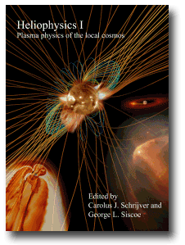
Heliophysics I:
“Plasma Physics of the Local Cosmos”
Cambridge Press: Hardback (ISBN-13: 9780521110617) Now published - available from July 2009
1) Prologue
2) Introduction to heliophysics
3) Creation and destruction of magnetic field
4) Magnetic field topology
5) Magnetic reconnection
6) Structures of the magnetic field
7) Turbulence in space plasmas
8) The solar atmosphere
9) Stellar winds and magnetic fields
10) Fundamentals of planetary magnetospheres
11) Solar-wind magnetosphere coupling: an MHD perspective
12) On the ionosphere and chromosphere
13) Comparative planetary environments
On-line Appendices:
1) Data archives, modeling sites, space weather forecasts
2) Descriptions on packages for numerical modeling
3) Problem sets

Slide 15
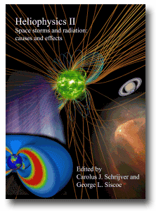
Heliophysics II:
“Space Storms and Radiation: Causes and Effects”
Cambridge Press: Hardback ) Now published - available from May 2010
1) Perspective on heliophysics
2) Introduction: space storms and radiation
3) In situ detection of energetic particles
4) Radiative signatures of energetic particles
5) Observations of solar and stellar eruptions, flares, and jets
6) Models of coronal mass ejections and flares
7) Shocks in heliophysics
8) Particle acceleration in shocks
9) Energetic particle transport
10) Energy conversion in planetary magnetospheres
11) Energization of trapped particles
12) Flares, CMEs, and atmospheric responses
13) Energetic particles and manned spaceflight
14) Energetic particles and technology
On-line Appendices:
1) Data archives, modeling sites, space weather forecasts
2) Descriptions on packages for numerical modeling
3) Problem sets

Slide 16
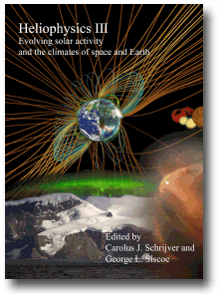
Heliophysics III:
“Evolving solar activity and climate of space and earth”
Cambridge Press: Hardback ) From- November 2010
1) Formation, evolution, and demise of stars and their planets
2) Planetary habitability on astronomical time scales
3) Long-term evolution of magnetic activity of Sun-like stars
4) Astrophysical dynamo actions and stellar dynamo models
5) Solar internal flows and dynamo action
6) Planetary fields and dynamos
7) The evolving heliosphere and its particle environment
8) Solar spectral irradiance: measurements and models
9) Long-term evolution of the geospace climate
10) Planetary ITM-magnetosphere processes and the solar cycle
11) Waves and transport processes in planetary atmosheres
12) Climate couplings via (photo-)chemistry
13) Records of climate and climate drivers
14) External influences on planetary climates
15) Climate models of Earth and planets
16) Heliophysics - epilogue
On-Line Appendices:
1) Data archives, modeling sites, space weather forecasts
2) Descriptions on packages for numerical modeling
3) Problem sets

Slide 17
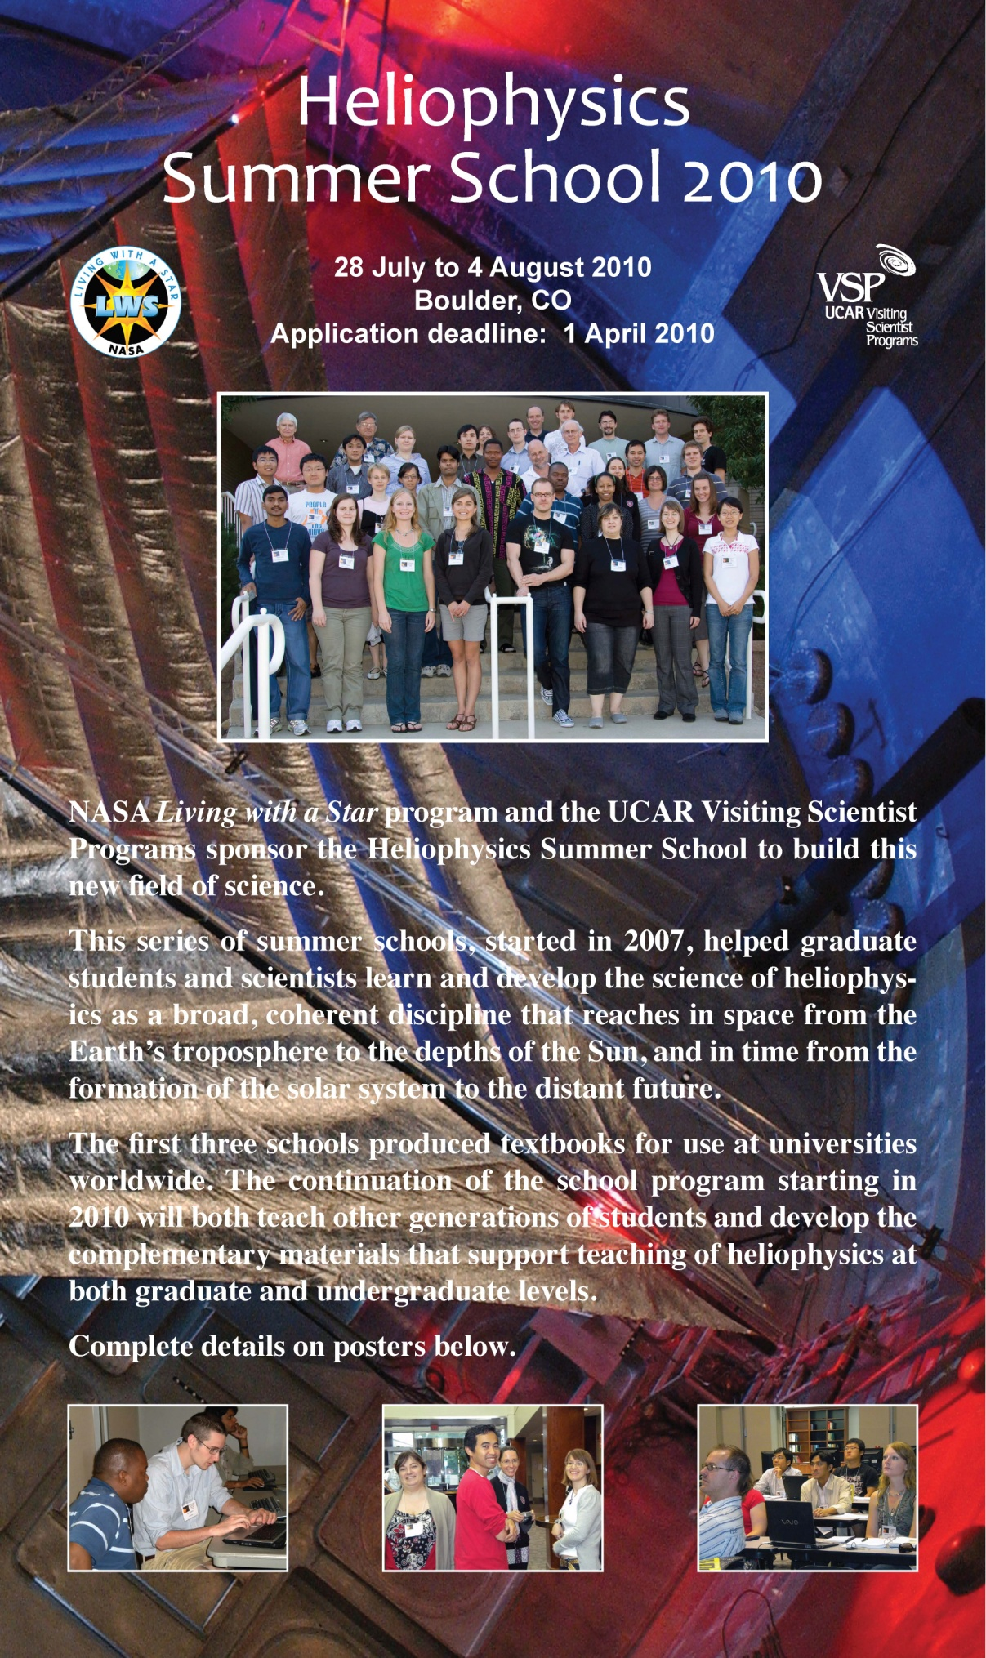

Slide 19
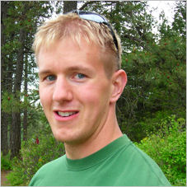
Class of 2010
Nicholas Bunch Research Topic: Plasmaspheric Erosion PhD Institution: Dartmouth College, Physics and Astronomy Host: Dr. Maria Spasojevic, Stanford University | Lynn Wilson III Research Topic: THEMIS Investigations PhD Institution: University of Minnesota at Minneapolis, Physics Host: Dr. David Sibeck, NASA Goddard Space Flight Center | Liang Zhao Research Topic:Solar minimum impacts on space weather PhD Institution:University of Michigan, Atmospheric and Space Sciences Host: Dr. Sarah Gibson, National Center for Atmospheric Research, High Altitude Observatory
EDDEddy Fellows

Slide 20
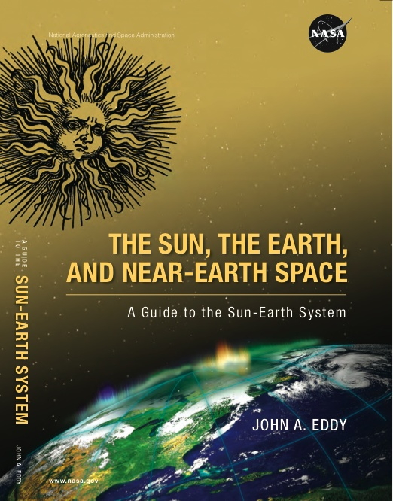
The Sun, The Earth, and Near-Earth Space John Allen Eddy
The Sun, The Earth, and Near-Earth Space is meant as a non-technical introduction, or primer, for those with an interest in knowing more about the totally different and highly hazardous world that lies just outside our door in near-Earth space: a largely unseen world governed by unfamiliar laws of physics and ruled by the iron hand of the often moody star we call our Sun. About what fills the space—long thought to be still and empty—between our Earth and the Sun. And the many ways in which the closely-entwined Sun-Earth system now affects much of what we do in our everyday lives.
It is aimed not at research scientists but at educators and students, at engineers and managers and administrators with responsibilities in activities related to exploration and utilization of near-Earth space, and at the reading public who take interest in the wider world in which our small green planet is wholly immersed. With this in mind, the author, John A. Eddy, wrote it in a non-mathematical way, often told in narrative form and embroidered here and there with allusions to things historical, literary and humanistic.

