Slide 1
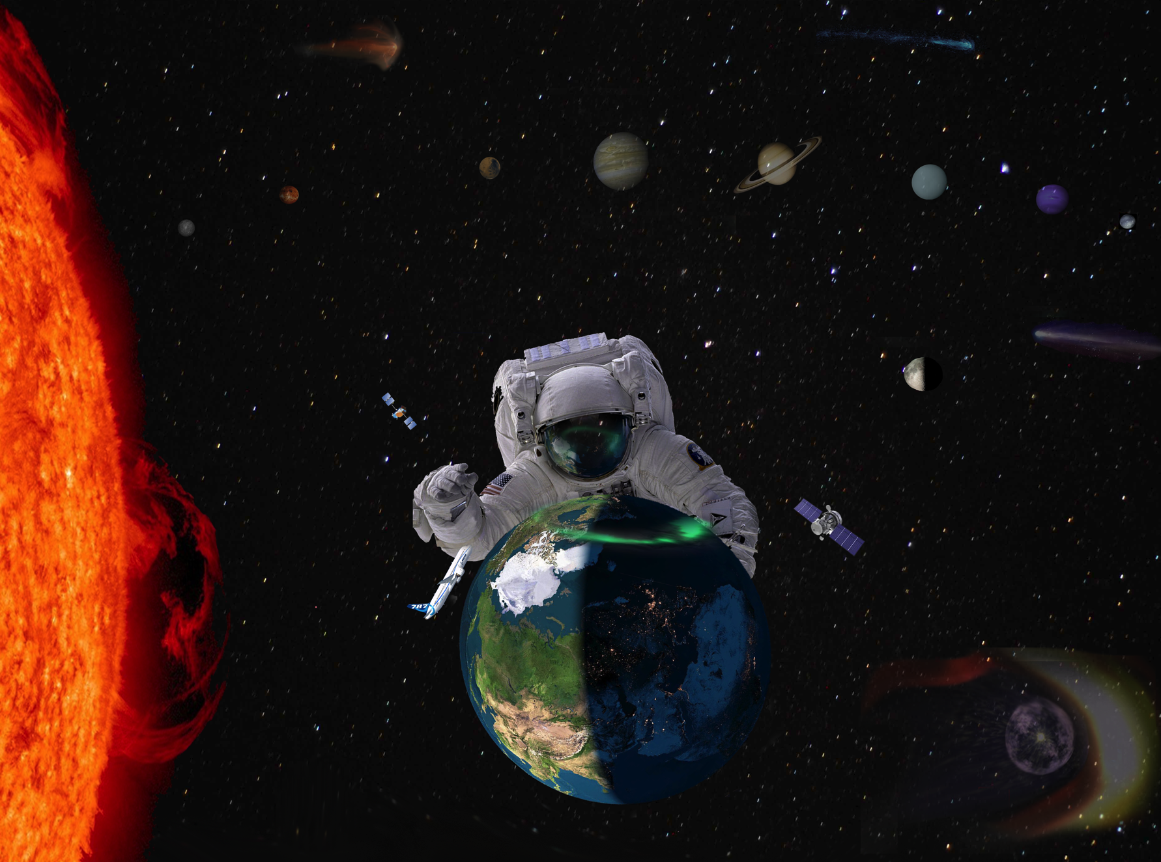
Living With A Star
Enabling Science, Technology and Exploration
to Advance Society
10 Year Vision

Slide 2


Living with a STAR –
TR & T Steering Committee 2013-2014
LWS Steering Committee Members:
Nathan Schwadron, UNH (Chair)
Tony Mannucci, JPL (Co-Chair)
Spiro Antiochus, GSFC
Amitava Bhattacharjee, Princeton
Tamas Gombosi, UMichigan
Nat Gopalswamy, NASA/GSFC
Farzad Kamalabadi, UIllinois
Jon Linker, PSI
Peter Pilewiske, U. Colorado
Antti Pulkkinen, NASA/GSFC
Harlan Spence, UNH
Kent Tobiska, Utah State University/SET
Daniel Weimer, Virgina Tech
Paul Withers, BU
Liaisons to TR&T SC:
Mario Bisi, Rutherford Appleton Laboratory
Masha Kuznetsova, CCMC
Kent Miller, AFOSR
Terese Morretto, NSF
Terry Onsager, NOAA
Ilia Roussev, NSF
Rodney Vierick, NOAA
LWS Program Ex Officio:
Madhulika Guhathakurta, NASA/HQ
Bob Leamon, NASA/HQ

Slide 3
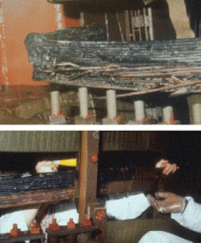
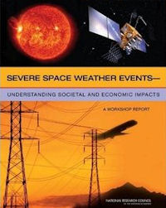
Societal Needs for Improved Space Weather Services (1/4)
Storm of March 13,
1989 damages Salem
New Jersey Nuclear
Plant
Heavy reliance on technologies affected by the space environment
Enormous population of airline customers affected by space climate and space weather
Space Tourism
Long duration human exploration
Society Needs predictive space weather models and detailed understanding of space weather effects and risks
LWS provides tools that enable technological expansion, human exploration, scientific development and discovery
NAS Study (2008) lays out the economic consequences of severe space weather.

Slide 4
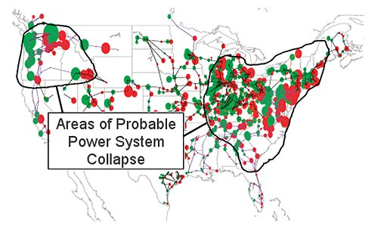
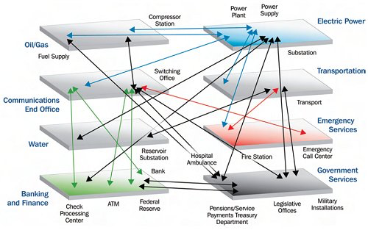
Societal Needs for Improved Space weather services (2/4)
Social and Economic Impacts (2008 NAS Study)
Societal Interdependency
"The concept of interdependency is evident in the unavailability of water due to long-term outage of electric power--and the inability to restart an electric generator without water on site.”
  Many examples
  The infrastructure on which we (society) rely is both invisible and vulnerable
  Report concludes: “Reliable Forecasting is key”
John Kappenmann (Metatech) great geomagnetic storm of May 1921:
  Ground currents ten times stronger than the 1989 Quebec storm
  Effect on the modern power grid
  More than 350 transformers at risk of permanent damage and 130 million people without power.
  "water distribution affected within several hours; perishable foods and medications lost in 12-24 hours; loss of heating/air conditioning, sewage disposal, phone service, fuel re-supply”
Image: Courtesy Tony Phillips

Slide 5
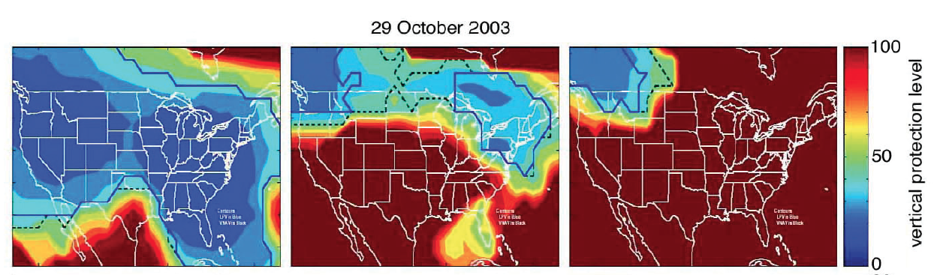
Availability of Aircraft Navigation
Societal Needs for Improved Space weather services (3/4)
Quiet before the storm
Precision landing approach using WAAS is effectively wiped out during the October 2003 geomagnetic storm
Source: FAA provided materials in “Severe Space Weather Events Understanding Societal and Economic Impacts: A Workshop Report”, National Research Council 2009
16:44 UT
October 29, 2003
17:48 UT
19:06 UT
meters
Operable level is 50m
Notes:
Source NRC report – Important! The slide shows maps of WAAS "availability" at different times, before the storm and during. Availability is where the WAAS ionosphere corrections are accurate enough to allow planes to do a precision landing using GPS and WAAS. This is really the point of WAAS: it allows planes to get very close to the runway (approach) with accurate navigation. The accuracy metric is called "vertical protection level", which is the quantity color-coded in the maps. If that level is < 50 m, planes can use WAAS to get close to the runway ("precision approach").
Under quiet conditions (top right), the VPL is < 50 m, and WAAS is available for precision approach nearly everywhere in the US.
Under geomagnetic storm conditions, the ionosphere becomes irregular and the WAAS ionosphere corrections become less accurate. The VPL then starts to exceed 50 m in many locations (two bottom panels). (WAAS is designed to determine its accuracy bound and act accordingly). Starting on October 29, WAAS could no longer be used for precision approach landings over much of the US. For this intense storm, WAAS was pretty much unavailable over the entire US for several hours. That's a major impact of space weather. If it could be anticipated, it would help significantly.

Slide 6
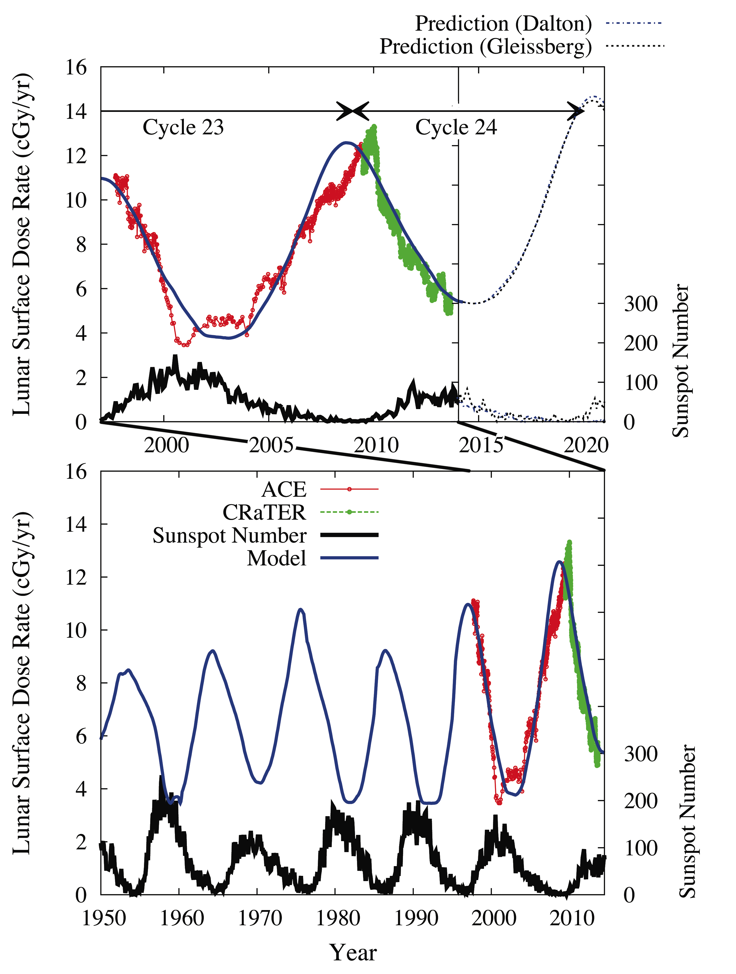
Societal Needs (4/4)
Highest GCR doses in space age in recent cycle 23 solar minima
Continues trend observed by Ulysses, ACE
Limits duration of human deep space exploration missions
What are the effects on our skyway travelers?
Knowledge and Prediction Enables Human and Scientific Exploration
Schwadron et al., Space Weather, 2014

Slide 7
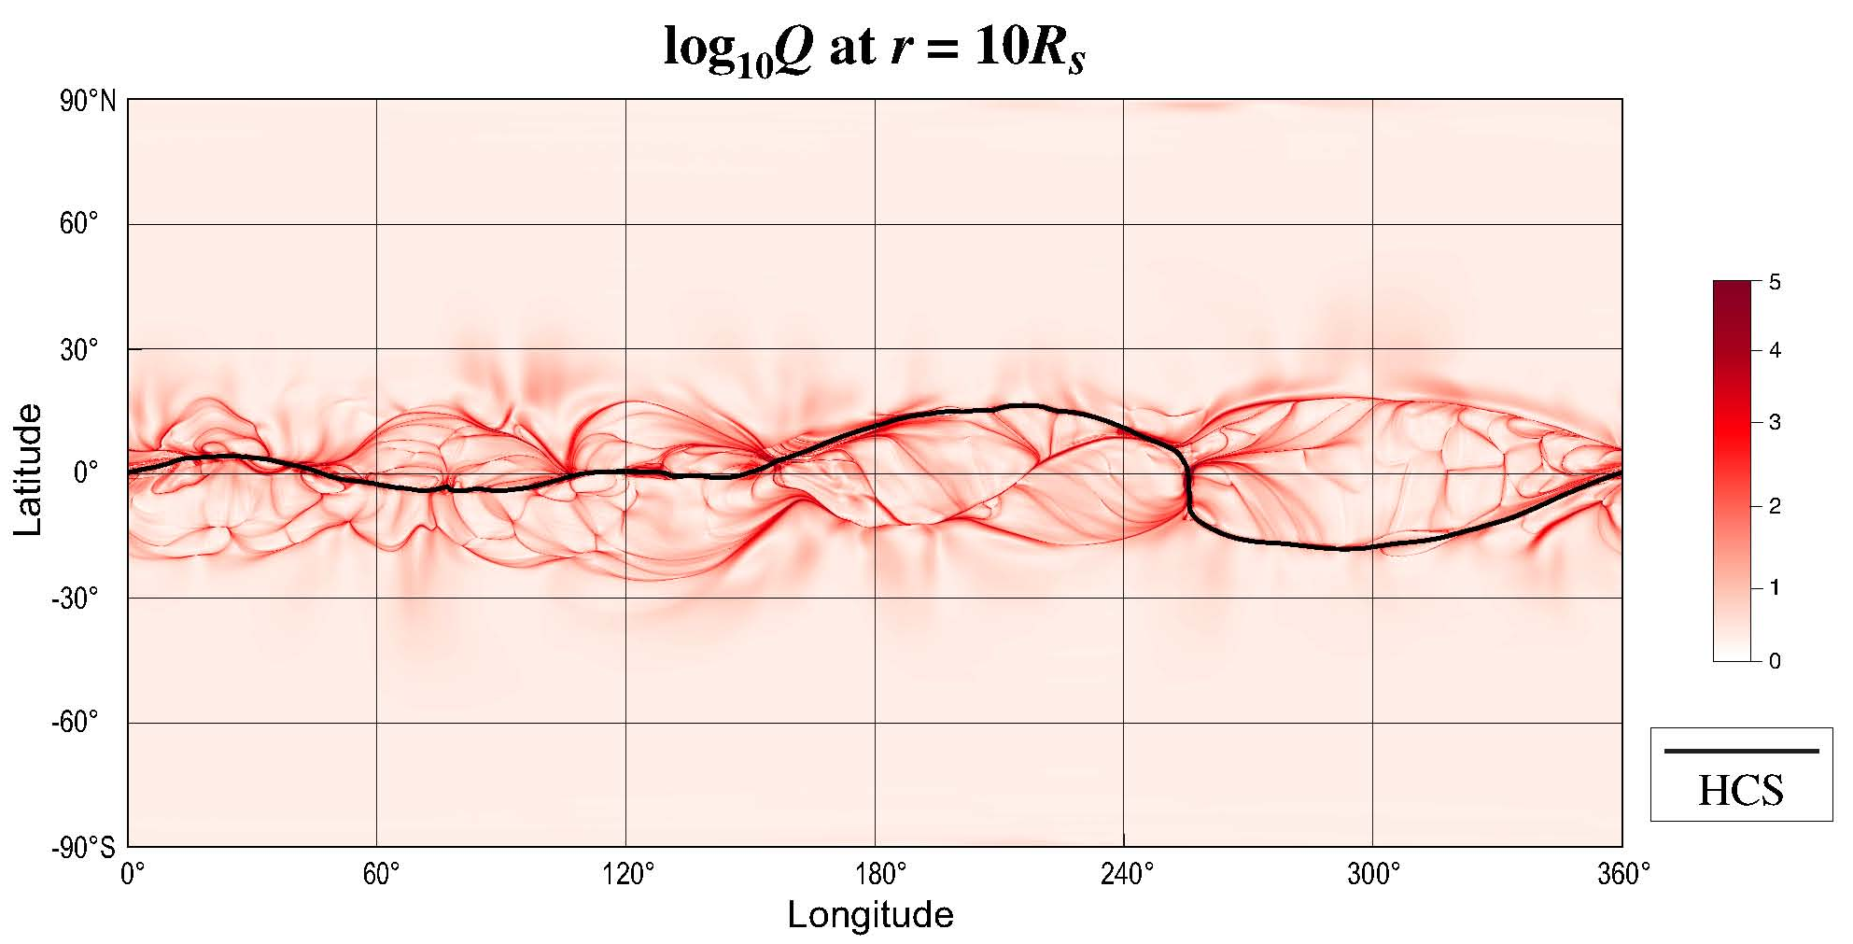
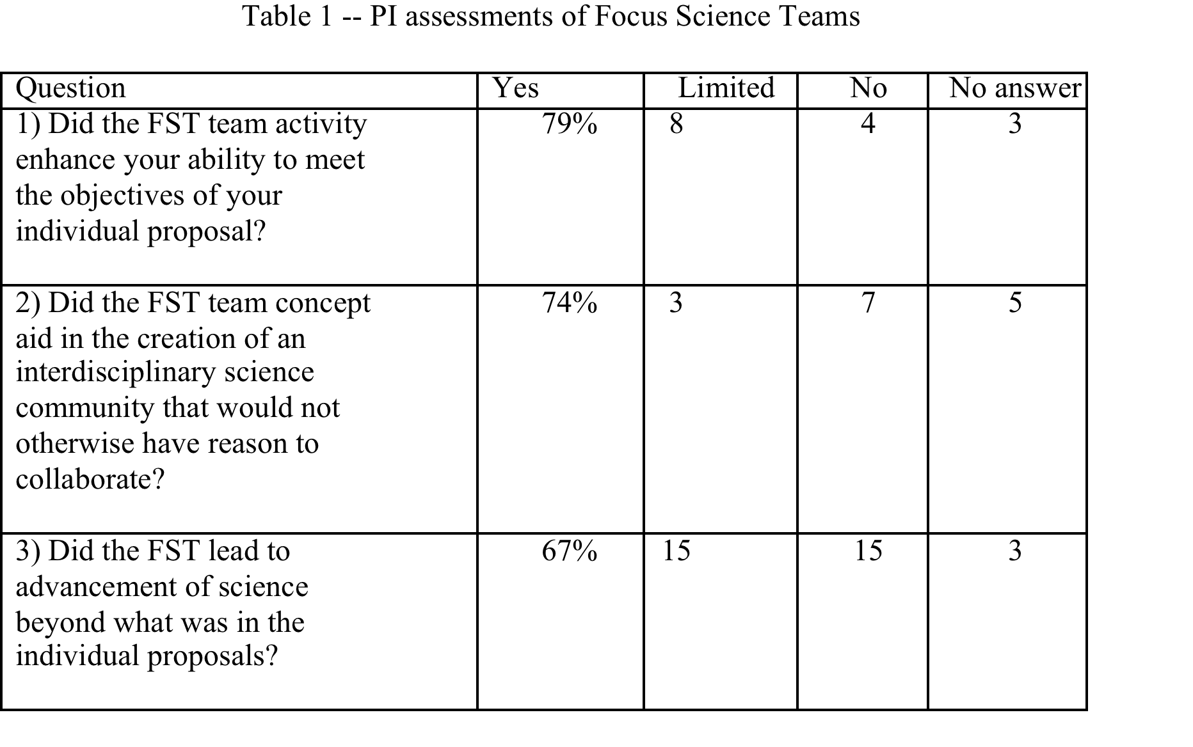
The 1st Decade:
LWS Science, Innovation – new Technology emerges
Example of Results from FST:
  Mapping of open field from heliosphere to Sun predicating locations of slow wind
  Our science has evolved toward detailed understanding, which requires models and continued observations
TR&T Program has been the primary driver for development of a unified Heliophysics science community
  Forced collaborations that would never have happened spontaneously
  Focused community toward science for purpose
  Recent community survey showed
    75%: “FST team concept aided creation of interdisciplinary collaboration”
    67%: “FST team led to advancement of science beyond the individual proposals.”

Slide 8
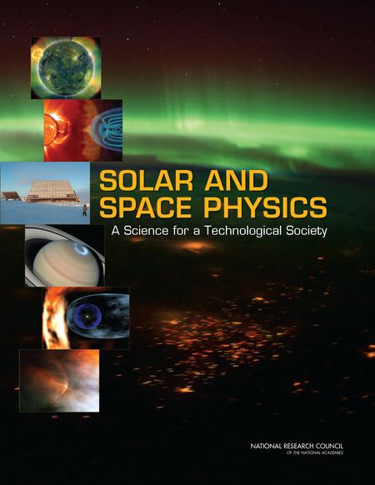
LWS Critical to Decadal GoalS
First Key Decadal Goal
“Determine origins of Sun’s activity and predict variations in the space environment.”
Societal needs in Decadal’s Ch. 3 are the four main goals of the LWS TR&T
Space Science: physics, dynamics, and behavior of the Sun-Earth system over 11-year solar cycle.
Earth Science: effects of solar variability and disturbances on terrestrial climate change
Human Exploration and Development: data and scientific understanding for advanced warning of energetic particle events that affect the safety of humans
Aeronautics and Space Transportation: detailed characterization of radiation environments useful in design of more reliable electronic components for air and space transportation systems
Living with a Star designed to meet these challenges

Slide 9
LWS Next Steps – Innovation is critical
  Stronger link between scientific and user communities
  Long-term targeted areas of System Science: Strategic Science Areas
  LWS-Drive Initiatives and science centers develop transformative predictive capabilities
    Science centers
    Small satellite programs
    Instrument development
  Foster a coordinated collaborative research environment in the national and international community*
  More flexible and affordable program makes better use of ground based facilities that fulfill critical needs of the LWS program
  * : “Advancing space weather science to protect society’s technological infrastructure:
  a COSPAR/ILWS roadmap”

Slide 10
WHAT ARE WE TRYING TO ACHIEVE?
  Examples of Long-term Strategic Science Topics
    Physics-based Geomagnetic Forecasting Capability
      Enable1-3 day (long lead-time) and 15-30 min (short lead-time) predictions of pending extreme fluctuations in geomagnetic field
    Physics-based Satellite Drag Forecasting Capability
      Enable specification of the global neutral density in the thermosphere and its variations over time
    Physics-based Solar Energetic Particle Forecasting Capability
      Probabilistic prediction of the intensity of SEP events, and increased time periods for all-clear forecasting capability with higher confidence level
    Physics-based TEC Forecasting Capability
      Enable specification of the global ion density in the topside ionosphere and plasmasphere and its variations over time under varying geomagnetic conditions
    Physics-based Scintillation Forecasting Capability
      Enable prediction of scintillation occurrence utilizing limited sources of available data and ascertain how radio signals are degraded by ionospheric irregularities
    Physics-based Radiation Environment Forecasting Capability
      Enable predictive capability for the radiation environment and its effective dose as well as dose rates based on GCR, SEP, cutoff rigidity, atmosphere density, and gamma-ray/X-ray inputs

Slide 11
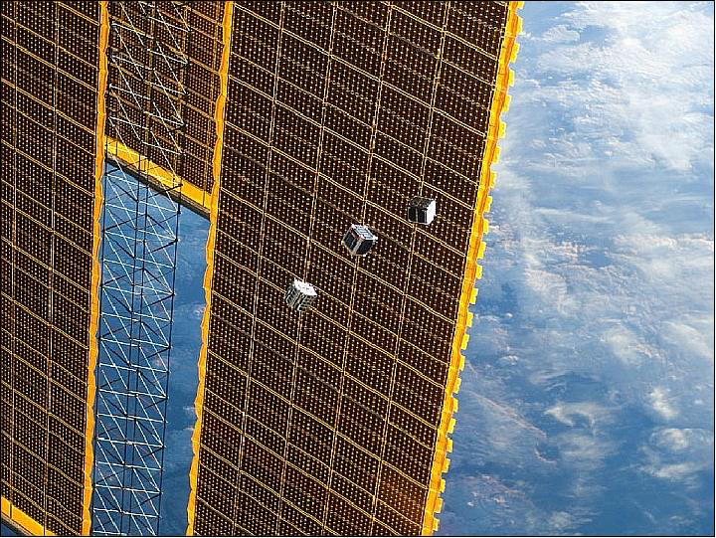
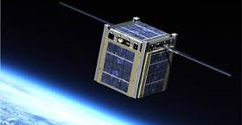
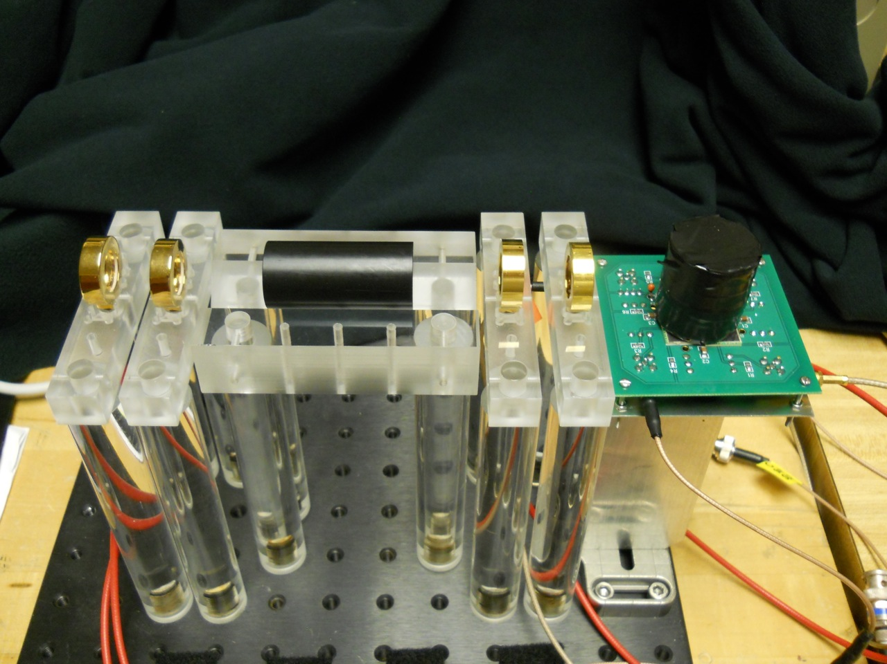
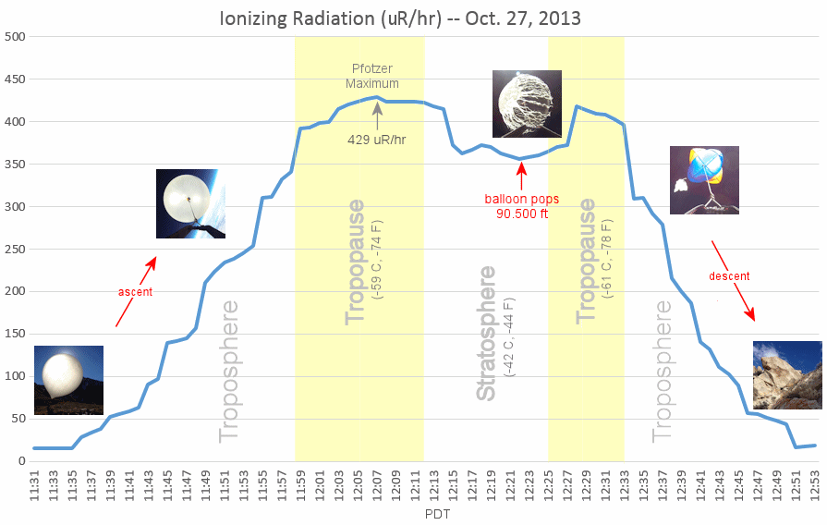
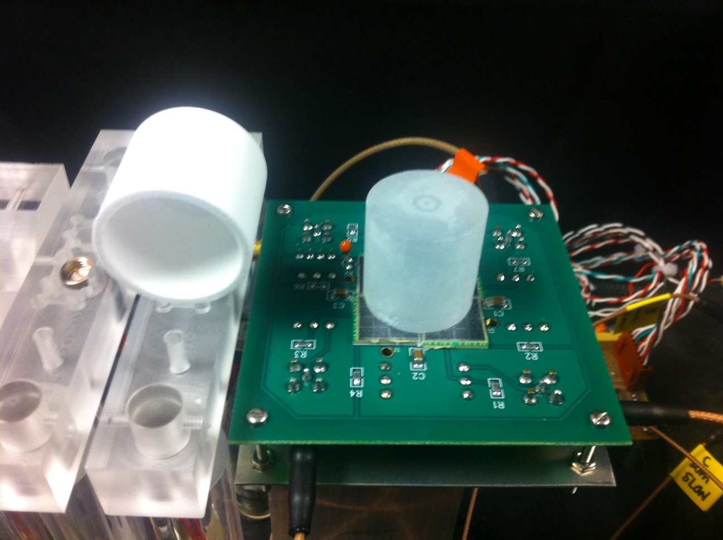
New mechanisms for Fulfilling Observational Needs
No single mission will in the future provide all needed LWS observations
Data needs are acute for LWS and advancement simply cannot take place without an expansion of the types of observations available for achieving predictive goals
Highlights the criticality of implementing new LWS-DRIVE initiatives involving a combination of small satellite programs, science centers and grants programs, and needed instrument development that would target the next generation predictive needs for LWS science. x
Three CubeSats released from the ISS
Cosmic ray results from balloon payload (Courtesy Tony Phillips)
DoSEN Detector for active measurement of all ionizing radiation components: neutrons, gammas, protons heavy ions

Slide 12
LWS Next Steps – New Interdisciplinary Programs
  Joint programs that build new dimensions into LWS observations
    LWS Heliophysics - Planetary Science program:
      Space weather throughout the solar system
    LWS Heliophysics – Astrophysics program:
            Effects of stellar variability on astrospheres and the exoplanets
  Forums for Model Validation
    1) assessment of a model’s abilities to reproduce space environment phenomena
    2) assessment of the predictive capabilities of models for user-defined metrics
    Outcomes of Validation should be made broadly accessible to the community
  Targeted development of community tools focused on analysis and interpretation of large data sets that advance LWS objectives.

Slide 13
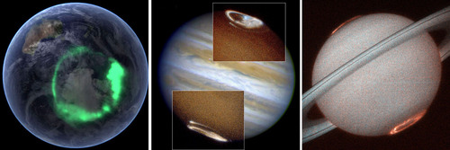
Space Weather Through Solar system
Joint Heliophysics and Planetary Science
Investigate the effects of space weather throughout the solar system
  Potentially game-changing for our view of planetary systems with stars like our own

Slide 14
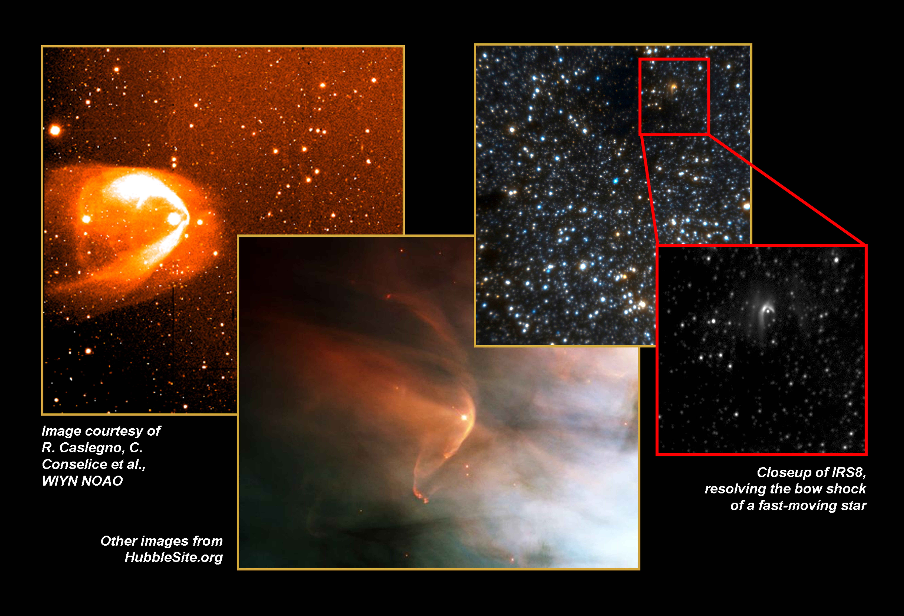
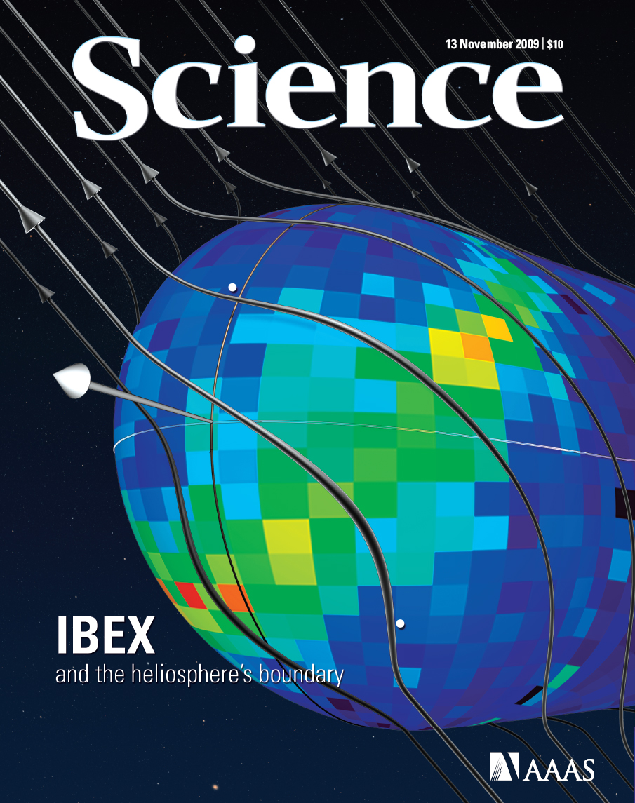
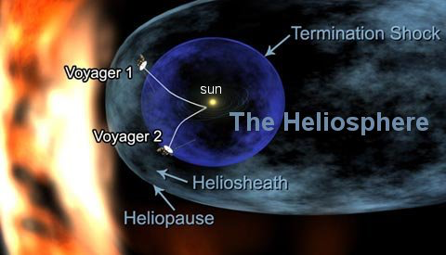
stellar variability on astrospheres and exoplanets
Joint Heliophysics and Astrophysics program to investigate the effects of stellar variability on astrospheres and exoplanets
Test theories developed in light of Voyager and IBEX discoveries concerning the heliospher, effects on cosmic rays
Kepler stellar observations to discover how dynamic stars affect long-term habitability of exoplanets
Larger view of our solar system in relation to other stellar systems informs distant past and future of our home in space
Sun – Solar Wind – SEPs – Heliosphere – Cosmic Rays
Stars – Stellar Winds- Astrophysics Acceleration – Astropspheres – Cosmic Rays

Slide 15
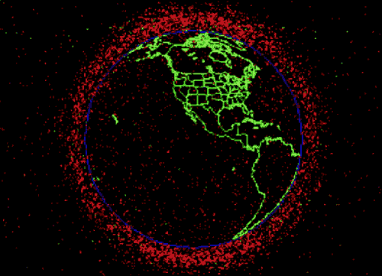
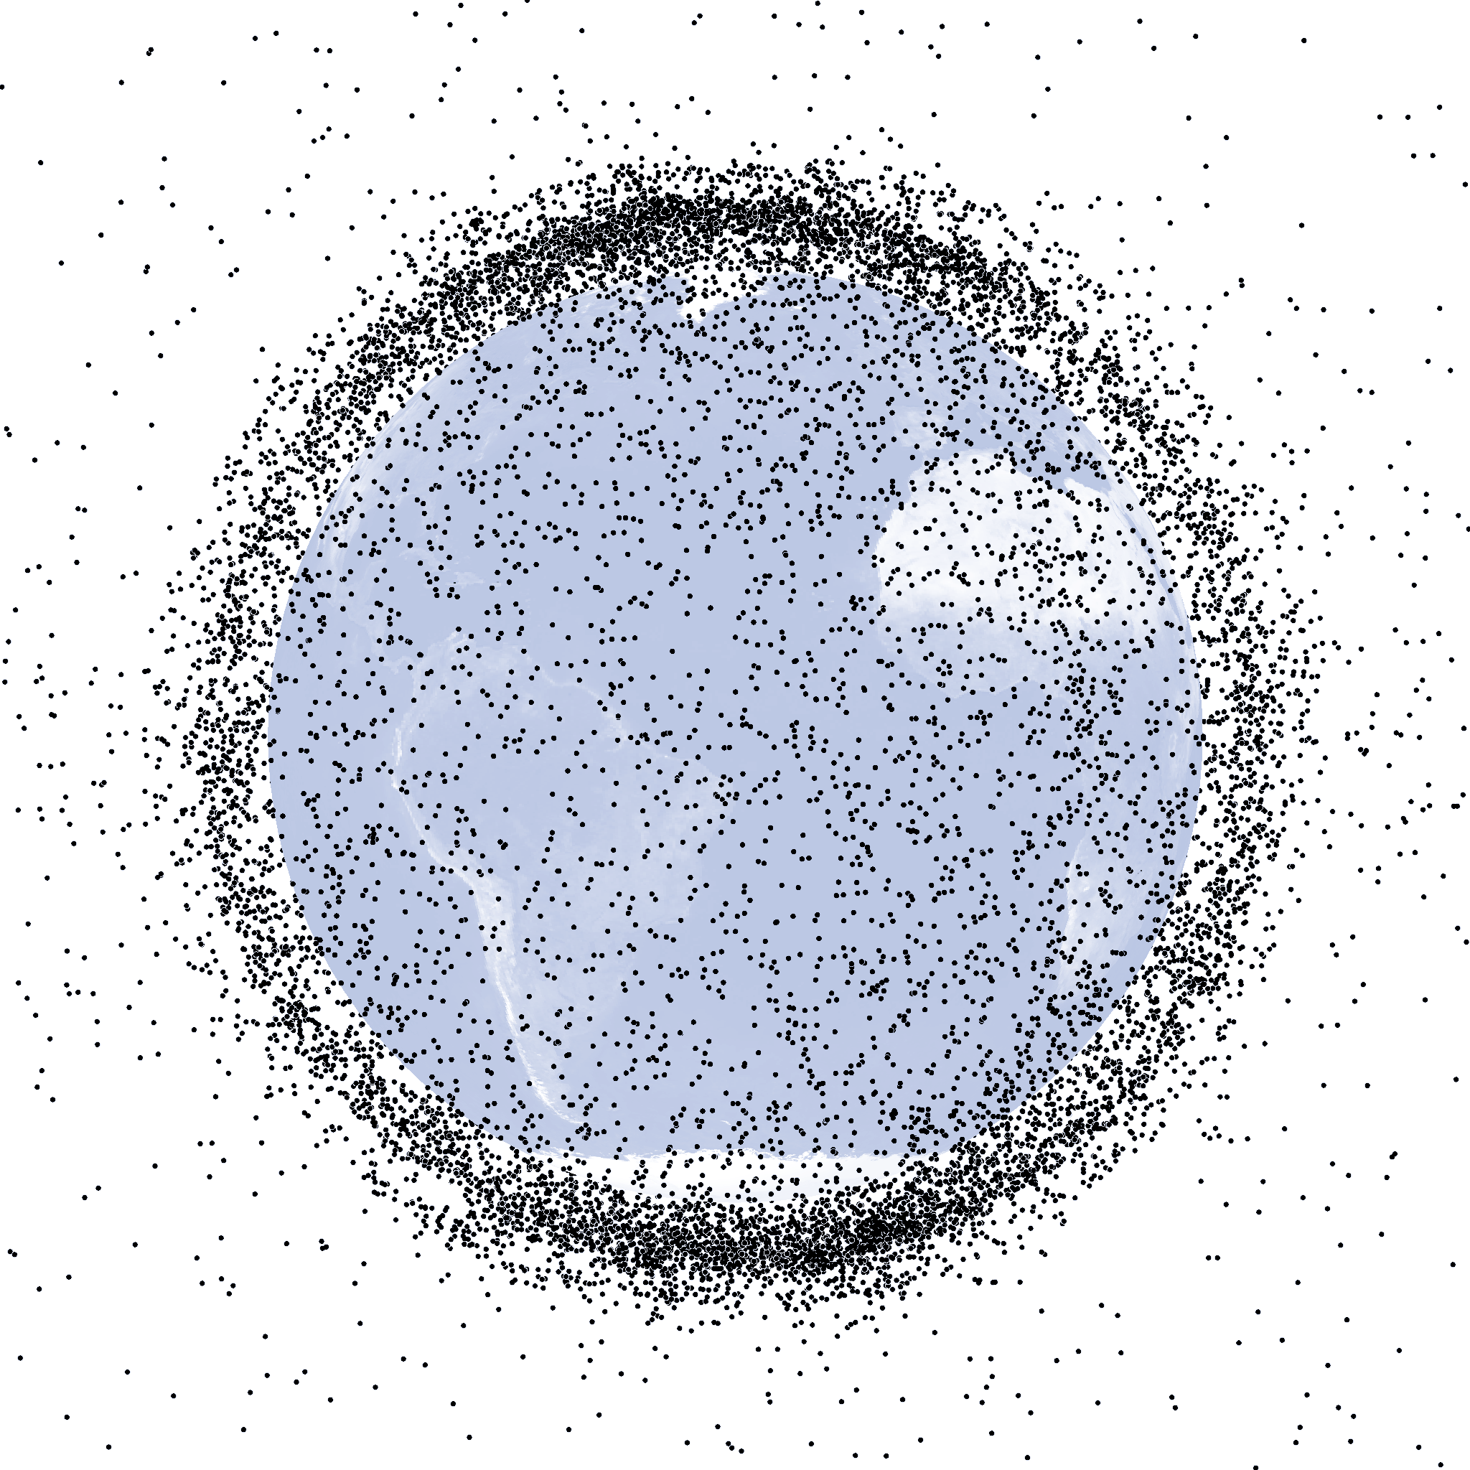
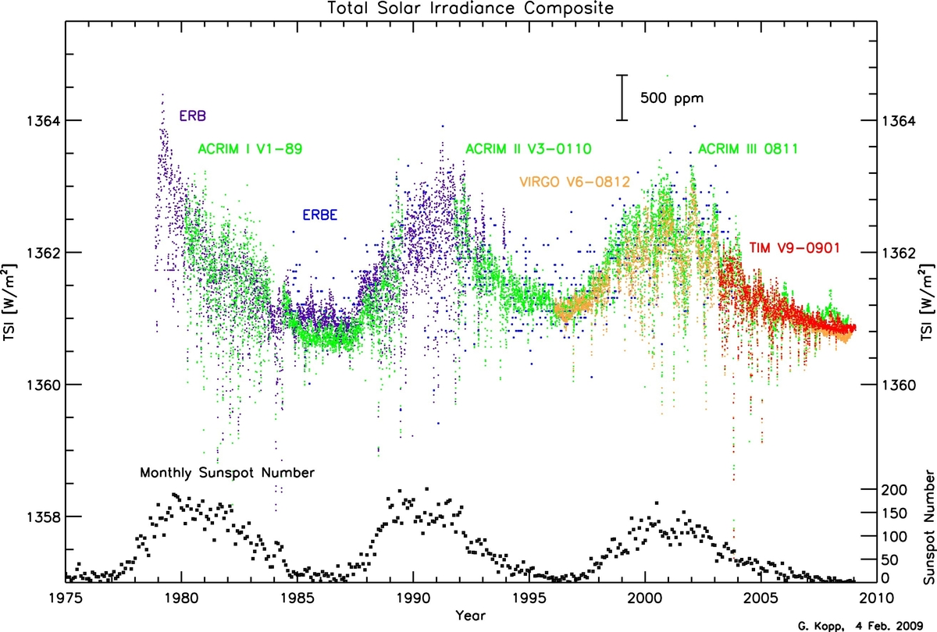
Critical future Areas for LWS Science
Forecasting collisions between operational satellites and the vast number of objects that have accumulated in low Earth orbit (LEO) over the past 60 years is related to many of the goals and challenges of the LWS program.
  Last such February 2009 - defunct Russian S/C destroyed Iridium 33, operating comm sat.
  Near-term (1-7 days) evolution of solar activity for
  Density forecast uncertainty (satellite drag)
  Long-term (decades to centuries) forecasting and remediation of the debris population.
    Atmospheric drag - only mechanism by which space objects are removed from orbit
    Long-term evolution of the Sun and Earth’s atmosphere have profound effects on the future size and characteristics of the debris field
Sun-climate theme has unique societal relevance
  Uniquely challenging inter-disciplinary theme extends into geo-sciences
  Complex web of physical processes to be studied
  LWS TR&T theme has proven important in overall study of climate and climate change because it stimulates the expertise close to the core of the LWS goals
0.1% TSI variability with solar cycle
Courtesy G. Kopp, UColorado

Slide 16
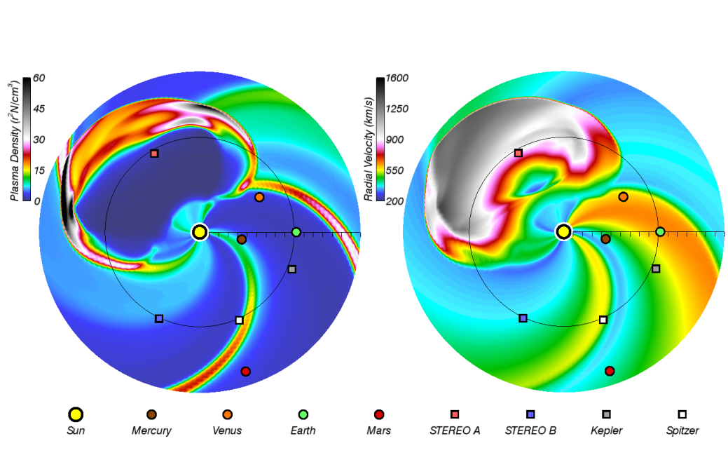
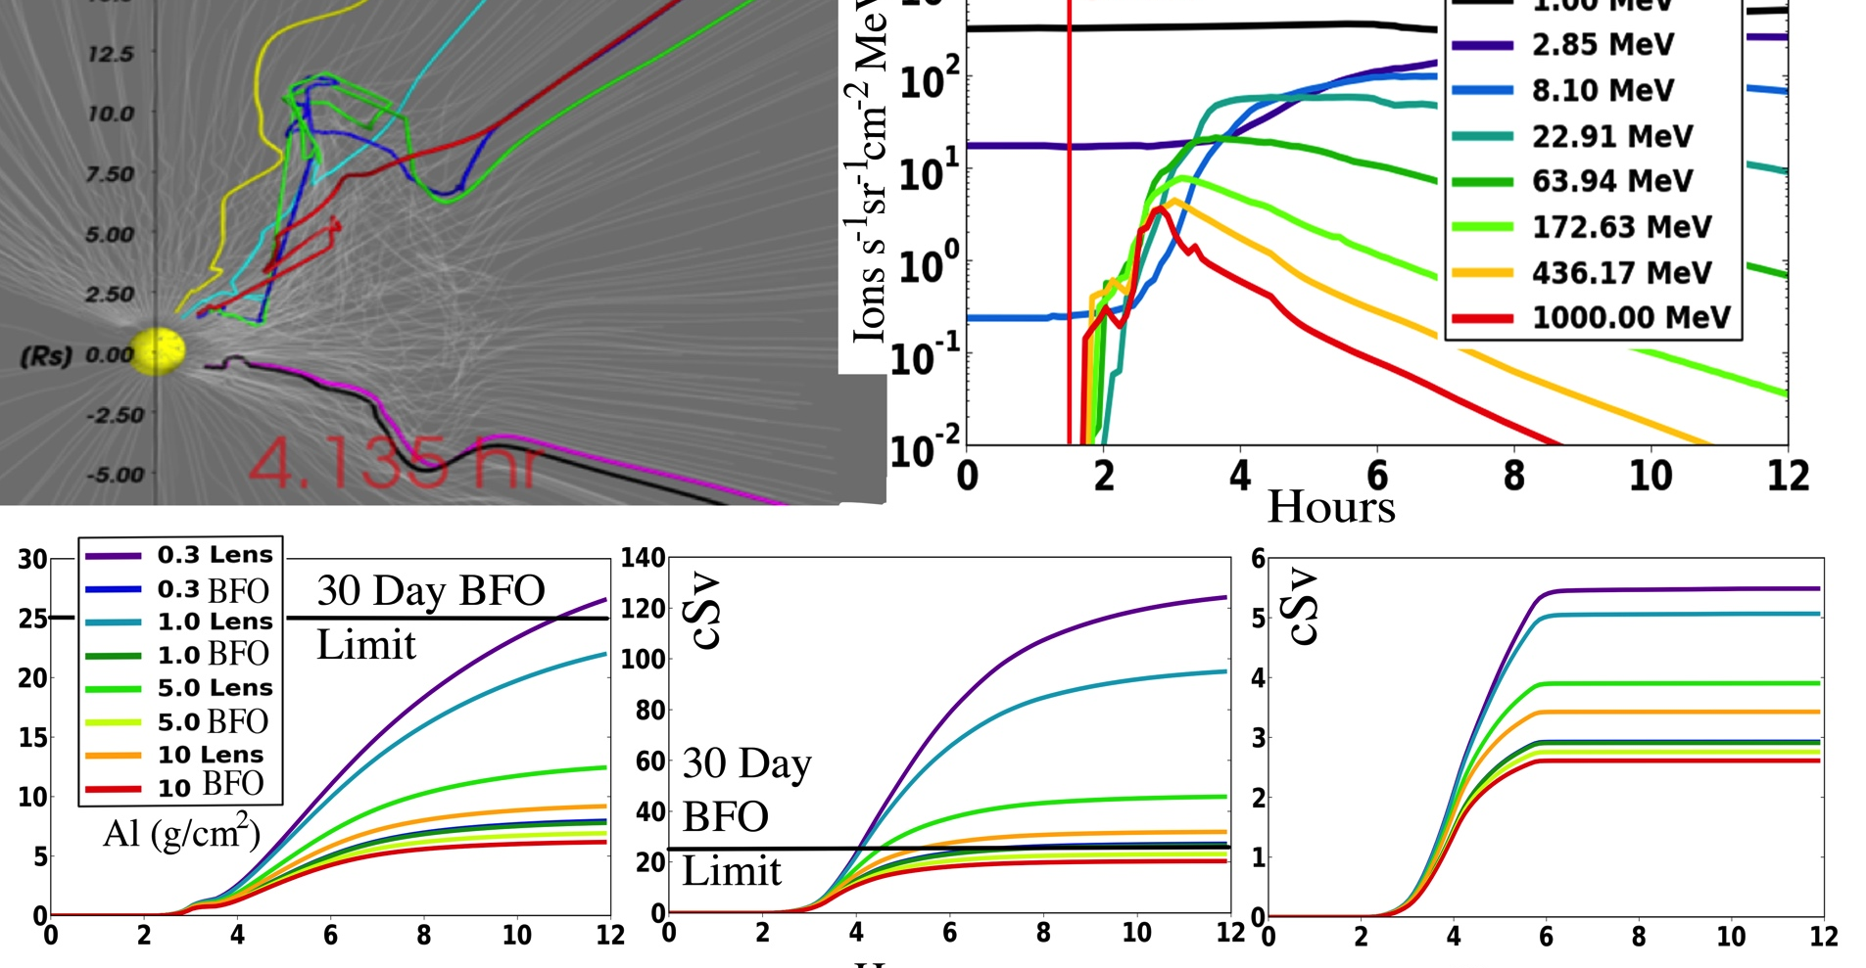
Transformative enhancements in computational modeling
Transition from the present-day terascale and petascale systems to the exascale in the near future, empowering the science community to further undertake challenges that can be potentially transformational
  High performance solvers and advanced algorithms for fluid simulations
  Advanced kinetic simulation approaches and algorithms
  Computational framework: coupling physics across disparate scales
  Analysis tools, parallel visualization and data mining and assimilation
Tracking CMEs via Enlil Modeling at CCMC
PSI MAS Model and C-SWEPA, Schwadron et al., 2014b

Slide 17
Interaction with User Communities
FST, SC and TST teams partner with members of key space weather centers (e.g., CCMC, NASA/SRAG, and NOAA/SWPC)
  facilitate better interaction with user communities
  deliverables that best serve user needs.
Upon team selection, NASA/HQ will contact relevant modeling centers to identify liaisons to appropriate user communities.

Slide 18
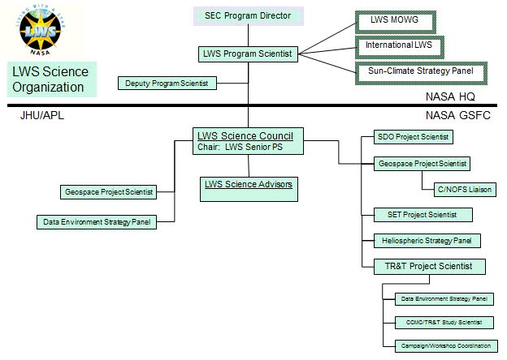
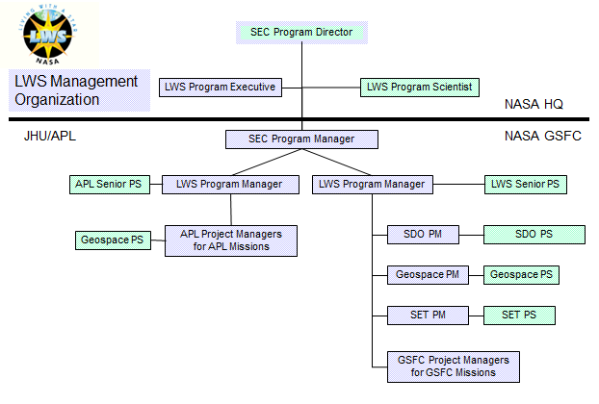
Sustainable Management of LWS
Current management unsustainable (2 program scientists)
Need to develop a structure in-line with LWS needs
  Re-establish LWS MOWG
  Structure enabling active management with interactions and coordination across groups, centers, organizations and divisions
  Structure for developing interactions and mediating delivery of products needed by user communities
Management structure of LWS in 2002

Slide 19
Living With A Star
Enabling Science, Technology and Exploration
to Advance Society
Building from a strong foundation of innovation in the first decade of LWS
LWS Fundamentally Rooted in the Science and Goals Laid out by the SSP Decadal Survey
LWS 10 Year Vision Responds to Societal Demand for Improved Space Weather Services
  Stronger link between scientific and user communities
  Long-term targeted areas of System Science: Strategic Science Areas
  LWS-Drive Initiatives and science centers develop transformative predictive capabilities
  Foster a coordinated collaborative research environment in the national and international community*
  More flexible and affordable program makes better use of ground based facilities that fulfill critical needs of the LWS program
  New and Augmented Fundamental Science and Technology Development Areas
Augmented Management Structure to Facilitate Delivery of Targeted Applications and Products for User Communities

