Slide 1
LWS TRT research elements

Slide 2
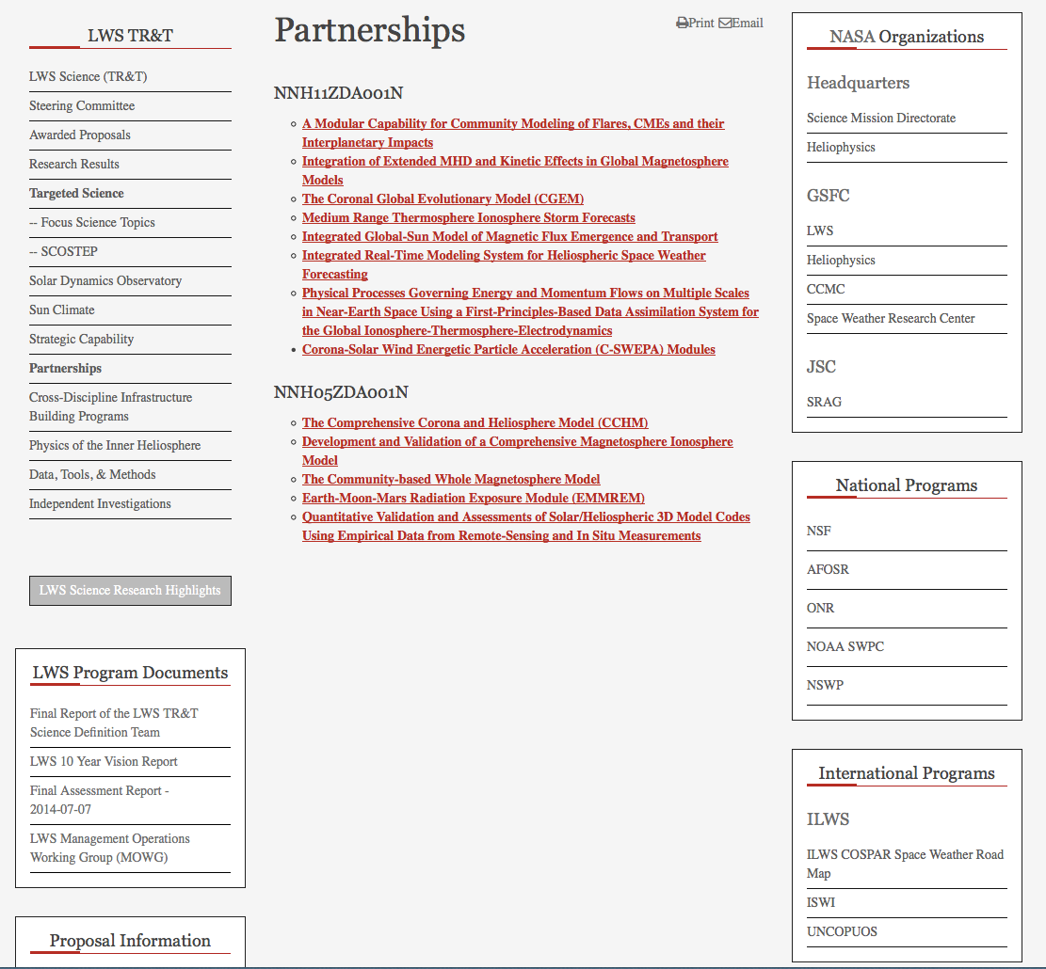

Slide 3
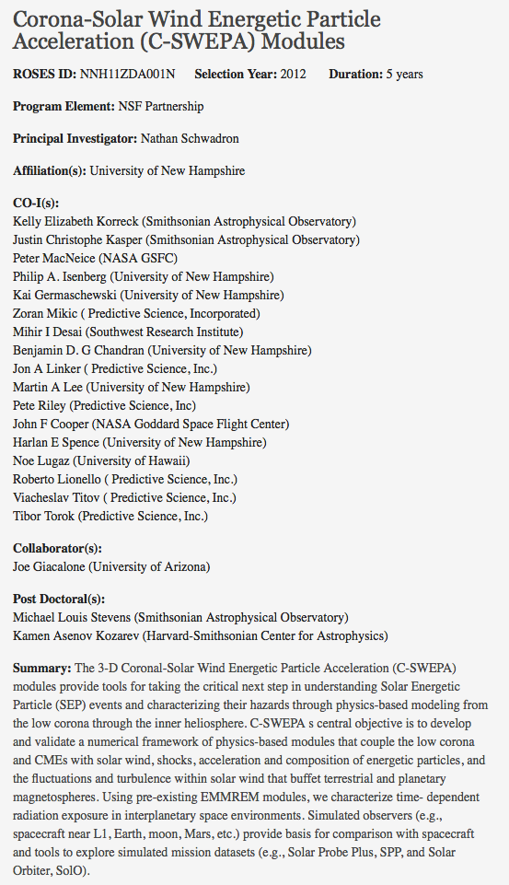
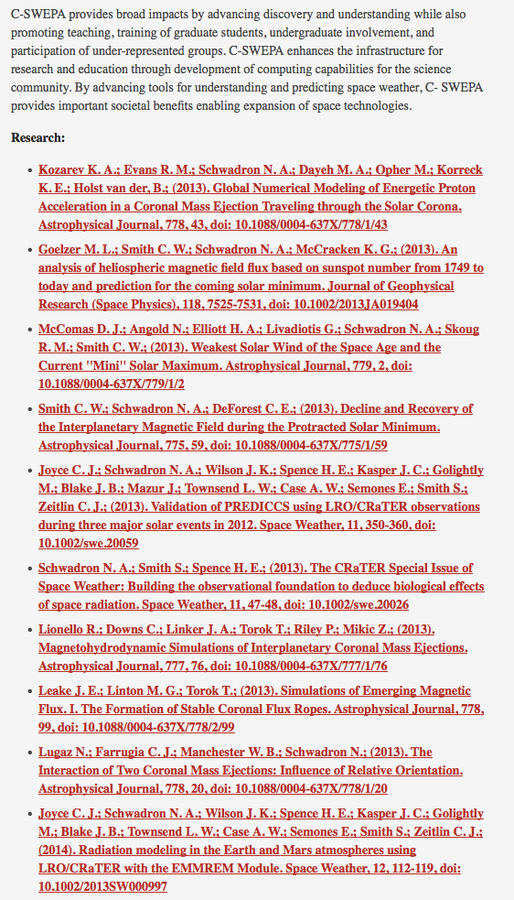
Selected project info

Slide 4
LWS TRT is a program by the Community, for the Community!

Slide 5
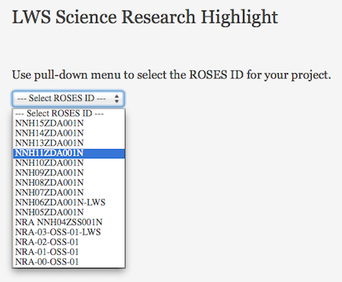
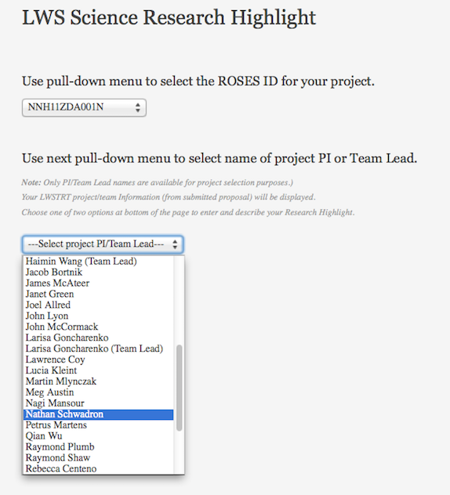
Instruction or prompt @ every step

Slide 6
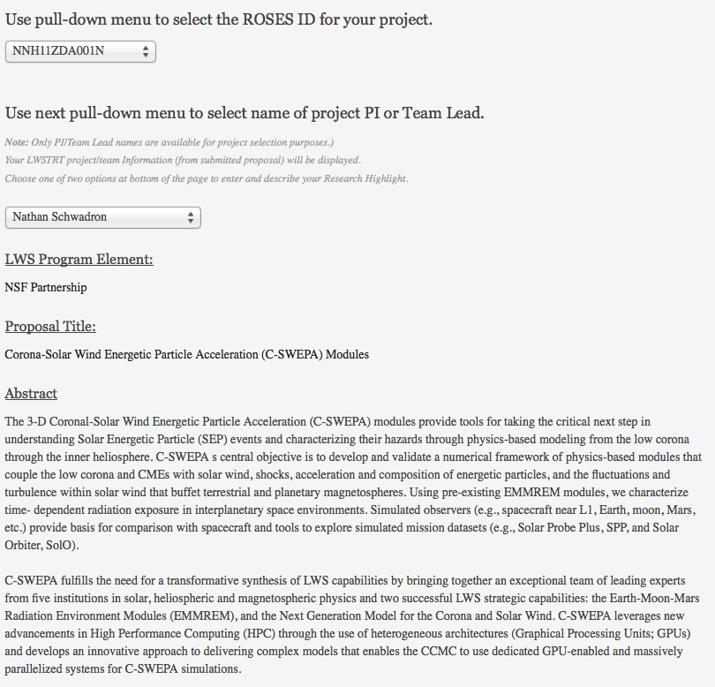
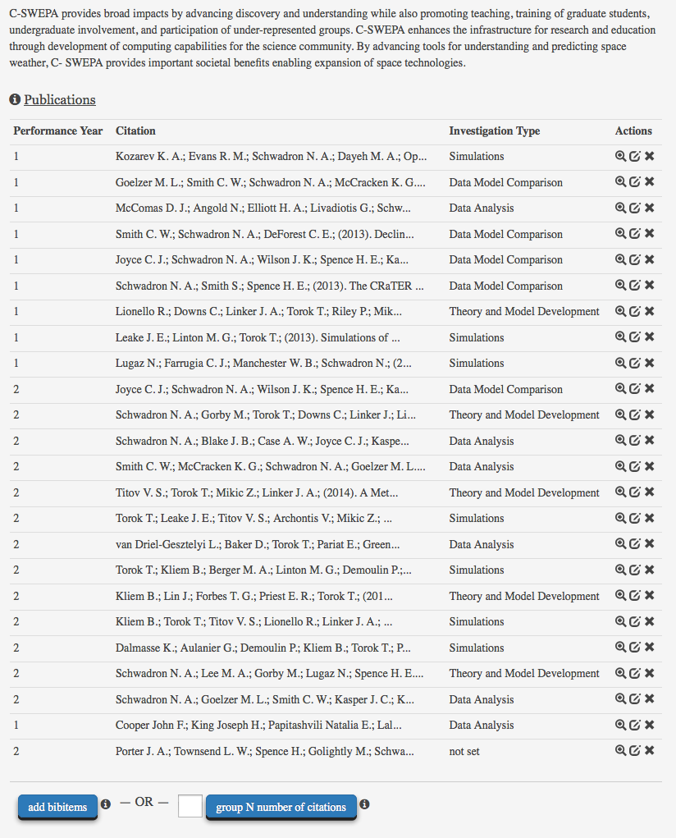
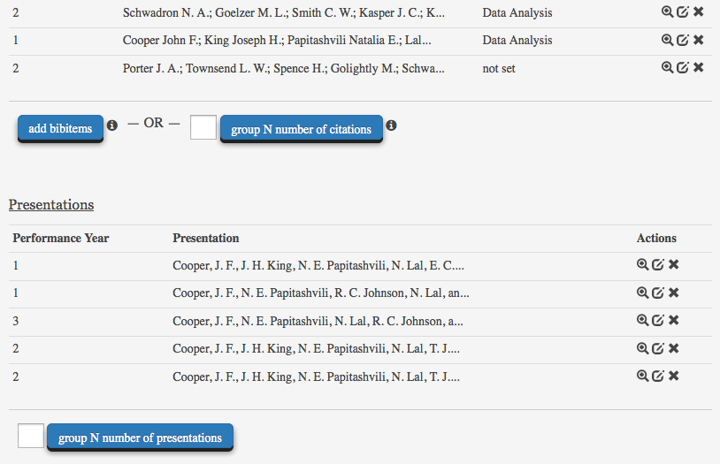
Project info
ADS BibTeX output
View, Edit, Delete
Single or small number of pubs or presentations

Slide 7
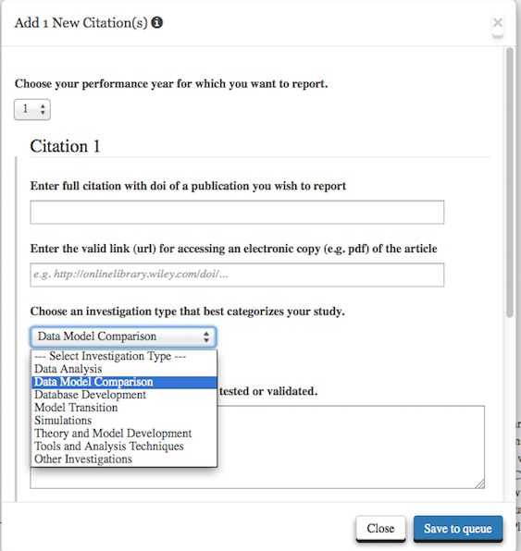
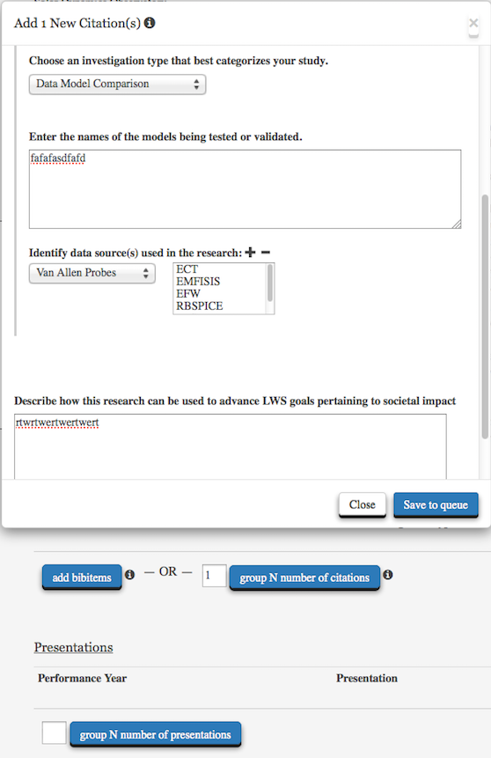
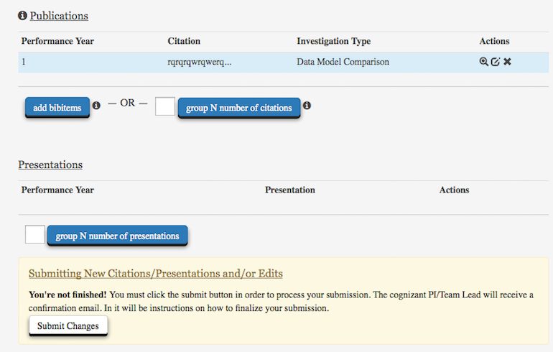
New info saved only upon confirmation by cognizant PI / Team Lead

Slide 8
Send: feedback & questions
To: shing.f.fung@nasa.gov

