Slide 1
Soliciting Community Input*
to NASA’s Living With A Star Program
for Focused Science Topics (FSTs)
https://lwstrt.gsfc.nasa.gov/communityinput/input/
https://lwstrt.gsfc.nasa.gov/communityinput/viewinput/2020/
* This community input will be used to influence the FSTs for ROSES LWS solicitations in 2021 and beyond.

Slide 2
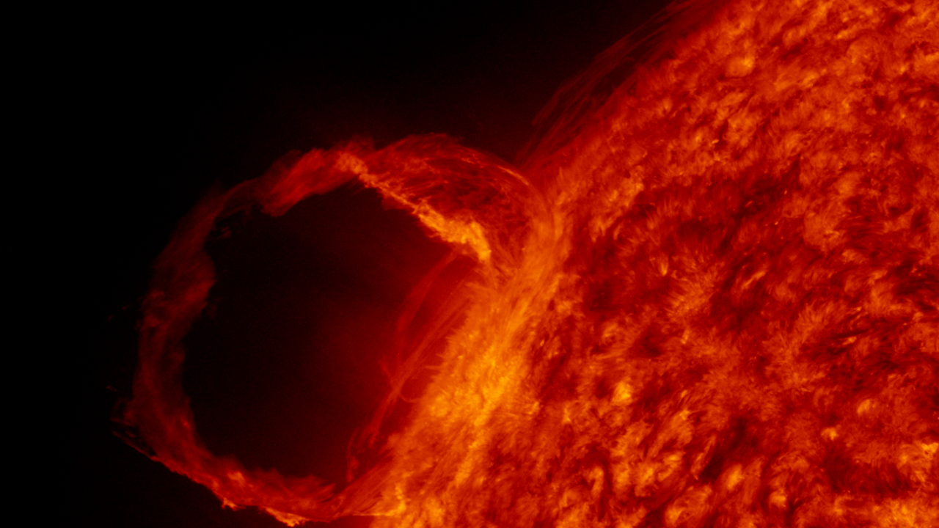
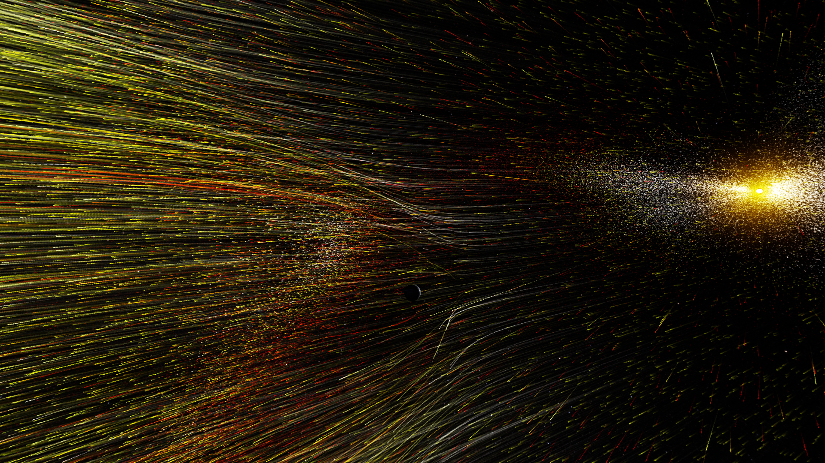
Outline
Introduce the LWS Program Analysis Group.
Brief overview of Strategic Science Areas and Focused Science Topics.
Review the 2019 and 2020 solicited FSTs.
Review the remaining FSTs for which we are soliciting comments.
Introduce the website for inputting new FST ideas and comments on the remaining FSTs.
Describe the Executive Committee’s process for crafting new FSTs from these inputs.
Brief overview of how NASA uses the FSTs.
Q&A.

Slide 3
i
NASA Living with a Star
Program Analysis Group
LPAG Purpose:
The NASA Living with a Star (LWS) Program Analysis Group (LPAG) serves as a community-based interdisciplinary forum for soliciting and coordinating community input for Living with a Star objectives and for examining the implications of these inputs for architecture planning, activity prioritization and future exploration.
Executive Committee (EC) Co-Chairs:
Anthea Coster, MIT Haystack Observatory
Sabrina Savage, NASA MSFC
EC Members:
Joe Borovsky, Space Science Institute
Richard Collins, University of Alaska-Fairbanks
Seebany Datta-Barua, Illinois Institute of Technology
Heather Elliott, Southwest Research Institute
Matina Gkioulidou, JHU APL
Fan Guo, Los Alamos National Laboratory
Brian Walsh, Boston University
Chuanfei Dong, PPPL Princeton University
Angelos Vourlidas, JHU APL
Shasha Zou, University of Michigan
LWS Program Ex Officio:
Jeff Morrill, NASA HQ
Simon Plunkett, NASA HQ
Madhulika Guhathakurta, NASA HQ
Shing Fung, NASA GSFC
LPAG: https://lwstrt.gsfc.nasa.gov/lpag

Slide 4
ii
Strategic Science Areas & Focused Science Topics
SSAs are long-term targeted areas of system science to guide LWS activities. SSAs encapsulate the overarching goals for the overall LWS Science program, which supports physics-based enabling science to benefit life and society.
In December 2019*, the LPAG EC finalized a revised list of SSAs**. The current Call for Input is the first opportunity for the community to influence LWS science topics within the framework of these new SSAs:
Origins and Variability of Global Solar Processes
Solar Eruptive and Transient Heliospheric Phenomena
Acceleration and Transport of Energetic Particles in the Heliosphere
Variability of the Geomagnetic Environment
Dynamics of the Global Ionosphere and Plasmasphere
Ionospheric Irregularities
Composition and Energetics of the Upper Neutral Atmosphere
Radiation and Particle Environment from Near Earth to Deep Space
Solar Impacts on Climate
Stellar Impacts on Planetary Habitability
*2019 LPAG EC Report: https://lwstrt.gsfc.nasa.gov/assets/docs/lpag/LPAG_EC_report_2019_12_31.pdf | **SSAs: https://lwstrt.gsfc.nasa.gov/strategic-science-areas-ssas

Slide 5
ii
Strategic Science Areas & Focused Science Topics
FSTs are one of the major ways the community can influence NASA research topics.
The topics we are soliciting now will contribute to the ideas used by NASA HQ for 2+ years to craft the final ROSES LWS solicitations.
In October 2018*, the LPAG EC finalized 20 Focused Science Topics topic write-ups:
8 of these FSTs have been used to construct the ROSES 2019 and 2020 calls.
12 potential FSTs remain, and we solicit your comments on these remaining topics.
For 2020, the primary focus of the LPAG EC is to solicit input for the development of an updated set of draft FSTs.
New FSTs will be used for ROSES 2021 and beyond.
*2018 LPAG EC Report: https://lwstrt.gsfc.nasa.gov/assets/docs/lpag/2018_LPAG_EC_Report_Final_11_30.pdf

Slide 6
iii
2019/2020 Selected FSTs
2019:
The Variable Radiation Environment in the Dynamical Solar and Heliospheric System
Fast Reconnection Onset
Magnetospheric and Ionospheric Processes Responsible for Rapid Geomagnetic Changes
Causes and Consequences of Hemispherical Asymmetries in the Magnetosphere – Ionosphere – Thermosphere System
2020:
Modeling and Validation of Ionospheric Irregularities and Scintillations
Understanding and Predicting Radiation Belt Loss in the Coupled Magnetosphere
The Origin and Consequences of Suprathermal Particles that Seed Solar Energetic Particles
Long Term Variability and Predictability of the Sun-Climate System
2019: https://lwstrt.gsfc.nasa.gov/images/pdf/roses/NNH19ZDA001N.pdf | 2020: https://lwstrt.gsfc.nasa.gov/images/pdf/roses/NNH20ZDA001N-LWS.pdf

Slide 7
iv
Remaining / Rollover 2018 FSTs
Understanding the Impact of Thermospheric Structure and Dynamics on Orbital Drag
Pathways of Cold Plasma through the Magnetosphere
Understanding the Variability of the ITM System Due to Tides, Planetary Waves, Gravity Waves, and Traveling Ionospheric Disturbances
Connecting Thermospheric Composition and Space Weather
Understanding Ionospheric Conductivity and Its Variability
Extreme Solar Events --- Probabilistic Forecasting and Physical Understanding
Connecting Auroral Phenomena with Magnetospheric Phenomena
Understanding Space Weather Effects and Developing Mitigation Strategies for Human Deep Space Flight
Solar Photospheric Magnetic Fields
Coupling of Solar Wind Plasma and Energy into the Geospace System
Combining Models and Observations to Study CME Plasma Energetics in the Inner Corona
Atmospheric Evolution and Loss to Space in the Presence of a Star
--

Slide 8
iv
Remaining / Rollover 2018 FSTs
Tools and Methods
Data Science and Analytics
Correcting or Mitigating Artifacts in HMI Photospheric Magnetic Fields
Note: Community input from years prior to 2018 were included in the development of the 2018 FSTs and is therefore carried over.
--

Slide 9
v
Community Input Solicitation
Due Date: July 3, 2020
The LPAG EC is soliciting community input to aid in the development of the next cycle of FSTs that will feed into the LWS ROSES science calls for 2021 and beyond.
Suggested science topics should be organized around achieving the goals set out in the recently revised Strategic Science Areas* (SSAs).
Enter new FST suggestions via https://lwstrt.gsfc.nasa.gov/communityinput/input/.
View and Comment on new and rollover FST community input via https://lwstrt.gsfc.nasa.gov/communityinput/viewinput/2020/.
Community input regarding updates to the rollover topics as well as the newly suggested topics is welcome through this View Input and Comment page.
*SSAs: https://lwstrt.gsfc.nasa.gov/strategic-science-areas-ssas

Slide 10
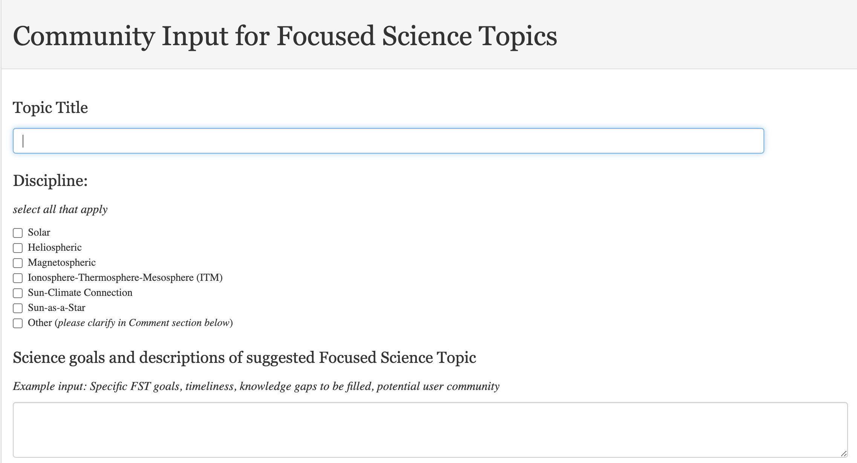
v
Community Input Solicitation
Due Date: July 3, 2020
New FST
input page
(1/4)
New FST Input: https://lwstrt.gsfc.nasa.gov/communityinput/input/

Slide 11
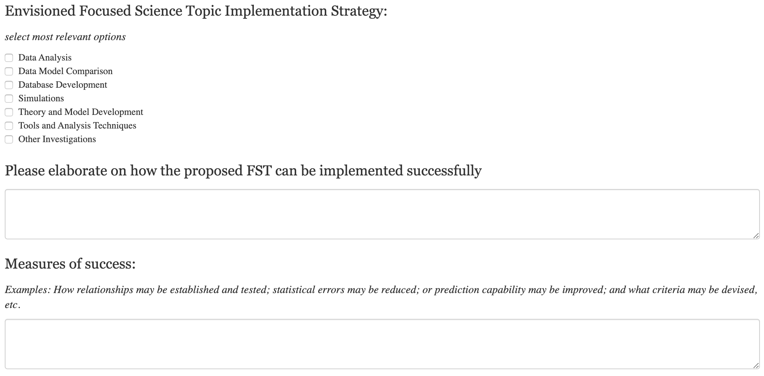
v
Community Input Solicitation
Due Date: July 3, 2020
New FST
input page
(2/4)
New FST Input: https://lwstrt.gsfc.nasa.gov/communityinput/input/

Slide 12
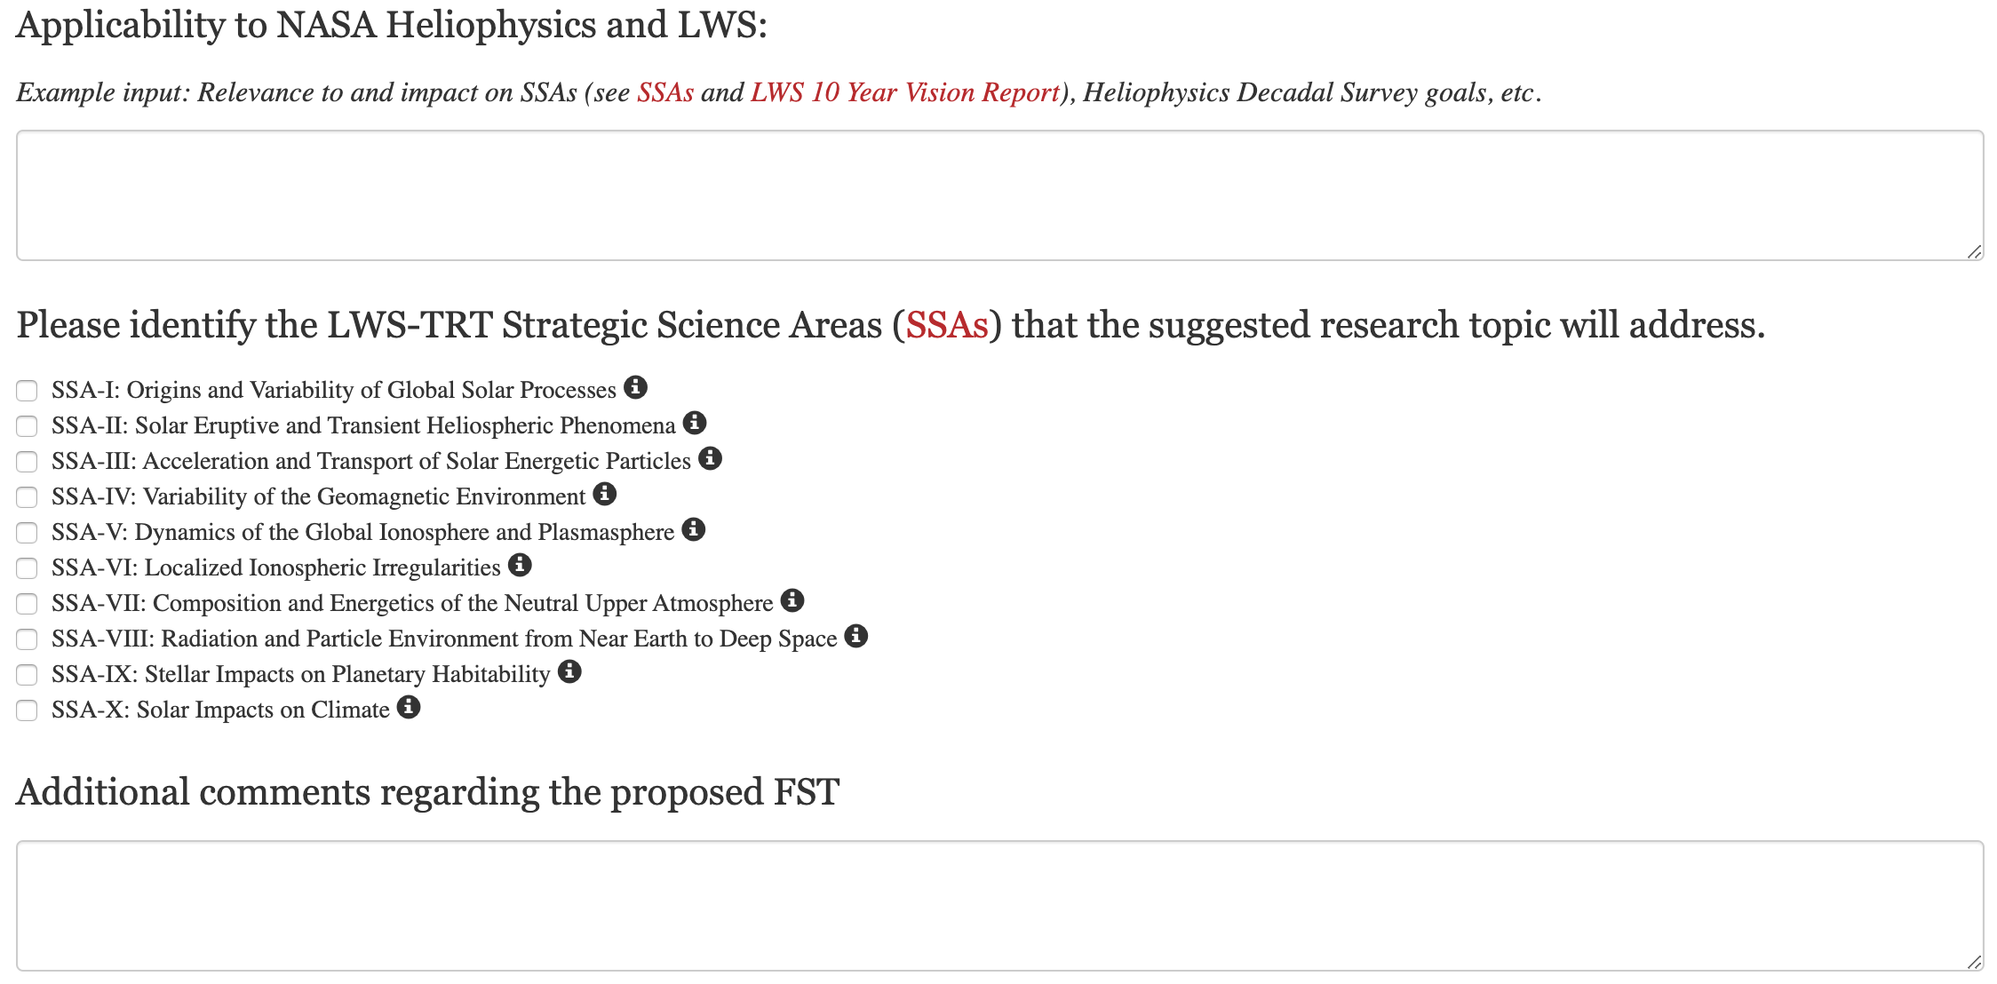
v
Community Input Solicitation
Due Date: July 3, 2020
New FST
input page
(3/4)
New FST Input: https://lwstrt.gsfc.nasa.gov/communityinput/input/

Slide 13
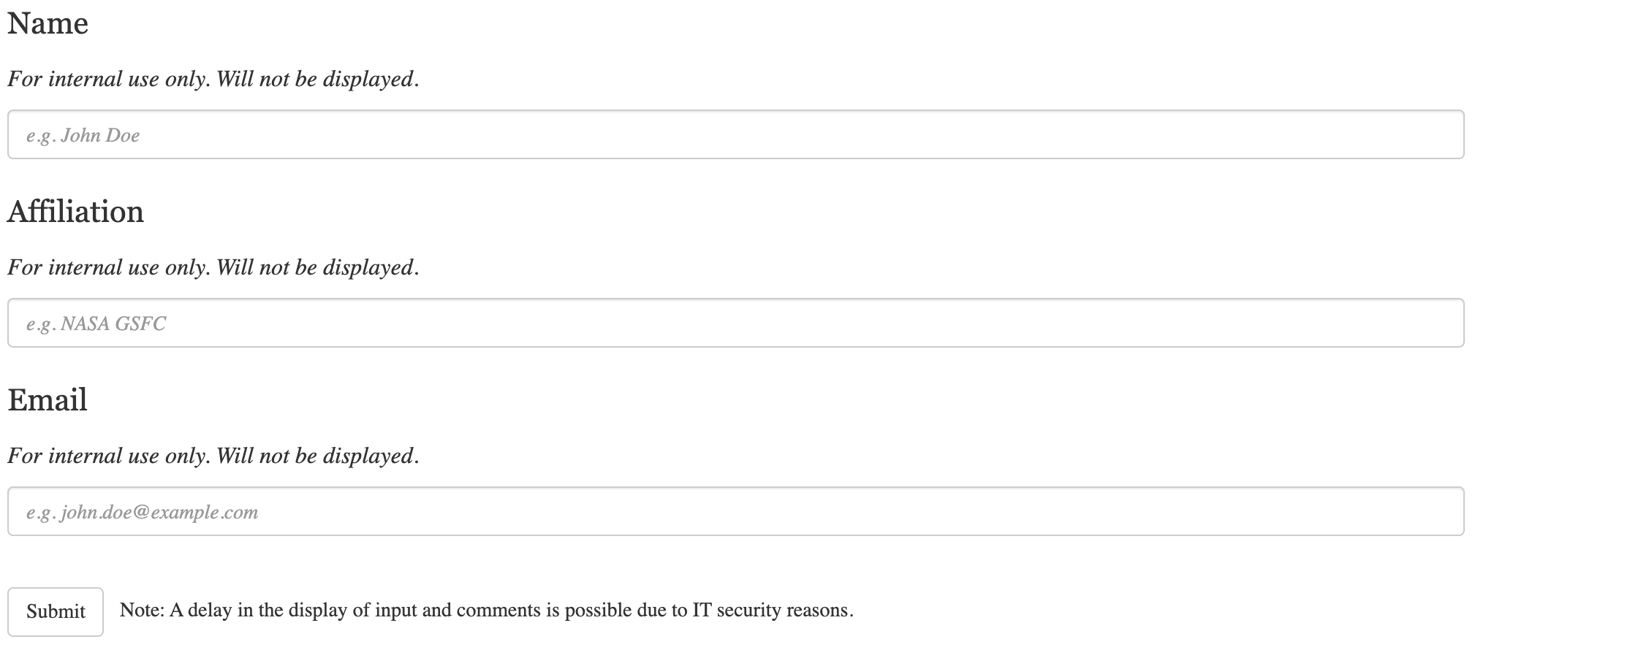
v
Community Input Solicitation
Due Date: July 3, 2020
New FST
input page
(4/4)
New FST Input: https://lwstrt.gsfc.nasa.gov/communityinput/input/

Slide 14
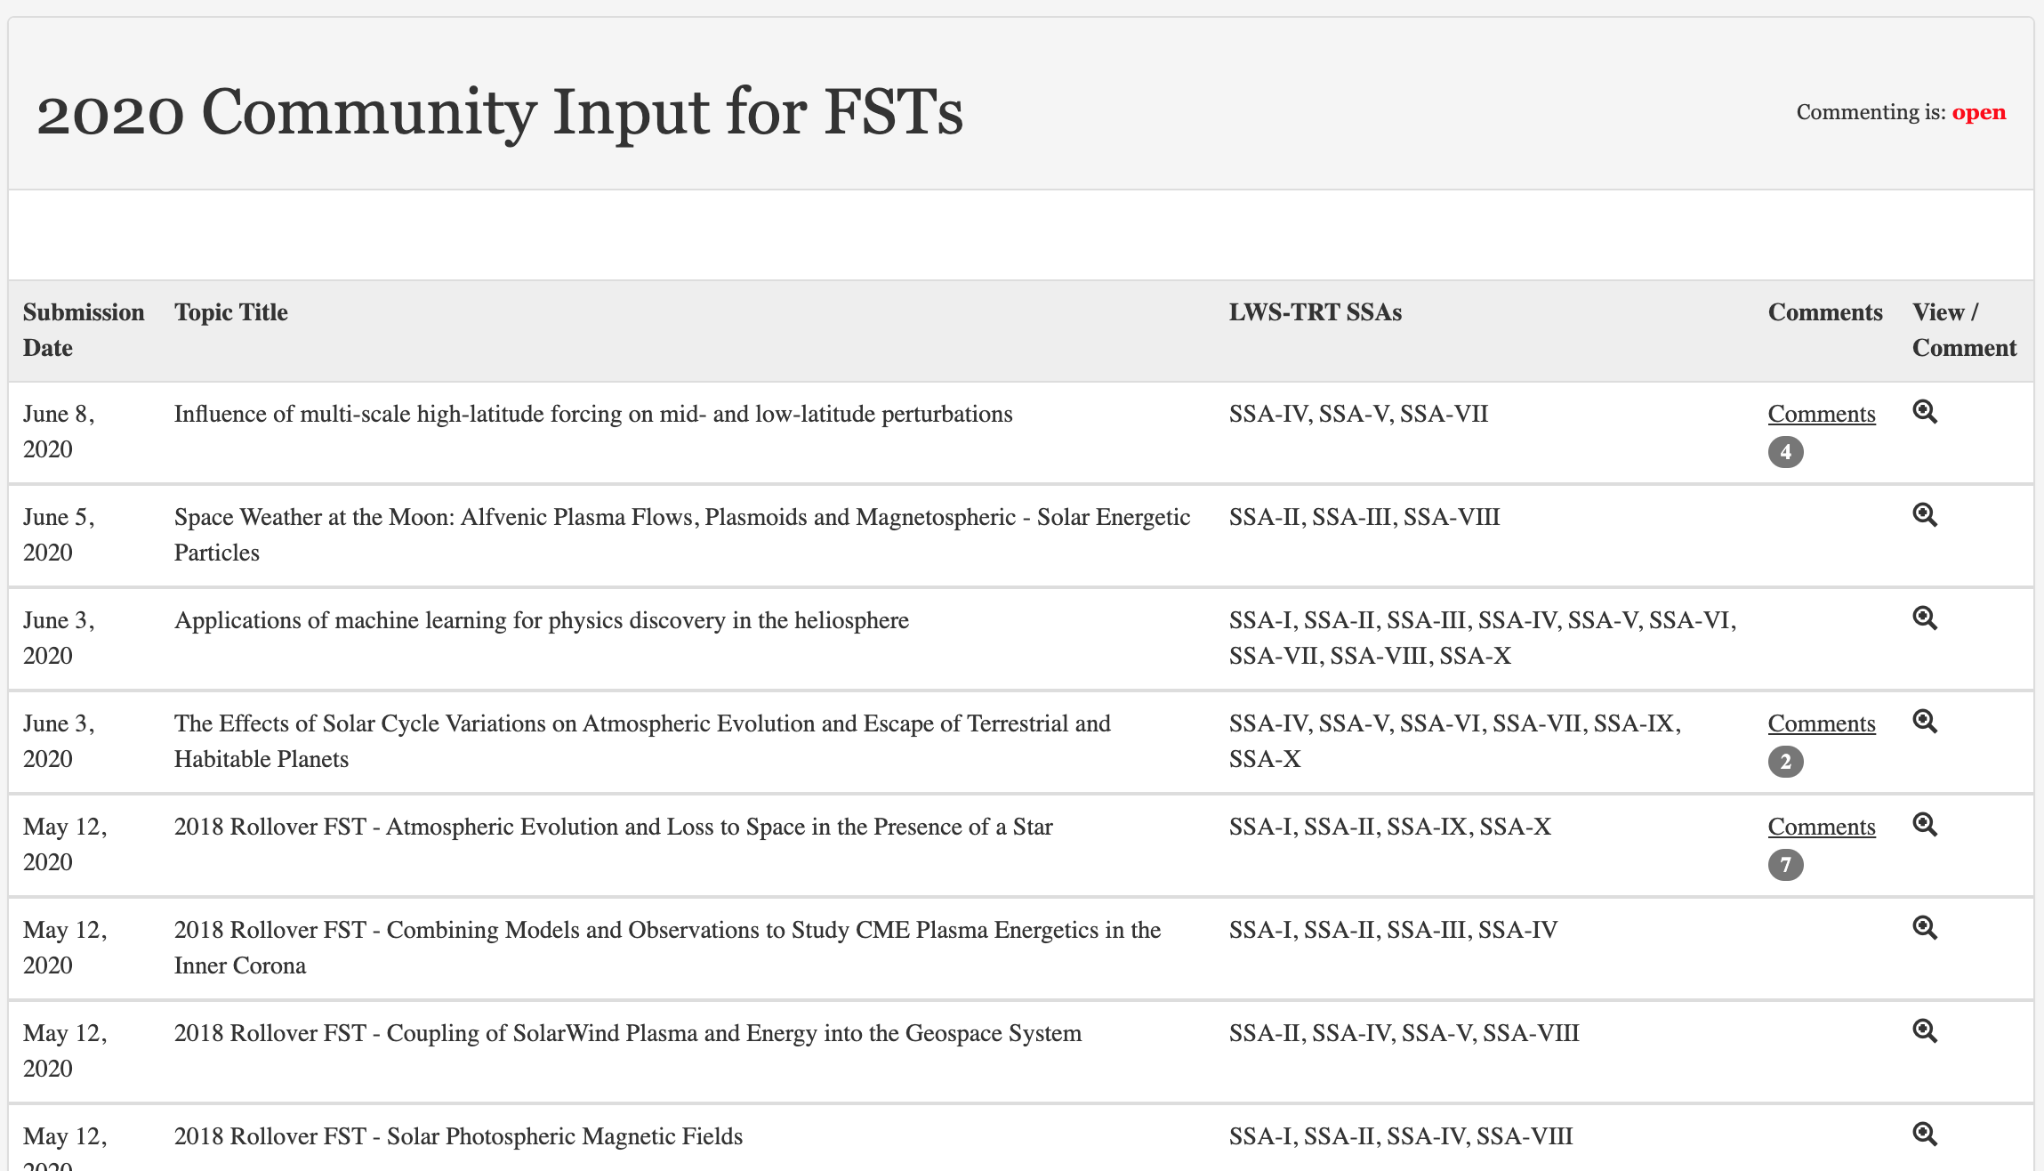
v
Community Input Solicitation
Due Date: July 3, 2020
View and
Input Page
View & Input: https://lwstrt.gsfc.nasa.gov/communityinput/viewinput/2020/

Slide 15
vi
LPAG EC FST Development Process
1
2
3
Gather input from the Heliophysics community* for new Focused Science Topic ideas and comments on rollover topics.
All FSTs and input are sorted and grouped.
Subject matter experts within the LPAG EC evaluate the input against the Strategic Science Areas.
4
5
6
New draft science topic list is developed.
Topic descriptions are developed incorporating community feedback** and rollover descriptions, where appropriate.
Final set of draft FSTs are sent to the HQs program office for evaluation.
Repeat ~ every other year
*LPAG EC members can also provide input for topics. | **Community input and LPAG comments are archived on the website.

Slide 16
vii
Incorporation of FSTs into ROSES
1
2
3
4
5
Community* Input
LWS Program Analysis Group (LPAG)** develops draft set of FSTs.
NASA Heliophysics Division
Draft FSTs revised
Final FSTs selected for LWS Science ROSES Calls
4a
4b
Past FSTs
(5-6 years)
Available Budget
*Community are LPAG members. | **Acts as Executive Committee. Refer to previous slide.

Slide 17
viii
Questions?
This is a chance for you to influence future research opportunities…
Please take advantage of this opportunity!
--

