Slide 1

LWS TR&T Town Hall Meeting
Fall AGU 2009
AGENDA
Brief summary of LWS TR&T Program Status (Lika Guhathakurta, for NASA HQ) (10m)
Open discussion of LWS TR&T Program and next Focus Topics (30m)
(Amitava Bhattacharjee, SC chair)
Comments on current Focus Team activities (Focus Team leads) (20m)

Slide 2

Four Strategic GOALS
..deliver the understanding and modeling required for useful prediction of the variable solar particulate and radiative environment at the Earth, Moon, Mars, and throughout the solar system
..deliver the understanding of how and to what degree variations in the solar radiative and particulate output contribute to changes in global and regional climate over a wide range of time scales
..deliver the understanding and modeling required for effective forecasting/specification of magnetospheric radiation and plasma environments
..deliver understanding and predictive models of upper atmospheric and ionospheric responses to changes in solar electromagnetic radiation, and to coupling above and below

Slide 3
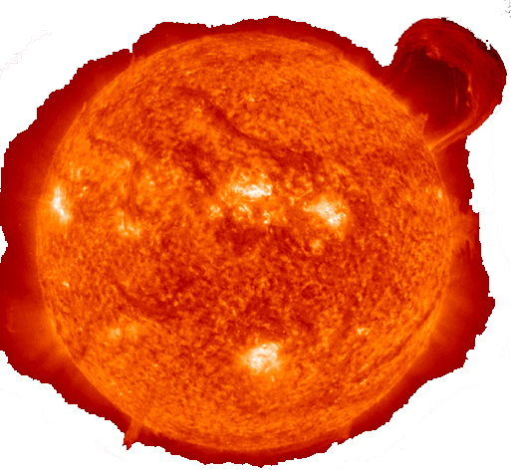
Proposals and Awards
155 current awards with average funding level of $121,000
  26% of these have separately funded co-Investigators
  Most have 3 year duration, some 4 year duration (FT) (SC - 5 year duration)
Selection for 2008
  105 proposals submitted; 35 selected (success ratio: 1/3)
  3 proposals submitted; 2 selected for Strategic Capability
  1 workshop selected
ROSES 2009
  New compliance criteria for Focus Topics and Tools and Methods
  No Independent Investigations
  137 proposals submitted for TR&T, a few are non-compliant, less $
  No Strategic Capability
  Proposal selection March 2010,
TR&T email: lws.trt@nasa.gov

Slide 4
4 New Focus Teams in 2008
  Measure the properties of the solar dynamo that affect solar irradiance and active region generation. 10 proposals, 5 funded, average $143 K
  Use Inner Heliospheric Observations to better constrain Coronal Mass Ejection (CME) and Solar Energetic Particle (SEP) Event models. 17proposals, 6 funded, average $119 K + 1 Workshop
  Integrate Non-MHD/Kinetic Effects on Magnetic Reconnection, Particle Energization, and Plasma Heating into Global Models
    23 proposals, 7 funded, average $127 K
  Determine and quantify the responses of atmospheric/ionospheric composition and temperature to solar XUV spectral variability and energetic particles 18 proposals, 5 funded, average $130 K
Tools and Methods
  18 proposals, 5 funded, average $126 K
Independent Investigataions
  22 proposals, 6 funded, average $123 K

Slide 5
Emphasis on Sun Climate Connection
NASA is planning to task NRC to conduct a study/workshop on
Beyond Radiative Forcing and Response:
Reconciling Observations and Understanding of Climate Response to
Solar Variability
What part of observed atmospheric variability is in response to solar forcing, particularly in the lower atmosphere? Are attributed signals consistent over different time scales?
What are associations between sunspots or cosmogenic isotopes and the magnitude of solar irradiance changes in the past?
If long-term irradiance variations are insufficient to impact climate, were other solar-modulated parameters, such as galactic cosmic rays, responsible for the reported paleo sun-climate connections?
Is empirical evidence sufficiently robust to conclude that the spatial response in climate models is consistent, or not? What does the evidence imply about the relative roles of the Sun and GHGs for past, present and future climate change and what does this mean for their projections of regional climate response to other radiative forcings, such as GHGs?
What are the research directions and model extensions necessary to improve the models, using solar forcings and observed climate responses to test their fidelity?
Are the long-standing concepts of radiative forcings and responses that are the basis for the models inadequate to accommodate the actual mechanisms?

Slide 6
Amitava Bhattacharjee, UNH (Chair)
Mark Moldwin, U of Michigan
Joe Mazur, Aerospace Corp.
Phil Erickson, MIT Haystack Observatory
Dolores Knipp, CIRES/NOAA/CU
Joe Huba, NRL
Casper Ammann, UCAR
Cora Randall, LASP
Doug Rabin, GSFC
Joe Giacalone, LPL, U Arizona
Christina Cohen, Caltech
Thoms Zurbuchen, U of Michigan
Phil Judge, HAO/NCAR
Karel Schryver, LMSAL
Liason to TR&T SC:
Spiro Antiochos, GSFC
Terry Onsager, NOAA SWPC
Farzad Kamlabadi, NSF
Kent Miller, AFOSR
Michael Hesse, GSFC
Ex Officio:
Lika Guhathakurta, Lead Program Scientist, NASA HQ
Mona Kessel, RBSP Program Scientist, NASA HQ
Chuck Goodrich, NASA HQ
New Steering Committee Members

Slide 7
Finishing FOCUS TEAMS
5 Focus Teams in 2006
  Focus Team: “Predict Emergence of Solar Active Regions Before they are Visible” - Birch
  Flares Particle Acceleration Near the Sun and Contribution to Large SEP Events - Mason
  Effects of Ionospheric-Magnetospheric
  Plasma Redistribution - Lottko
  Global Distribution, Sources and Effects of Large Density Gradients - Heelis
  Solar Origins of Irradiance Variation - Klimchuck

Slide 8
Focus Team: “Predict Emergence of Solar Active Regions Before they are Visible”
NWRA/CoRA, MSU, NSO, Stanford

Slide 9
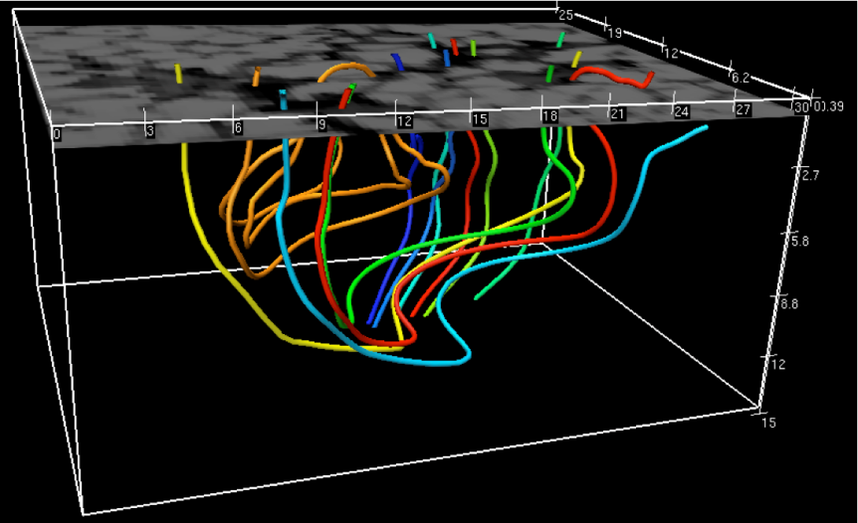
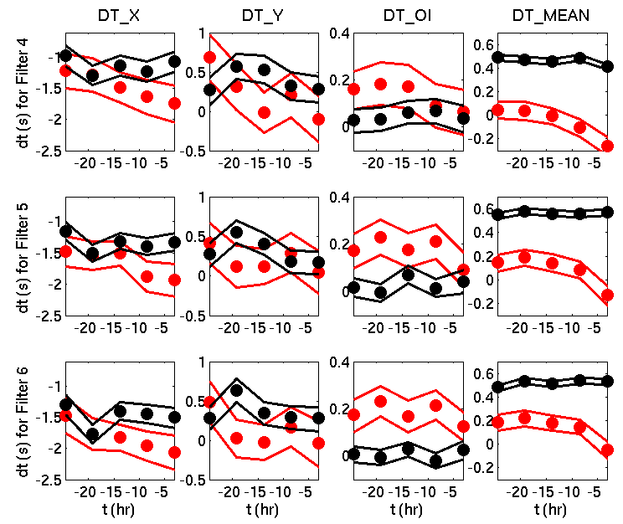
Team Successes
Far-side prediction of the first AR of the new cycle
Simulations:
  Magnetoconvection simulations of rising flux (MSU)
  Wave propagation in magnetic fields (Stanford)
  Waves in spherical geometry (Stanford)
  Team analysis of simulations is ongoing.
Statistical studies of the emergence of AR. This was a significant data analysis effort (about 600 GONG data cubes were analyzed).
Stein et al.
Birch et al.

Slide 10
Some Thoughts
Team leaders: aim to combine team meetings with other community meetings.
Most progress has come from interaction of theory & data analysis. Teams need both.
Meaningful collaborations take time. Extend awards to five years ?
Allow (or require) team proposals ? Would provide a coherent team plan (and budget) from the beginning.

Slide 11
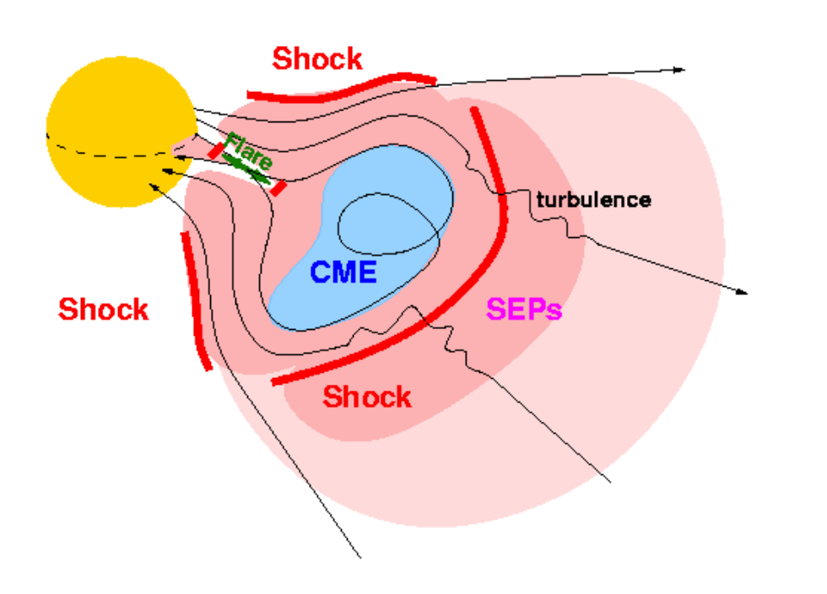
2006 LWS TR&T Focus Team:
Flares Particle Acceleration Near the Sun and Contribution to Large SEP Events
presented by R. A. Mewaldt, Caltech
Benjamin Chandran, UNH - Stochastic particle acceleration
Judy Karpen, GSFC -- 3D MHD CME/eruptive flare initiation
Glenn Mason APL, chair -- Role of interplanetary propagation
Nariaki Nitta, LMSAL -- Solar flare sources of gradual events
Gerald Share, NRL/UMd -- 1 AU vs solar particles (γ-rays)
Allan Tylka, NRL -- Disappearance of large Fe-rich events
LWS TR&T Town Hall Meeting
AGU, San Francisco, Dec 14, 2009
http://lws-trt.gsfc.nasa.gov/trt_ft2006sep.htm

Slide 12
Stochastic acceleration in back of CME at reconnection site (Chandran)
CME/flare initiation physics (Karpen)
Role of turbulence in Fe-rich events (Mason)
Primary question:
Do particles accelerated at “flares” contribute directly or indirectly to the accelerated particles seen in interplanetary space?
Solar flare sources of gradual events (Nitta)
-and-
γ-ray determined flare source particle composition (Share)
Collaborative topics addressed by team --
Comparison of x-ray images from SEP-productive & SEP non-productive CMEs (Nitta, Tylka, Mason, Karpen)
Particle properties of γ-ray events (Share, Tylka, Mason, Karpen teams)
Shock characteristics at ~2.5 R_{s} (Tylka & Karpen)
Characterizing bulk turbulence in flaring regions (Karpen macroscopic modeling with Chandran team microscopic scale)
Disappearance of Fe-rich events in decline of SC 23
(Tylka)
figure: Pacheco et al. 2008

Slide 13
FST Team meetings --
APL June 2008
APL Jan 2009
UNH Oct 2009
• Will propose topic session for SHINE 2010 & have meeting
Meeting comments --
1.5 - 2 days
No regular science meeting (eg AGU) attended by all teams due to wide range of disciplines
Meetings also attended by students
Experiences of team –
It takes about a year to get team activity ramped up due to time required to distribute funds to PIs, then often followed by setting up subcontracts
Team meetings very useful to participants due to mixing of disciplines yet with a broad focus on a single theme
Only limited success in identifying collaborative projects that tie different groups together -- most groups very much focused on the activities proposed
Probably most successful collaborative effort is between CME/flare model & stochastic acceleration model, where CME/flare MHD simulations may help constrain extremely broad range of parameters in the acceleration model
Team still has ~9 months to go, collaborative efforts should make more progress and result in some joint publications in the modeling area, and perhaps others

Slide 14
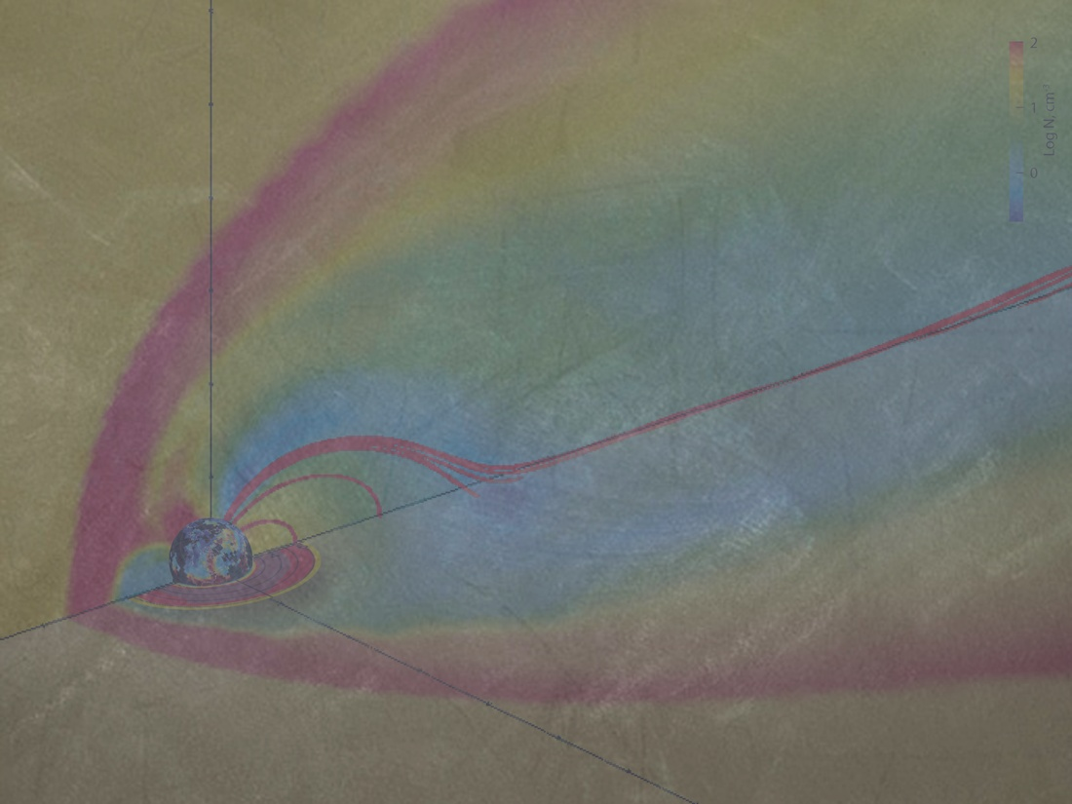
“Effects of Ionospheric-Magnetospheric
Plasma Redistribution on Storms”
TEAM PIs
John Foster, MIT Haystack Observatory
Jim Horwitz (deceased), University of Texas, Arlington
Vania Jordanova, Los Alamos National Laboratory
Lynn Kistler, University of New Hampshire
William Lotko (coordinator), Dartmouth College
Tom Moore, NASA/GSFC
Bob Strangeway, UCLA/IGPP

Slide 15
Team successes, experiences, lessons learned
Team selection – The review panel is critical!
Collaborative spirit, complementary expertise
Realistic team plan, early
Organization & efforts around system-level problems
Expand the circle – workshops, special sessions, ...
Leverage team resources and research
Three years – sufficient for individual progress, optimum team outcomes take more time

Slide 16
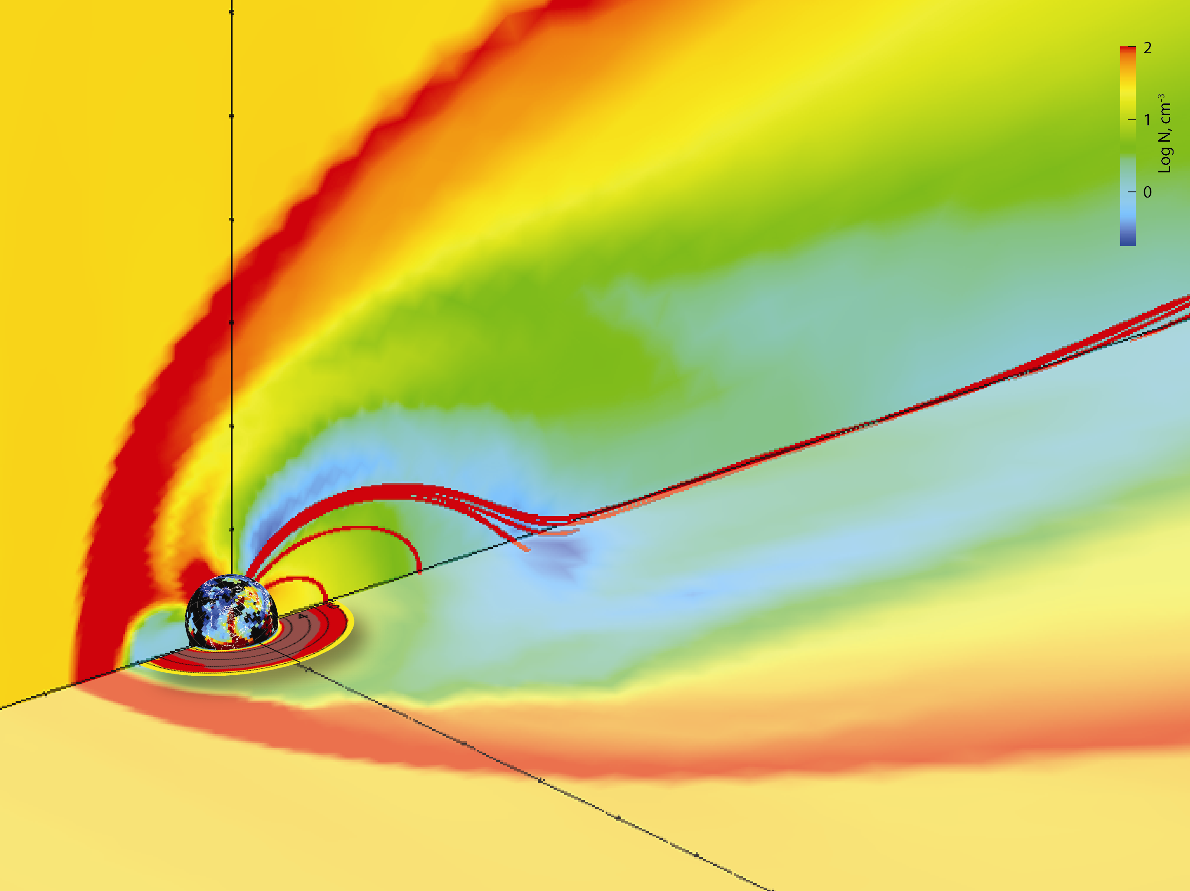
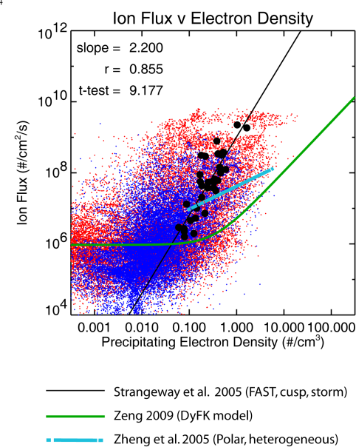
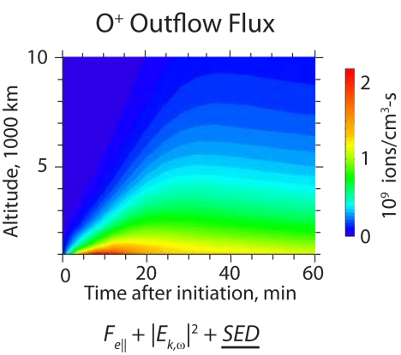
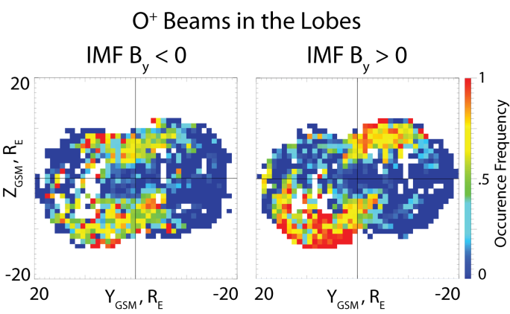
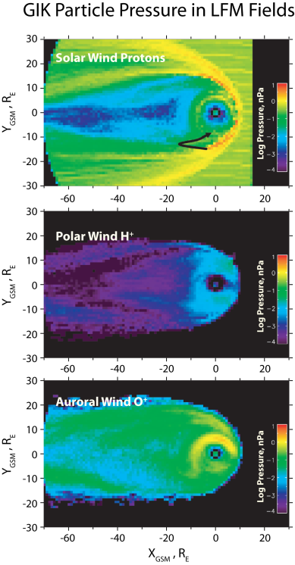
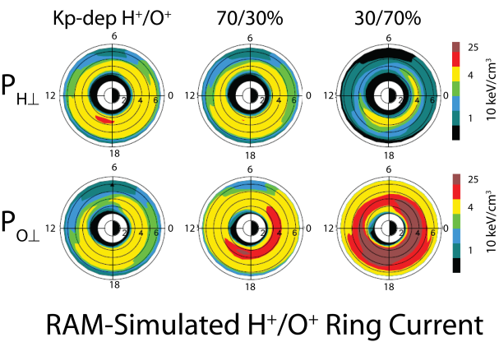
UT, Arlington
UNH
UCLA
10¹⁰ ions/cm²-s
MIT
LANL
NASA/GSFC
Dartmouth
Dst ≈ -140 nT
31 Aug 2005, 1400 UT

Slide 17
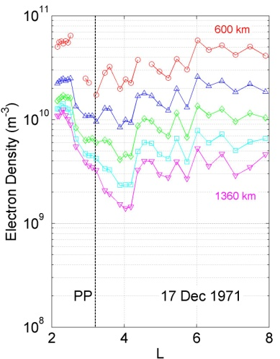
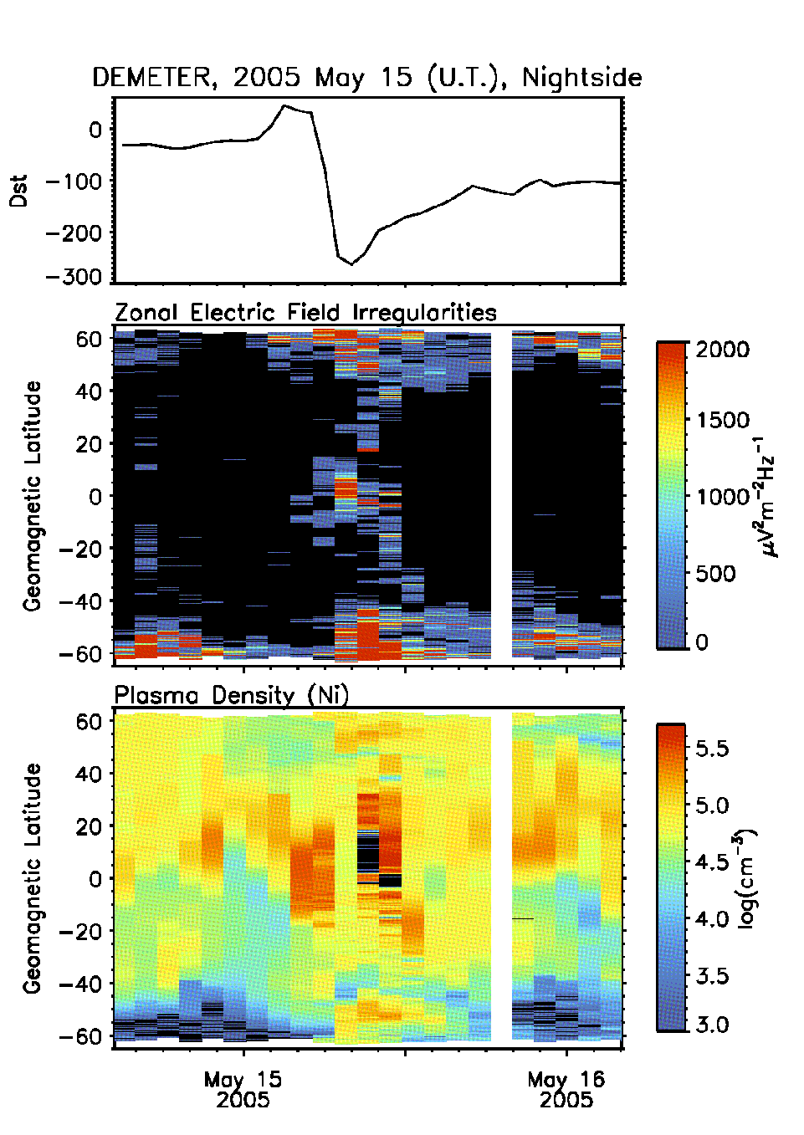
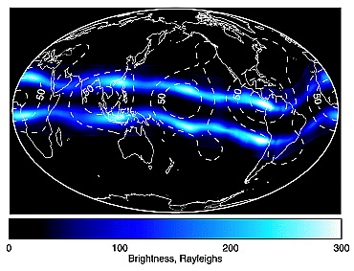
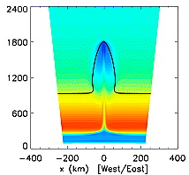
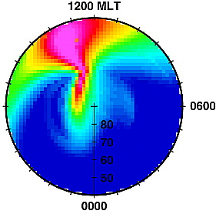
LWS TR&T, 2006
Global Distribution, Sources and Effects of Large Density Gradients
Rod Heelis, Bob Benson, Joe Huba, Tom Immel, Rob Pfaff
Density Gradients occur over a wide spectrum of spatial scales at all latitudes
Transport/Production of O+
(E-field from the Troposphere)
Transport/Production of O+ to O+/H charge exchange
Transport of O+
(E-field from Magnetosphere and Disturbance Dynamo)
Transport/Production of O+
(E-field from Magnetosphere)
Transport of lower ionosphere
(E-field from gravitational force)
AGU Special Session SA 09

Slide 18
Global Distribution, Sources and Effects of Large Density Gradients
Major Findings
• Gradients produced by transport and transport assisted photochemistry
Transport induced externally from below, internally, and externally from above.
• Spatial gradients created in daytime by vertical ion motions that lower loss rates
Finite dip angle at middle and high latitudes
Vertical ExB drift at equator
• Spatial gradients established during daytime persist into the night
WN4 signatures : Storm-time equatorial bite-outs
• Spatial gradients created during nighttime by transport of existing spatial gradient
• Spatial gradients associated with transport and O+ chemistry at low altitudes are not
coincident with transport and H+ chemistry at higher altitudes
• Field-aligned motions associated with transport change the energy balance and composition
Teamwork
• Different science perspectives challenge true understanding of physics
• Additional science questions emerge from the same evaluation of data
• Peer pressure to make good on promises made at team meetings
• New generation of problems to work on that were not originally planned

Slide 19
Solar Origins of Irradiance Variations
Team Members:
James Klimchuk (Leader)
Juan Fontenla
Roberto Lionello
Dibyendu Nandi
Judit Pap
Goals (from the NRA):
Understand the physical processes underlying the solar spectral irradiance (e.g., plasma heating).
Determine how the SSI depends on key physical parameters (e.g., magnetic field strength and flux).
Construct physics-based models of active regions.
Productivity:
23 publications
2 NASA press releases
1 radio interview
1 press conference
http://solar.physics.montana.edu/irradiance/

Slide 20
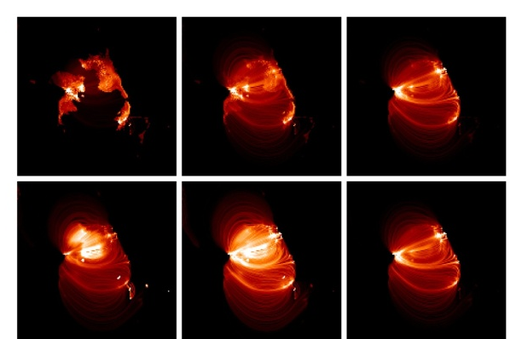
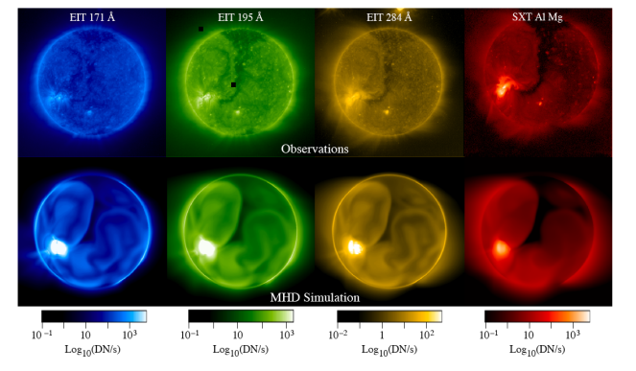
Successes
Used X-ray observations from Hinode to discover hot (~ 10 MK) plasma expected from coronal nanoflares.
Constructed physics-based models of active regions and the global Sun (corona and transition region) using both impulsive and steady heating.
Constructed semi-empirical models of the chromosphere and trans. region that match the observed non-LTE irradiance spectrum.
Determined the relationship between SSI and total unsigned magnetic flux, including a temporal delay component.
Discovered that TSI and probably SSI depend on sunspot type, not simply area.
Calibrated MDI magnetogram zero point and E/W asymmetry.
Showed that coronal loops can be explained by storms of nanoflares but not thermal nonequilibrium.
Integrated coronal and chromospheric models (in progress).

