Slide 1
LWS TR&T Town Hall Meeting Fall AGU 2011
Brief summary of LWS TR&T Program Status Lika Guhathakurta, Chuck Goodrich, Bob Leamon from NASA HQ
Comments on current Focus Team and Strategic Capability activities (Team leads)
Open discussion of LWS TR&T Program and next Focus Topics
AGENDA

Slide 2
TR&T Steering Committee
New Membership for 2012 established
Establishing and continually updating targets and top-level priorities;
Measuring the progress of the program in meeting science goals and objectives;
Providing mechanisms for monitoring how well products that result from the program are transferred into societal benefits.
SC has broad science and application community representation and rotating membership, who will support NASA Headquarters in:
Agency Liasion:
NOAA (Terry Onsager)
NSF (Farzad Kamlabadi)
AFSOR (?)
CCMC (Michael Hesse/Masha Kuznetsova)
Neal Zapp NASA (SRAG/JSC)

Slide 3
Bill Abbett, UC Berkeley Chair & few more membership pending Geoff Crowley, ASTRA, LLC Frank Eparvier, LASP, UC Boulder Tamas Gambosi, U Michigan Chuck Goodrich, George Mason U Justin Kasper, SAO Barry Mauk, JHU APL Pete Riley, Pred. Science Karel Schryver, LMSSL Nathan Schwadron, UNH Harlan Spence, UNH Amitava Bhattacharjee, Outgoing Chair, UNH Liason to TR&T SC: Terry Onsager, NOAA SWPC Farzaad Kamalabadi, NSF ?, AFOSR Masha Kuznetsova, CCMC Neal Zapp SRAG Project & Mission Scientists Dean Pesnell, Dave Sibeck, Adam Szabo, Chris St.cyr, Nicky Fox
New SC Members
Ex Officio: Lika Guhathakurta, Lead Program Scientist, NASA HQ Bob Leamon, NASA HQ , LWS Discipline Scientist Mona Kessel, RBSP Program Scientist Jeff Newmark, Solar & Helio Discipline Scientist

Slide 4
Proposals and Awards 2010
4 New Focus Teams in 2011
Jets in the Solar Atmosphere and their Effects in the Heliosphere. 14 proposals, 6 funded (some partial), average $93 K
Factors that Control the Highly Variable Intensity and Evolution of Solar Particle Events. 17 proposals, 6 funded, average $111 K
Incorporating Plasma Waves in Models of the Radiation Belts and Ring Current. 19 proposals, 5 funded, average $118 K
Low-To Mid-Latitude Ionospheric Irregularities and Turbulence. 21 proposals, 5 funded, average $105 K
SDO Data Analysis
47 proposals, 13 funded, average $109 K
Sun-Climate Theme
18 proposals, 7 funded, average $128 K
Workshops
4 proposals, 2 funded, average $34 K

Slide 5
Proposal Topics for ROSES 2011
ROSES 2011
Released Nov. 2011; NOIs due next week, Proposals late Feb. 2012
3 FSTs, Sun Climate Theme
No Tools and Methods
New opportunity NASA/NSF Partnership For Collaborative Space Weather Modeling (renamed from Strategic Capability )
Proposal selection June/July 2012; Funding October 2012 (FY13)
TR&T email: lws.trt@nasa.gov

Slide 6
LWS TR&T Focus Topics
2006 | 2007 | 2008 | 2009 | 2010 | 2011
Predict emergence of solar active regions before visible | Magnetic Connection of Photosphere and Low Corona | Properties of the Solar Dynamo that affect Irradiance and Active Regions | Behavior of the Plasmasphere and its Influence on the Iono-/Magnetosphere | Jets in the Solar Atmosphere and their Effects in the Heliosphere | Interaction between the magnetotail and the inner magnetosphere and the impact of that interaction on the radiation belt environment
Understand how flares accelerate particles near the Sun and contribution to large SEP events | Modulation of Galactic Cosmic Rays,… due to Long-term Solar Activity | Use Inner Heliosphere Obs. to Better Constrain CME and SEP Models | Origin and Nature of the Slow Solar Wind, and its effect on Helio Structures, and SEP Transport | Factors that Control the Highly Variable Intensity and Evolution of Solar Particle Events | Atmosphere-Ionosphere Coupling During Stratospheric Sudden Warmings
Plasma redistribution during storms in the ITM system | Daily Variability in the Thermosphere and Ionosphere | Integrate Non-MHD/Kinetic Effects into Global Models | Predict the Onset and Space Weather Impacts of Fast CMEs/Eruptive Flares | Incorporating Plasma Waves in Models of the Radiation Belts and Ring Current | Flare Dynamics in the Lower Solar Atmosphere
Middle and low latitude sources, effects, and distribution of large electron density gradients | Combined Modelling of Loss, Acceleration, and Transport of Magnetospheric Electrons, Protons | Response of ITM Composition and Temperature due to Solar XUV and Energetic Particle Variation | Plasma-Neutral Gas Coupling | Low-To Mid-Latitude Ionospheric Irregularities and Turbulence
Solar origins of irradiance variations | Prediction of the Interplanetary Magnetic Field Vector Bz at L1 |  | The Sun-Climate Strategic Theme | The Sun-Climate Strategic Theme | The Sun-Climate Strategic Theme

Slide 7
NASA/NSF Partnership For Collaborative Space Weather Modeling (ROSES 2011)
New opportunity for development of Strategic Capabilities addressing goals of the LWS and NSWP programs.
Funding (~$4 M) to start in FY2013
5-8 awards of up to 5 years each
Mid term review
Proposals must specify the science focus of project
Should address problems poised for major advance
Demonstrate the transformative nature of project
Demonstrate critical contribution to LWS and NSWP
Proposals must specify specific deliverables and provide a development/management plan for their development and delivery
Demonstrate how deliverables will provide a transformative step toward LWS/NWSP goals
Demonstrate need and importance of deliverables to scientific and operation communities
Proposals should specify how results of LWS Focused Science Teams and other current research will be assimilated

Slide 8
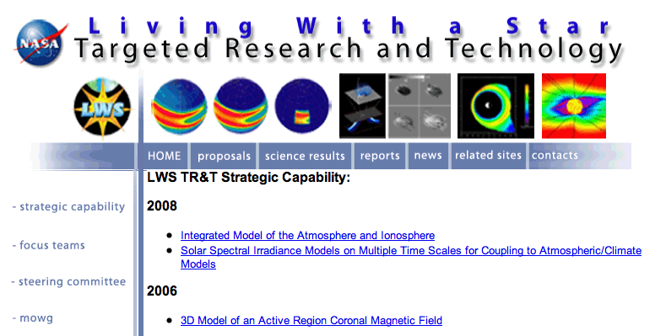
TR&T website: http://lws-trt.gsfc.nasa.gov

Slide 9
TR&T website: http://lws-trt.gsfc.nasa.gov
How would you, the community, like to see this improved?

Slide 10
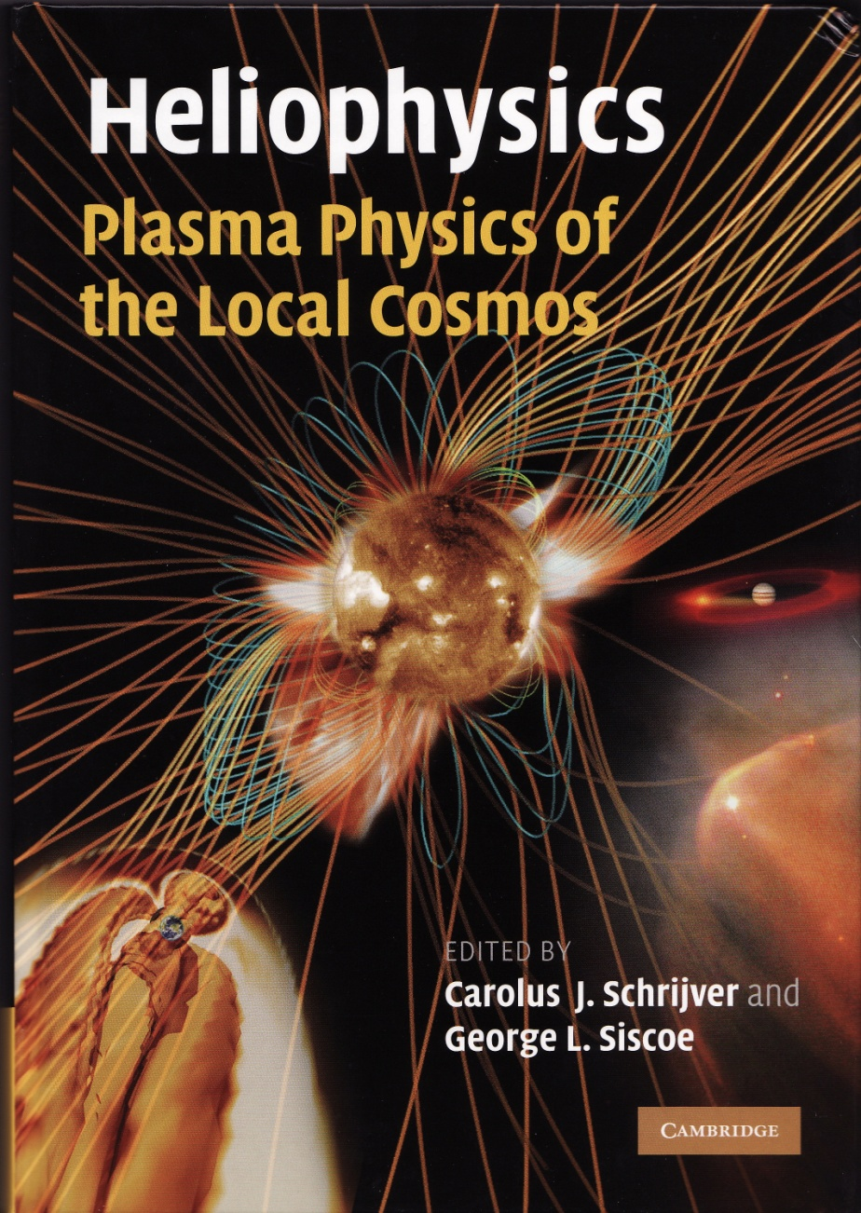
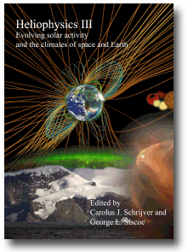
NOTE: The Heliophysics textbooks
A three volume
Series, an outgrowth of the
LWS summer school series.
Vol 1 Plasma Physics of the Local Cosmos
Vol 2 Space Storms and Radiation
Vol 3 Evolving Solar Activity and the Climates of Earth and Space
Summer School Resources:
http/www.vsp.ucar.edu/HeliophysicsSummer School
NOTE: The Heliophysics textbooks have been published by Cambridge University Press. All appendices are online. The textbooks do not have 'numerical modeling descriptions' nor 'problem sets'.
A new set of Heliophysics summer schools are developing 'numerical modeling descriptions‘ and 'problem sets‘ to aid in teaching.
LWS Graduate Level
Education

Slide 11
The Heliophysics Postdoctoral Fellowship Program: Renamed to the Jack Eddy Postdoctoral Fellowship.
In 2009, the NASA Living With a Star joined with the UCAR Visiting Scientist Programs (VSP) to create the Jack Eddy Postdoctoral Fellowship Program. The program matches early career PhDs with experienced scientists at U.S. research institutions. Hosting scientists mentor the postdoctorates during their two-year fellowships. The goal of the program is to train the next generation of researchers needed for the emerging field of Heliophysics.
John "Jack" Eddy was a pioneering solar researcher, and he is being honored with the debut of the Jack Eddy Postdoctoral Fellowship.
Among his many contributions to solar & climate research, Jack served as editor of The Sun, the Earth, and Near-Earth Space: A Guide to the Sun-Earth System, published by NASA and the Living with a Star program shortly before his death.
2011 Fellows:
1. Narayan Chapagain, Host: Jonathan Makela, University of Illinois at Urbana-Champaign
2. Andrés Muñoz-Jaramillo, Host: Edward DeLuca, Harvard-Smithsonian Center for Astrophysics
3. Neel Savani, Host: Angelos Vourlidas, U.S. Naval Research Laboratory
2010 Fellows: Nicholas Bunch, Host: Dr. Maria Spasojevic, Stanford University, Liang Zhao: Dr. Sarah Gibson, National Center for Atmospheric Research, High Altitude Observatory

Slide 12
Aron ridley SC

Slide 13
Gombosi SC

Slide 14
Linker SC

Slide 15
Martens FT

Slide 16
Lotko FT

Slide 17
Gopal FT

Slide 18
Fontenal FT

Slide 19
Mason FT

