Slide 1
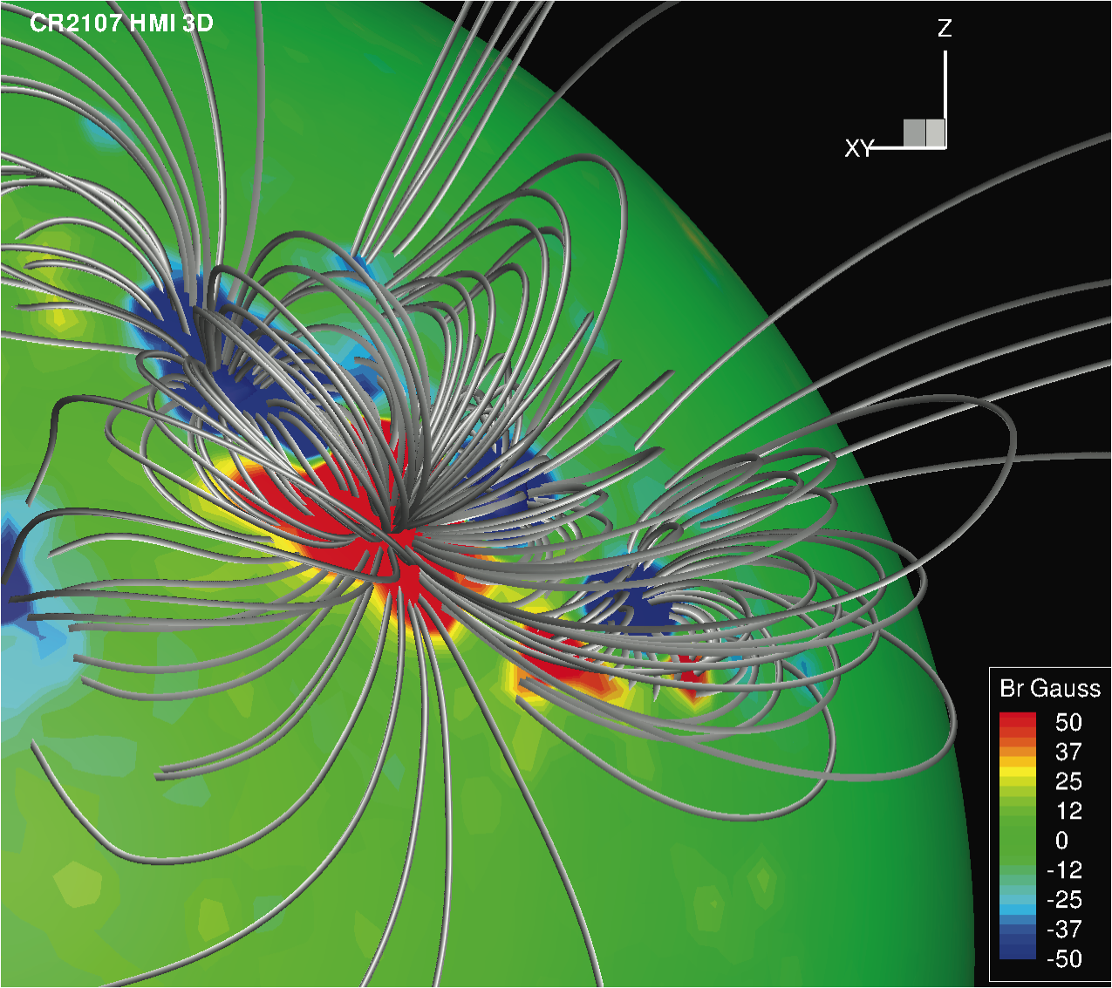
The Comprehensive Corona and Heliosphere Model (CCHM)
PI: Tamas Gombosi (Michigan)
CoIs:
D. De Zeeuw, W. Manchester, I. Roussev, I. Sokolov, G. Toth (Michigan)
W. Abbett, G. Fisher, B. Welsch (Berkeley)
J. Giacalone, R. Jokipii, J. Kota (Arizona)
S. Antiochos, A. Vourlidas (NRL)

Slide 2
CCHM Goals
Develop and maintain a first-principles based comprehensive numerical model of the 3D time-dependent structure and dynamics of the slowly varying corona and the ambient solar wind based on the SWMF.
Main features:
  Provide 3D description of the corona and the heliosphere
  Incorporate magnetograms as input
  Be able to initiate solar eruptions
  Predict the solar wind parameters at any point in space
  Provide modularity to incorporate new or more sophisticated physics
  Have a user-friendly web portal
  Enable faster than real-time simulation capability
  Be able to run continuously in a “pipeline mode”
  Deliver a working version to the CCMC
  Apply rigorous evaluation and validation
Goals are accomplished, code is available at CCMC

Slide 3
CCHM Corona Models
Frazin et al.: SH41B-03
Sokolov et al.: SH43A-1936
Manchester & van der Holst: SH23A-1931
Fang et al.: SH54A-06
Oran et al.: SH43A-1938
Jin et al.: SH53C-08
Downs et al.: SH43A-1939
Van der Holst et al.: SH43B-1944

Slide 4
CCHM CME Initiation Models
Empirical: Erupting flux rope
  Location, orientation and strength are free parameters
  Fast, present workhorse model
Photospheric physics-based: Shear flow model
  Driven by boundary conditions
  Breakout
  Can be used in real-time simulations
Subphotospheric physics-based: Magnetic flux emergence
  Most complete physics
  Very resource intensive, cannot be used in real-time simualtions

Slide 5
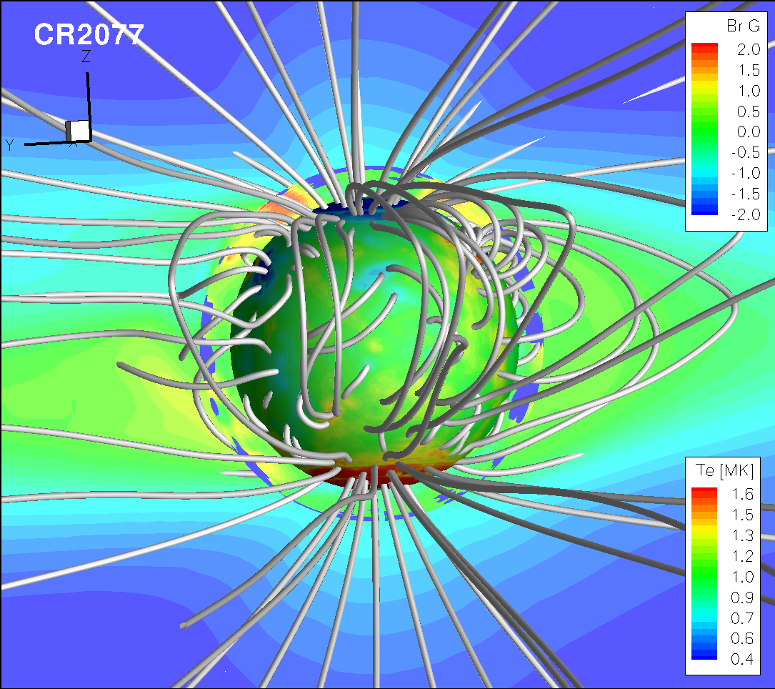
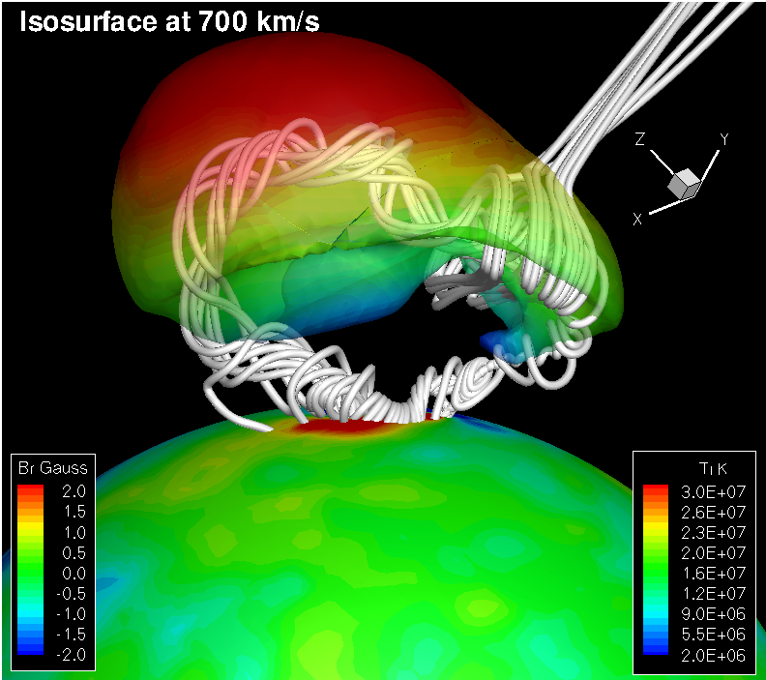
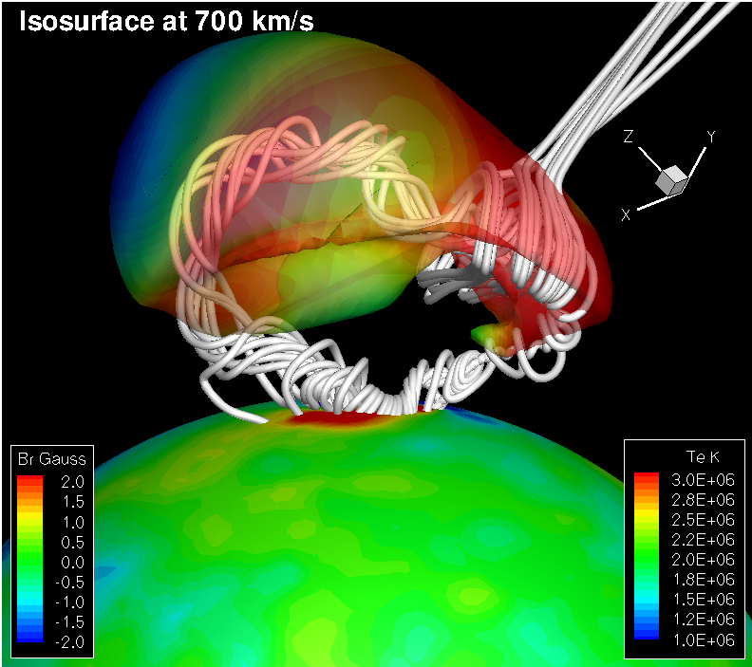
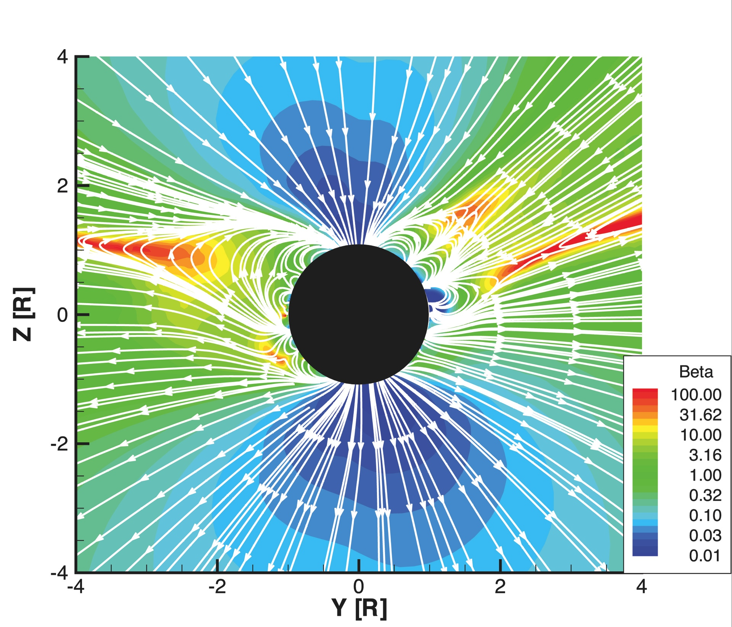
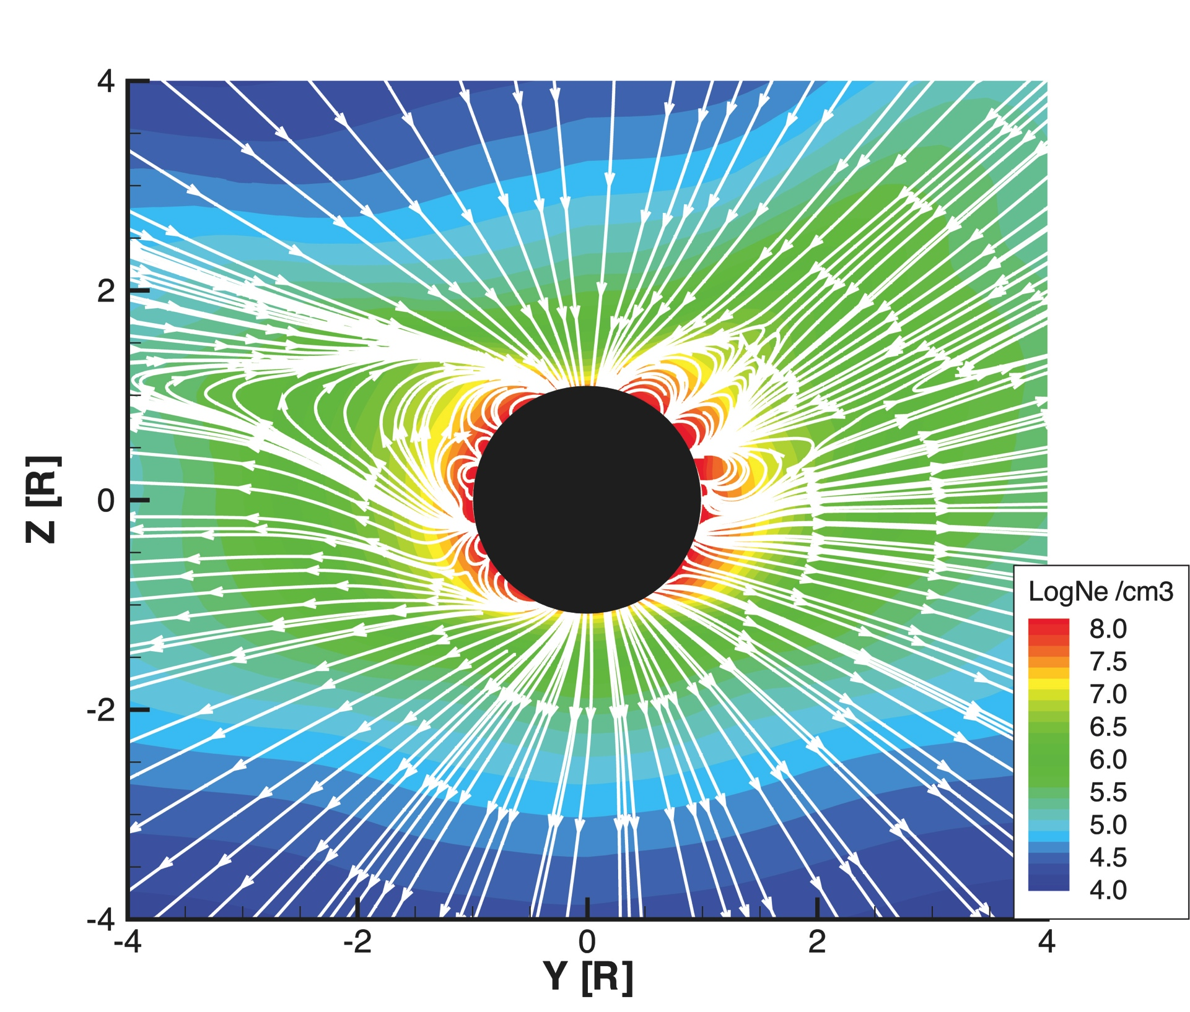
Some Examples
Comparison of simulated and DEMT electron temperatures for CR2077
At the CME shock front limited ion coupling, and heat conduction keep electrons much cooler than the cospatial ions.
CR2107

