Slide 1
LWS TR&T Town Hall Meeting Fall AGU 2012

Slide 2
AGENDA
1) Brief summary of LWS TR&T Program Status, new awardees Lika Guhathakurta, Bob Leamon
2) Comments on current Focus Team and activities Team representatives
3) NRC “The Effects of Solar Variability on Earth’s Climate” workshop Lika, Peter Pilewskie
4) Assessment of 10 years of LWS Glenn Mason
5) ROSES 13 Bob Leamon
6) Open discussion

Slide 3
Proposals and Awards 2012
3 New Focus Teams in 2012
Flare Dynamics in the Lower Solar Atmosphere. 30 proposals, 3 non-compliant, 6 funded, average $144 K Team lead: Haimin Wang, NJIT
Interaction Between the Magnetotail and the Inner Magnetosphere and its Impacts on the Radiation Belt Environment. 52 proposals, 4 non-compliant, 7 funded, average $134 K Team lead: Frank Toffolette, Rice Univ.
Atmosphere-Ionosphere Coupling During Stratospheric Sudden Warmings. 20 proposals, 8 funded (some partial), average $97 K Team lead: Larisa Goncharenko, MIT Haystack
Sun-Climate Theme
23 proposals, 6 funded, average $132 K
Workshops
4 proposals, 3 funded, average $19 K

Slide 4
NASA/NSF Partnership For Collaborative Space Weather Modeling (ROSES 2011)
New opportunity for development of Strategic Capabilities addressing goals of the LWS and NSWP programs.
Funding (~$4 M) to start in FY2013
5-8 awards of up to 5 years each
Mid term review
Proposals must specify the science focus of project
Should address problems poised for major advance
Demonstrate the transformative nature of project
Demonstrate critical contribution to LWS and NSWP
Proposals must specify specific deliverables and provide a development/management plan for their development and delivery
Demonstrate how deliverables will provide a transformative step toward LWS/NWSP goals
Demonstrate need and importance of deliverables to scientific and operation communities
Proposals should specify how results of LWS Focused Science Teams and other current research will be assimilated

Slide 5
MA
Separate presentation for

Slide 6
FOUKAL
Separate presentation for

Slide 7
VOURLIDAS/ LUGAZ
Separate presentation for

Slide 8
JOHNSON/ ANTIOCHOS
Separate presentation for

Slide 9
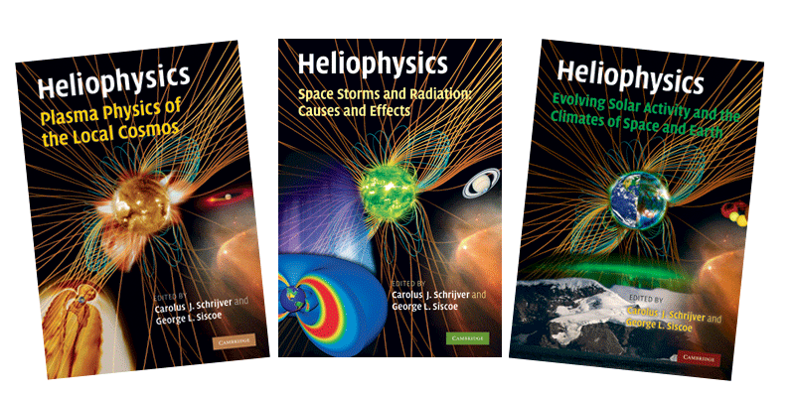
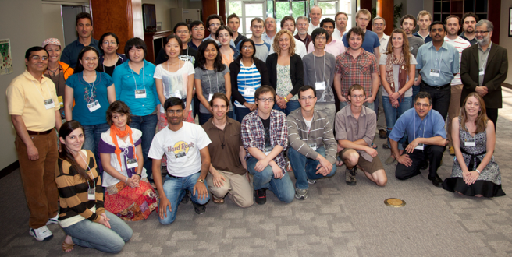
Heliophysics Summer School
Application deadline 1 March
Since 2007, we have had: Total Students | 190
International Students | 82
U.S. Students | 108
PhD Level | 170
Masters Level | 20
Each year, approximately 35 graduate level students are appointed from 13-15 different countries. Starting in 2013, 3 to 5 physics teachers of upper division undergraduate classes will be invited to attend.

Slide 10
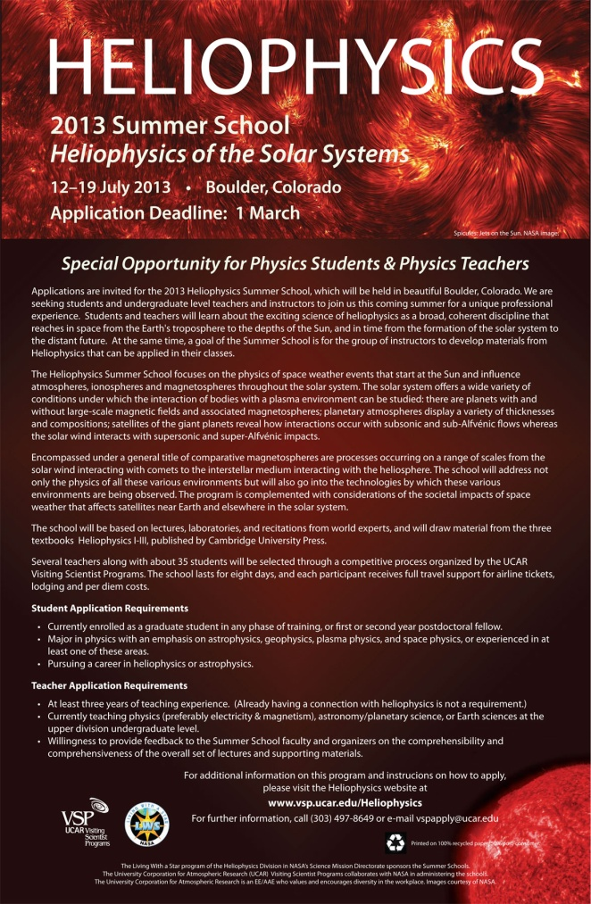
2013 Summer School
Heliophysics of the Solar System
12-19 July, Boulder, CO
A select group of students and teachers will learn about the exciting science of heliophysics as a broad, coherent discipline that reaches in space from the Earth's troposphere to the depths of the Sun, and in time from the formation of the solar system to the distant future.
School Deans
Dr. Karel Schrijver
Lockheed Martin Advanced Technology Center
Prof. Jan Sojka
Utah State University
Frances Bagenal
University of Colorado/LASP/APS
Apply online at www.vsp.ucar.edu/Heliophysics

Slide 11
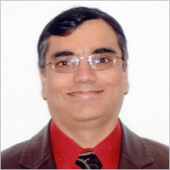
Jack Eddy Postdoctoral Fellowship Program
Application deadline 11 January 2013
www.vsp.ucar.edu/Heliophysics
Established 2009 to train the next generation of researchers needed for the emerging field of heliophysics
9 postdoctoral fellows were awarded two-year appointments as of December 2012
Nicholas Bunch
Narayan Chapagain
King-Fai Li
Andres Munoz-Jaramillo
Maria Spasojevic
Stanford University
Jonathan Makela
University of Illinois
Ka-Kit Tung
University of Washington
Edward DeLuca
Harvard-Smithsonian Center for Astrophysics
Kamen Kozarev
Ksenia Orlova
Neel Savani
Roger Varney
Liang Zhao
John Raymond
Harvard-Smithsonian Center for Astrophysics
Yuri Shprits
UCLA
Angelos Vourlidas
Naval Research Lab
Stanley Solomon
NCAR HAO
Sarah Gibson
NCAR HAO

Slide 12
LWS Targeted Research & Technology Steering Committee Program Assessment
After ~10 years of TR&T program, HQ requests program assessment to:
Describe progress made by TR&T program over past 10 years in achieving strategic goals concerning:
particulate & radiative environment of Earth, etc.; degree to which solar output influences global and regional climate; magnetospheric radiation & plasma; upper atm. and ionospheric responses to solar radiation & coupling
Describe progress in past 10 years (use Decadal Study)
Assess how TR&T structure impacted meeting goals (FSTs, Strategic Capabilities, etc.)
Identify where LWS program should concentrate in next 10 years
Address how goals will be implemented in terms of LWS TR&T program elements

Slide 13
LWS Targeted Research & Technology Steering Committee Program Assessment
Feedback from community:
assessment questionnaire to 152 FST TR&T PIs (May 2012)
39 responses received through July
 | did FST enhance your meeting objectives? | did FST team concept aid creation of interdisciplinary collaboration? | did FST team lead to advancement of science beyond the individual proposals?
Yes/Probably | 79% | 74% | 67%
Limited/Partial/Maybe | 7% | 3% | 15%
No/Don't know | 10% | 18% | 15%
No comment | 3% | 5% | 3%

Slide 14
LWS Targeted Research & Technology Steering Committee Program Assessment
Question 4 -- Any additional comments on the FST team concept? Please include suggestions, if any, on how implementation of the FST concept could be improved.
Overwhelmingly constructive suggestions -- Very little negative input
Repeated Themes [39 responses]:
Collaboration as a positive [13] [2]
Re-propose (re-align) on new joint topic [6]
Importance of Team Leader [4]
Duration 4 years versus 3 years [2]
Travel burden [2]

Slide 15
LWS Targeted Research & Technology Steering Committee Program Assessment
Preliminary recommendations –
only minor adjustments to program elements required
ideas for strengthening FST concept, e.g.,
start parallel track of Targeted Research & Technology teams where FST is addressed by single proposal with PI led team addressing all aspects of an FST; about same overall size as current Focus Science Teams
adjust FST concept to increase PI support, lengthen time for team to organize a common approach, deliver to CCMC, expand oversight, partner with a Space Weather organization
introduce metrics for validation of Strategic Capability; more coupling of space weather models; enhance partnership with CCMC

Slide 16
Glenn Mason, JHU APL, Chair Spiro Antiochos, NASA GSFC Bill Abbett, UC Berkeley Amitava Bhattacharjee, Princeton Geoff Crowley, ASTRA, LLC Frank Eparvier, LASP, UC Boulder Tamas Gombosi, U Michigan Chuck Goodrich, U Maryland Liason to TR&T SC: Terry Onsager, NOAA SWPC Anja Stromme, NSF Raymond Walker, NSF Therese Moretto Jorgensen, NSF Kent Miller, AFOSR Masha Kuznetsova, CCMC Project & Mission Scientists Dean Pesnell, Dave Sibeck, Adam Szabo, Chris St.Cyr, Nicky Fox
2012 Steering Cttee Members
Justin Kasper, SAO
Farzad Kamalabadi, U Illinois
Tony Mannucci, NASA JPL
Barry Mauk, JHU APL Pete Riley, Pred. Science Karel Schrijver, LMSAL Nathan Schwadron, UNH Harlan Spence, UNH
Ex Officio: Lika Guhathakurta, Lead Program Scientist, NASA HQ Bob Leamon, LWS Discipline Scientist Mona Kessel, RBSP Program Scientist Jeff Newmark, Solar & Helio Discipline Scientist

Slide 17
Proposal Topics for ROSES 2013
Yes, ROSES 2013!
Amendment to ROSES 12 (“There is no ROSES 12”) posted to NSPIRES Nov 30, 2012; ~complete draft for ROSES 13
4 FSTs, including a Sun-Climate Theme
No separate SC or Tools and Methods
‘12>’13 change really only internal NASA administrative;
Step 1 due March 1, 2013
Step 2 due May 1, 2013
Proposal selection August/ Sept 2013;
Funding October 2013 (FY14)

Slide 18
COMMITTEE ON THE EFFECTS OF SOLAR VARIABILITY ON EARTH’S CLIMATE
GERALD R. NORTH, Texas A&M University, Chair
DANIEL N. BAKER, University of Colorado, Boulder
RAYMOND S. BRADLEY, University of Massachusetts
PETER FOUKAL, Heliophysics, Inc.
JOANNA D. HAIGH, Imperial College, London
ISAAC M. HELD, NOAA Geophysical Fluid Dynamics Laboratory
GERALD A. MEEHL, NCAR
LARRY J. PAXTON, Johns Hopkins University
PETER PILEWSKIE, University of Colorado, Boulder
CAROLUS J. SCHRIJVER, Lockheed Martin ATC
KA-KIT TUNG, University of Washington

Slide 19
Workshop on “The effects of Solar Variability on Earth’s Climate”
Workshop: Sept. 8-9, 2011, at NCAR, Boulder: 47 attendees (53% from Boulder)
The Sun and Solar Variability: Past and Present
Overview of solar and heliospheric variability
Observations of the Sun’s variable outputs
Techniques for revealing past solar changes
Sun-Climate Connections on Different Timescales
Evidence of solar influences in the troposphere and stratosphere
How the climate system works and how it might respond to solar influences
Indications of influence based on paleoclimate records
Mechanisms for Sun-Climate Connections
Mechanisms connecting variations in total solar irradiance directly to the troposphere
Mechanisms that influence upper parts of the atmosphere, such as variations in solar ultraviolet radiation and possibly solar energetic particles
Mechanisms that link variations in galactic cosmic rays to climate change.
Report mostly completed in early February …
NRC guideline: “Summaries and Executive Summaries are not included in workshop products.” and Task: “a workshop report that will summarize what transpired at the event but will not contain any findings or recommendations.” Hence: “This workshop report contains no recommendations, findings, or statements of consensus. Instead, this workshop report summarizes the views expressed by individual workshop participants (invited speakers and guests).”

Slide 20
Workshop agenda
Session 1
9:00 Overview and Advances in Radiometry for Solar Observations Greg Kopp, University of Colorado, Boulder
10:00 Assessing Solar and Solar-Terrestrial Influences as a Component of Earth’s Climate Change Picture Daniel N. Baker, CU, Boulder
11:00 Heliospheric Phenomena Responsible for Cosmic Ray Modulation at the Earth Joe Giacalone, University of Arizona
11:45 Behavior of Quiet Sun Contributions to Solar Irradiance Peter Foukal, Heliophysics, Inc. (by WebEx), Session Chair
1:15 The Record of Solar Forcing in Cosmogenic Isotope Data Raimund Muscheler, Lund University, Sweden
Session 2
2:00 Issues in Climate Science Underlying Sun/Climate Research Isaac M. Held, NOAA GFDL, Session Chair
3:00 Indirect Climate Effects of the Sun Through Modulation of the Mean Circulation Structure Caspar Ammann, NCAR
4:00 Climate Response to the Solar Cycle as Observed in the Stratosphere Lon Hood, University of Arizona
4:45 Direct Solar Forcing of the Lower Atmosphere and Ocean Gerald A. Meehl, National Center for Atmospheric Research
Session 3
9:00 Detection of the Solar Signal in Climate from Paleorecords Raymond S. Bradley, University of Massachusetts
9:45 Detecting the Solar Cycle Via Temperature Proxies Back to the Maunder Minimum Gerald North, Texas A&M University
10:45 Climate Response at Earth’s Surface to Cyclic and Secular Solar Forcing Ka-Kit Tung, University of Washington, Session Chair
11:40 Solar Effects Transmitted by Stratosphere-Troposphere Coupling Joanna D. Haigh, Imperial College, London
Session 4
1:30 The Impact of Energetic Particle Precipitation on the Atmosphere Charles Jackman, NASA Goddard Space Flight Center
2:15 Cosmic Rays and Cloud Nucleation Jeffrey Pierce, Dalhousie University
3:00 Solar Grand Minima Inferred from Observations of Sun-like Stars Dan Lubin, Scripps Institution of Oceanography, UCSD
Panel Discussion
3:45 Panel Discussion led by Joanna Haigh and Daniel Baker
What is the most recent and/or most compelling evidence of the impact of solar variability on climate, particularly in the lower atmosphere, over decadal timescales?
What can we learn of the variability of solar irradiance using paleoclimate records?
What can we learn of climate responses to solar variability using paleoclimate records?
Are there any significant climate impacts of solar variability on regional scales?
What are the research directions, additional observations, and/or model improvements necessary to improve understanding and forecast ability regarding solar variability and climate, particularly over the solar cycle timescale?

Slide 21
Research rationale
“… no satellite measurements have indicated that solar output and variability have contributed in a significant way to the increase in global mean temperature in the last 50 years. Locally, however, correlations between solar activity and variations in average weather may stand out beyond the global trend; such has been argued to be the case for the El Niño-Southern Oscillation, even in the present day.”
Understanding the significance and magnitude of apparent multi-decade to multi-century Sun-climate couplings is very important. We need to identify the mechanism(s) by which solar magnetic activity (1) drives weak but significant changes in Earth global climate as well as (2) forces measurable impacts in some present-day regional climates (such as the El Niño/La Niña cycle).
Understanding the impact of solar activity on climate provides climate modelers with a multi-century pre-industrial baseline for comparison with industrial-era changes, and provides solar-heliospheric physicists with multi-century proxies of solar activity in addition to currently available cosmogenic radionuclide measurements.

Slide 22
Research needs
Understanding of apparently significant long-term Sun-climate couplings and current regional impacts requires
improved absolute calibration of the observed total solar irradiance, and
establishment of multi-decade records of the solar spectral irradiance, leading to
extension of the TSI and SSI components into to pre-instrumentation past by:
utilization the solar-stellar connection to expand the knowledgebase for possible solar variability patterns on time scales of years to decades.
improved understanding of the various climate proxies to create a uniform global climate history.
understanding how to translate empirical proxies of solar activity (such as cosmogenic radionuclides and historically-recorded sunspot numbers) into solar spectral irradiance (via heliospheric modulation of galactic cosmic rays and photospheric flux distributions of spots and faculae).
understanding differential impact of distinct parts of the solar spectral irradiance on different parts of the Earth’s regional climates and ocean circulation system.
With multi-century TSI and SSI data and heliospheric wind and field models in hand, attribution studies can be performed
to differentiate between irradiance and cosmic-ray effects, and
to establish the relative roles and couplings of top-down and bottom-up mechanisms compared to ‘internal’ drivers (such as volcanic eruptions).

Slide 23
Any questions?
That’s All, Folks…

Slide 24
LWS Focus Topics (Updated)
2007 | 2008 | 2009 | 2010 | 2011 | 2013
Magnetic Connection of Photosphere and Low Corona | Properties of the Solar Dynamo that affect Irradiance and Active Regions | Behavior of the Plasmasphere and its Influence on the Iono-/Magnetosphere | Jets in the Solar Atmosphere and their Effects in the Heliosphere | Interaction between the magnetotail and the inner magnetosphere and the impact of that interaction on the radiation belt environment | Thermospheric wind dynamics during geomagnetic storms and their influence on the coupled M-I-T system
Modulation of Galactic Cosmic Rays,… due to Long-term Solar Activity | Use Inner Heliosphere Obs. to Better Constrain CME and SEP Models | Origin and Nature of the Slow Solar Wind, and its effect on Helio Structures, and SEP Transport | Factors that Control the Highly Variable Intensity and Evolution of Solar Particle Events | Atmosphere-Ionosphere Coupling During Stratospheric Sudden Warmings | Connection between Solar Interplanetary Structures and the response of Earth’s radiation belts
Daily Variability in the Thermosphere and Ionosphere | Integrate Non-MHD/Kinetic Effects into Global Models | Plasma-Neutral Gas Coupling | Incorporating Plasma Waves in Models of the Radiation Belts and Ring Current | Flare Dynamics in the Lower Solar Atmosphere | Magnetic Flux Ropes from the Sun to the Heliosphere
Combined Modelling of Loss, Acceleration, and Transport of Magnetospheric Electrons, Protons | Response of ITM Composition and Temperature due to Solar XUV and Energetic Particle Variation | Predict the Onset and Space Weather Impacts of Fast CMEs/Eruptive Flares | Low-To Mid-Latitude Ionospheric Irregularities and Turbulence |  | Short term solar/ atmospheric variability and climate
Prediction of the Interplanetary Magnetic Field Vector Bz at L1 |  | The Sun-Climate Strategic Theme | The Sun-Climate Strategic Theme | The Sun-Climate Strategic Theme

