Slide 1
LWS TR&T Town Hall Meeting Fall AGU 2013

Slide 2
AGENDA
Introduction Lika Guhathakurta
LWS/TR&T at 10 years Spiro Antiochos
Success of the Summer School Karel Schrijver
Steering Committee Chair Report Nathan Schwadron
Brief summary of LWS TR&T Program Status, new awardees Bob Leamon
Comments on current Focus Team and activities Team representatives
Open discussion

Slide 3
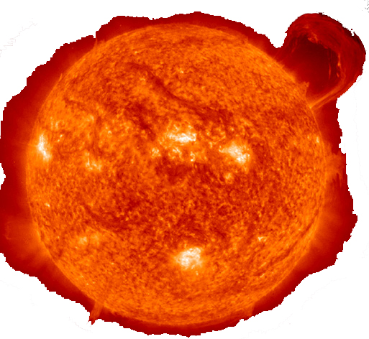
Proposals and Awards 2013
4 New Focus Teams in 2013
Magnetic Flux Ropes from the Sun to the Heliosphere. 30 proposals, 2 funded (TST+1), average $396k Team lead: Mark Linton, NRL
Short term solar/atmospheric variability and climate. 10 proposals, 2 funded (TST+1), average $327k Team lead: Cora Randall, University of Colorado
Connection between Solar Interplanetary Structures and the response of Earth's radiation belts. 51 proposals, 3 funded (TST+2), average $253k Team lead: Alex Glocer, GSFC
Thermospheric wind dynamics during geomagnetic storms and their influence on the coupled magnetosphere-ionosphere-thermosphere system. 29 proposals, 5 funded, average $130k Team lead: TBD

Slide 4
Proposals and Awards 2013
SDO Science Analysis
57 proposals, 8 funded, average $114k
Workshops
9 proposals, 3 funded, average $57k

Slide 5
FST Topics for ROSES 2014
“Flat is the new up” – overall LWS Science budget has declined FY11-15, and remains at ~$17M.
Anticipated ~$3.5M for new awards
Posting of DRAFT ROSES14 to NSPIRES anticipated by mid-December
Likely 4-5 Science Topics – No Workshops, or SDO Initiative – No Strategic Capabilities
Step 1 due March 15, 2014 (TBD) – Title and team binding – No down-select other than compliance (cf. GI)
Step 2 due May 7, 2014 (TBD)
Proposal selection August/ Sept 2014;
Funding October 2014 (FY15)

Slide 6
LWS Focus Topics (Updated)
2008 | 2009 | 2010 | 2011 | 2013 | 2014
Properties of the Solar Dynamo that affect Irradiance and Active Regions | Behavior of the Plasmasphere and its Influence on the Iono-/Magnetosphere | Jets in the Solar Atmosphere and their Effects in the Heliosphere | Interaction between the magnetotail and the inner magnetosphere and the impact of that interaction on the radiation belt environment | Thermospheric wind dynamics during geomagnetic storms and their influence on the coupled M-I-T system
Use Inner Heliosphere Obs. to Better Constrain CME and SEP Models | Origin and Nature of the Slow Solar Wind, and its effect on Helio Structures, and SEP Transport | Factors that Control the Highly Variable Intensity and Evolution of Solar Particle Events | Atmosphere-Ionosphere Coupling During Stratospheric Sudden Warmings | Connection between Solar Interplanetary Structures and the response of Earth’s radiation belts
Integrate Non-MHD/Kinetic Effects into Global Models | Plasma-Neutral Gas Coupling | Incorporating Plasma Waves in Models of the Radiation Belts and Ring Current | Flare Dynamics in the Lower Solar Atmosphere | Magnetic Flux Ropes from the Sun to the Heliosphere
Response of ITM Composition and Temperature due to Solar XUV and Energetic Particle Variation | Predict the Onset and Space Weather Impacts of Fast CMEs/Eruptive Flares | Low-To Mid-Latitude Ionospheric Irregularities and Turbulence |  | Short term solar/ atmospheric variability and climate
 | The Sun-Climate Strategic Theme | The Sun-Climate Strategic Theme | The Sun-Climate Strategic Theme

Slide 7
Any questions?
That’s All, Folks…

