Slide 1
Living with a Star: Science That Matters to People
Living with a Star: Past Accomplishments and Future Promise
Madhulika Guhathakurta
LWS Lead Program Scientist, Heliophysics
NASA Headquarters

Slide 2
Understanding the Sun and its interactions with the Earth and the Solar System.
Solve fundamental mysteries of Heliophysics
Understand the nature of our home in space
Build the knowledge to forecast space weather throughout the heliosphere
Notes:
Explore the physical processes in the space environment from the sun to the Earth and throughout the solar system
Advance our understanding of the connections that link the sun, the Earth and planetary space environments, and the outer reaches of our solar system.
Develop the knowledge and capability to detect and predict extreme conditions in space to protect life and society and to safeguard human and robotic explorers beyond Earth.

Slide 3
Why Do Science?
For Utility
No
Yes
For Understanding
Yes
Bohr
Pasteur
No
Edison
From Donald Stokes (Woodrow Wilson School for Public and International Affairs, Princeton University)
The Sun-Earth Connection -- Science in the Pasteur Mode
• How a star works
• How it affects humanity’s home
• How to live with a star

Slide 4
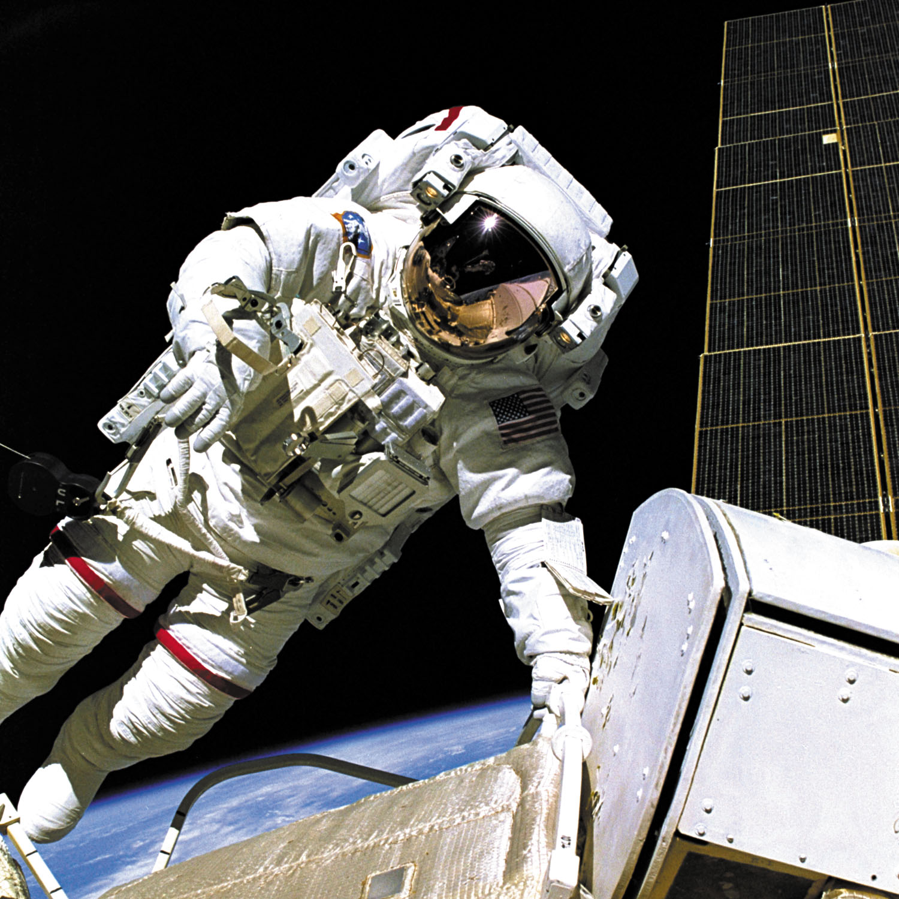
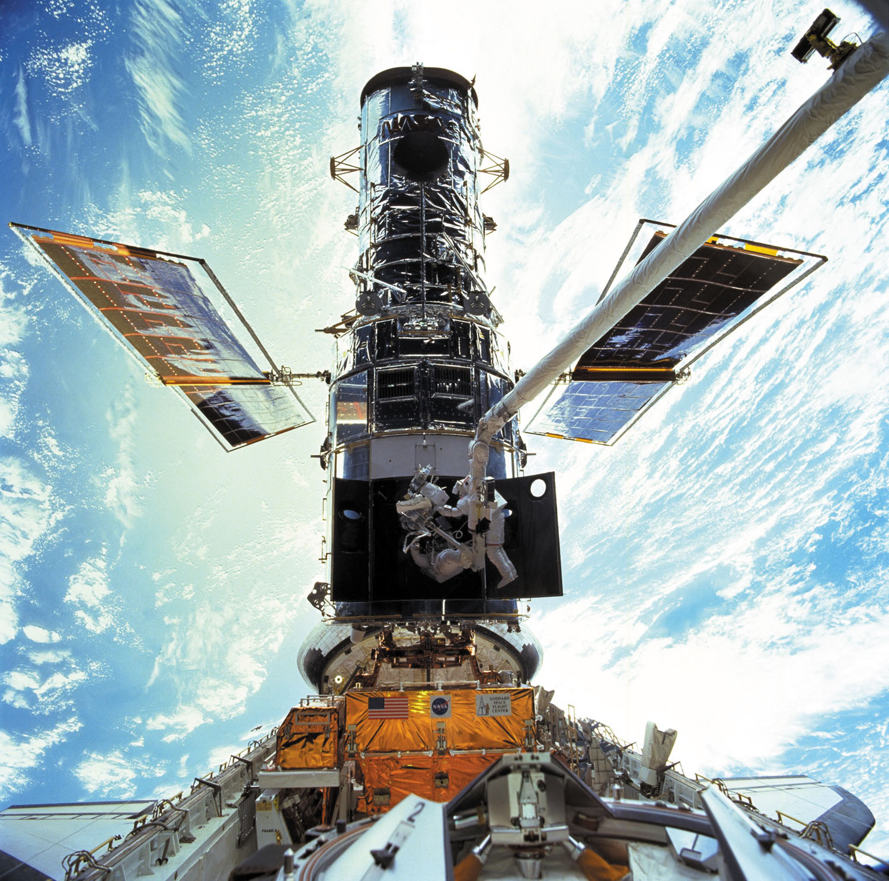
SOCIETAL CONSEQUENCES OF SOLAR VARIABILITY
Human Radiation Exposure
- Space Station
- Space Exploration and Utilization
- High Altitude Flight
Impacts on Technology
- Space Systems
- Communications, Navigation
- Terrestrial Systems
Terrestrial Climate
- Short Term
- Long Term
4

Slide 5
SCIENCE FLOWDOWN
Human Radiation Exposure
Space Weather Hazards
- Solar Energetic Particles Events (SPE)
Relativistic Electron Events (REE)
Galactic Cosmic Rays (GCR)
Science Questions
- What Determines When SPE or REE Will Occur?
- What Determines Their Spatial, Temporal, and Spectral Development?
- What are the Mitigation Strategies?
5

Slide 6
SCIENCE FLOWDOWN
Impacts on Technology
Space Weather Hazards
- Variable Atmospheric Drag
- Enhanced Ionospheric Ionization
- Solar X-ray (SX) & Energetic Particle Events (SEP)
- Relativistic Electron Events (REE)
- Magnetospheric Particles and Fields
Science Questions:
- What Determines the Heliospheric, Magnetospheric, Atmospheric, and Ionospheric Responses to Solar Variability?
- What Causes Onset and Development of Ionospheric Scintillations?
- What Determines When Solar Generated Particle and Radiation Events,
Magnetospheric Storms and Substorms Occur?
- What Determines the Spatial, Temporal, and Spectral Development of All These Phenomena?
- What Drives These Phenomena and How Much Warning Can Reliably Be Obtained?
6

Slide 7
SCIENCE FLOWDOWN
Terrestrial Climate
Impacts on Life and Society
- Climate Change (past & future)
- Surface Warming
- Ozone Depletion and Recovery
Space Weather Sources
- Solar Electromagnetic Radiation
- Solar and Galactic Cosmic Rays
- Upper Atmospheric/Ionosphere Boundary Region
Science Question
- What is the Role of the Sun and Heliosphere in
Global Climate Change on Multiple Time Scales
(Seasonal, Decadal, Centennial)?
7

Slide 8
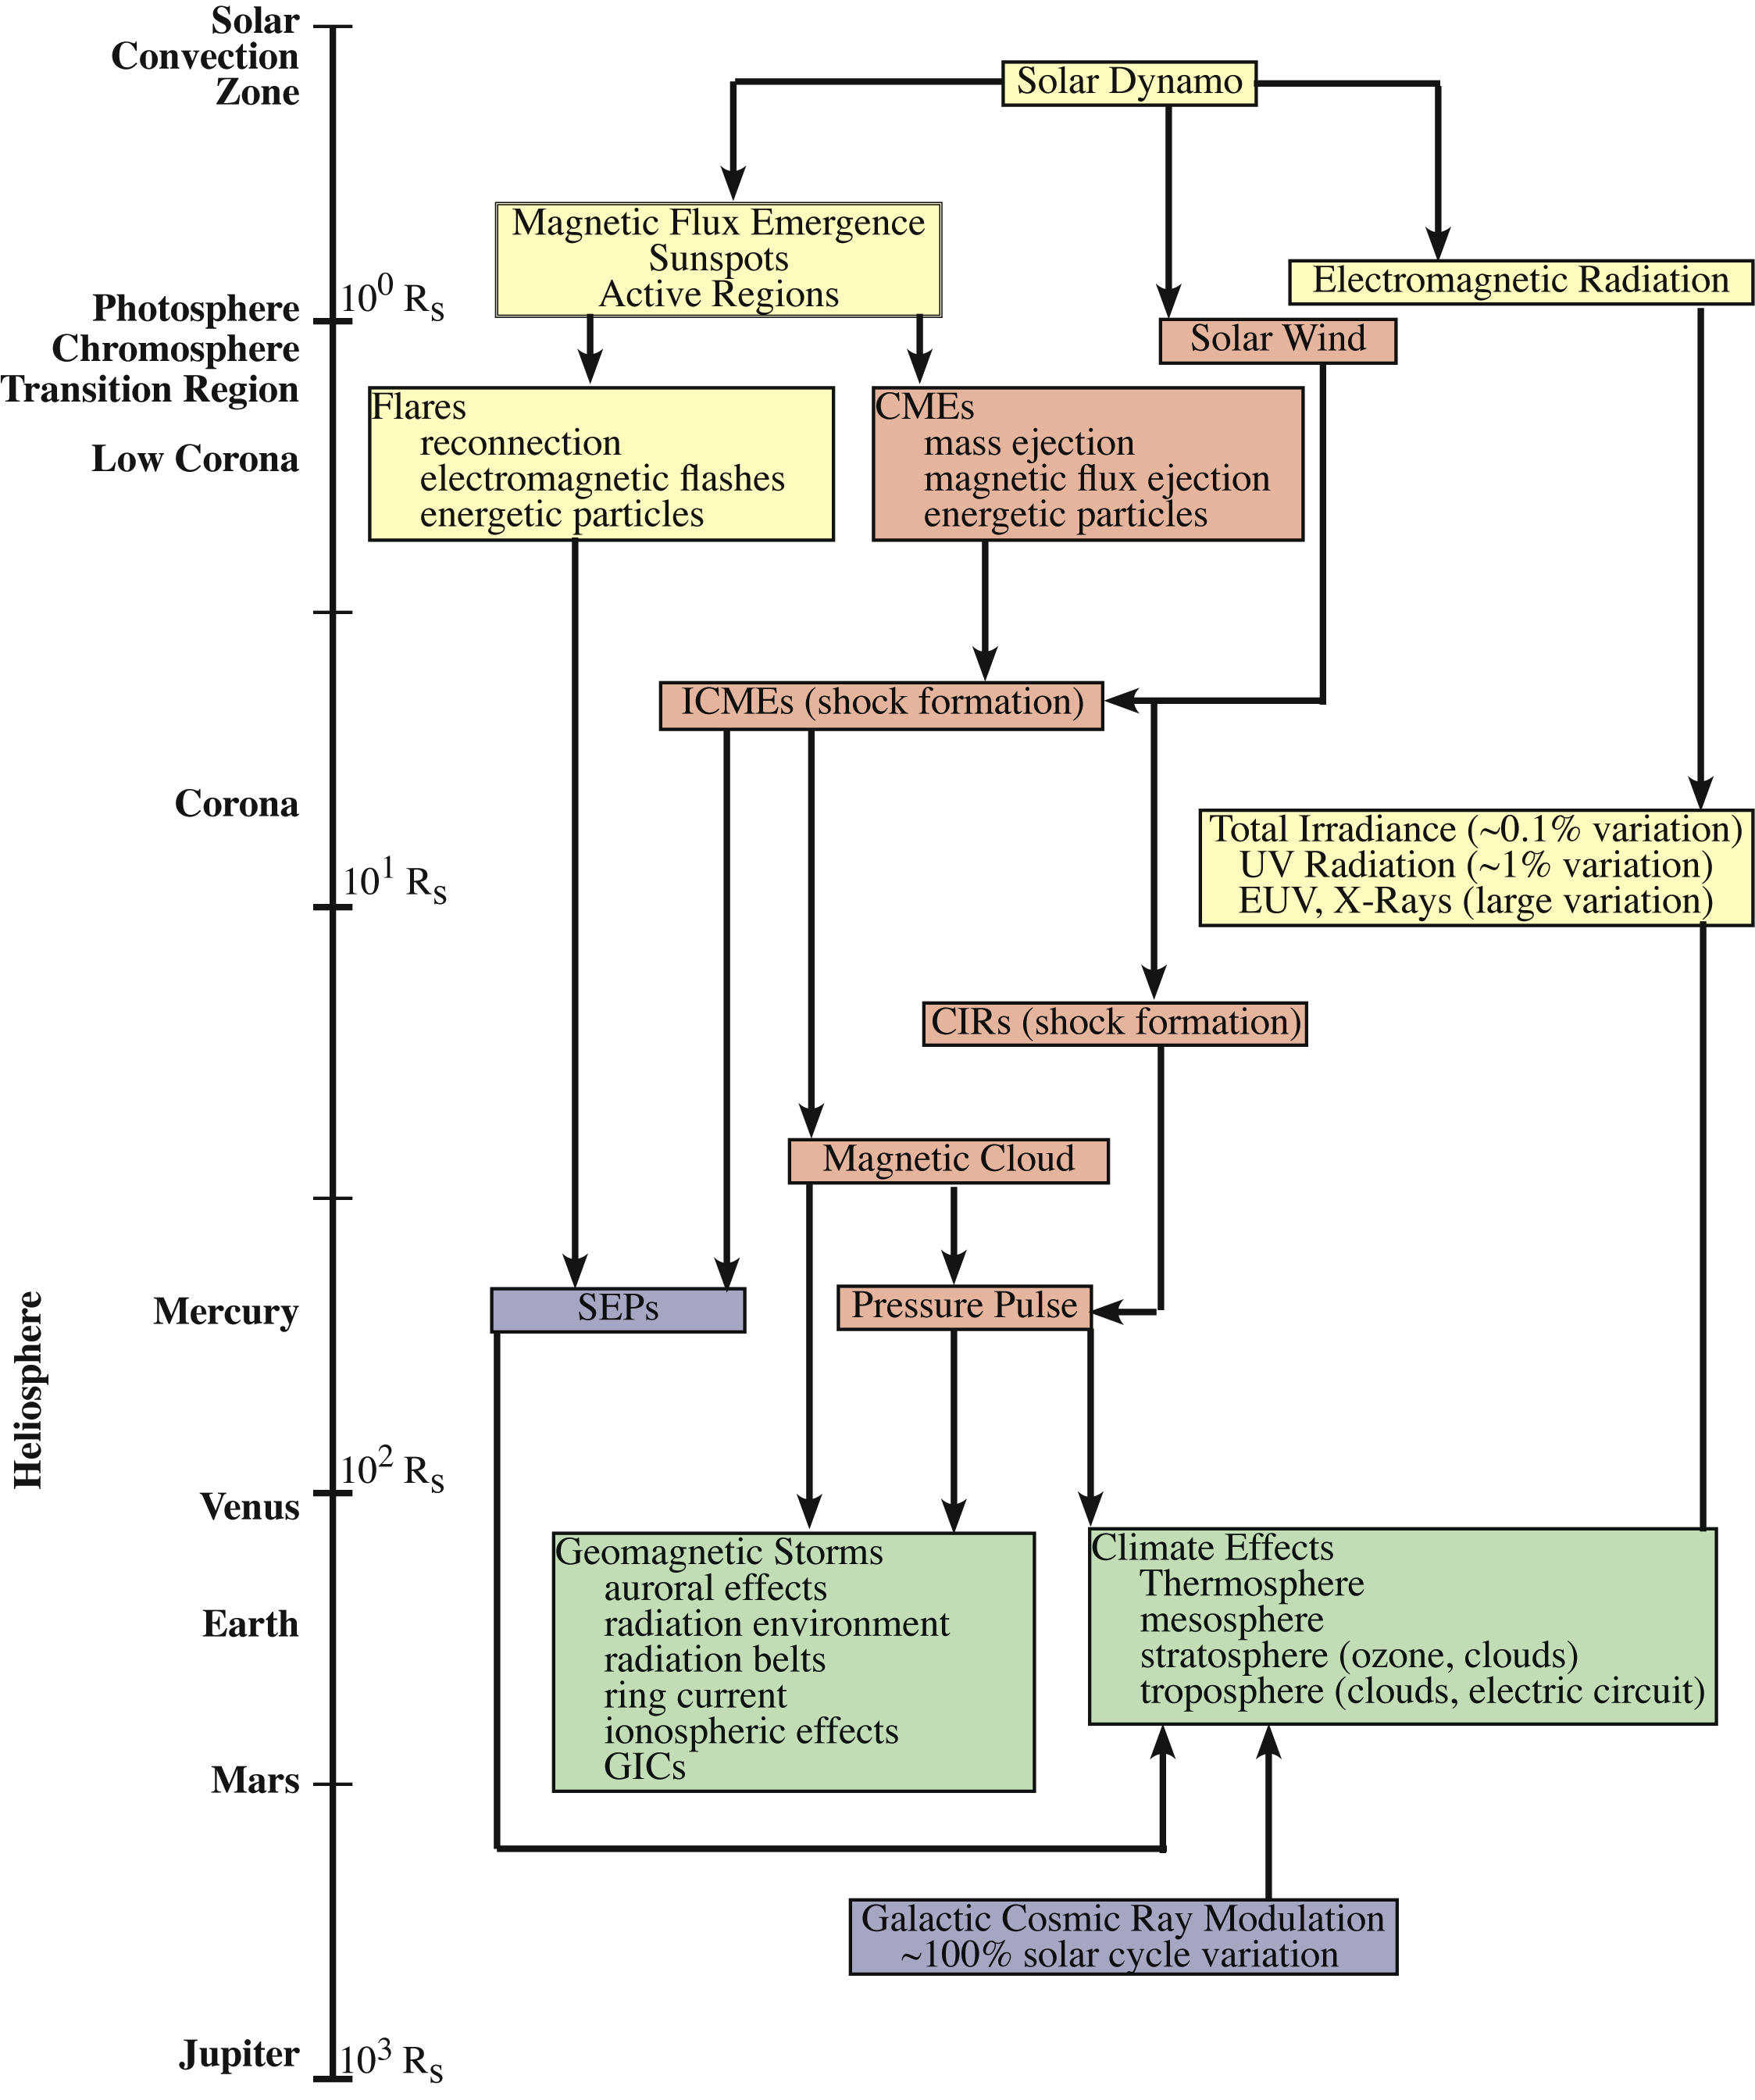
Key Elements of the Plan

Slide 9
SCIENCE FLOWDOWN
Measurement Definition Issues
What are the required predictive capabilities?
What parameters should be measured?
Where is the best place to measure them?
What models and theory are needed?
What long-term studies of sources of energy from the Sun should be undertaken to advance understanding of solar effects on climate change?
What long-term studies are needed to understand the role of the intermediate regions such as the heliosphere, magnetosphere and the upper atmosphere/ionosphere on climate?
How should development of quantitative models proceed?
9

Slide 10
Living With A Star
Science
Space Weather
Living With a Star
Global Climate Change

Slide 11
Living With a Star (LWS) Program Elements
LWS Program
Associated Elements
International LWS (ILWS)
Jack Eddy Postdoctoral Fellowships
Heliophysics Summer School
Heliophysics Institutes
Committee on Space Weather (CSW)
U.N. Global Space Weather Program
Infrastructure
Funded Elements
LWS Science Missions
LWS Science
(TR&T)
Space Environment Testbeds (SET)
Solar Dynamics Observatory (SDO)
Solar Probe Plus (SPP)
SET-1
Solar Orbiter Collaboration (SOC)
Van Allen Probes (aka RBSP)

Slide 12
LWS future viewed in the context of the past (one solar cycle…or so)
TR&T SDT, 2003 and on-going (~250 M)
Launched SDO, 2/2010
Launched RBSP, 8/2012
Developed curriculum and Heliophysics Text Books
Established Eddy Fellowship for early career scientists
Established Heliophysics Summer School
Started ILWS an inter agency cooperation in 2003
Space Weather is a regular agenda item at UNCOPUOS
Notes:
Almost one solar cycle, accomplished a lot, missing elements are it and sun-climate

Slide 13
LWS Future: Short term
Increasing emphasis on future FSTs on science focused on societal impacts including sun-climate.
4.2 M/year effort of strategic capability to fill gaps and develop end to end space weather models.
Maximize scientific return from SDO & Van Allen Probes.
Lead the UN effort on Space Weather with other US agencies and International partners.
More inter-agency and international partnership.
More cross-directorate partnership within NASA.
COSPAR/ILWS Space Weather Roadmap Study.

Slide 14
Heliophysics/LWS Coordination with HEOMD, Earth, Planetary, and Astrophysics
14

Slide 15
Future: Medium Term
Solar Probe Plus
Solar Orbiter Collaboration
Support Russia’s Inter-Helio Probe and China’s SPORT missions
These 3 missions will offer a truly unique epoch in heliospheric science. While each mission will achieve its own important science objectives, taken together these 3 spacecraft will be capable of doing the multi-point measurements required to address problems of CME initiation and propagation, including the large-scale topology and propagation dynamics. In particular, it may be possible to achieve many of the science objectives of previously envisioned multi-spacecraft heliospheric missions, such as NASA's 'Sentinels' concept. We would like to know more about IHP.
(ilwsonline.org/)
In light of reduced budgetary environment develop appropriate small mission concepts to satisfy space weather model/observational needs.
Implement a robust sun-climate program utilizing feedback from the NRC report.
Strategic Capability emphasizing more societal impacts
Next two text books from summer school on Interplanetary SWx & Societal Imapacts.
Develop curriculum for 4 year degree colleges
Establish the interdisciplinary science of “Interplanetary Space Weather”

Slide 16
Looking Forward: O2R: High Priority Goals for Space Weather Research
From Rodney Veireck
Forecasts of solar flares (timing and magnitude)
Forecasts of Solar Energetic Particle (SEP) events and radiation storms at Earth
Specification and forecasts of the radiation levels at LEO and aircraft altitudes
Forecasts of Bz with a CME when it arrives at Earth
Spatially resolved forecasts of geomagnetic storm impacts
Forecasts of the location and intensity of the Aurora
Forecasts of ionospheric scintillations and TEC gradients

Slide 17
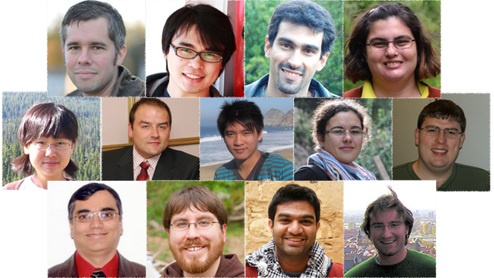
Jack Eddy Postdoctoral Fellowships
Science Objectives
To train the next generation of researchers needed in the emerging field of heliophysics, in honor of the pioneering solar researcher, Jack Eddy.
Relevance to Heliophysics Goals
Appointments are made in areas addressing space weather or the Sun-Earth connection as well as cross-traditional Heliophysics subdomains of the Sun, heliosphere, magnetosphere, and ionosphere/upper atmosphere, and sun-climate.
Implementation Description
Annual call for applications: Due 17 January 2014
Postdocs are placed with experienced scientists at U.S. research institutions and universities.
Three to four new appointments made each year.
Two-year UCAR fellowships, which include relocation allowances and travel allowances to present research
Annual alumni gathering each year at AGU meeting in San Francisco.
Measurement Strategy
Thirteen (13) appointments since inception in 2010.
UCAR maintains alumni records to track career path of each fellow.

