Slide 1
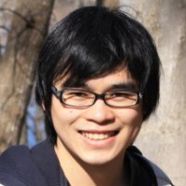
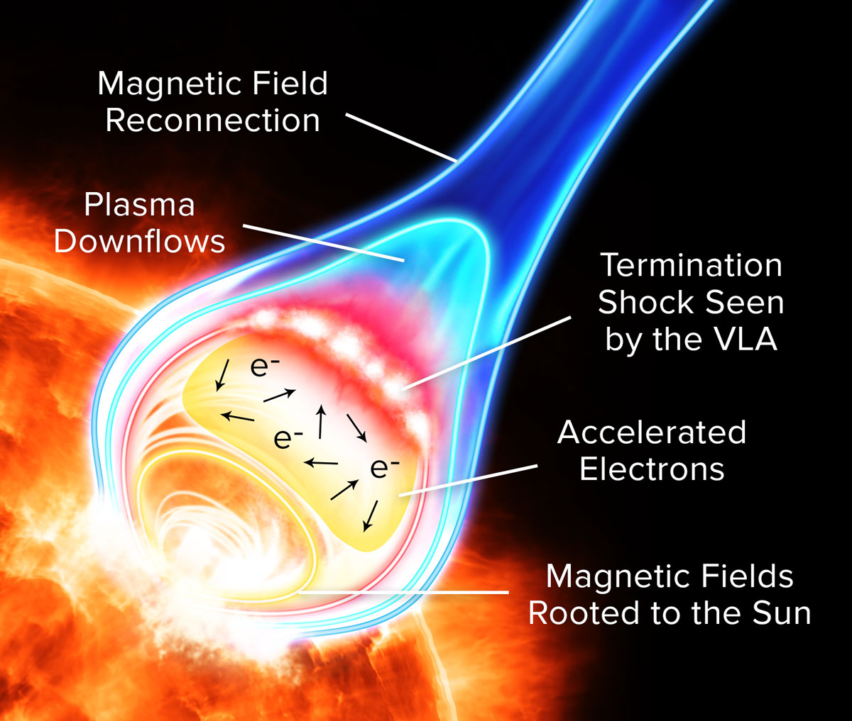
2013 Alumni: Bin Chen
Brief Bio
08/2013: PhD in Astronomy, University of Virginia
08/2013-08/2014: NASA/LWS Eddy Fellow, hosted by New Jersey Institute of Technology
08/2014-12/2015: Astrophysicist, Harvard-Smithsonian Center for Astrophysics
01/2016: Assistant Professor (tenure-track), New Jersey Institute of Technology
Chen et al 2015, Science, “Particle Acceleration
by a Solar Flare Termination Shock”
Research Interests
solar flares, coronal mass ejections, solar radio/EUV/X-ray astronomy
Achievements as an Eddy Fellow
Published two first-author journal articles, including one in Science
Research featured by NASA, NRAO, CfA, NJIT.

Slide 2
How Eddy Fellow helped me with my career
This is my first postdoc job: critical support for a fresh PhD in today’s tough job market!
Free to choose host scientist and institution: ideal for achieving the best fit
Award considered prodigious, financially independent: I was treated very well by the host
Generous support for travel: chance to get myself known by potential employers - my job after the Fellow was offered by someone who listened to my talk in a conference

