Slide 1
My Experience as a Jack Eddy Fellow
M. de Soria-Santacruz Pich
14 December 2015
LWS Science Town Hall Meeting

Slide 2
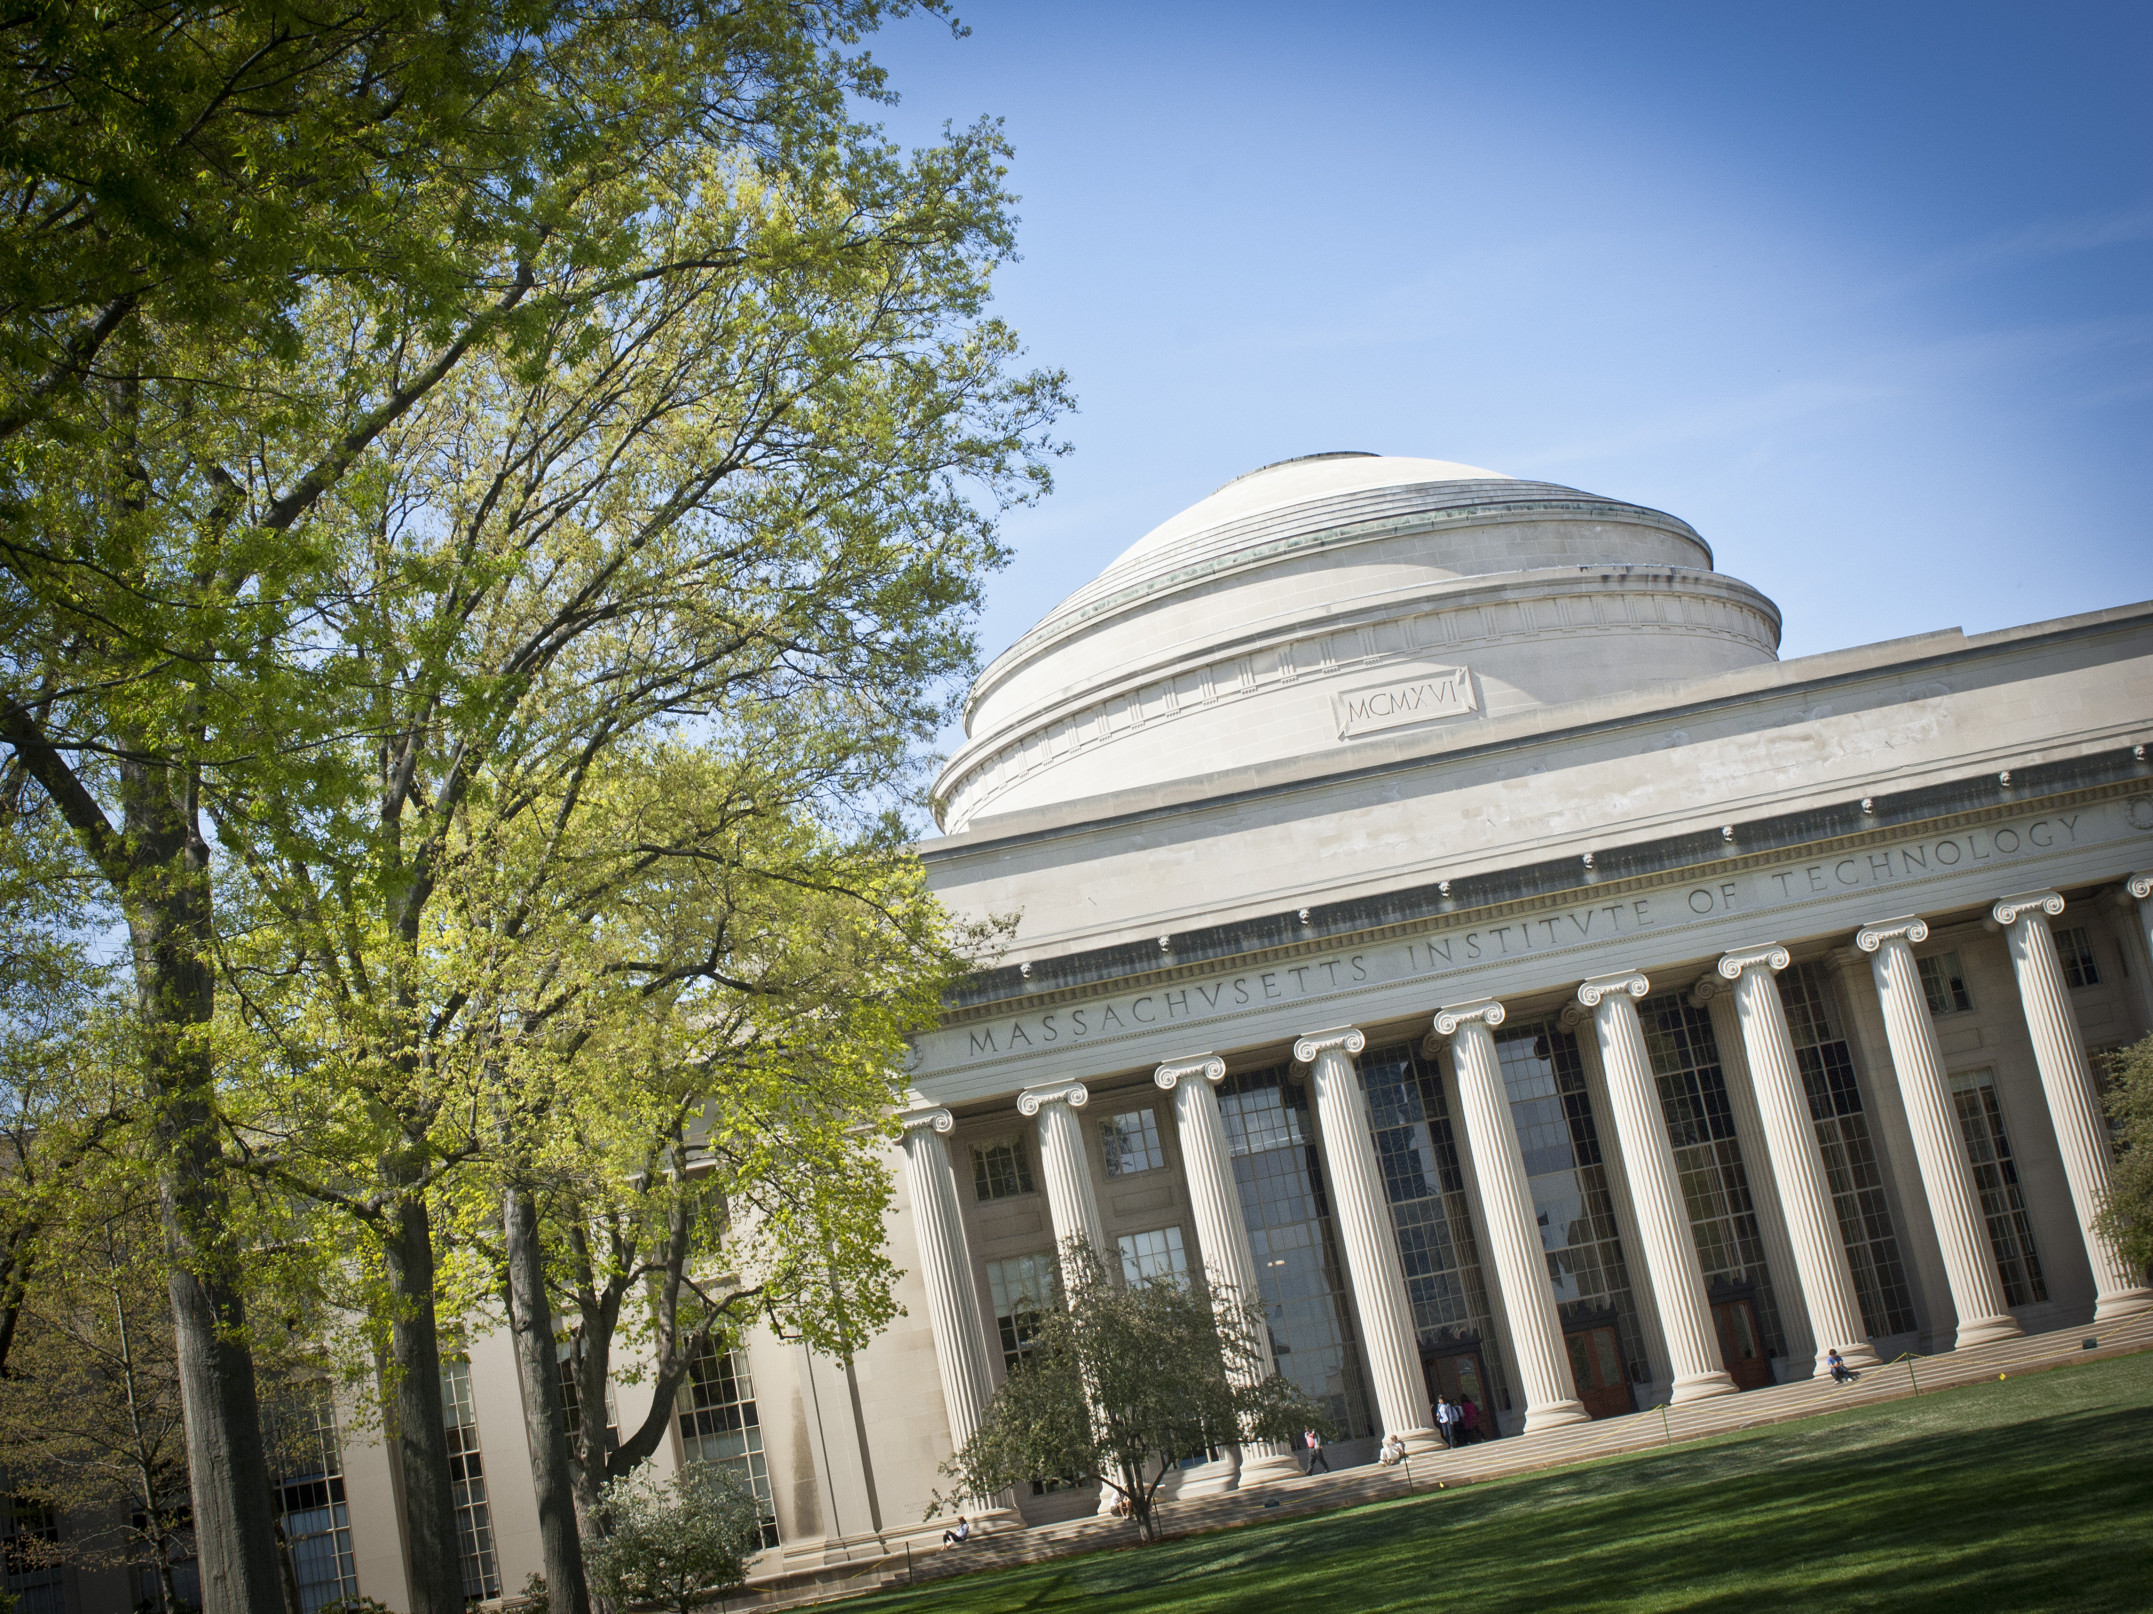
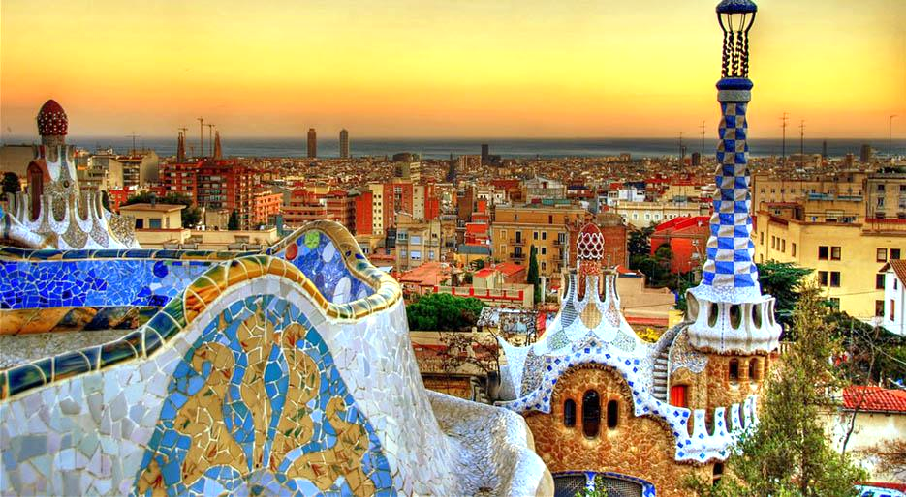

Slide 3
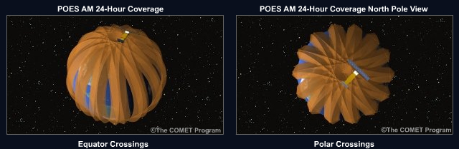
Research developed at UCLA in Richard Thorne’s group (Apr 2014 - Apr 2015)
The specification of a dynamic model of plasmaspheric hiss was the purpose of this investigation. The model is not based on in-situ wave observations alone, but on a technique capable of providing global dynamic estimates of the hiss intensity from low-altitude electron measurements
Wave amplitude inferred from precipitating and trapped electrons from POES
In-situ wave observations (EMFISIS) used to validate inferred hiss amplitudes
De Soria-Santacruz et al., JGR, [2015a, 2015b]
Credit: UCAR

Slide 4
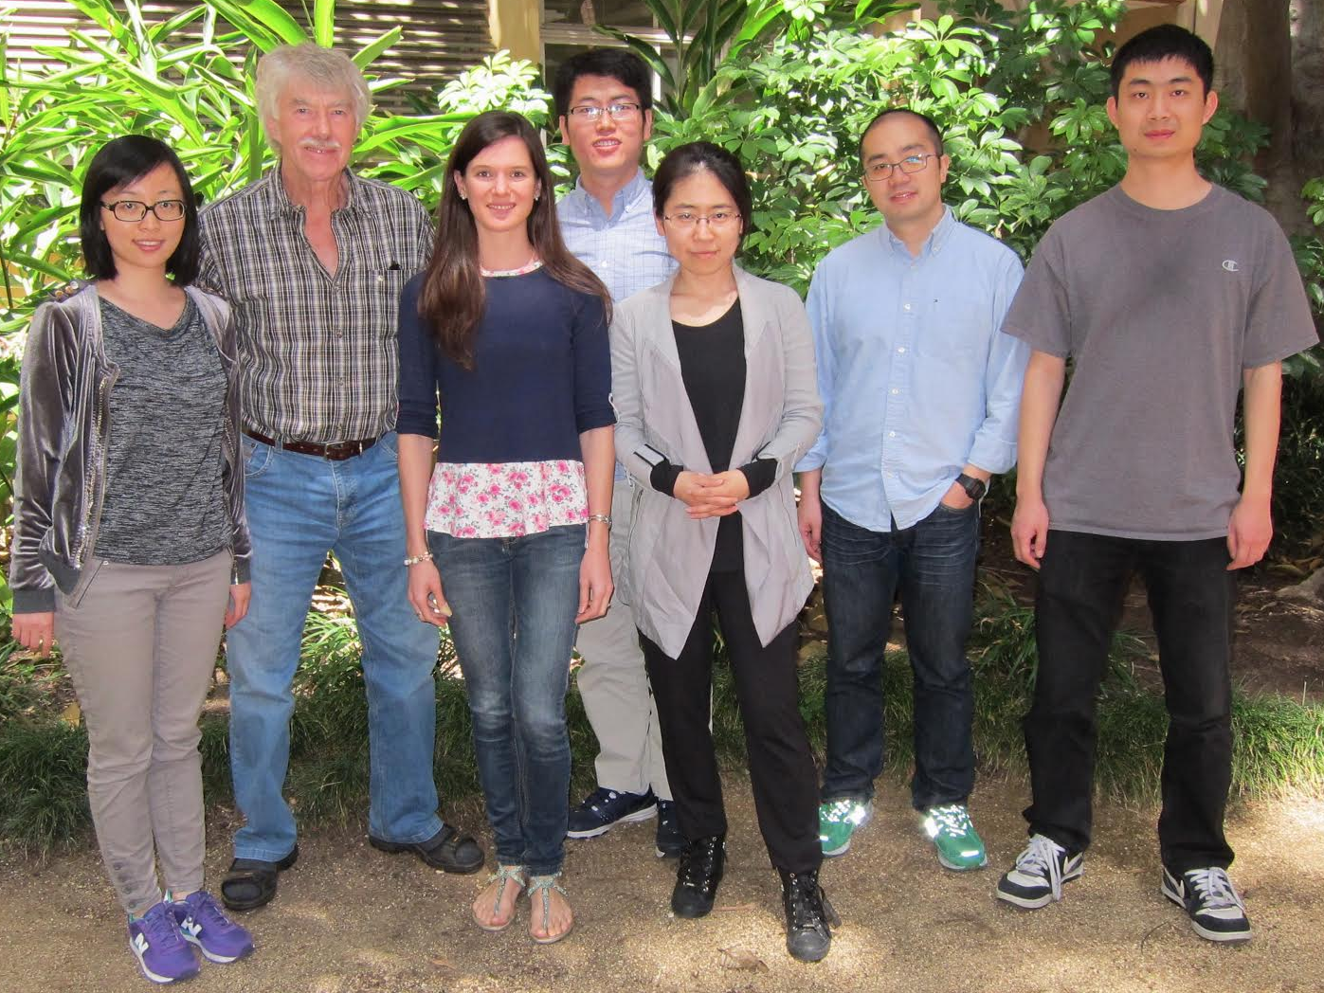
Previously attended the 2013 Heliophysics Summer School in Boulder, CO
Made colleagues and friends from UCLA
Attended AGU Fall Meeting 2014, Geospace Environment Modeling (GEM) 2014
Helped with the first UCLA Cubesat – Electron Losses and Fields Investigation (ELFIN)
Richard Thorne’s group
Present work
After one year under the Jack Eddy Fellowship I started working for the Natural Space Environments Group at the Jet Propulsion Laboratory (JPL) doing related research
Develop models of the space environment around the different planets
Design spacecraft and instruments capable of surviving the harsh conditions of space
Understand instruments’ response to the radiation environment

Slide 5
Thank you!
Questions?

