Slide 1
NASA LWS Institute GIC Working Group
Antti Pulkkinen et al.
(antti.a.pulkkinen@nasa.gov)
NASA Goddard Space Flight Center

Slide 2
NASA LWS Institute concept
You can read the program’s version at http://www.vsp.ucar.edu/Heliophysics/science-LWS.shtml.
PI’s interpretation:
  Space weather version of the International Space Science Institute (ISSI).
  Interdisciplinary, international.
  End-user focus, which is really good → basic scientific research feeding into applications addressing the hazard.

Slide 3
GIC group goals
Identify, advance, and address the open scientific, engineering, applications etc questions pertaining to GIC.
Advance predictive modeling of GIC.
Advocate and act as a catalyst to identify resources for addressing the multidisciplinary topic of GIC.
Establish new personal connections and collaborations!

Slide 4
The team
Core members
A. Pulkkinen (PI) | NASA Goddard Space Flight Center
E. Bernabeu (Co-lead) | PJM
A. Viljanen | Finnish Meteorological Institute
R. Pirjola | Finnish Meteorological Institute and Natural Resources Canada
D. Boteler | Natural Resources Canada
J. Eichner | Munich-Re, Germany
A. Thomson (Co-lead) | British Geological Survey
P. Cilliers | South African National Space Agency
D. Welling | University of Michigan
N. Savani | George Mason University and Naval Research Laboratory
R. Weigel | George Mason University
J.J. Love | US Geological Survey
C. Balch | NOAA Space Weather Prediction Center
C. Ngwira | The Catholic University of America
G. Crowley | Atmospheric & Space Technology Research Associates, LLC
A. Schultz | Oregon State University
R. Kataoka | National Institute of Polar Research, Japan
B. Anderson | Applied Physics Laboratory
D. Fugate | Electric Research & Management
J. Simpson | University of Utah

Slide 5
The team
Advisory members
M. MacAlester |  | Federal Emergency Management Agency
R. Waggel |  | Federal Energy Regulatory Commission
M. Olson |  | North American Electric Reliability Corporation
S. Mahmood |  | Department of Homeland Security
J. Ostrich |  | Department of Energy
R. Lordan |  | Electric Power Research Institute
Observing members
C.T. Gaunt | University of Cape Town, South Africa
C. Felton | Civil Contingencies Secretariat, UK

Slide 6
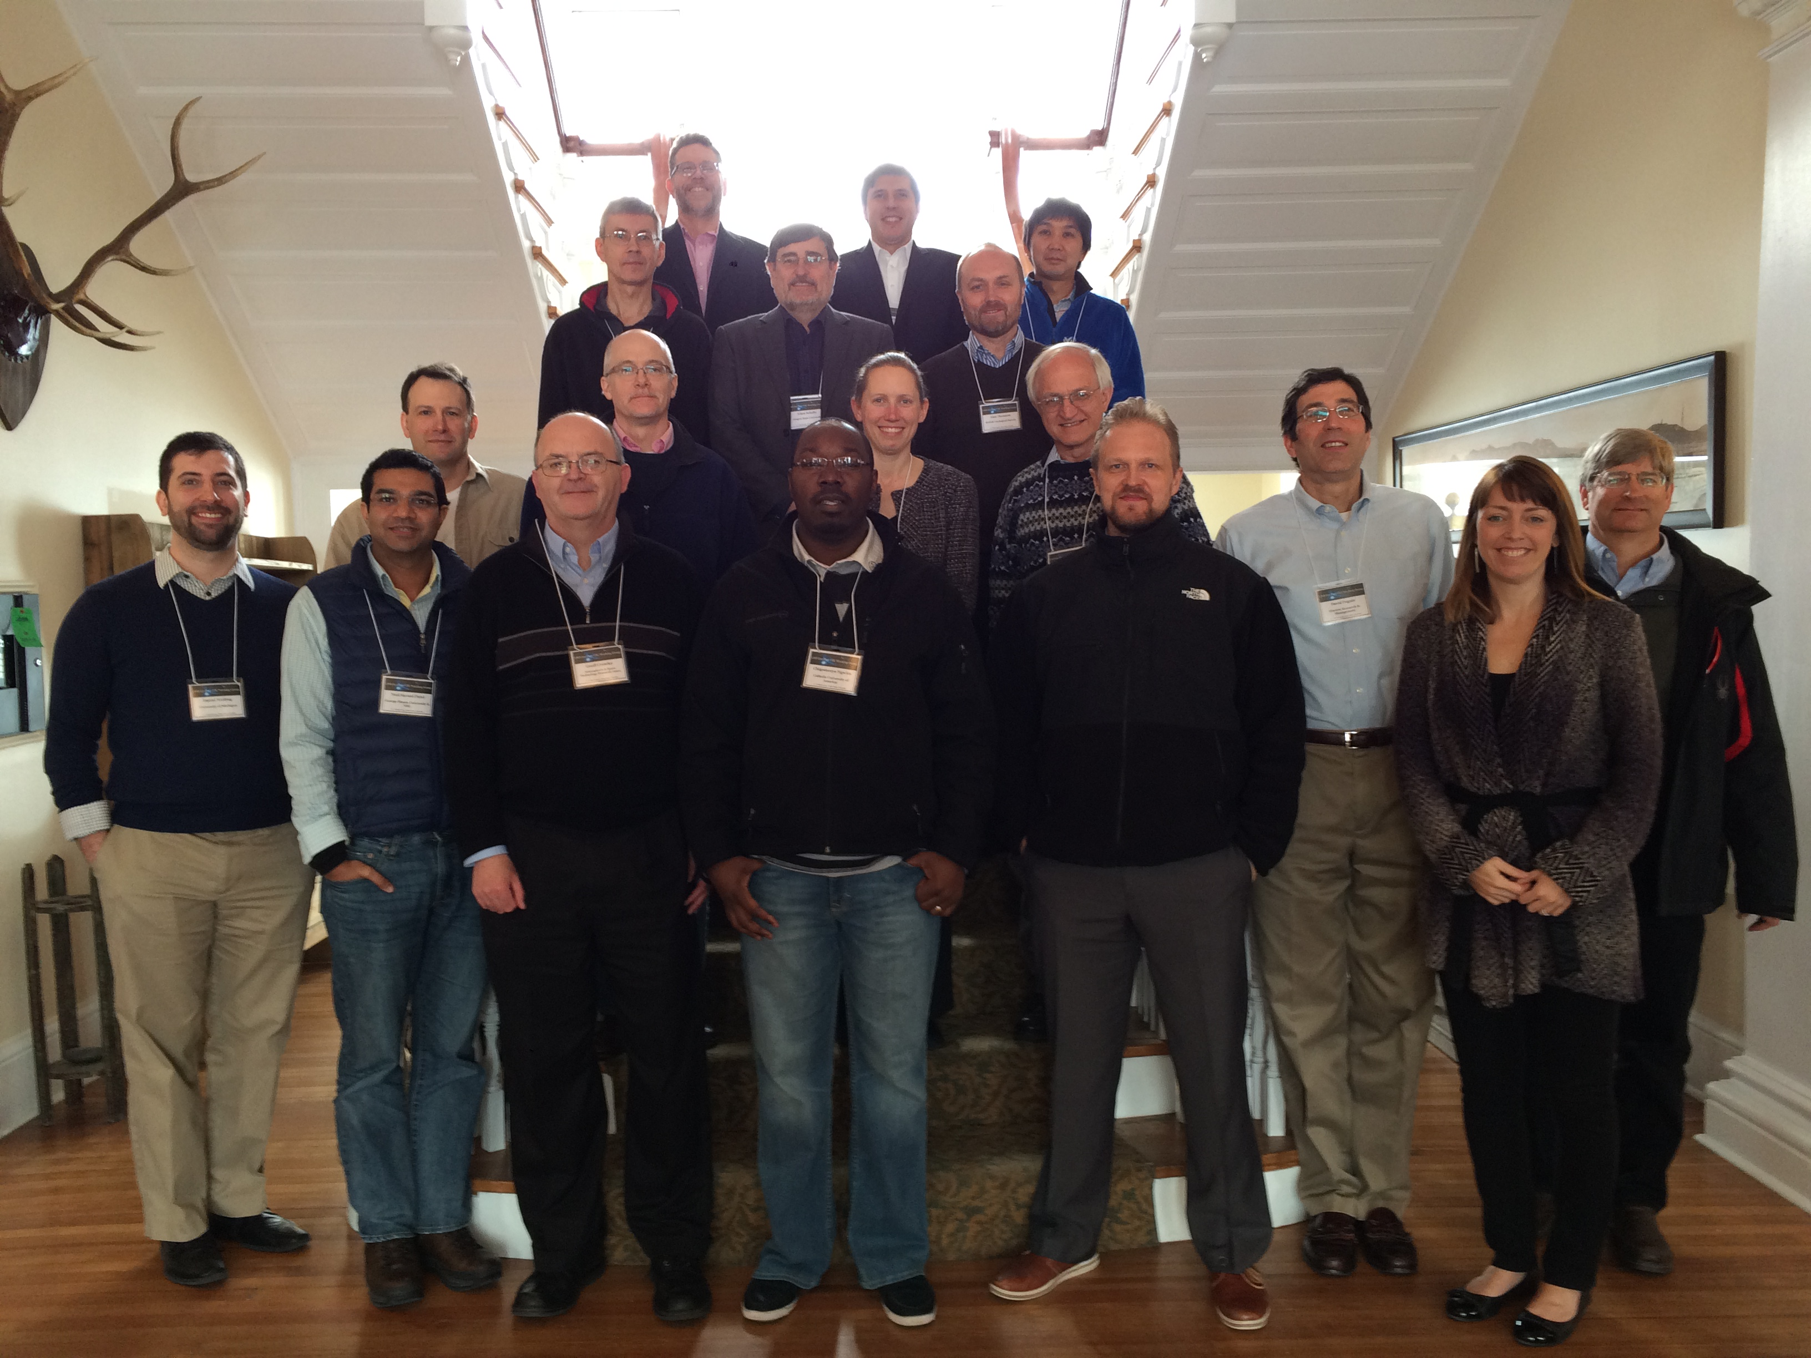
The team

Slide 7
Deliverables
The group’s work will lead to:
  A peer-reviewed publication that provides an integrated view of the field of GIC. This will include societal impacts and the status of the science and applications. The publication will also identify paths forward for addressing the key science and application gaps that need to be solved for improvements in models and predictions.
  A working group report informing the LWS community about the work performed during the workshops. The report will include a roadmap for the future directions of the Working Group.
+ technical articles addressing the identified issues

Slide 8
Findings

Slide 9
Backup

Slide 10
Key open questions
1) 1D, 2D, 3D modeling of the geomagnetic induction and GIC.
  How much our GIC modeling improves by moving from 1D to 2D and 3D modeling of the geomagnetic induction?
  Under what conditions 1D approach becomes insufficient?
2) How can we improve the work on extreme GIC event scenarios?
  Improved statistics?
  Improved modeling, improved understanding of the physics of extremes?
  What are the theoretical upper bounds for the extreme GIC events?
3) What is the optimal number and distribution of B-field measurements for GIC modeling purposes?
  –Can we build and utilize “representative grid” in the analyses?

Slide 11
Key open questions
4) “GIC-index’ development.
  What could be a good new indicators for GIC activity?
  How can we package B-field information into data products that are useful for the end-users?
5) Model validation.
  How can we study and characterize key model (interplanetary transient, geospace, induction, ground model) accuracy for GIC applications?
  How can we build realistic error bars for our end-products?
  Localized geoelectric field enhancements? Can our models reproduce those?
6) How to improve predictive GIC modeling?
  How can we improve lead-time and accuracy?
  Should we focus on specific transient features and geospace processes?

