Slide 1

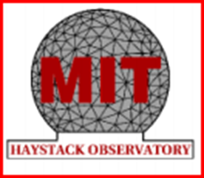


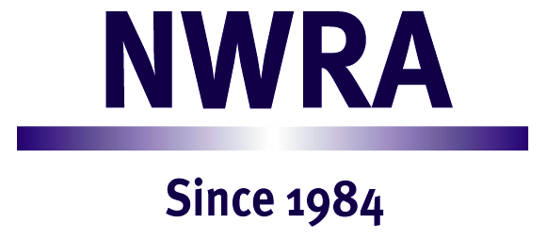
Atmosphere-Ionosphere Coupling During Stratospheric Sudden Warmings
Principal investigators:
Goncharenko, Larisa (MIT Haystack Observatory), team leader
Azeem, Irfan (ASTRA LLC)
Burns, Alan (HAO NCAR)
Lieberman, Ruth (GATS Inc.)
Maute, Astrid (HAO NCAR)
McCormack, John (NRL)
Ortland, David (NorthWest Research Associates)
Wu, Qian (HAO NCAR)
Co-Investigators and Collaborators:
Akmaev, Rashid (NOAA/NWS), Alexander, Joan (NorthWest Research Associates), Bust, Gary (JHU/APL), Chau, Jorge (IAP, Germany), Coster, Anthea (MIT Haystack Observatory), Fang, Tsu-Wei (NOAA), Hagan, Maura (NCAR), Harvey, Lynn (U Colorado LASP), Liu, Hanli (NCAR), Maruyama, Naomi (CIRES/CU Boulder), McInerney, Joseph (NCAR), Pedatella, Nickolas (COSMIC/UCAR), Plumb, Alan (MIT), Qian, Liying (NCAR), Richmond, Art (NCAR), Sassi, Fabrizio (NRL), Siskind, David (NRL), Smith, Anne (NCAR), Wang, Wenbin (NCAR), Yamazaki, Yosuke (NCAR/Kyushu University), Yudin, Valery (NCAR), Zhang, Shunrong (MIT Haystack Observatory), Zhang, Xioali (CU Boulder)
NASA LWS TR&T Town Hall meeting, Dec 14, 2015, San Francisco

Slide 2
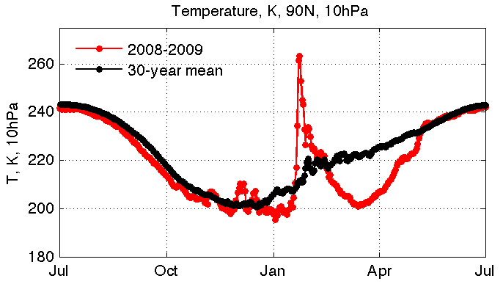
Known by 2011:
TEC before SSW
TEC during SSW
Stratospheric temperature over Arctic rapidly increases during SSW…
…and low-latitude ionosphere is strongly disturbed few days later
NASA SSW team goals:
Advance our understanding of mechanisms connecting lower and upper atmosphere
Planned outcomes:
Comprehensive characterization of anomalies observed during SSW in the middle atmosphere, MLT and ionosphere with experimental data.
Verification of nonlinear interaction between the strong-amplitude planetary waves and tides as source of ionospheric drivers during SSW events.
Improvements in numerical models for simulating upper atmospheric and ionospheric response to disturbances driven from below.
✔
✔
✔

Slide 3
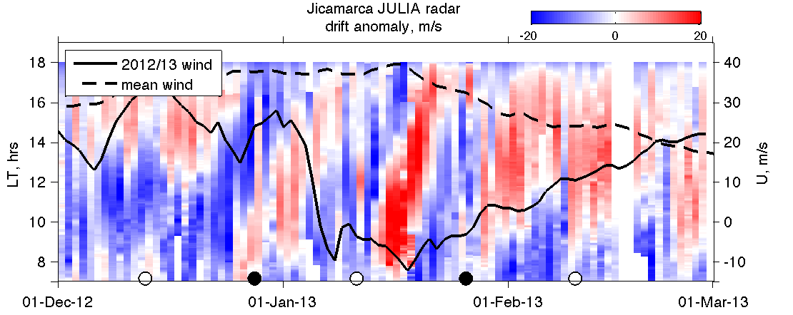
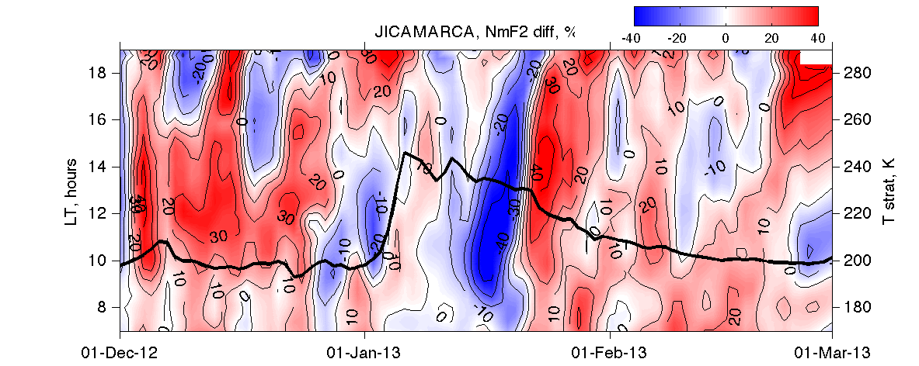
Main results: observations
SSWs effect ionosphere for solar min AND solar moderate conditions
Main observational features are repeatable for both major and minor SSW events
At low latitude, variations in the dynamo electric field are the primary reason for ionospheric anomalies
Both solar and lunar (surprise!) tides are important
At middle latitudes, SSW effects appear to be stronger in the SH than NH (needs further studies; limited observational networks in SH)
Ionospheric anomalies during Arctic SSW are observed even over Antarctica – interhemispheric coupling
Periodic variation in vertical drift anomaly…
…leads to periodic variation in electron density anomaly

Slide 4
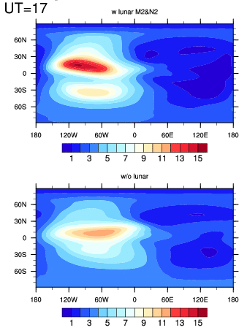
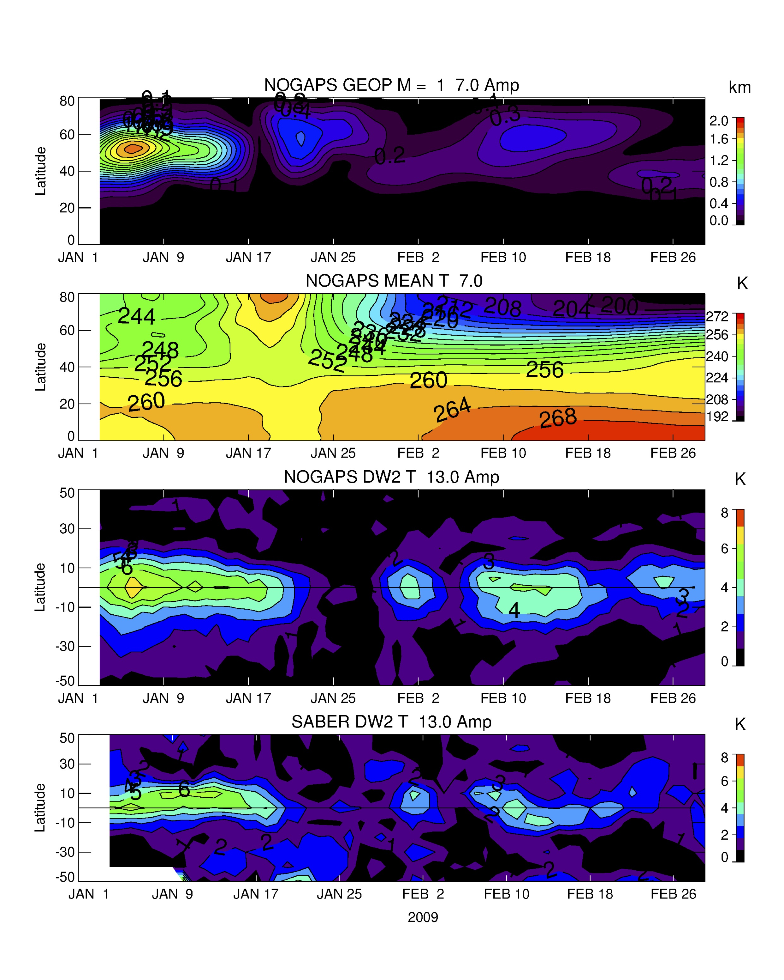
Main results: theory and modeling
Variations in the dynamo electric field are the primary reason for ionospheric anomalies at low latitude
Major driver of electric field variations are modified tides
Variety of migrating and non-migrating tides
Primary reason for tidal modification is a resonant amplification due to the propagation through disturbed middle atmosphere
GCM can reproduce anomalies only with realistic solar and lunar tidal forcing
TIMEGCM with lunar
TIMEGCM without lunar
Planetary wave at 30 km
zonal wind at 30 km
Model: diurnal tide at 90 km
Semidiurnal tide at 106 km
Data: diurnal tide at 90 km

Slide 5
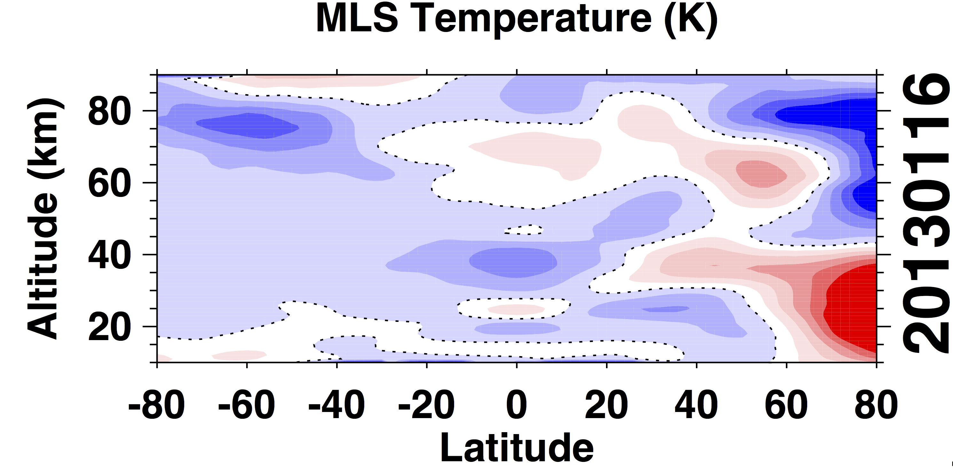
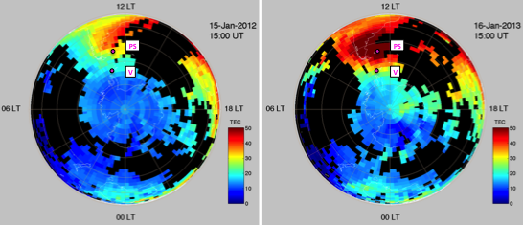
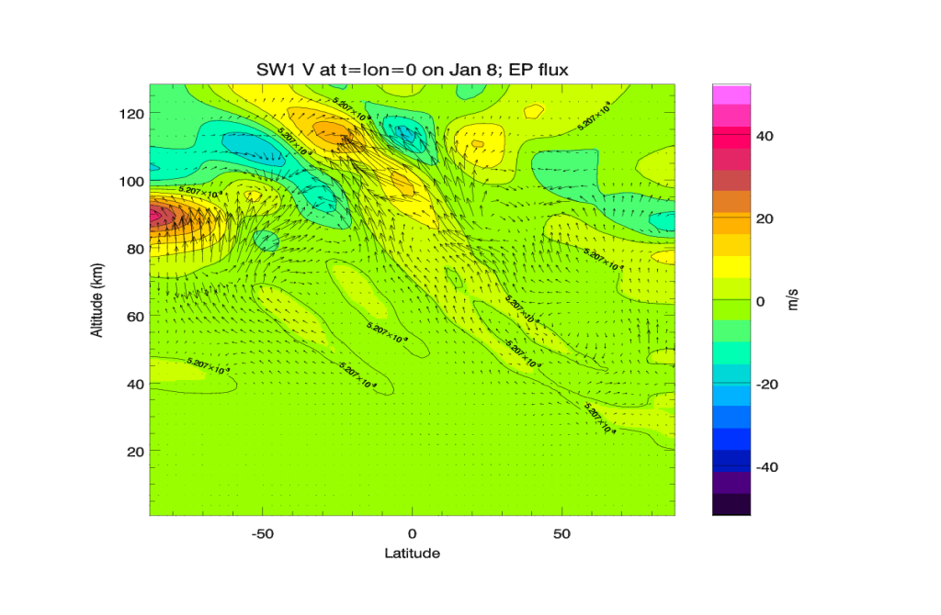
Work in progress: worldwide extent of anomalies during SSW events
Observations: global coupling,
pole to pole, stratosphere to ionosphere
TIMEGCM simulations
NASA Aura MLS
GPS TEC over Antartica
Theory: nonlinear interaction of planetary waves and tides
pre-SSW
SSW
SW1 v and EP flux resulting from PW1-SW2 nonlinear interaction.

Slide 6
Implications and impact
Results highlight feasibility of multi-hour and multi-day prediction of the state of the Earth’s space environment based on the multi-day forecast of the state of the stratosphere
This research sets the stage for the upcoming NASA ICON and GOLD missions aiming to connect the Earth’s weather and space weather
Dissemination of results and community involvement
23 publications, +8 to be submitted ~Jan 2016
> 70 presentations at national and international meetings
International partnerships
Special sessions at multiple meetings
Planned:
  JGR special issue (joint JGR-Atmosphere & JGR-Space Physics), 2016
  Review paper, Rev. of Geophysics, 2017
  Chapman Conference on vertical coupling, ~2017

Slide 7
Publications
Azeem, I., G. Crowley, and C. Honniball (2015), Global ionospheric response to the 2009 sudden stratospheric warming event using Ionospheric Data Assimilation Four-Dimensional (IDA4D) algorithm, J. Geophys. Res. Space Physics, 120, doi:10.1002/2015JA020993.
Azeem, I, R. Walterscheid, G. Crowley, R. Bishop and A. Christensen (2015), Observations of the Migrating 6-hour Tide from the RAIDS/NIRS Instrument and TIMED/SABER, subm. to J. Geophys. Res. Space Physics.
Burns, A. G., S. C. Solomon, W. Wang, L. Qian, Y. Zhang, L. J. Paxton, X. Yue, J. P. Thayer and H. L. Liu, Explaining Solar Cycle Effects on Composition as it Relates to the Winter Anomaly, J. Geophys. Res., 120, 5890-5898 , doi:10.1002/2015JA021220,2015.
Fagundes, P. R., L. P. Goncharenko, A. J. deAbreu, K. Venkatesh, M. Pezzopane, R. deJesus, M. Gende, AJ. Coster, and V. G. Pillat (2015), Ionospheric response to the 2009 sudden stratospheric warming over the equatorial, low- and mid-latitudes in the South American sector, J. Geophys. Res. Space Physics, 120, doi:10.1002/2014JA020649.
Goncharenko, L. P., J.L. Chau, P. Condor, A.Coster, L. Benkevitch (2013), Ionospheric effects of sudden stratospheric warming during moderate-to-high solar activity: case study of January 2013, Geophys. Res. Lett., DOI: 10.1002/grl.50980
Goncharenko, L. P., V.W. Hsu, C. G. M. Brum, S.-R. Zhang, and J. T. Fentzke (2013), Wave signatures in themidlatitude ionosphere during a sudden stratospheric warming of January 2010, J. Geophys. Res.: Space Physics, 118, doi:10.1029/2012JA018251.
Goncharenko, L. P., A. J. Coster, S.-R. Zhang, P. J. Erickson, L. Benkevitch, N. Aponte, I. Galkin, M. Spraggs, A. Hernández-Espiet (2015), Deep Ionospheric Hole Created by Sudden Stratospheric Warming in the Post-Midnight Ionosphere, subm. to Radio Science.
Qian, L., Alan G. Burns, Wenbin Wang, Stanley C. Solomon, Yongliang Zhang, and V. Hsu, Effects of the Equatorial Ionosphere Anomaly on the Inter-Hemispheric Circulation in the Thermosphere, submitted to J. Geophys. Res., 2015.
Häusler, K., M. E. Hagan, A. J. G. Baumgaertner, A. Maute, G. Lu, E. Doornbos, S. Bruinsma, J. M. Forbes, and F. Gasperini (2014), Improved short-term variability in the Thermosphere-Ionosphere-Mesosphere-Electrodynamics General Circulation Model, J. Geophys. Res. Space Physics, 119, 6623-6630, doi:10.1002/2014JA020006.
Jones Jr., M., J.M. Forbes, M.E. Hagan, A. Maute (2014), Impacts of vertically propagating tides on the mean state of the ionosphere-thermosphere system, J. Geophys. Res. Space Physics, 119, 2197-2213, doi:10.1002/2013JA019744.
Klimenko M. V., V.V. Klimenko, F.S. Bessarab, Yu.N. Korenkov, H.-L. Liu, L.P. Goncharenko, M.V. Tolstikov (2015), Study of the thermospheric and ionospheric response to the 2009 sudden stratospheric warming using TIME-GCM and GSM TIP models - first results, J. Geophys. Res. Space Physics, doi: 10.1002/2014JA020861.
Maute, A., M. E. Hagan, V. Yudin, H.-L. Liu, and E. Yizengaw (2015), Causes of the longitudinal differences in the equatorial vertical E × B drift during the 2013 SSW period as simulated by the TIME-GCM. J. Geophys. Res. Space Physics, 120, 5117–5136. doi: 10.1002/2015JA021126.

Slide 8
Publications (cont.)
Maute, A., M.E. Hagan, A.D. Richmond, R.G. Roble (2014), TIME-GCM study of the ionospheric equatorial vertical drift changes during the 2006 Stratospheric Sudden Warming, J. Geophys. Res. Space Physics, 119, 1287-1305, doi:10.1002/2013JA019490.
Maute, A., M. E. Hagan, A. D. Richmond and R. G. Roble (2014), TIME-GCM study of the ionospheric equatorial vertical drift changes during the 2006 stratospheric sudden warming, J. Geophys. Res. Space Physics, 119, 1287–1305, doi: 10.1002/2013JA019490.
Maute, A., B. G. Fejer, J. M. Forbes, X. Zhang, V. Yudin, Equatorial vertical drift modulation by the lunar and solar semidiurnal tides during the 2013 Sudden Stratospheric Warming, subm. to JGR Space Physics.
Lieberman, R. S., D. M. Riggin, D. A. Ortland, J. Oberheide, D. E.Siskind, (2015): Global observations and modeling of nonmigrating diurnal tides generated by tide-planetary wave interactions, J. Geophys. Res. Atmos., 120, doi:10.1002/2015JD023739.
Liu, H.-L., J. M. McInerney,S. Santos, P. H. Lauritzen, M. A. Taylor, and N. M. Pedatella (2014), Gravity waves simulated by high-resolution Whole Atmosphere Community Climate Model, Geophys. Res. Lett., 41, 9106–9112, doi:10.1002/2014GL062468.
Oberheide, J., M. G. Mlynczak, C. N. Mosso, B. M. Schroeder, B. Funke, and A. Maute (2013), Impact of tropospheric tides on the nitric oxide 5.3 μm infrared cooling of the low-latitude thermosphere during solar minimum conditions, J. Geophys. Res. Space Physics, 118, 7283–7293, doi:10.1002/2013JA019278.
Pedatella, N.M., T. Fuller-Rowell, H. Wang, H. Jin, Y. Miyoshi, H. Fujiwara, H. Shinagawa, H.-L. Liu, F. Sassi, H. Schmidt, V. Matthias, L. Goncharenko (2014), The neutral dynamics during the 2009 sudden stratosphere warming simulated by different whole atmosphere models, J. Geophys. Res. Space Physics, DOI: 10.1002/2013JA019421
Pedatella, N. M. and Maute, A.,(2015) Impact of the semidiurnal lunar tide on the mid latitude thermospheric wind and ionosphere during sudden stratosphere warmings, J. of Geophy. Res.: Space Physics, doi10.1002/2015JA021986.
Siskind, D. E., and J. P. McCormack (2014), Summer mesospheric warmings and the quasi-2 day wave, Geophys. Res. Lett., 41, 717-722, doi:10.1002/2013GL058875.
Yamazaki, Y., A. D. Richmond, A. Maute, H.-L. Liu, N. Pedatella, and F. Sassi (2014), On the day-to-day variation of the equatorial electrojet during quiet periods, J. Geophys. Res. Space Physics, 119, 6966-6980, doi:10.1002/2014JA020243.
Yamazaki, Y., A. D. Richmond, A. Maute, Q. Wu, D. A. Ortland, A. Yoshikawa, I. A. Adimula, B. Rabiu, M. Kunitake, and T. Tsugawa (2014), Ground magnetic effects of the equatorial electrojet simulated by the TIE-GCM driven by TIMED satellite data, J. Geophys. Res. Space Physics, 119, 3150-3161, doi:10.1002/2013JA019487.

