Slide 1
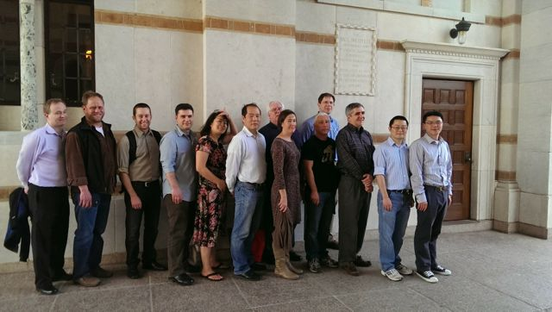
LWS: Interaction Between the Magnetotail and the Inner Magnetosphere and the Impact of that Interaction on the Radiation Belt Environment
Team Members:
Jacob Bortnik, UCLA
  Wen Li, Binbin Ni, and Richard Thorne, UCLA, Vania Jordonova, LANL
Scot Elkington, University of Colorado
  Mike Wiltberger, HAO
Janet Green, NOAA
  Chia-Lin Huang, UNH, Janet Machol and Juan Rodriguez, NOAA
John Lyon, Dartmouth College, [Dartmouth]
  Slava Merkin, JHU/APL
Shin Ohtani, JHU/APL
  Slava Merkin and Pontus Brandt, JHU/APL
Andrei Runov, UCLA
  Christine Gabrielse, UCLA and Drew Turner, Aerospace
Frank Toffoletto (organizer), Rice University
  Stan Sazykin, Jian Yang and Richard Wolf, Rice University
LWS team meeting, Rice University
February 2014

Slide 2
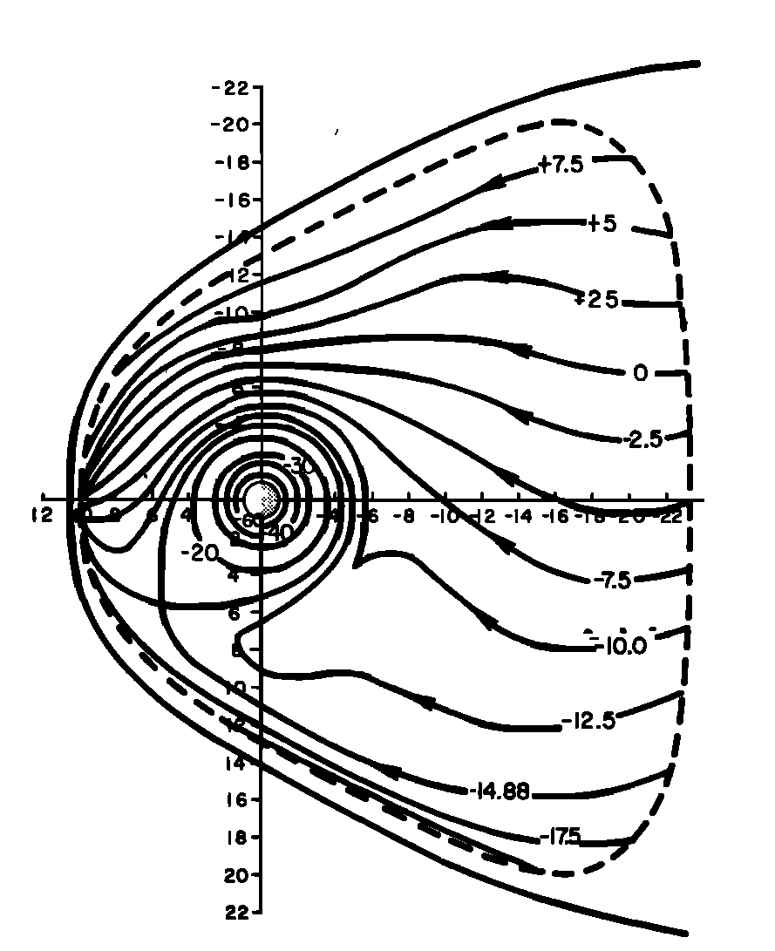
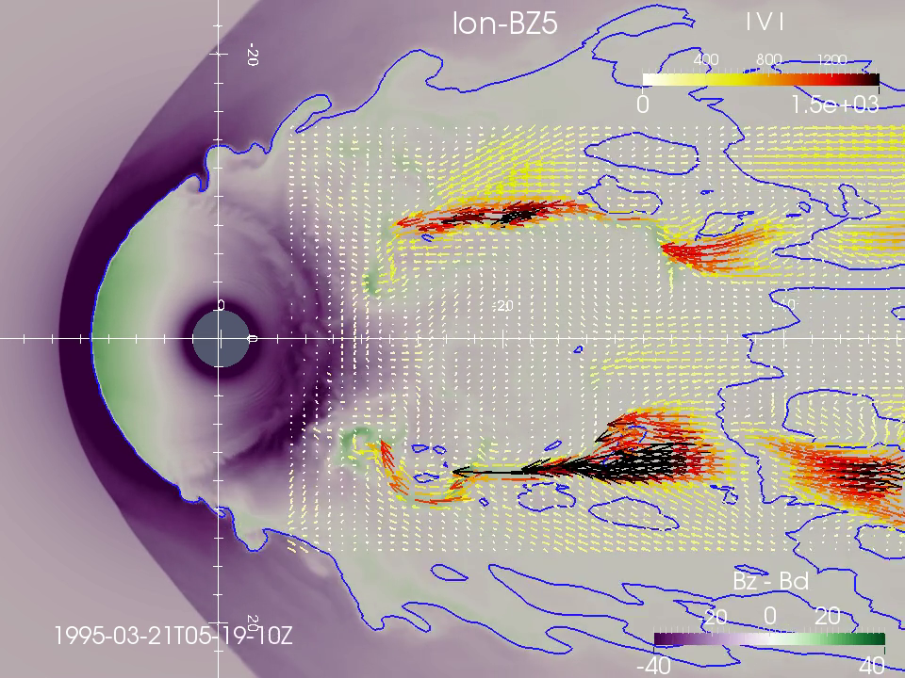
Background: A Paradigm Shift in our Understanding of Magnetospheric Transport
Equatorial plane view
with the Sun to the left.
Current view of Magnetospheric Convection
[from Wiltberger et al, JGR 2015]
showing Bursty Bulk flows (BBFs)/
Dipolarization Fronts (DF)/Bubbles
Traditional view of Magnetospheric Convection
[from Jaggi and Wolf, 1973]

Slide 3
Interaction Between the Magnetotail and the Inner Magnetosphere and the Impact of that Interaction on the Radiation Belt Environment
Goals:
  To understand the transport and energization of plasma that originates in the tail and ends up in the inner magnetosphere.
Science questions:
What are the physical mechanisms that determine Bursty bulk flows/Dipolarization fronts (BBF/DF) formation and evolution?
How important are BBFs for overall plasma transport and energization?
What is the impact of BBFs on the inner magnetosphere, including the ring current and radiation belts?
How do BBFs interact with the ionosphere?

Slide 4
Some Physics We’ve Learned
(Sample from 35+ Papers)
Global MHD provides a pretty good picture of overall effect of BBFs (Wiltberger).
Better understanding on oscillations generated by BBFs (Runov).
Better understanding of ion composition in BBFs (Ohtani).
Better understanding of the generation of flow bursts and the applicability of MHD (Merkin).
Most ring current particles traversed the plasma sheet in BBFs (Yang/Toffoletto).
Better understanding of the role of the solar wind on radiation belt losses (Bortnik)
Evidence that BBFs provide seed particles for radiation-belt electrons (Turner + work in progress by Elkington, Wiltberger, Bortnik, Huang) .

Slide 5
Lessons Learned
Practical:
  Keep in touch: Face to face meetings are better than teleconferences. Twice yearly meetings seem to work well.
  Not all things go according to plan, but when you put smart and motivated group of people together interesting and exciting science happens.
Science:
  We now understand a lot more about BBFs/DFs in the plasma sheet.
  We are beginning to get a quantitative handle on how BBFs affect storm-time ring current and energization of outer belt electrons.

Slide 6
Backup Slide

Slide 7
Some recent highlights from the LWS team (Out of ~35+ papers published)
[Science question]
Wiltberger et al. [JGR 2015] found good agreement between a LFM MHD simulation and observations of dipolarization fronts [1,2,4].
Yang et al. [JGR 2015] modeled 20 idealized geomagnetic storm main phases using the Rice Convection Model – Equilibrium (RCM-E) found that up to 60% of ring current energy comes from bubbles/dipolarization fronts [2,3,4].
Runov et al. [JGR 2014] studies of dipolarization front braking, thermodynamics and interaction with the ambient plasma found they excited diamagnetic (mirror-type) oscillations that interacts with energetic particles and cause Pi-2-like magnetic oscillations observed on GEO and on the ground [1,2,3].
Turner et al. [GRL 2015], using Van Allen Probes data, found that the compressional waves from the braking dipolarization front can also interact with energetic electrons in the inner magnetosphere, causing deep injections [2,3].
Ohtani et al. [JGR 2015] performed a statistical study with Geotail/EPIC data Ion composition measurements at 9-210 keV and found no preferable acceleration of O⁺ in dipolarization fronts [2,3].
Ohtani et al. [submitted, JGR 2015], using a version of the Rice Convection Model, found that the ionospheric feature known as the Harang reversal and its associated arcs are natural consequences of the interchange stability of the steady magnetotail [2,4].
Merkin et al. [JGR 2015], using MHD simulations that started from 2-D magnetotail equilibria with magnetic flux accumulation, show the generation of earthward flows and a proto-dipolarization front similarly to analogous fully kinetic simulations which suggests much of the physics is captured by MHD[1,2].
Gao et al, [JGR, 2015] found that the solar wind dynamic pressure and interplanetary magnetic field (IMF) B_{z} play key roles in causing the relativistic electron flux dropouts [3].
Elkington, Wiltberger and Bortnik [in progress] are working on energetic particle transport in LFM MHD fields and dipolarization fronts and the impact on EMIC/Chorus wave growth [2,3].
Huang et al [in progress] is working looking at the plasma sheet seed particle injections on radiation belt dynamics by analyzing Van Allen Probes data [3].
1: formation and evolution; 2: transport and energization; 3: ring current and rad. belts; 4: ionosphere

