Slide 1
Team Report
Flare Dynamics in the Lower Solar Atmosphere
Joel Allred (NASA GSFC) --Team 1
Phil Judge (HAO) & Lucia Kleint
(Original PI)-- Team 2
Alexander Kosovichev (NJIT/Stanford) –Team 3
Chang Liu (NJIT)--Team 4
Vahe Petrosian (Stanford)-- Team 5
Haimin Wang (NJIT)-- Team 6

Slide 2
Main collaborative results
Teams 2 and 5 on RADYN simulations that match very well with observations of spectral line profiles;
Teams 2, 4, 6 on IRIS and magnetic field data analysis, discovered new flare topologies and emission patterns;
Teams 1 and 6 on the discovery and understanding of negative flares;
Teams 3 and 5 on thick-target modeling;
Teams 3, 4, 6 on analysis and gained basic understanding of sunquakes;
Teams 1 and 5 on the combination of Stanford flare code with hydrodynamic code successfully

Slide 3
Key results: publications, presentations, awards…
Over 50 refereed journal publications, almost all in high-impact journals such as ApJ, one paper in Nature Communications; similar number presentations were made in domestic and international conferences
Involving 6 Ph.D. students, and around 10 junior researchers
Regular team meetings with active participations from all teams
Obtained several well observed events from multi-observatories and wavelengths, including most advanced data from BBSO 1.6m telescope, newly upgraded EOVSA, and most recent solar mission IRIS

Slide 4
Summary and lessons learned
With joint observational and modeling effort we gained fundamental understanding and made discoveries related to the lower atmospheric dynamics of flares. All team goals have been either fully or most fulfilled;
The education/training is an important part of the process. We had very good experience in involving different team members of Ph.D. Thesis committee;
Selecting team observational events that have comprehensive coverage ensured success in data analysis and modeling.

Slide 5
Have you achieved the team goal?
Progress in understanding the transport of energy and momentum into the interior from the solar atmosphere (sunquakes) during flares.---mostly, however, explanations to sunquakes are not unique
Progress in understanding high-energy phenomena in the impulsive phase of a flare.—yes
Extensions of the photospheric field changes from the line-of-sight field to the full vector field. –yes
Progress in revising the standard thick-target model of the flare impulsive phase.– considerable progress and more on the way

Slide 6
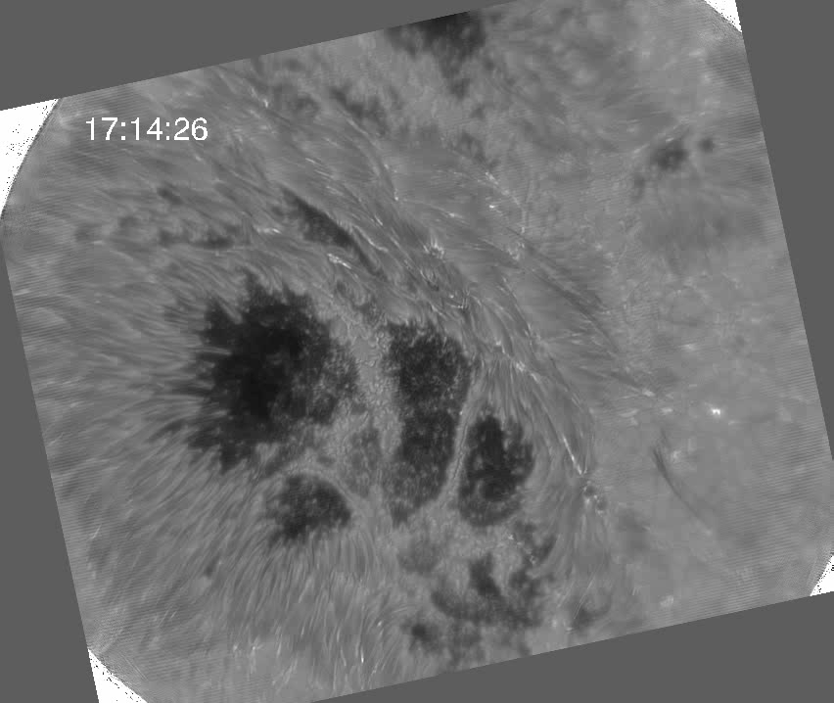
Example of Most Advanced Flare Observation as a Team Event

