Slide 1
LWS TRT Website http://lwstrt.gsfc.nasa.gov
A portal….
For communication
Disseminating program info
Collecting community input
For documenting
Program activities (e.g., LPAG activities, meetings,…etc)
Program output & successes

Slide 2
New LWSTRT Website Menu items
New
Research Highlight (RH) records export
For project information and documentations
LWSTRT RH metrics
investigator input
Back-filling process on going (need investigators’ confirmation)
Project Search
By investigator
By keyword search (coming)
Website feedback button
Coming attractions
Presentation & media material upload
Team reporting by FSTs/TSTs
Website analytics

Slide 3
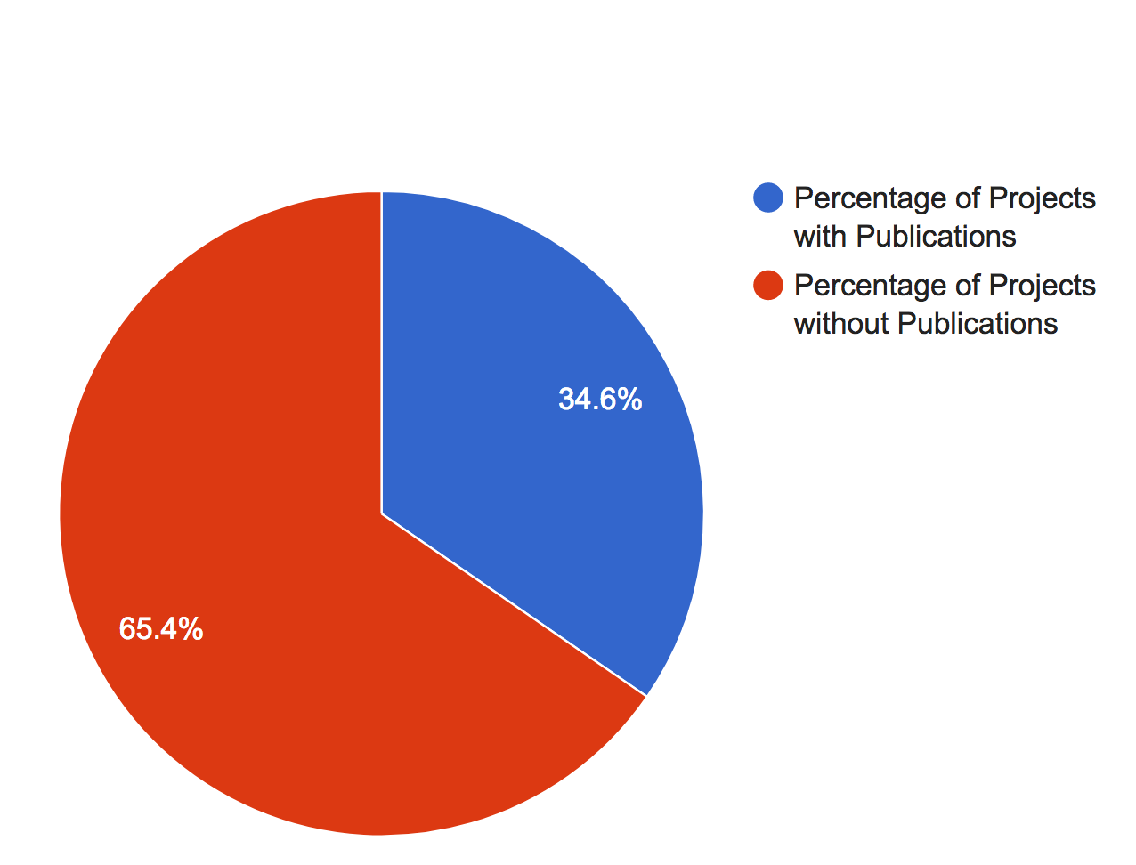
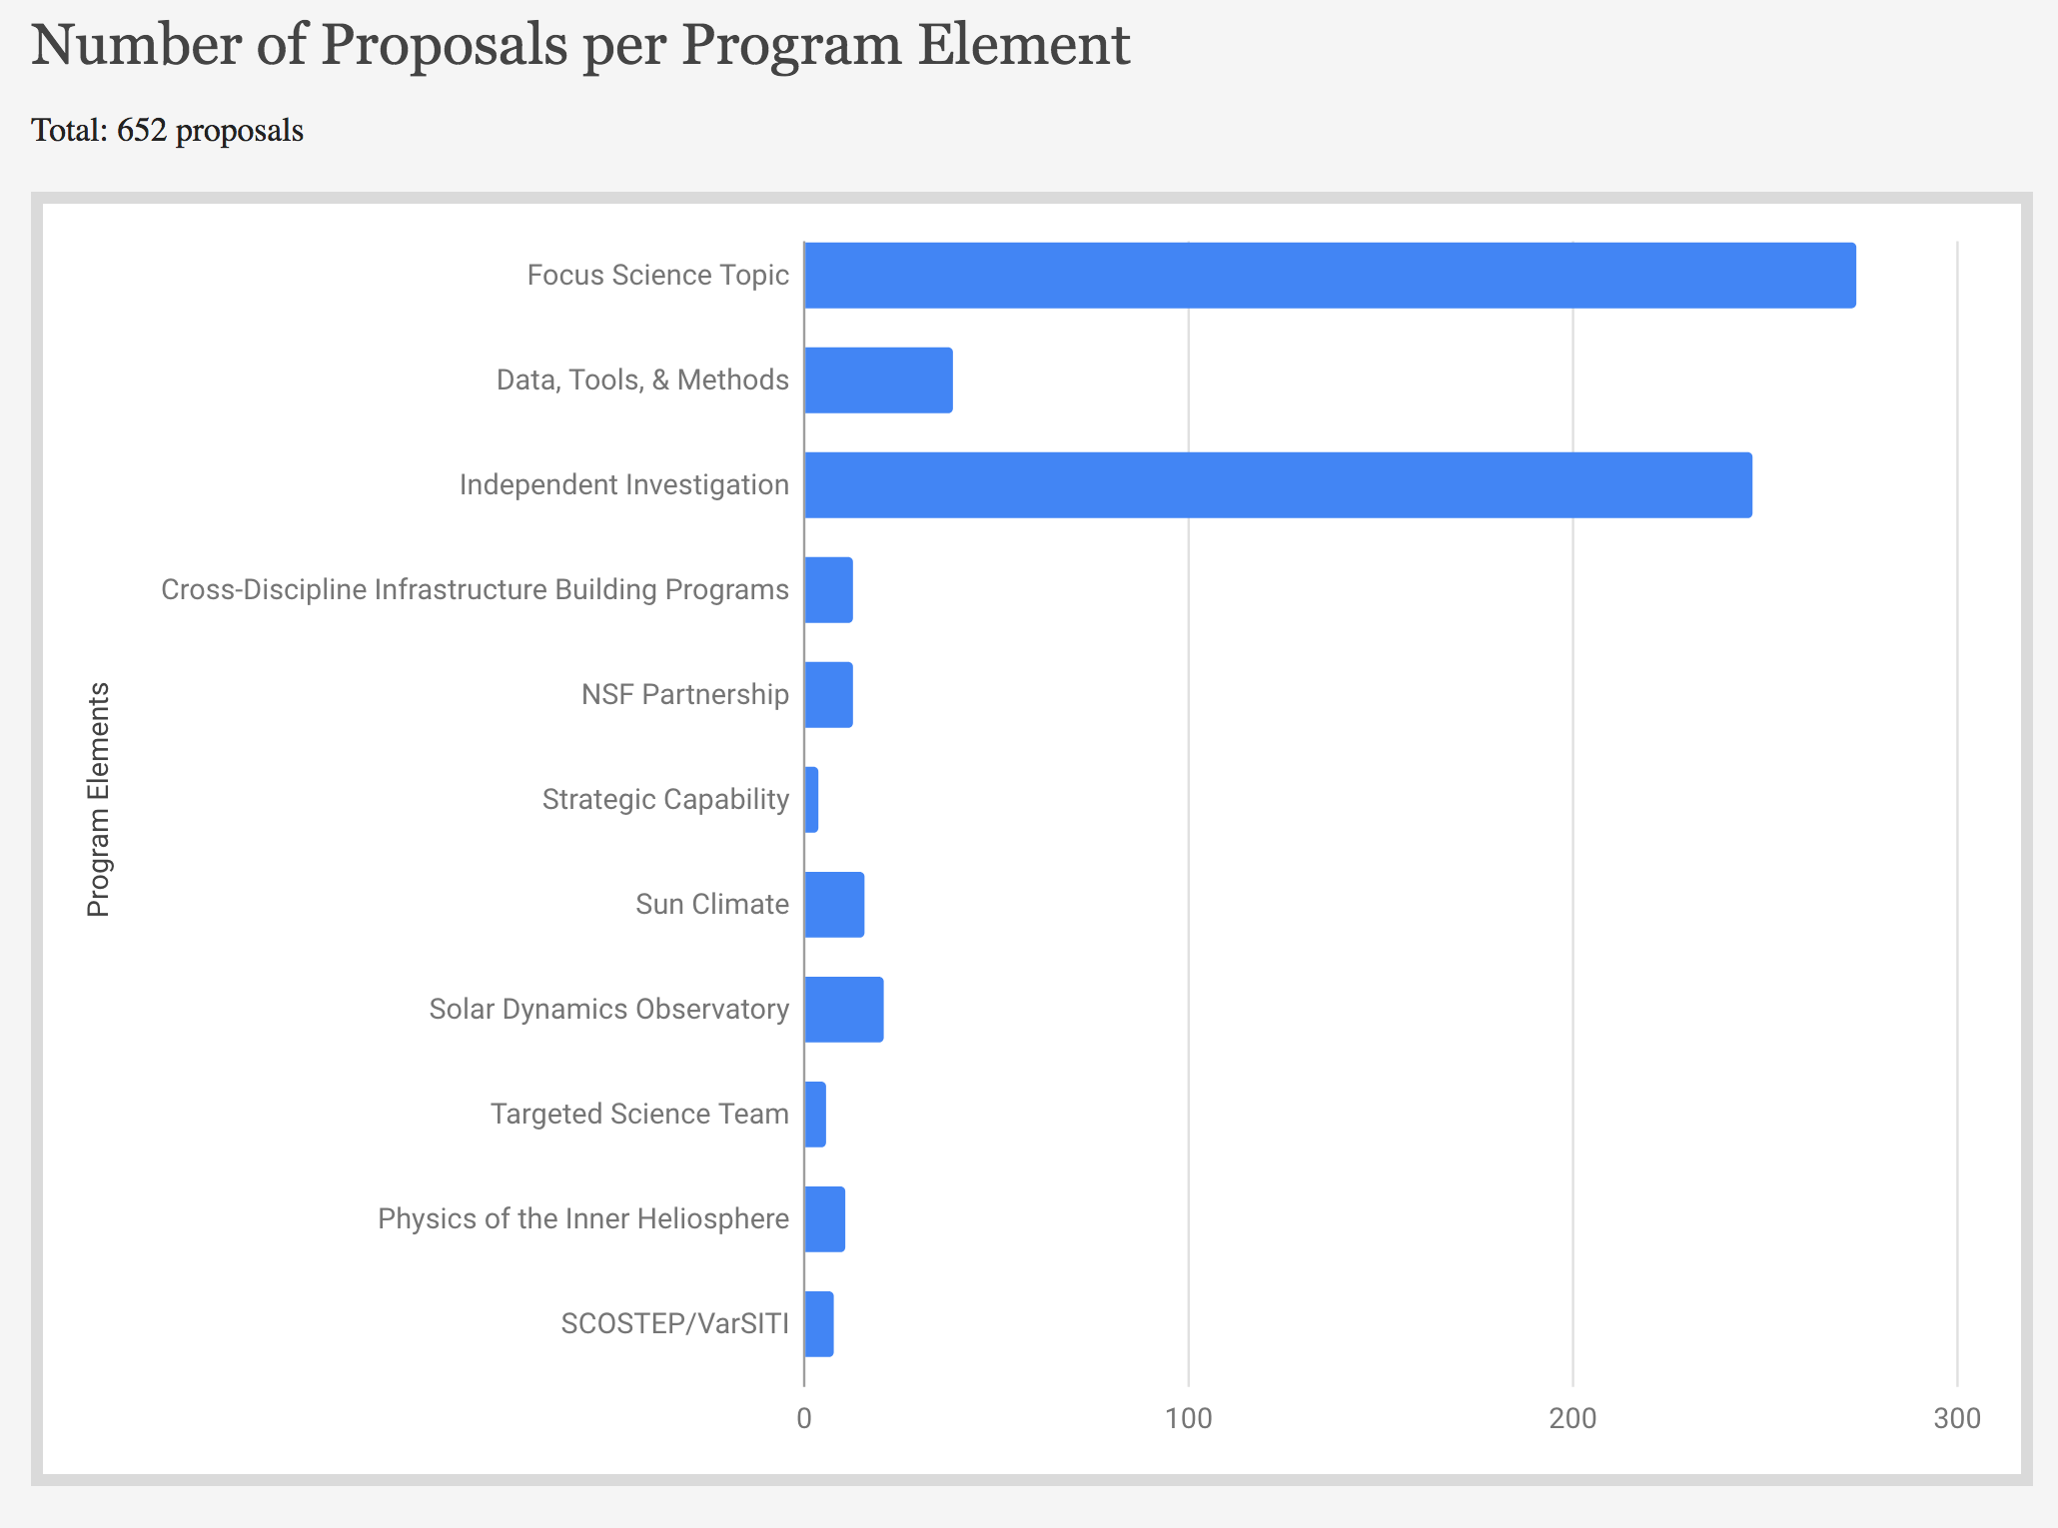
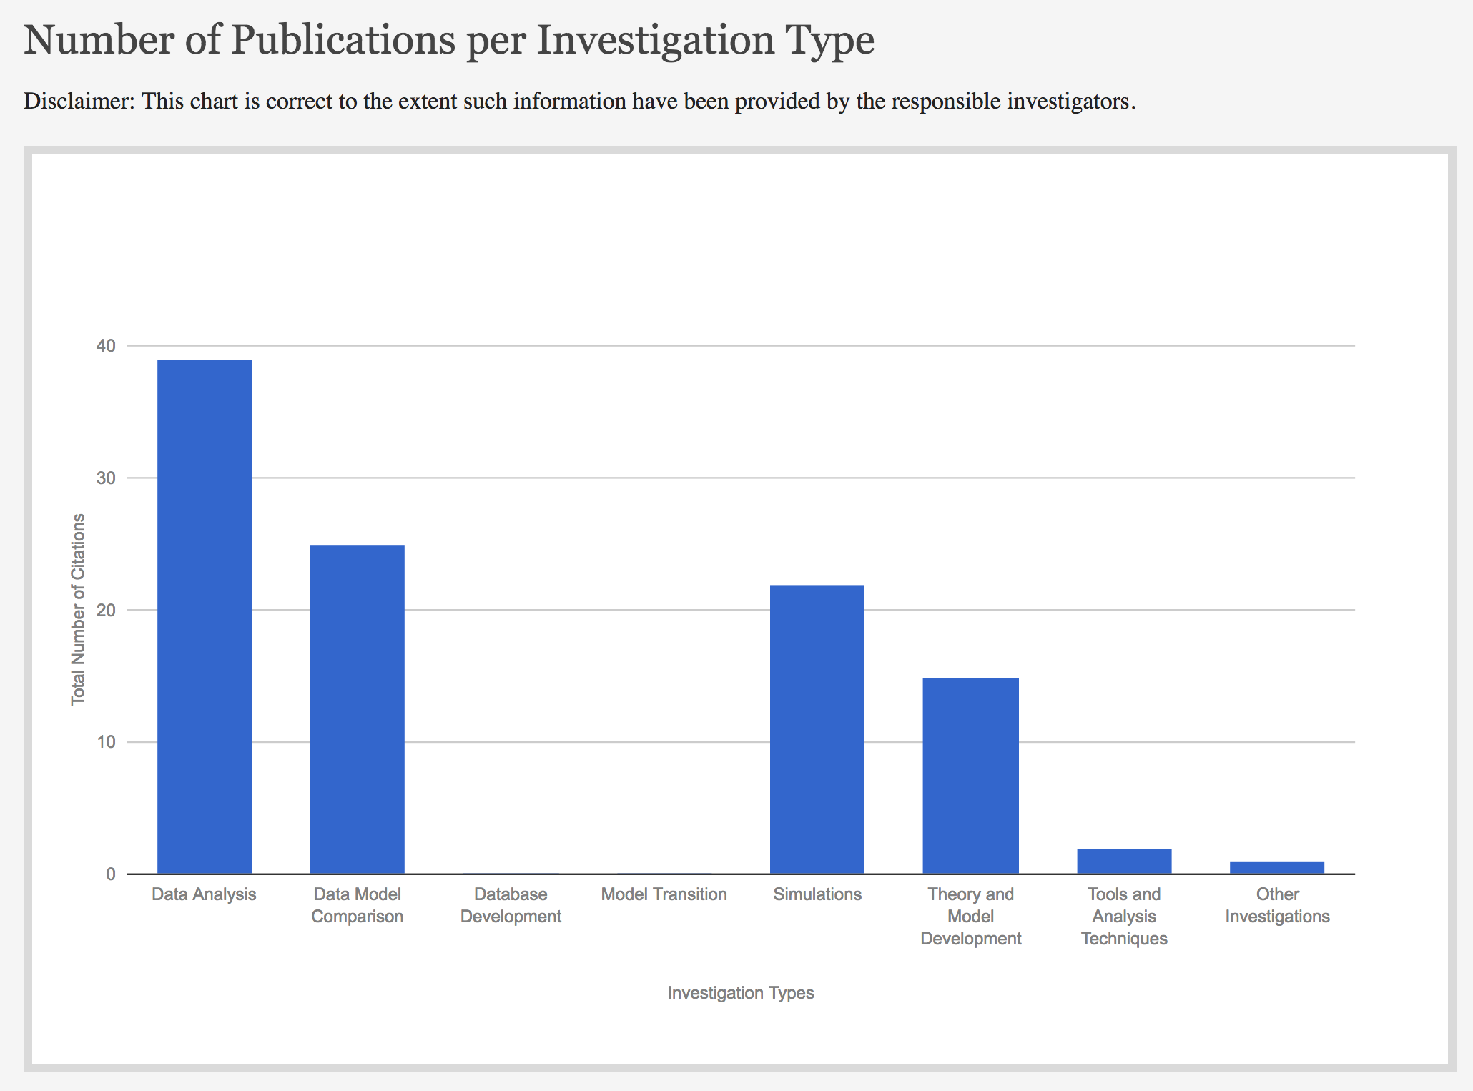
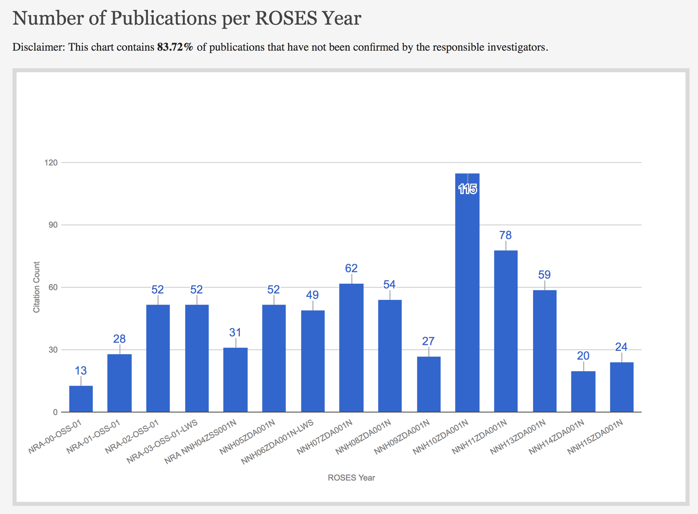
LWSTRT Research Highlight Metrics
LWRTRT RH Reporting Percentage
This includes publications yet to be confirmed by responsible investigators

