Slide 1

Heliophysics: Integrating Knowledge Across Disciplines
Heliophysics Summer School
Jack Eddy Postdoctoral Fellowship Program
Living With a Star Institutes
2nd Eddy Cross Disciplinary Symposium
In partnership with

Slide 2
History
NASA’s Living With a Star Program has been partnering with UCAR’s Cooperative Programs for the Advancement of Earth System Science since 2007 to develop a new generation of heliophysicists through science-based education, training, and support for the Heliophysics community.
Heliophysics Summer School
Jack Eddy Postdoctoral Fellowships
Living With a Star Institutes
Purpose: To teach the next generation of scientists about the physics of space weather events that start at the Sun and influence atmospheres, Ionospheres and the Magnetospheres throughout the solar system.
418 Students to date
First School held in 2007
Purpose: To train the next generation of scientists needed in the field of Heliophysics.
First class appointed in 2010
31 Jack Eddy Postdoctoral Fellows to date
Purpose: The LWS Institute is designed to facilitate a bridge between cutting-edge heliophysics research and a societally relevant technology area that is affected by space weather.
2015 first Institute held
4 Institutes held to date
Notes:
Bring many research disciplines and applications communities together to deepen the understanding of the system of systems created by the Sun-Earth connection.

Slide 3
Heliophysics Summer School

Slide 4
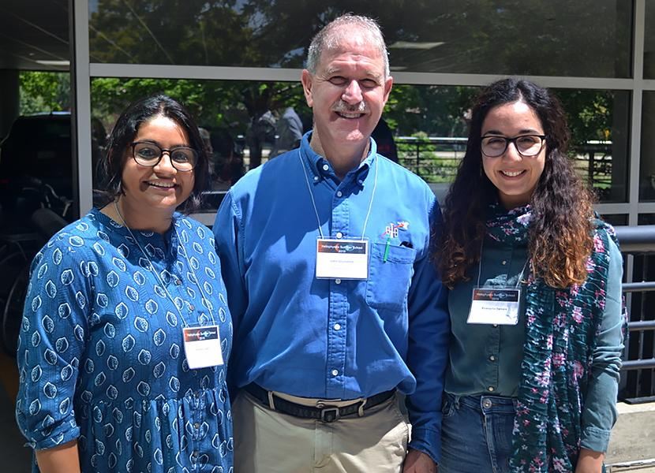
2019 Heliophysics Summer School Highlights
Heliophysics Exploration - Focus on Heliophysics System Observatory (HSO)
21 Short Student talks on topics from across the spectra of space physics research including:
Impact of small-scale electric field variability on the ionosphere-thermosphere system: GITM simulation
Outer radiation belt response to sheath regions of coronal mass ejections
Identifying Sources of the Variable Solar Wind Through Advanced Image Processing Techniques
Using CubeSats and SmallSats to Probe HOT Plasma in the Atmosphere of a COOL Star
Surprise Guest Lecturer
Astronaut Dr. John Grunsfeld presented “A Conversation with an Astronaut/Scientist and Human Solar Cosmic Ray Detector”

Slide 5
Heliophysics Summer School Deans
2016 - 2020
Amitava Bhattacharjee | Princeton University
Dana Longcope | University of Montana-Bozeman
2013 – 2015
Karel Schrijver | Lockheed Martin Advanced Technology Center
Jan Sojka | Utah State University
Frances Bagenal | University of Colorado/LASP/APS
2010 – 2012
Amitava Bhattacharjee | University of New Hampshire
Dana Longcope | University of Montana-Bozeman
Jan Sojka | Utah State University
2007 – 2009
Karel Schrijver | Lockheed Martin Advanced Technology Center
George Siscoe | Boston University

Slide 6
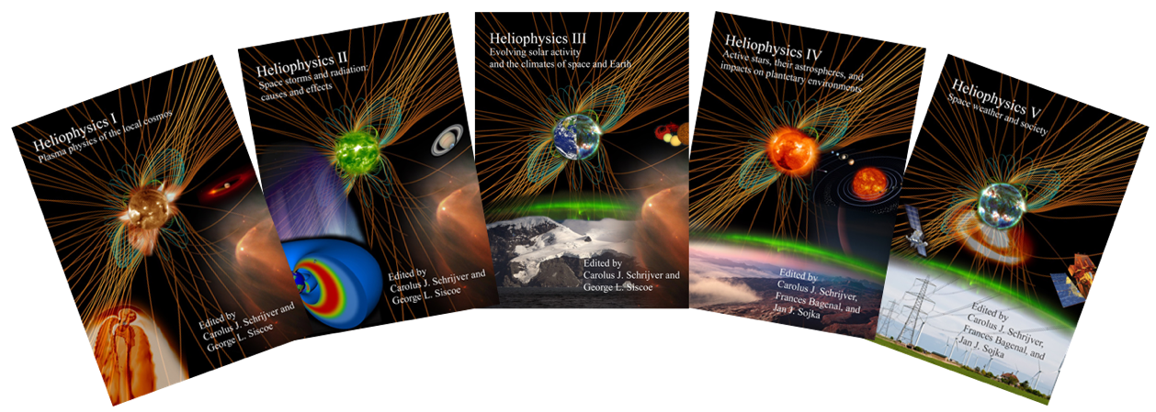
Heliophysics Summer School Resources
Textbooks I, II, III, IV & V
Laboratory primers created by Goddard’s Community Coordinated Modeling Center (CCMC):
Use the CCMC tools designed to interrogate Heliophysics models at CCMC, and
Obtain a top-level view of the connectivity and naming of regions and parameters that comprise the heliophysics system.
Additional resources, compiled from 13 years of Heliophysics Summer Schools, include:
Textbook problem sets and solutions
Slide presentations from lectures
155 Videos of lectures hosted on CPAESS YouTube Channel

Slide 7
Heliophysics Summer School Resources
NEW RELEASE
Principles of Heliophysics: a textbook on the universal processes behind planetary habitability
Written by Karel Schrijver et al
Based on the previously published Heliophysics series, this free online volume weaves together excerpts from the original texts, organized to emphasize universal processes from a perspective that draws attention to what provides Earth (and similar (exo-)planets) with a relatively stable setting in which life as we know it can thrive.
This text aims to serve as a textbook-style volume for which the original Heliophysics books are the extended "readers" with much more detail, references, and domain-specific topical chapters.
This volume is intended for students in physical sciences in later years of their university training and for beginning graduate students in fields of solar, stellar, (exo-)planetary, and planetary-system sciences. New here is the inclusion of 200 "activities" in the form of problems, exercises, explorations, literature readings, and "what if" challenges.

Slide 8
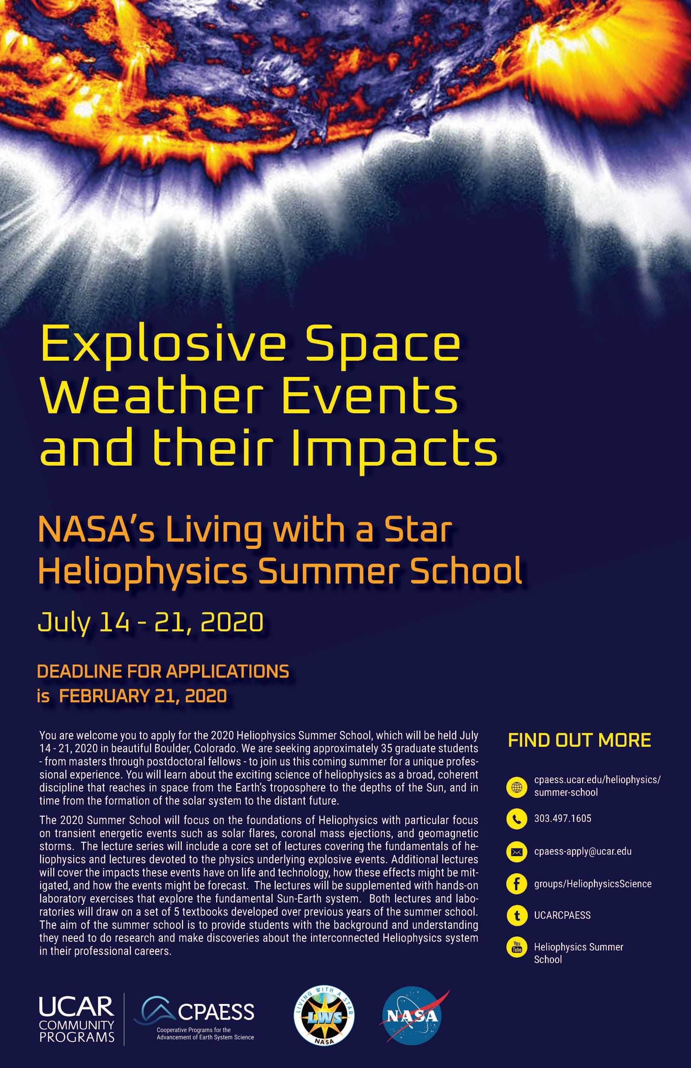
2020 Heliophysics Summer School
Explosive Space Weather Events and their Impacts
July 14 - 21, 2020 - Boulder, CO
The 2020 Summer School will focus on the foundations of Heliophysics with particular focus on transient energetic events such as solar flares, coronal mass ejections, and geomagnetic storms. The lecture series will include a core set of lectures covering the fundamentals of heliophysics and lectures devoted to the physics underlying explosive events. Additional lectures will cover the impacts these events have on life and technology, how these effects might be mitigated, and how the events might be forecast.
The lectures will be supplemented with hands-on laboratory exercises that explore the fundamentals Sun-Earth system. The aim of the summer school is to provide students with the background and understanding they need to do research and make discoveries about the interconnected Heliophysics system in their professional careers.

Slide 9
Jack Eddy Postdoctoral Fellowship

Slide 10
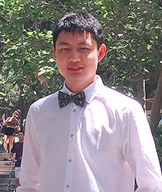
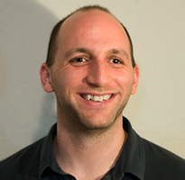
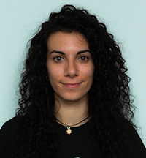
Newly Appointed - 2019 Jack Eddy Fellows
TERRY LIU
Project: Magnetic reconnection at the foreshock and the space weather effects of the associated accelerated particles
Host: University of Alaska, Fairbanks (Dr. Hui Zhang)
WILLIAM LONGLEY
Project: Investigating the nonlinear interaction between Landau damping and Coulomb collisions in Geospace plasmas
Host: Rice University (Dr. Anthony Chan)
ERIKA PALMERIO
Project: Understanding the Evolution of the Space Weather Drivers at Earth and Mars
Host: University of California, Berkeley (Dr. Christina Lee)

Slide 11
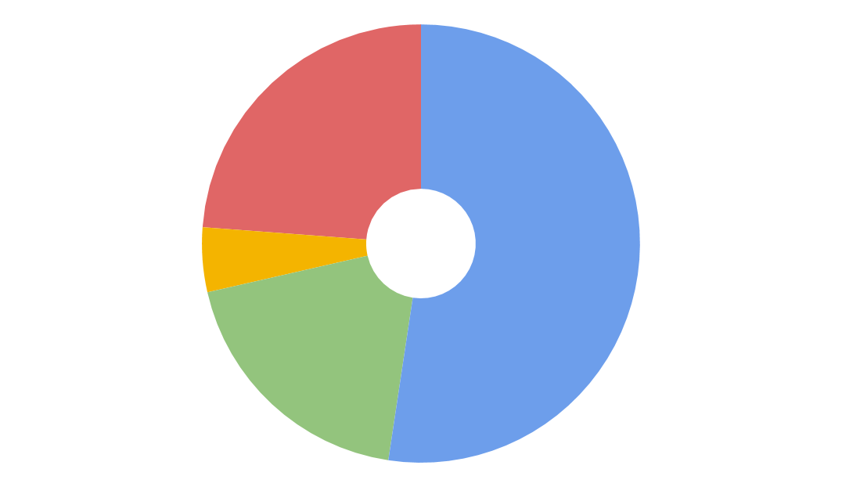
Jack Eddy Fellowship Alumni Survey Results
In an effort to gather a more comprehensive set of metrics and capture the impact of the Jack Eddy Fellowship, a survey was sent out to all alumni in February 2019.
Briefly describe the value/impact of your Jack Eddy fellowship experience to the scientific community?
Career Development (5%)
Community:
“My fellowship led to substantial impact on the scientific community, [including 7 peer-reviewed publications, numerous conference presentations, the opportunity to convening radically interdisciplinary sessions at the AGU Fall Meeting, an International Space Sciences Institute team, a successful trans-disciplinary pilot program with the JPL Data Science Working Group, and] a new Working Group within the NSF Earthcube Research Coordination Network).”
100% of all respondents felt that the Jack Eddy postdoctoral experience:
Met their expectations to conduct their own research.
Met their expectations to work independently.
Publish:
“I published 10 papers with 5 first author papers, and these papers have been cited more than 50 times now.”
Publish (19%)
Community (24%)
Research:
“I was able to contribute to the problem of particle acceleration in flares from a unique cross-disciplinary position bridging basic microphysics with solar modeling efforts.”
Research (52%)

Slide 12
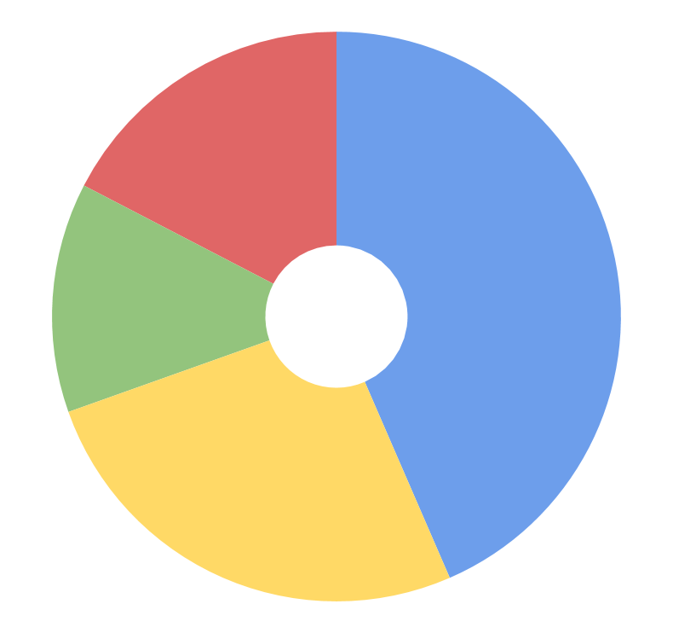
Jack Eddy Fellowship Alumni Survey Results
How did the Jack Eddy Fellowship enable your career success?
New Collaborations:
“The autonomy and excellent admin support enabled me to freely explore new collaborations outside the traditional paradigms. This capability was instrumental in the progress I was able to achieve...”
Research Independence:
“It allowed me to be independent for 2 years and pursue something that I was personally interested in. This fellowship makes this freedom possible, which is not abundant in our field and in science in general anymore.”
New Collaborations (17%)
Research
Independance (44%)
Prestige (13%)
Career Development:
“No other fellowship enables career progression with as much speed and focus.”
Career Development (26%)

Slide 13
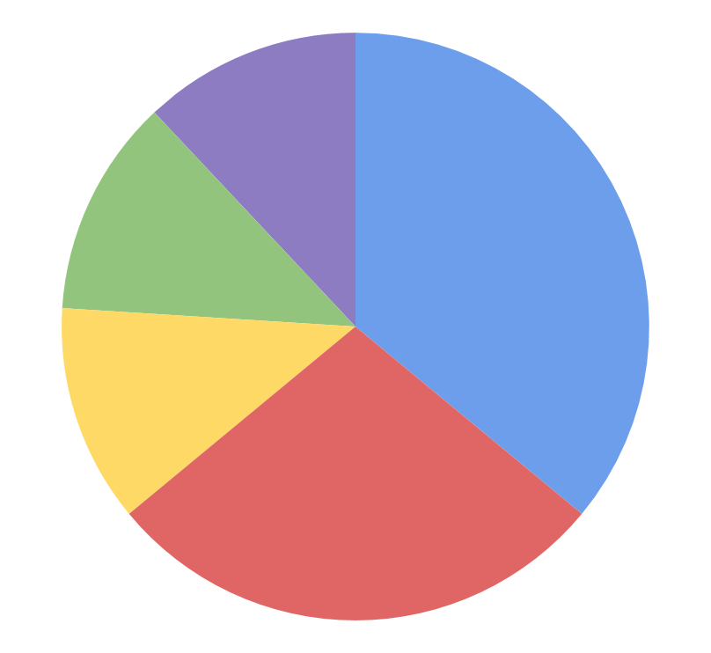
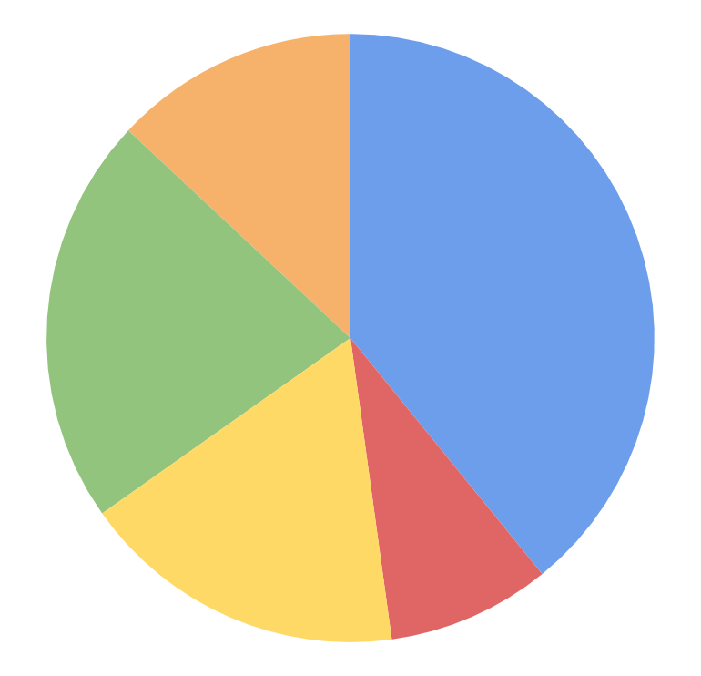
Jack Eddy Fellowship Alumni Survey
None (12%)
“I have served on NASA proposal review panels. I am serving as a committee member of NASA's Nexus for Exoplanet System Science (NExSS) Steering Council. I received three grant funding from NASA as the PI. I am a science team member of NASA's MAVEN mission. I was invited to give one 90-minute lecture on the topic of ‘Living with Stars and Societal Relevance’ in 2018 Heliophysics Summer School.”
Non-Profit (13%)
Served on Committees or Panels (36%)
Other Current Connections (12%)
US Academia
(39%)
Corporate (22%)
Received NSF Grant Funding (13%)
Received NASA Grant Funding (28%)
International (17%)
Federal (9%)
How you served on any NASA and/or NSF committees or panels, received grant funding from NASA and/or NSF, or have any current connections with NASA and/or NSF during the past year?
Jack Eddy Alumni Employers

Slide 14
Living With a Star Institutes

Slide 15
Living With A Star Institutes
2015
Topic Area
Principles in relation to the effects of geomagnetically induced currents (GICs) during CME-driven geomagnetic disturbances (GMDs)
Nowcasts of radiation storms (proton events) at energy levels that could create a radiation hazard for aircrew and passengers
Nowcasts of atmospheric drag for LEO spacecraft
2016
Topic Areas
2017 - 2018
Topic Areas
TEC and ionospheric scintillation for GPS applications
Prediction and specification of >10 MeV proton flux

Slide 16
Living With A Star Institutes
AMS Town Hall – Wednesday, Jan. 15, 2020
LWS Institutes: Pathways for Reducing Risk to Aviation and Satellite Operations
A joint panel will discuss the current state and future directions of aviation radiation and atmospheric drag and how to better understand and mitigate space weather related risks.
2018 Topic Area: TEC and ionospheric scintillation for GPS applications
Space Weather Impacts on GNSS Radio Occultations at Mid-Latitudes
Meetings held:
Feb. 18 - 22, 2019
Sept. 30 - Oct. 4, 2019

Slide 17
2nd Eddy Cross Disciplinary Symposium

Slide 18
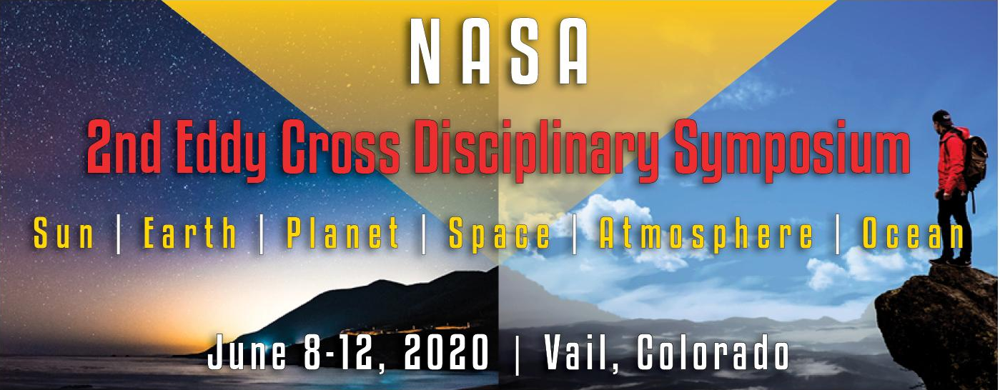
The aim of the 2nd Eddy Cross Disciplinary Symposium is to bring scientists (both early-career and more senior) together, from diverse disciplines, to help define the next decade of helio-physical research, including its implications for planetary and astrophysical objects.

Slide 19
2nd Eddy Cross Disciplinary Symposium
This Eddy Symposium will focus upon techniques for optimizing scientific return to broad questions such as:
How do we tackle the diversity of physical conditions and multi-scale science needed to arrive at a more holistic understanding of heliophysics?
What new threads does solar variability bring within a changed climate?
Agenda Overview:
Monday, June 8 - Wednesday, June 10
General session open to all attendees. Will include talks, discussions, posters, and more.
Thursday, June 11 - Friday, June 12
By invitation only. The final two days will focus on discussions and workshop activities, led by the Eddy fellows, that will focus on defining important and tractable problems ripe for implementation.
https://cpaess.ucar.edu/meetings/2019/symposium-2020

Slide 20
NASA Frontier Development Laboratory

Slide 22
FDL Related Presentations at Fall AGU 2019
Wednesday, 11 December 2019
Time: 08:00 - 12:20
Location: Moscone South - Poster Hall
Paper: Auto-calibration and reconstruction of SDO’s Atmospheric Imaging Assembly channels with Deep Learning
Luiz Fernando Guedes dos Santos
Thursday, 12 December 2019
Time: 13:40 - 18:00
Location: Moscone South - Poster Hall
Paper: Machine learning tools to produce 3D shape models of asteroids from radar observations
Michael Busch
Thursday, 12 December 2019
Location: Moscone South - Poster Hall
Time: 13:40 - 18:00
Paper: An Overview of the NASA Frontier Development Lab 2019: An Applied Artificial Intelligence Accelerator (Invited)
Paul Wright
Tuesday, 10 December 2019
Location: Moscone West – 2012, L2
Time: 12:05 – 12:20
Paul Wright
Super-Resolution Maps of the Solar Magnetic Field Covering 40 Years of Space Weather Events
Tuesday, 10 December 2019
Locations: Moscone South - 208, L2
Time: 14:45 - 14:53
Validating and Cross-Calibrating Long-term Solar Cycle Data for Driving Solar Cycle Models (Invited)
Andres Munoz-Jaramillo
Wednesday, 11 December 2019
Location: Moscone South - Poster Hall
Time: 08:00 - 12:20
Validating and Cross-Calibrating Long-term Solar Cycle Data for Driving Solar Cycle Models (Invited)
Andres Munoz-Jaramillo

