Slide 1
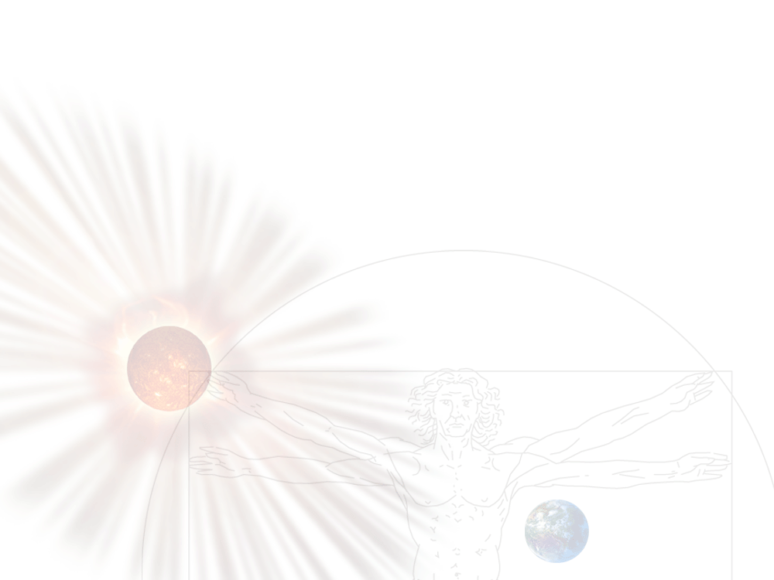
Living with a Star: Opportunities & Challenges for the Next Decade
Madhulika Guhathakurta
Lead Scientist, Living with a Star
Heliophysics Division, NASA HQ
LWS/SDO 2013 Science Workshop
4th March, 2013, Cambridge, MD

Slide 2
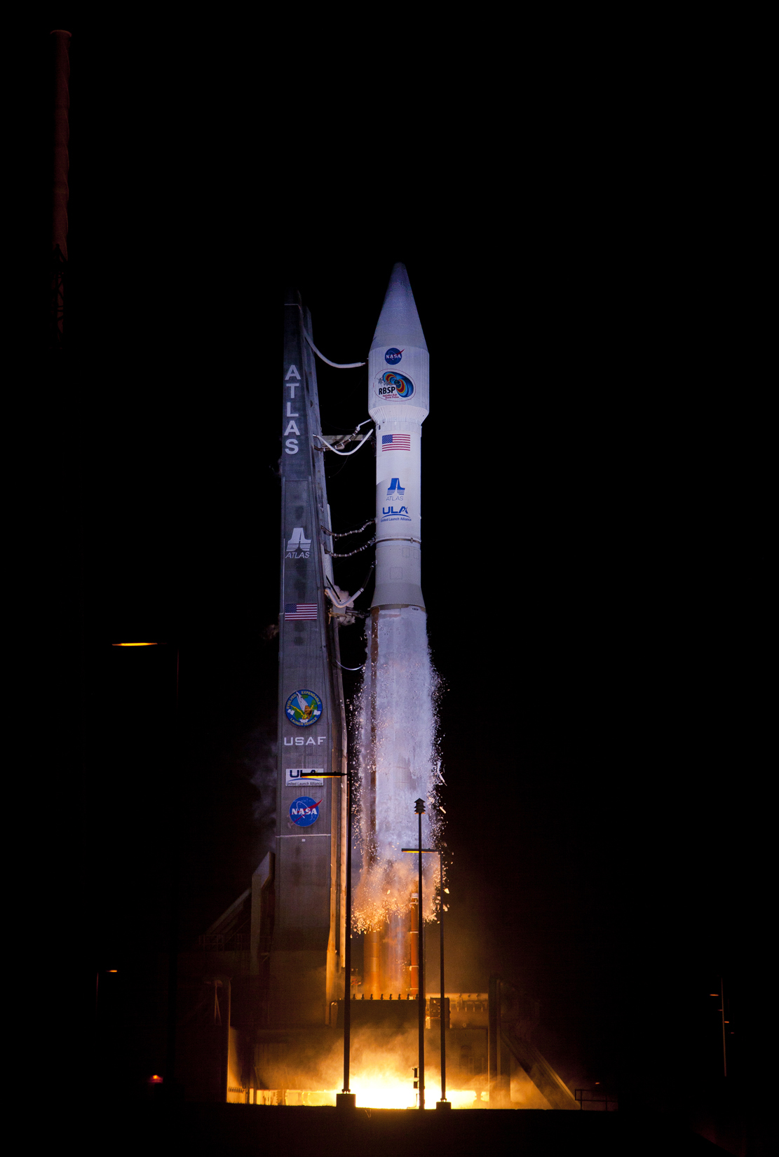
Heliophysics/LWS Recent Accomplishments
NRC Release of Decadal Survey August 15, 2012
RBSP launch on August 30, 2012
Renamed RBSP mission to “Van Allen Probes” after successful commissioning
Congressional Testimony on November 28, 2012 to the House Subcommittee on Space and Aeronautics - National Priorities for Solar and Space Physics Research and Applications for Space Weather Prediction - http://science.house.gov/hearing/subcommittee-space-and-aeronautics-national-priorities-solar-and-space-physics-research-and
Release of NRC Workshop Report: The Effects of Solar Variability on Earth’s Climate - http://www.nap.edu/catalog.php?record_id=13519
NASA / NSF collaboration on space weather modeling
NASA Spacecraft Observed the Transit of Venus on June 5, 2012 as the planet made its final trek across the face of the sun as seen from Earth until the year 2117
International Living With a Star; engagement of the international community (10 year anniversary at UNCOPUOS, 02/14/2012)
Space Weather as a permanent agenda item at UNCOPUOS

Slide 3
Excerpts from the Heliophysics Testimony
From acting chair Mr. Palazzo
…..Our hearing today will focus on the incredible work being accomplished by NASA's Heliophysics Division and on the important operational aspect this research has for space weather prediction at NOAA.
NASA has developed and launched a broad network of spacecraft that allow researchers to better understand the Earth-Sun system. Their findings are used daily to help preserve our technological infrastructure by allowing system operators to better react to variations of the Sun. Building our knowledge in this field is essential for maintaining our way of life on Earth as well as for improving the capability of enabling human exploration beyond the protection of Earth's atmosphere and magnetosphere.
Together with a ground-based infrastructure of solar telescopes managed by the National Science Foundation, NASA and NOAA coordinate critical measurements into useable models that predict how space weather will affect our satellites, electric power grid, airline operators, and more…..
From member Ms. Edwards
…..And Mr. Chairman, I'd be remiss if I didn't mention the budgetary challenges for this research and a crunched budget environment, there are significant implications for our society if we don't continue and expand research in this area. We need to protect these R&D investment, our assets, our quality of life, and our economic strength as a nation depend on this research…..

Slide 4
LWS Future viewed in the context of the past (one solar cycle…or so)
TR&T SDT, 2003 and on-going (~250 M)
Launched SDO, 2/2010
Launched RBSP, 8/2012
Developed curriculum and Heliophysics Text Books
Established Eddy Fellowship for early career scientists
Established Heliophysics Summer School
Started ILWS an inter agency cooperation in 2003
Space Weather is a regular agenda item at UNCOPUOS
Notes:
Almost one solar cycle, accomplished a lot, missing elements are it and sun-climate

Slide 5
LWS Future: Short term
Increasing emphasis on future FSTs on science focused on societal impacts including sun-climate.
4.2 M/year effort of strategic capability to fill gaps and develop end to end space weather models.
Maximize scientific return from SDO & Van Allen Probes.
Lead the UN effort on Space Weather
More inter-agency and international partnership.
More cross-directorate partnership within NASA.

Slide 6
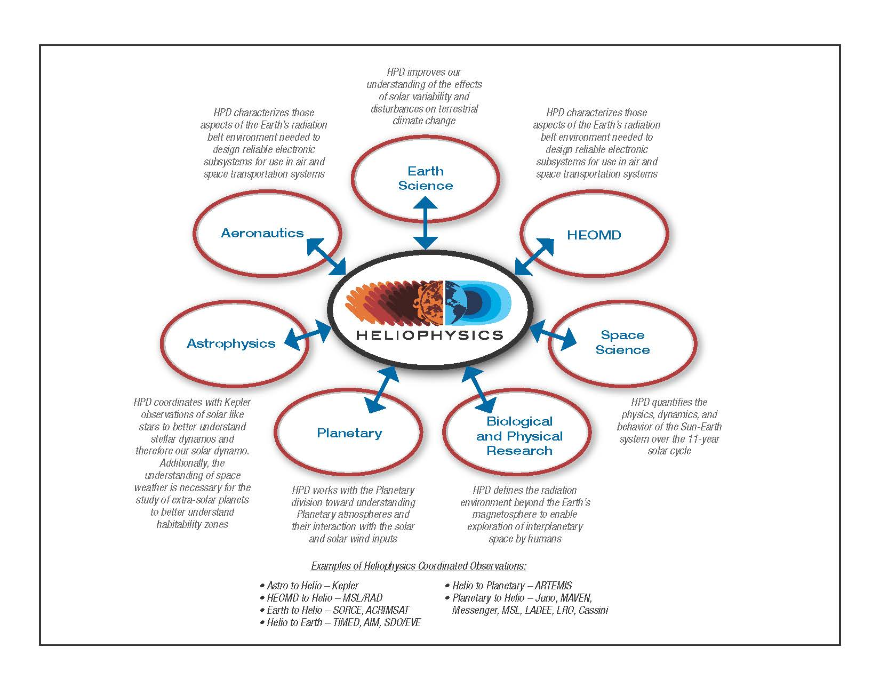
Heliophysics/LWS Coordination with HEOMD, Earth, Planetary, and Astrophysics
6

Slide 7
Future: Medium Term
Solar Probe Plus
Solar Orbiter Collaboration
Support Russia’s Inter-Helio Probe .
These 3 missions will offer a truly unique epoch in heliospheric science. While each mission will achieve its own important science objectives, taken together these 3 spacecraft will be capable of doing the multi-point measurements required to addres problems of CME initiation and propagation, including the large-scale topology and propagation dynamics. In particular, it may be possible to achieve many of the science objectives of previously envisioned multi-spacecraft heliospheric missions, such as NASA's 'Sentinels' concept. We would like to know more about IHP.
Develop appropriate mission concepts to satisfy space weather observational needs.
Implement a robust sun-climate program utlizing feedback from the NRC report.
Strategic Capability emphasizing more societal impacts
Next three text books from summer school.
Developing curriculum for 4 year degree colleges
Interplanetary Space Weather

Slide 8
Societal Needs
Power Grid
Energetic Particles
Particle Precipitation
HF Communication
Single-Frequency Navigation
Dual-Frequency Navigation
Safety of Human and Robotic Explorers in Space

Slide 9
Current Physics Understanding
Climatology (background state) has the measurements available for characterization
  Research into mechanisms continues
Weather (disturbed state) includes solar and geospace storms, plasma structures, wave activity, and plasma instabilities
  Weather characterization and mechanism is main research focus of community

Slide 10
Modeling status
Models now can simulate the progress of a disturbance from the Sun to the Earth
Have we captured the physics?
How well are subgridscale and boundary conditions parameterized?
How accurate are the models?
How acccurate and robust are predictions?

Slide 11
Limitations of Current/Future Space Assets
Need careful evaluation

Slide 12
Future: Long Term
Develop mission formulation that provide observations for space weather needs.
Through UN, establish space weather space and ground-based data sharing world wide.
Introduce Heliophysics at universities world wide.
Interplanetary Space Weather— wherever "society" takes us —

Slide 13
Future?
Interplanetary Space Weather & Climate Program
As human activity expands into the solar system, the need for accurate space weather and climate forecasting is expanding, too. Space probes are now orbiting or en route to flybys of Mercury, Venus, Earth and the Moon, Mars, Vesta, Ceres, Saturn, and Pluto.
As agencies around the world prepare for these missions to send robotic space craft, each of these missions (plus others on the drawing board) has a unique need to know when a solar storm will pass through its corner of space or how the subsequent solar cycles will behave.
Ultimately, astronauts will follow beyond Earth orbit, and their need for interplanetary space weather and climate forecasting will be even more compelling.

Slide 14
Future
Ultimately, expanding the reach of space weather & climate forecasts throughout the solar system will require advances in theory, observations, and computing power.
Recently published series of three volumes entitled the “Heliophysics Lecture Series that deal with this subject matter and the facility called the Community Coordinated Modeling Center (CCMC) are laying the groundwork for the accurate interplanetary forecasts using physics-based models.
The combination of two can really help in a big way to move this interdisciplinary field forward.

Slide 15
If we might be entering into a period of extended low activity, does this mean that we may not have to worry about the sun? Or living with the Sun?
ABSOLUTELY NOT

Slide 16
As the solar cycle unfolds in an unexpected way, it is important to remember that
The Sun is NEVER Boring
To see this, we simply turn the solar cycle sideways:

Slide 17
