Slide 1
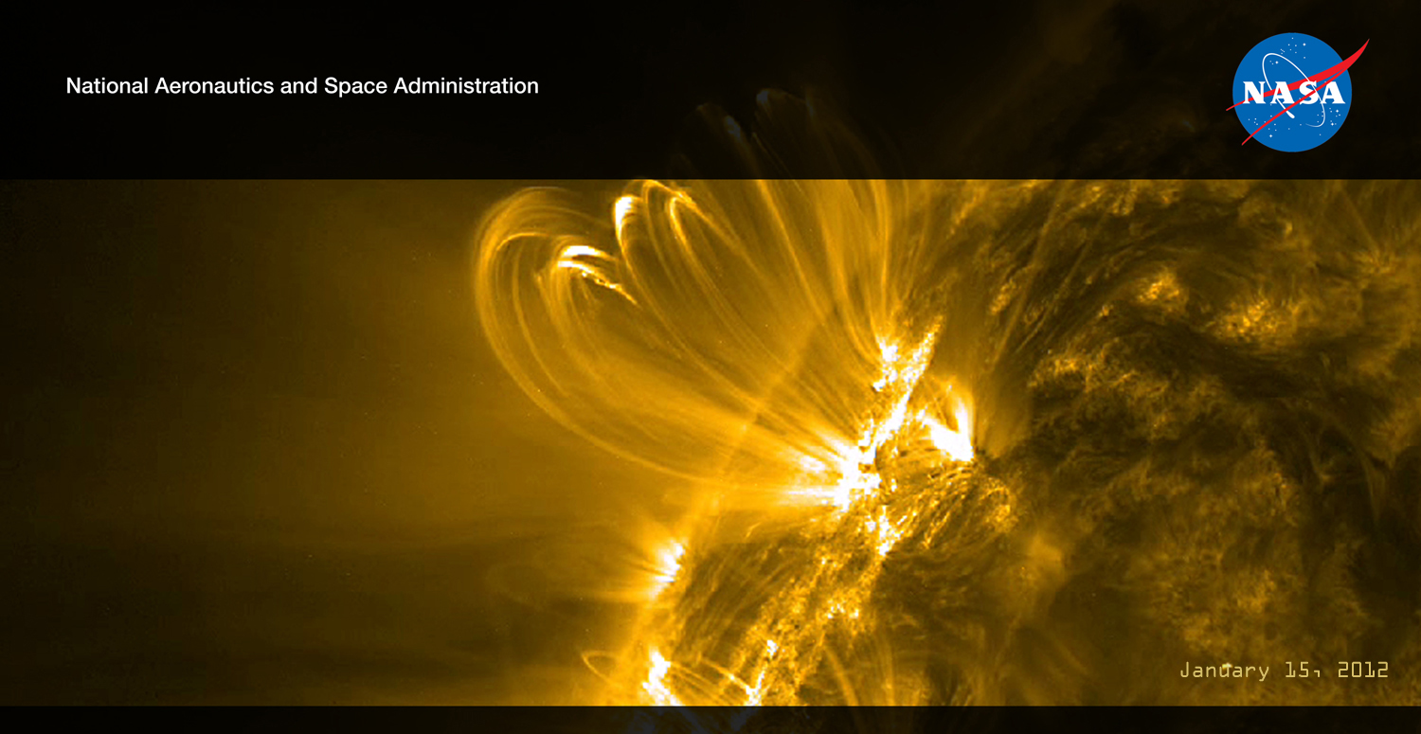
Living with a Star: Science That Matters to People
Living with a Star: Past Accomplishments and Future Promise (2001-…..)
LWS Workshop, November 3rd, 2014)
Understanding the Sun and its interactions with the Earth and the Solar System.
Solve fundamental mysteries of Heliophysics
Understand the nature of our home in space
Build the knowledge to forecast space weather throughout the heliosphere
Madhulika Guhathakurta
LWS Lead Program Scientist, Heliophysics
NASA Headquarters

Slide 2
Why Do Science?
For Utility
No
Yes
For Understanding
Yes
Bohr
Pasteur
No
Edison
From Donald Stokes (Woodrow Wilson School for Public and International Affairs, Princeton University)
The Sun-Earth Connection -- Science in the Pasteur Mode
• How a star works
• How it affects humanity’s home
• How to live with a star

Slide 3
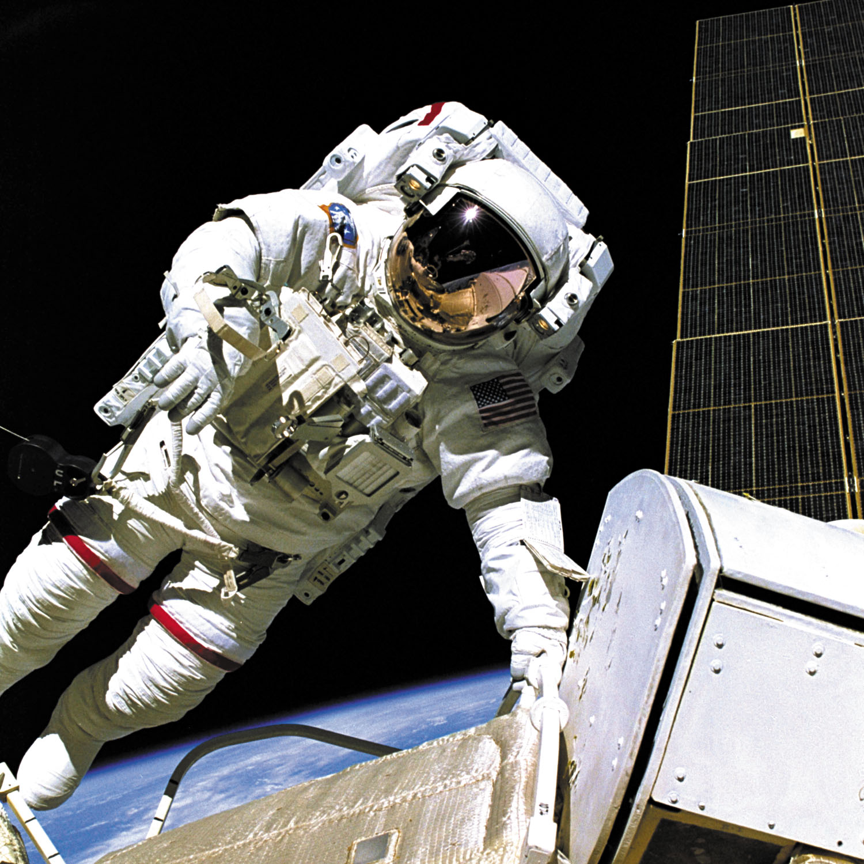
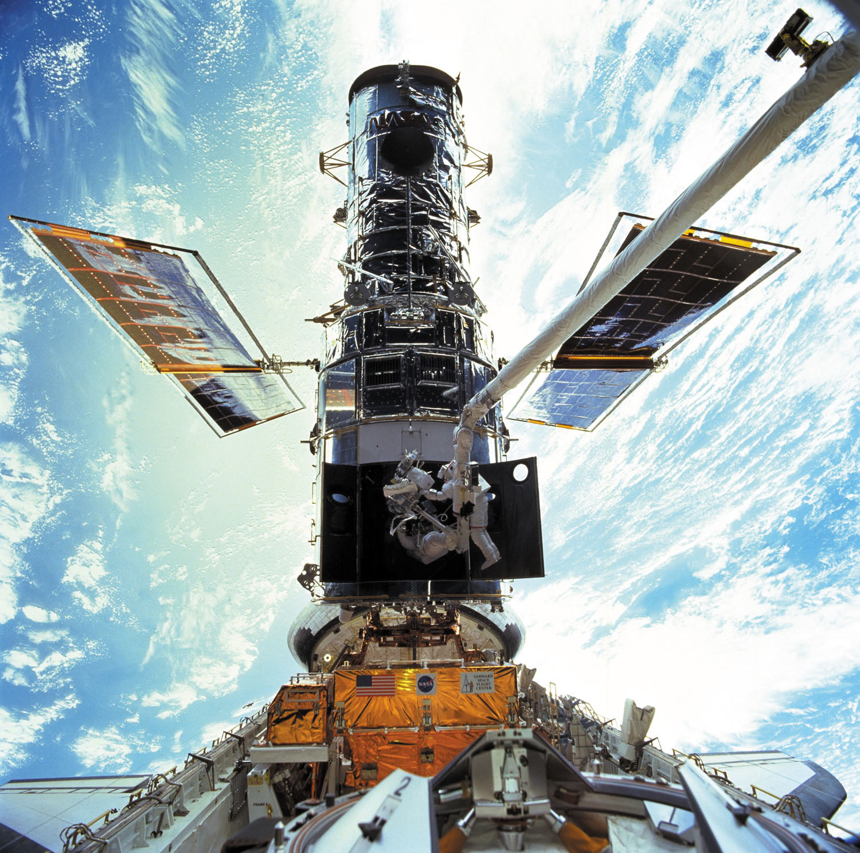

SOCIETAL CONSEQUENCES OF
SOLAR VARIABILITY
Human Radiation Exposure
- Space Station
- Space Exploration and Utilization
- High Altitude Flight
Impacts on Technology
- Space Systems
- Communications, Navigation
- Terrestrial Systems
Terrestrial Climate
- Short Term
- Long Term
3

Slide 4
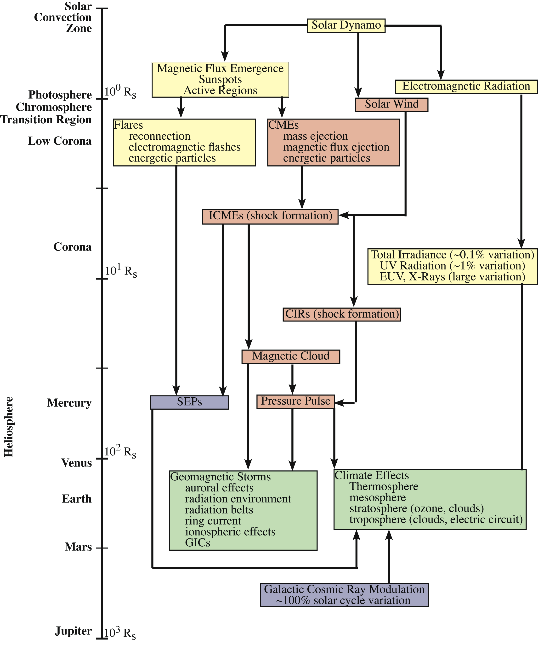
Key Elements of the Strategic Plan

Slide 5
Drivers of Space Weather
Coronal Mass Ejections (CMEs):
Arrive 1- 4 Days later
Last a day or two
Produce Geomagnetic Storms at Earth
Systems Affected
  Radio Communications
  Navigations
  Electric Power Grids
  Pipelines
Solar X-Rays:
Arrive in 8 Minutes
Last minutes to hours
Increases ionosphere density
Systems Affected:
  Radio Communications
  Navigation
High-Speed Solar Wind:
Common During Solar Minimum
Enhances Radiation Belts
Systems Affected
  Satellite Charging
  Astronouts
Solar Energetic Particles:
Arrive in 30 Minutes to 24 hours
Last several days
Systems Affected:
  Astronauts
  Spacecraft
  Airlines
  Radio Communications

Slide 6
Living With A Star
Science
Space Weather
Living With a Star
Global Climate Change

Slide 7
SCIENCE FLOWDOWN
Measurement Definition Issues
What are the required predictive capabilities?
What parameters should be measured?
Where is the best place to measure them?
What models and theory are needed?
What long-term studies of sources of energy from the Sun should be undertaken to advance understanding of solar effects on climate change?
What long-term studies are needed to understand the role of the intermediate regions such as the heliosphere, magnetosphere and the upper atmosphere/ionosphere on climate?
How should development of quantitative models proceed?
7

Slide 8
Strategies for the LWS Science Program
(aka Targeted Research & Technology Program)
Background:
Role of TR&T within LWS as defined by 2003 Science Definition Team
Captures essential difference between LWS and previous science programs
  Program targeted toward the quantitative understanding that can lead directly for utility
Notes:
LWS is a systematic, goal-oriented research program targeting those aspects of the Sun-Earth system that affect life and society.
The TR&T component of LWS is to provide the theory, modeling, and data analysis necessary to enable an integrated, system-wide approach to LWS science.

Slide 9
Present Status
Current Physics Understanding
Modeling status
Climatology (background state) has the measurements available for characterization
  Research into mechanisms continues
Weather (disturbed state) includes solar and geospace storms, plasma structures, wave activity, and plasma instabilities
  Weather characterization and mechanism has been main research focus of community
Models now can simulate the progress of a disturbance from the Sun to the Earth
Have we captured the physics?
How well are subgridscale and boundary conditions parameterized?
How accurate are the models?
How acccurate and robust are predictions?
What is the role of assimilation?

Slide 10
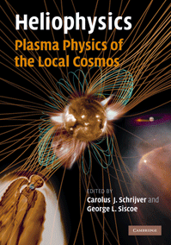
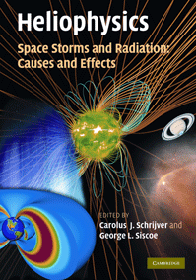
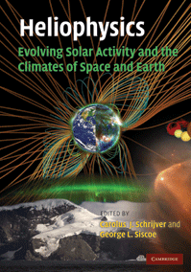
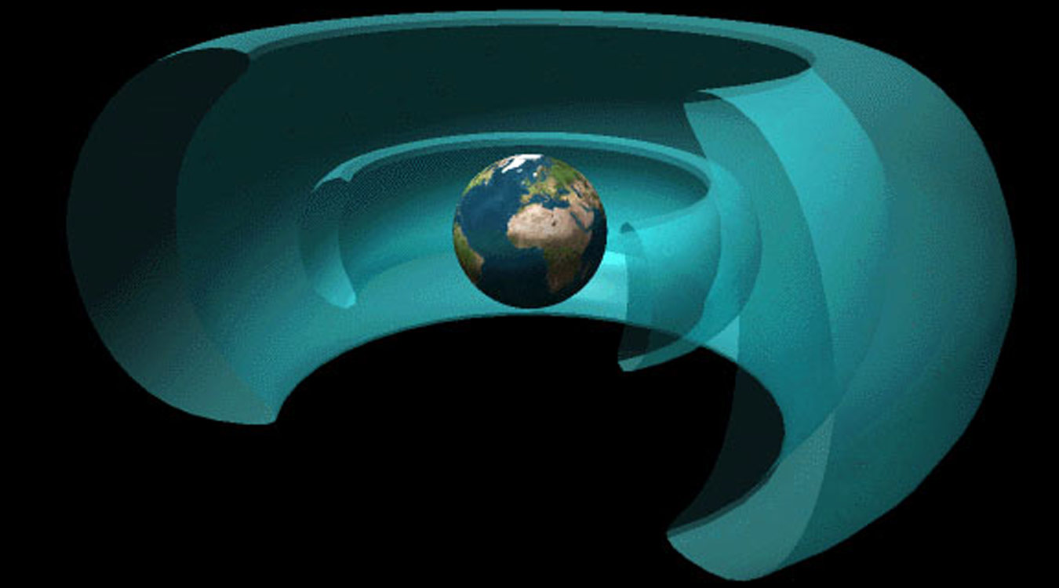
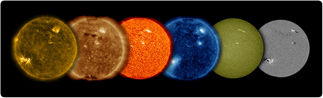
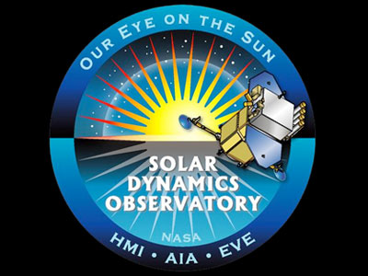
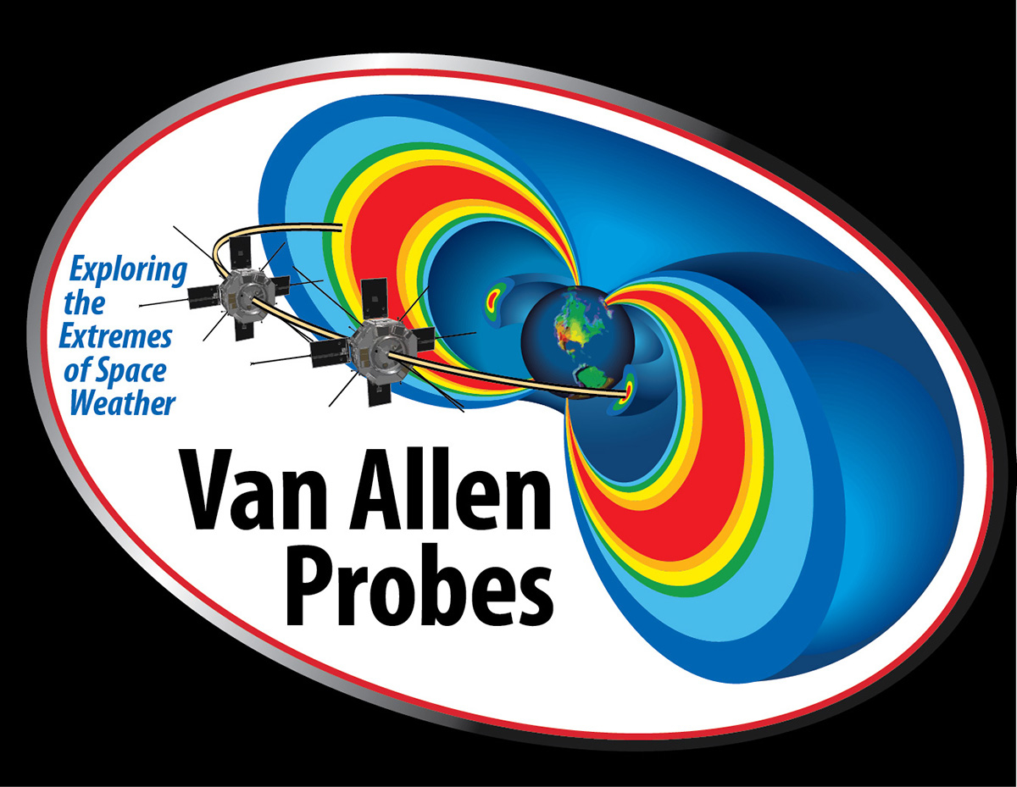
LWS Accomplishments
Heliophysics Institutes:
Interdisciplinary topics chosen annually by steering committee of international experts.
Developed series of heliophysics textbooks – a fourth is in work
LWS missions: Solar Dynamics Observatory, launched in 2010 and Van Allen Probes, launched in 2012

Slide 11
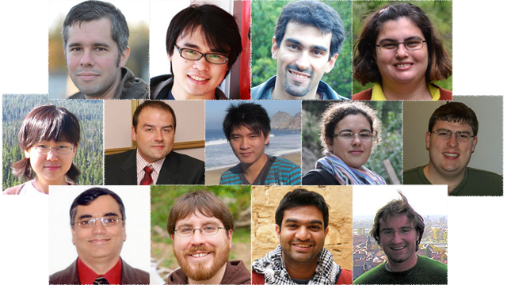
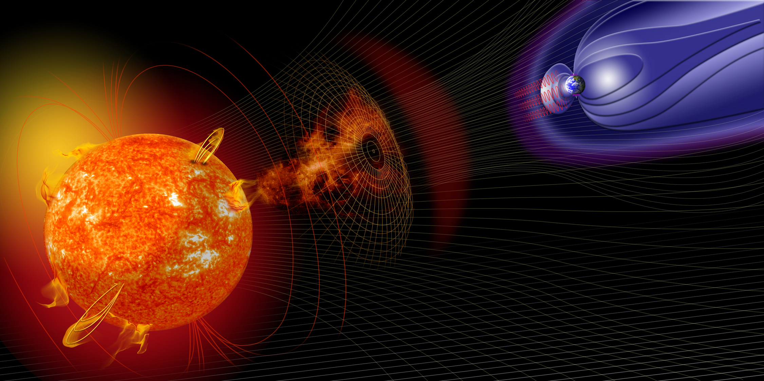
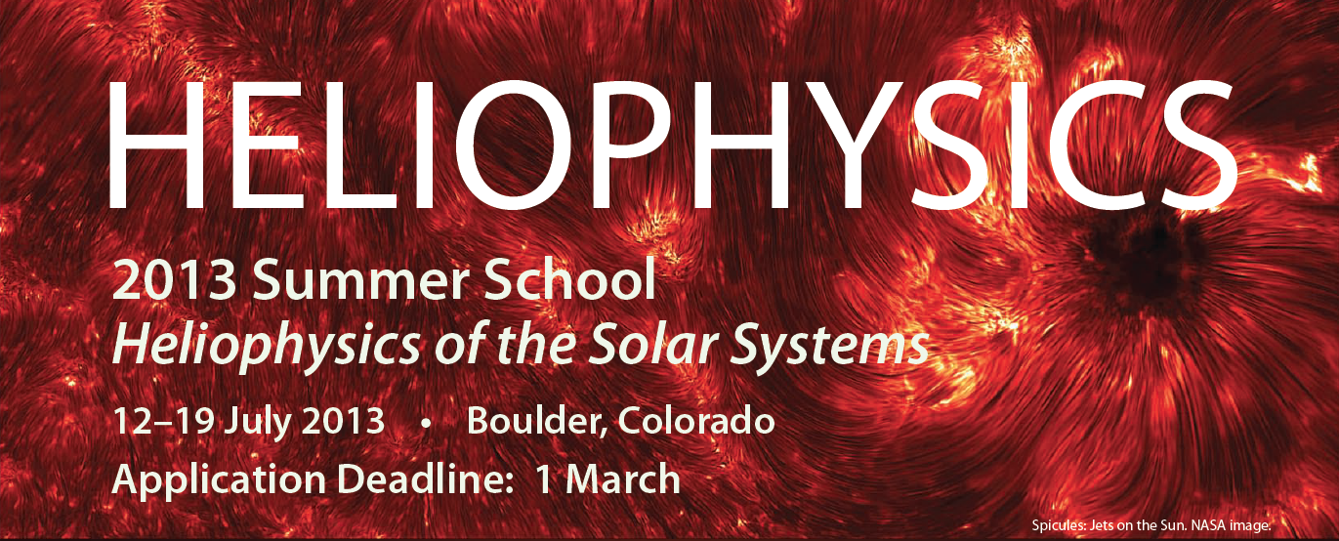
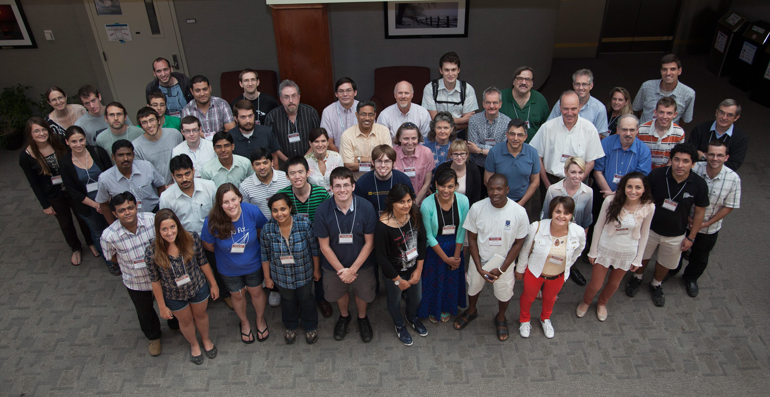
LWS Accomplishments
LWS is training the next generation of interdisciplinary researchers
Over 40 Focused Science Topics &Teams supported in cross-disciplinary over 9 years,
13 Jack Eddy Postdoctoral Fellowship appointments since 2010
Approx. 35 students (graduate & advanced graduate and post docs) attend each year since 2007

Slide 12
LWS Accomplishments
  LWS Targeted Research & Technology Program delivers cutting-edge science that is relevant to life and society

Slide 13
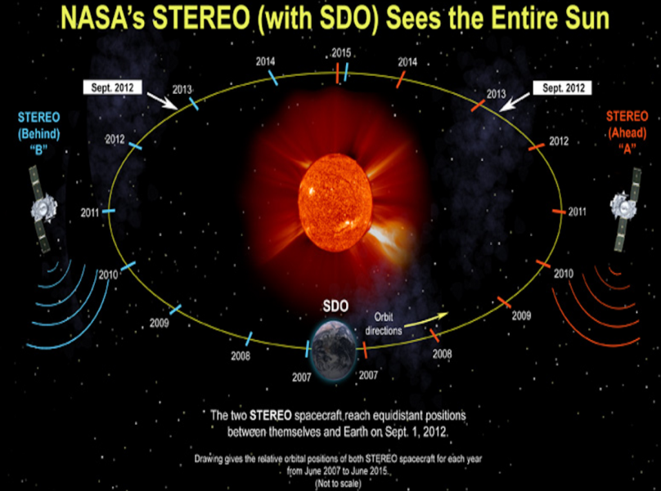
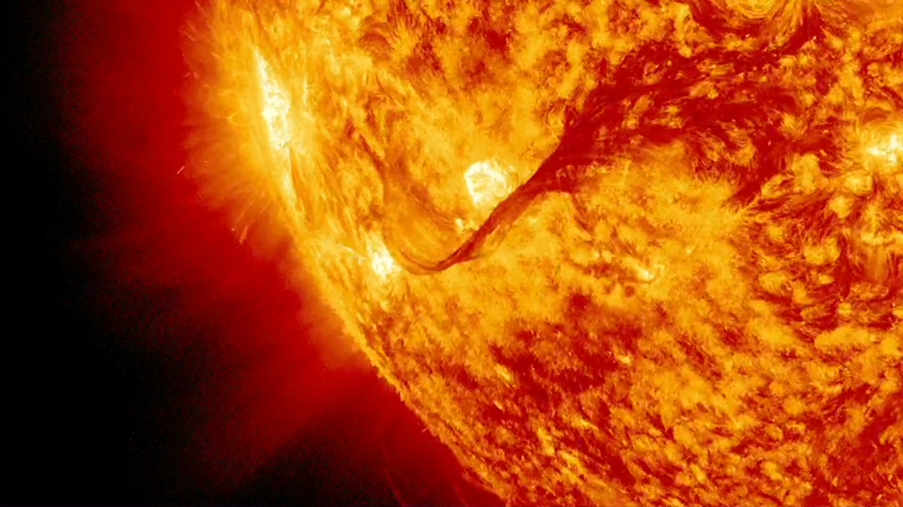
Birth of Interplanetary Space Weather(How new is it?)
February 6, 2011
Until recently, forecasters could scarcely predict space weather in the limited vicinity of Earth. Interplanetary forecasting was even more challenging. This began to change in 2006 with the launch of the twin STEREO probes followed almost four years later by the Solar Dynamics Observatory. Together with SOHO, these spacecraft now surround the sun, monitoring active regions, flares, and coronal mass ejections around the full circumference of the star. No matter which way a solar storm travels, the STEREO-SDO-SOHO fleet can track it.

Slide 14
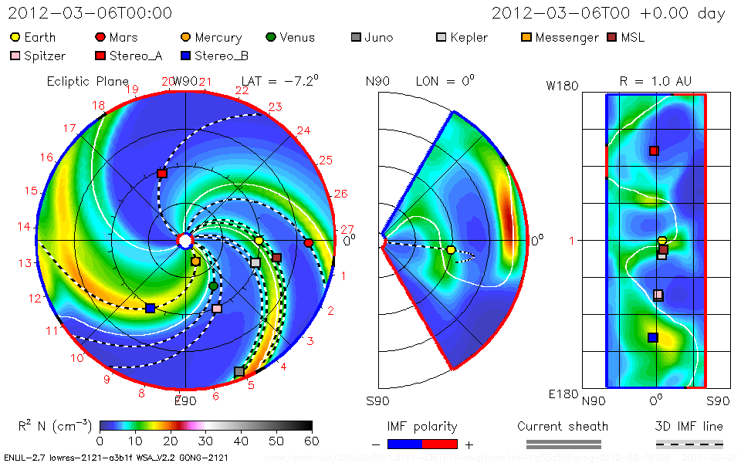
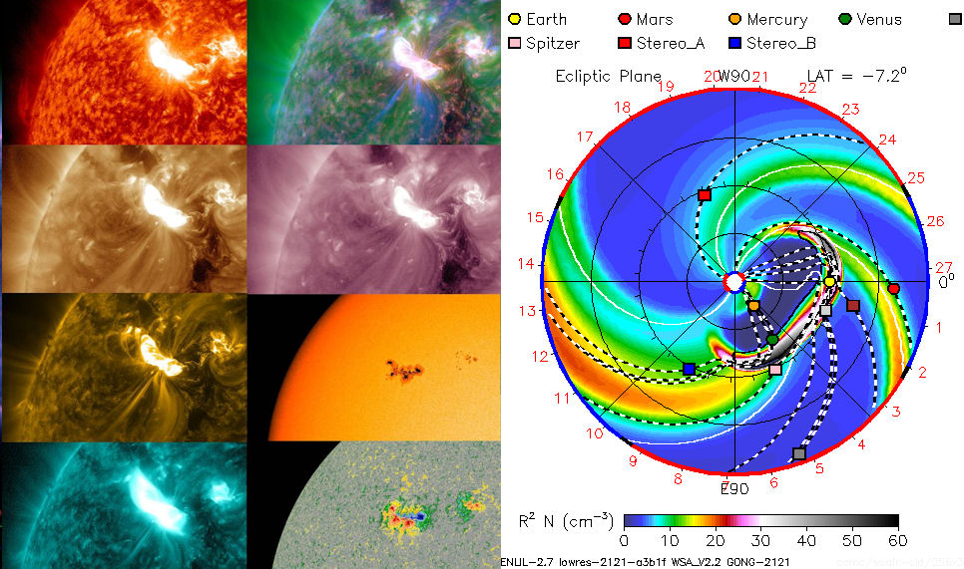
Interplanetary Space Weather & Climate: A New Paradigm
NASA and other space agencies have begun to expand their research into the solar system. Probes are now orbiting or en route to Mercury, Venus, the Moon, Mars, Ceres, Saturn, and Pluto—and it is only a matter of time before astronauts are out there too. Each mission has a unique need to know when a solar storm will pass through its corner of space.
An intense episode of solar activity in March 2012 drove this point home. It began on 2 March with the emergence of sunspot AR1429. For the next 2 weeks, this active region rotated across the solar disk and fired off more than 50 flares, 3 of which were X‐class flares, the most powerful type of flare. By the time the sunspot finally decayed in April 2012, it had done a 360‐degree pirouette in heliographic longitude, hitting every spacecraft and planet in the solar system at least once with either a coronal mass ejection or a burst of radiation. This extraordinary series of solar storms, referred to as the “St. Patrick’s Day storms” caused reboots and data outages on as many as 15 NASA spacecraft.
This highlights NASA’s need for interplanetary space weather forecasting.

Slide 15
Sun Climate Connection
As the scope of space weather forecasting expands to other planets, it is also expanding in directions traditionally connected to climate research. Climate refers to changes in planetary atmospheres and surfaces that unfold much more slowly than individual storms. There is no question that solar activity is pertinent to climate time scales.
The radiative output of the Sun, the size and polarity of the Sun’s magnetic field, the number of sunspots, and the shielding power of the Sun’s magnetosphere against cosmic rays all change over decades, centuries, and millennia.
TSI
Total Solar Irradiance (TSI)
Spectral Solar Irradiance (SSI): SMax vs. SMin
UV
Vis
IR
F10.7
Small variations in the visible (0.1%), but big changes in the UV.
Notes:
Attribute to Lean.

Slide 16
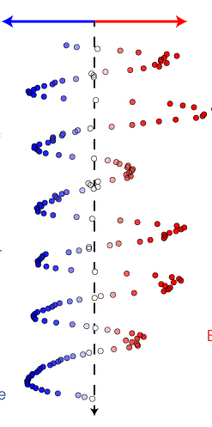
As the solar cycle unfolds in an unexpected way, it is important to remember that
Space Weather Swings Between Extreme Effects &
Occurs at All Phases of the Solar Cycle
Solar La Niña
(low sunspot number)
Solar El Niño
(high sunspot number)
super solar flares
extreme galactic cosmic rays
extreme solar “cosmic rays”
(energetic particles)
rapid accumulation of space junk
radio blackouts
extreme geomagnetic
storms
sharp contraction of the heliosphere
power grid impacts
– power blackouts
collapse of the upper atmosphere
solar wind streams hit Earth
total solar irradiance changes
Illustration shows smoothed monthly sunspot counts from the past six solar cycles plotted horizontally instead of vertically. High sunspot numbers are in red and on the right, low sunspot numbers are in blue and on the left. Associated with each high and low sunspot numbers are different space weather impacts experienced at Earth (Image: Guhathakurta, M. et al, “The Solar Cycle Turned Sideways,” Space Weather, Wiley,
doi: 10.1002/swe.20039
)

Slide 17
Reasons for developing this predictive capability may be divided into three pressing areas:
Human safety is of paramount concern. At the moment, humans are confined to low-Earth orbit where the planetary magnetic field and the body of Earth itself provide substantial protection against solar storms. Eventually, though, astronauts will travel to the Moon, Mars and beyond where natural shielding is considerably less.
Spacecraft operations are also key. Energetic particles accelerated by solar storms can cause onboard computers to reboot, introduce confusing noise in cameras and other digital sensors, or simply accumulate on the surface of a spacecraft until a discharge causes serious problems.
Scientific research could be the greatest beneficiary of interplanetary space weather forecasting. What happens to asteroids, comets, planetary rings and planets themselves when they are hit by solar storms? Finding out often requires looking at precisely the right moment.

Slide 18
Looking Forward
Ultimately, expanding the reach of space weather & climate forecasts throughout the solar system will require advances in theory, observations, and computing power.
Recently published series of three volumes entitled the “Heliophysics Lecture Series that deal with this subject matter and the facility called the Community Coordinated Modeling Center.(CCMC) are laying the groundwork for the accurate interplanetary forecasts using physics-based models.
The combination of two can really help in a big way to move this interdisciplinary field forward.

Slide 19
LWS future viewed in the context of the past (one solar cycle…or so)
TR&T SDT, 2003 and on-going (~250 M)
Launched SDO, 2/2010
Launched RBSP, 8/2012
Developed curriculum and Heliophysics Text Books
Established Eddy Fellowship for early career scientists
Established Heliophysics Summer School
Started ILWS an inter agency cooperation in 2003
Initiated COSPAR/ILWS Space Weather Roadmap Study.
(http://tinyurl.com/swxrm) https://cosparhq.cnes.fr/sites/default/files/executivesummary_compressed.pdf
Initiated Space Weather as a regular agenda item at UNCOPUOS
Notes:
Almost one solar cycle, accomplished a lot, missing elements are it and sun-climate

Slide 20
LWS Future: Short term
Increasing emphasis on future FSTs on science focused on societal impacts including sun-climate.
4.2 M/year effort of strategic capability to fill gaps and develop end to end space weather models.
Maximize scientific return from SDO & Van Allen Probes.
Lead the UN effort on Space Weather
Utilize the COSPAR SWxRM
More inter-agency and international partnership.
More cross-directorate partnership within NASA.
LWS Institues
Implement a robust sun-climate program utilizing feedback from the NRC report and in partnership with NSF and ESD.
Initiate model competion

Slide 21
Comparative Heliophysics
Solar Stellar Connection
Solar Planetary Connection
Tools originally developed for the Sun are now becoming broadly applicable to stars
Technical breakthroughs in stellar astrophysics now permit us to place solar questions in a broad astrophysical context
Seismology is now a powerful tool for both the Sun and stars
Deep time-domain studies are placing the Sun in context
  Magnetism impacts structure
  Future prospects: butterfly diagrams, rotation-age diagnostics
Differential rotation measurements indicate that the solar pattern is not universal
New stellar capability: magnetic topology reconstruction
Each of the rocky planets with atmospheres in our solar system has a climate and also experience space weather. Initial conditions, climate forcing, climate feedbacks, solar wind interactions are all different on these worlds, resulting in environments that are radically different from Earth’s.
TOPICS
1. Climate and atmosphere
2. Clouds, hazes, and precipitation
3. Interior-surface-atmosphere interactions
4. Solar-atmosphere interactions
1.What is the observational evidence for climate change on the terrestrial planets?
2. How do variations in solar output affect the climates of the terrestrial planets?
3. How are energy balance and atmospheric dynamics coupled on Venus, Earth, Titan, and Mars?

Slide 22
Future: Medium Term
Solar Probe Plus
Solar Orbiter Collaboration
Support other ILWS missions such as Aditya from India, Inter-Helio Probe Russia.
In light of constrained budgetary environment develop appropriate small mission concepts to satisfy space weather model/observational needs.
Implement a robust sun-climate program utilizing feedback from the NRC report and in partnership with NSF and ESD.
Invest in Strategic Capability emphasizing more societal impacts.
Next text book from the summer school on Comparative Heliophysics.
Develop curriculum for 4 year degree colleges
Continue developing the interdisciplinary science of “Interplanetary Space Weather”

Slide 23
Looking Forward: O2R: High Priority Goals for
Space Weather Research
Forecasts of solar flares (timing and magnitude)
Forecasts of Solar Energetic Particle (SEP) events and radiation storms at Earth
Specification and forecasts of the radiation levels at LEO and aircraft altitudes
Forecasts of Bz with a CME when it arrives at Earth
Spatially resolved forecasts of geomagnetic storm impacts
Forecasts of the location and intensity of the Aurora
Forecasts of ionospheric scintillations and TEC gradients

Slide 24
Looking Forward: New HSO Components
Addition of new HSO component where each component need not carry a comprehensive payload
  The network can grow serendipitously, with key measurements made on distributed platforms
  Single instrument MOOs
  Cubesats dedicated to one or two instruments
  Individual measurement sets add value by complementing the existing network
In addition, we need techniques to assess the value of additional components to the HSO as a whole
  Models of data assimilation effectiveness
  What is the minimum infrastructure?
  How can we assess and maintain system reliability?

Slide 25
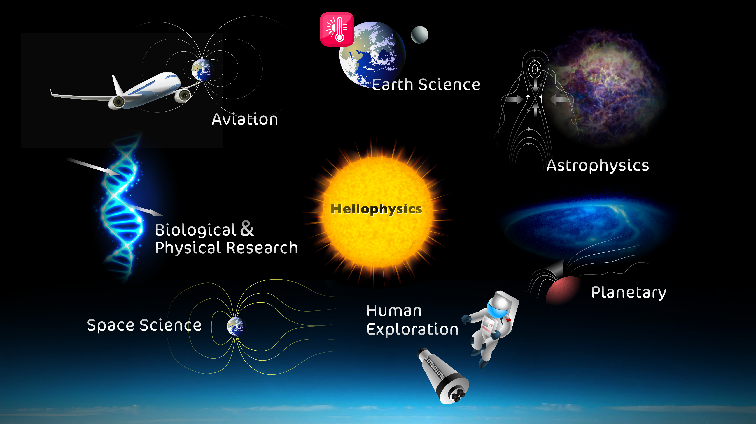
Characterizes Earth’s radiation environment to design reliable electronic subsystems for use in air and space transportation systems
Solar variabiity
On global/regional climate
Solar-stellar connectio,
Habitability of exoplanets
Understanding /modelingradiation from SEPs & GCRs
LWS
Planetary atmospheres
and their interactions with solar variabilty,(climate & weather)
Quantifies the physics, dynamics, and behavior of the Sun-Earth system over the 11-year solar cycle
Predict solar energetic particle events that affect the safety of humans and technology in space

