Slide 1
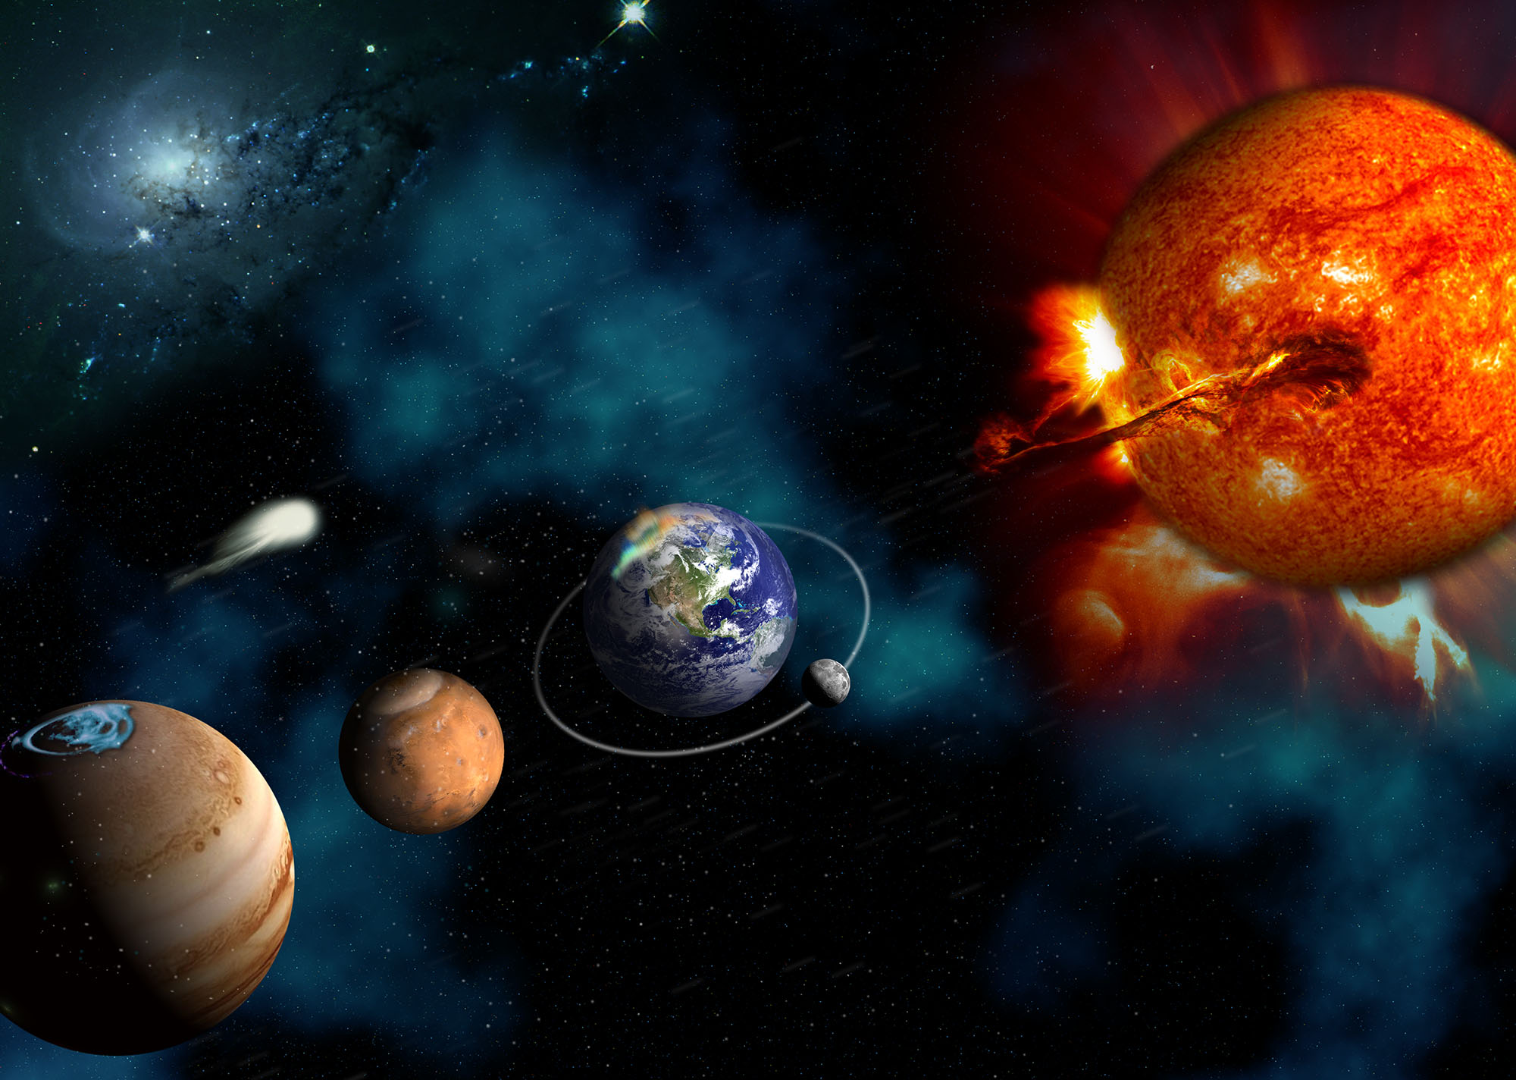
National Aeronautics and Space Administration
NASA LWS Town Hall
Fall AGU meeting, New Orleans, LA
13 December 2017
Notes:
I’m here to bring you news about relevant programs at NASA.
Jeff Morrill is the program manager for LWS, I’ve just become the LWS program scientist. Still learning the ropes.
Elsayed is the Chief Scientist in Heliophysics

Slide 2
LWS Town Hall Agenda Wed, Dec 13, 0630-0845 pm
Item | Time | Agenda Item | Presenter
1 | 0630 | Welcome | Peg Luce/Elsayed Talaat
2 | 0635 | LWS Status | Jeff Morrill
3 | 0645 | GDC Status | Jared Leisner
4 | 0655 | LWS Activities | Lika Guhathakurta
5 | 0710 | Science Centers, SWAP, LWS | Janet Kozyra
6 | 0725 | Why LPAG | Jeff Morrill
7 | 0735 | Future LPAG Activities | Eftyhia Zesta & Mark Linton
8 | 0750 | FST: Interplanetary Structures & Radiation Belts | Mei Ching Fok
9 | 0805 | FST: RAISE | Stan Solomon
10 | 0820 | Open Discussion | All
11 | 0845 | ADJOURN

Slide 3
LWS Town Hall Agenda Wed, Dec 13, 0630-0845 pm
Item | Time | Agenda Item | Presenter
1 | 0630 | Welcome | Peg Luce/Elsayed Talaat
2 | 0635 | LWS Status | Jeff Morrill
3 | 0645 | GDC Status | Jared Leisner
4 | 0655 | LWS Activities | Lika Guhathakurta
5 | 0710 | Science Centers, SWAP, LWS | Janet Kozyra
6 | 0725 | Why LPAG | Jeff Morrill
7 | 0735 | Future LPAG Activities | Eftyhia Zesta/Mark Linton
8 | 0750 | FST: Interplanetary Structures & Radiation Belts | Mei Ching Fok
9 | 0805 | FST: RAISE | Stan Solomon
10 | 0820 | Open Discussion | All
11 | 0845 | ADJOURN

Slide 4
Some Heliophysics Division News
New (and relatively new) faces:
Janet Kozyra (IPA -recently joined NASA from NSF)
Jared Leisner (Fed - hired from NASA PSD - Jan. ‘17)
Terry Onsage (Detailee from NOAA)
Jim Spann (Detailee from MSFC)
Roshanak Hakimzadeh (Detailee from Glenn)
Ekaterina (Katya) Verner (Contractor)
Galen Fowler (Contractor)
Thanks to departing Detailees (returning to GSFC):
EJ (Errol) Summerlin
Liz MacDonald

Slide 5
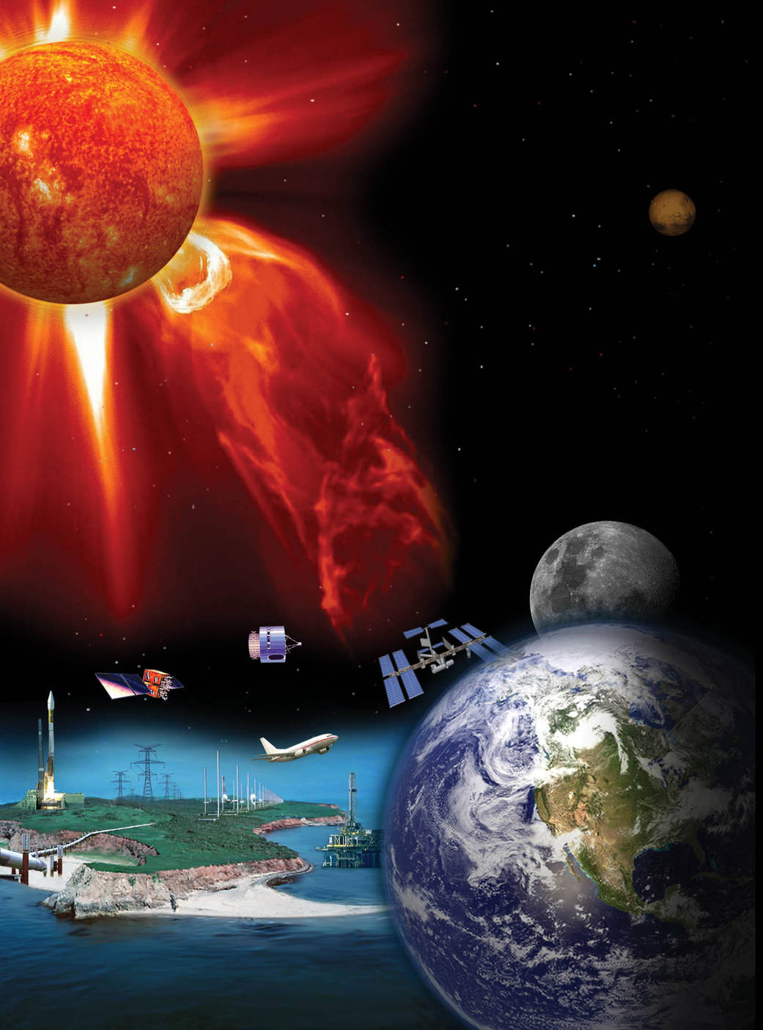
Living With A Star (LWS)
Objectives are to understand (and model):
The variable sources of mass and energy from our Star
The associated reactions of heliospheric and geospace regions and
The implications for life and habitability at the Earth and beyond.

Slide 6
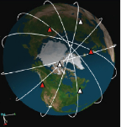
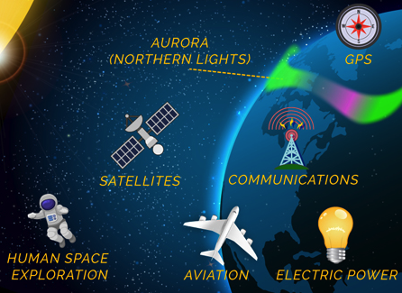
Living with a Star program elements
LWS Institutes, Fellowships, Summer School
Multi-Agency & Int’l Partnerships, Space Weather Opportunities
Strategic Missions
Targeted Research
Strategic Capabilities
Smaller Flight Programs, Competed Science Topics, often PI-led
Scientific Research Projects Utilizing Existing Data, plus Theory and Modeling
Geospace Dynamics Constellation “System behavior of the coupled ionosphere- thermosphere”
RFI & GDC STDT
ROSES-16 selections.
ROSES-17 solicitation
Distribution of FSTs vs SAAs
ROSES-18 FSTs
Creation of future FSTs
Large scale models joint with NSF 2013-2018
Future plans under consid-eration (topic for LPAG)
LWS Institutes bridge cutting-edge helio-physics research & societally rele-vant technology Proposal dead-line 1 Nov 2017
2018 Call - Jack Eddy Fellowships
SWAP-related activities. Also augments TR&T efforts that address space weather
Solicitation for Tri-Agency O2R 1-year testbed - soon
Future plans
06:45 Jared
This presentation & LPAG Chairs
06:55 Lika
07:10 Janet

Slide 7
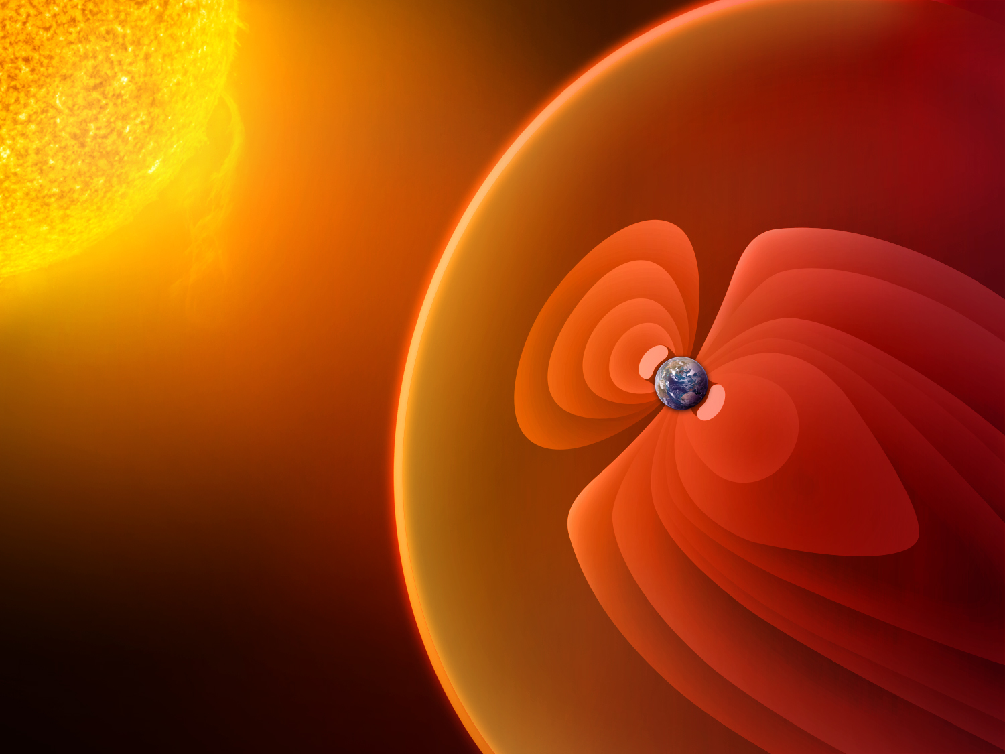
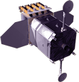
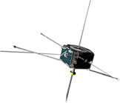
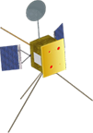
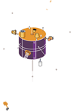
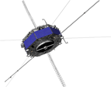
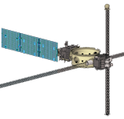
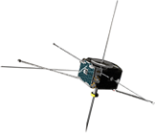
LWS Missions
STEREO (2)
Formulation
Implementation
Operating
In Development
RHESSI
Primary Ops
Extended Ops
SOHO (ESA)
ACE
GOLD
ICON
SDO
AIM
IBEX
July 2018
Van Allen Probes (2)
Solar Probe Plus
Voyager (2)
TIMED
TWINS (2)
Feb 2019
THEMIS (3)
Hinode (JAXA)
Solar Orbiter (ESA)
Geotail (JAXA)
WIND
Apr 2018
ARTEMIS (2)
MMS (4)
SET-1
IRIS
Notes:
Heliophysics Fleet (with Color Key) - editable
Updated Feb. 5, 2016
Credit: NASA/J. Mottar

Slide 8
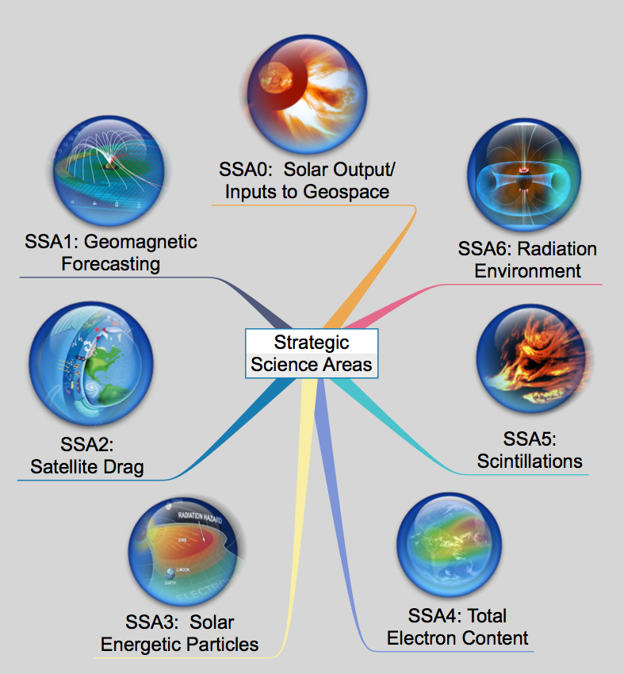
LWS Strategic Science Areas (SSA)
Strategic Science Areas (SSAs) from which Focus Science Topics (FSTs) are chosen.
Notes:
SSA-0, Physics-based forecating of solar electromagnetic, energetic particle and plasma outputs
Enable forecast capabilities across temporal scales (years to centuries) for the variability of solar magnetism, focused on processes that drive formation, interaction, and emergence of magnetic flux systems within the solar interior and their implications for the space environment and responses of Earth’s atmosphere.
SSA-1, Physics-based Geomagnetic Forecasting Capability
Enable1-3 day (long lead-time) and 15-30 min (short lead-time) predictions of pending extreme fluctuations in geomagnetic field
SSA-2, Physics-based Satellite Drag Forecasting Capability
Enable specification of the global neutral density in the thermosphere and its variations over time
SSA-3, Physics-based Solar Energetic Particle Forecasting Capability
Probabilistic prediction of the intensity of SEP events, and increased time periods for all-clear forecasting capability with higher confidence level
SSA-4, Physics-based TEC Forecasting Capability
Enable specification of the global ion density in the topside ionosphere and plasmasphere and its variations over time under varying geomagnetic conditions
SSA-5, Physics-based Scintillation Forecasting Capability
Enable prediction of scintillation occurrence utilizing limited sources of available data and ascertain how radio signals are degraded by ionospheric irregularities
SSA-6, Physics-based Radiation Environment Forecasting Capability
Enable predictive capability for the radiation environment and its effective dose as well as dose rates based on GCR, SEP, cutoff rigidity, atmosphere density, and gamma-ray/X-ray inputs

Slide 9
DRIVE implemented in FY18 President’s Budget
$M |  | FY16 | FY17 | FY18 | FY19 | FY20 | FY21 | FY22
Sounding Rocket Program Office | FY15 PBR | 48.3 | 53.0 | 53.0 | 53.0
 | FY18 PBR | 49.8 | 53.3 | 59.0 | 61.1 | 63.1 | 63.1 | 63.1
Guest Investigator | FY15 PBR | 8.0 | 8.0 | 8.0 | 8.0
 | FY18 PBR | 10.5 | 11.6 | 15.2 | 20.0 | 20.0 | 20.0 | 20.0
Research & Analysis (HSR, H-TIDeS, H-GCR) | FY15 PBR | 34.0 | 33.9 | 33.9 | 33.9
 | FY18 PBR | 36.3 | 39.4 | 49.9 | 58.2 | 58.6 | 58.6 | 58.6
LWS Science | FY15 PBR | 17.5 | 17.5 | 17.5 | 17.5
 | FY18 PBR* | 18.4 | 21.9 | 29.0 | 35.5 | 35.3 | 35.3 | 35.3
* Includes $5M/yr Space Weather Funding for FY17 and beyond

Slide 10
HPD ROSES16 Status
ELEMENT | STEP 1 PROPOSALS | STEP 2 PROPOSALS | AWARDS [Expected] | 1st Year Funding (~ Amt.) | Success Rate (~ % )
B.2 H-SR | 235 | 212 | 31 | $6.3M | 15
B.3 H-TIDeS | 87 | 71 | 13 | $5.3M | 18
B.4 H-GI Open | 197 | 181 | 33 | $3.0M | 18
B.5 H-GCR TMS | 44 | 40 | 10 | $4.4M | 25
B.6 H-LWS | 74 | 63 | 20 | $4.3M | 32
B.7 H-DEE | 28 | 24 | 7 | $0.5M | 29
B.8 H-GI MMS | 57 | 40 | 11 | ($1.3M) | 28
B.9 H-GCR SC | PPD ROSES17 | PPD ROSES17 | - | -
B.10 H-USPI | 7 | 5 | (2) | ($0.4M) | (40)
E.5 ISE | 41 | 39 | 11 | $0.95M | 28
Success rate = # proposals funded / # STEP 2 proposals received x 100

Slide 11
FST Development and Selection Process w/ Steering Committee (ROSES 2016)
Community Input
Steering Committee
St Cp+FST >FST
2 FSTs from SC Report w/ Mods
Concerns about Impact of FACA
Available Budget
NASA HPD
7 FST
1 Strategic Capability
Selected3 FSTs
Advances Toward a Near Real Time Description of the Solar Atmosphere and Inner Heliosphere
Characterization of the Earth’s Radiation Environment
Studies of the Global Electrodynamics of Ionospheric Disturbances.
Notes:
New process demonstrated in ROSES 2017 development.
Steering Committee discussed and recommended a process which involved significant community input. Heliophysics Subcommittee (HPS) approved this process.
Community provided ~ 60 inputs to the Steering Committee. These were used to develop a set of 15 Focused Science Topics (FST).
These FSTs were presented by the Steering Committee to the HPS which provided a ranking of these FSTs.
Heliophysics staff compared the current 15 FSTs to FSTs that appeared in recent ROSES announcement (past 5 – 6 years).
Based on the HPS ranking, available funds, and recently selected topics, the following four FSTs were selected.

Slide 12
FST Development and Selection Process w/ Steering Committee (ROSES 2017)
Community Input
Steering Committee
NASA HPD
Past FSTs (5-6 years)
Available Budget
Heliophysics Advisory Committee
60 inputs
15 FSTs
Ranked FST List
Understanding The Onset of Major Solar Eruptions
Toward a Systems Approach to Energetic Particle Acceleration and Transport on the Sun and in the Heliosphere
Ion Circulation and Effects on the Magnetosphere and MI-Coupling
Selected4 FSTs
Understanding Physical Processes in the Magnetosphere & Ionosphere Thermosphere / Mesosphere System During Extreme Events
Notes:
New process demonstrated in ROSES 2017 development.
Steering Committee discussed and recommended a process which involved significant community input. Heliophysics Subcommittee (HPS) approved this process.
Community provided ~ 60 inputs to the Steering Committee. These were used to develop a set of 15 Focused Science Topics (FST).
These FSTs were presented by the Steering Committee to the HPS which provided a ranking of these FSTs.
Heliophysics staff compared the current 15 FSTs to FSTs that appeared in recent ROSES announcement (past 5 – 6 years).
Based on the HPS ranking, available funds, and recently selected topics, the following four FSTs were selected.

Slide 13
FST Development and Selection Process w/ Steering Committee (ROSES 2018)
Community Input
Steering Committee
NASA HPD
Past FSTs (5-6 years)
Available Budget
Heliophysics Advisory Committee
60 inputs
15 FSTs
11 Remaining FSTs from Original List
Mid-latitude and Equatorial Dynamics of the Ionosphere-Thermosphere System
Origins, Acceleration and Evolution of the Solar Wind
Understanding the Response of Magnetospheric Plasma Populations to Solar Wind Structures
Selected4 FSTs
Understanding Global-scale Solar Processes and their Implications for the Solar Interior
Notes:
New process demonstrated in ROSES 2017 development.
Steering Committee discussed and recommended a process which involved significant community input. Heliophysics Subcommittee (HPS) approved this process.
Community provided ~ 60 inputs to the Steering Committee. These were used to develop a set of 15 Focused Science Topics (FST).
These FSTs were presented by the Steering Committee to the HPS which provided a ranking of these FSTs.
Heliophysics staff compared the current 15 FSTs to FSTs that appeared in recent ROSES announcement (past 5 – 6 years).
Based on the HPS ranking, available funds, and recently selected topics, the following four FSTs were selected.

Slide 14
New FST Development and Selection Process (ROSES 2019 and Beyond)
Community are LPAG members
Acts as Executive Committee
Community Input
LWS Program Analysis Group (LPAG)
NASA HPD
Past FSTs (5-6 years)
Available Budget
SelectedFSTs
NB: Details of this process will be discussed in a later presentation
Notes:
New process demonstrated in ROSES 2017 development.
Steering Committee discussed and recommended a process which involved significant community input. Heliophysics Subcommittee (HPS) approved this process.
Community provided ~ 60 inputs to the Steering Committee. These were used to develop a set of 15 Focused Science Topics (FST).
These FSTs were presented by the Steering Committee to the HPS which provided a ranking of these FSTs.
Heliophysics staff compared the current 15 FSTs to FSTs that appeared in recent ROSES announcement (past 5 – 6 years).
Based on the HPS ranking, available funds, and recently selected topics, the following four FSTs were selected.

Slide 15
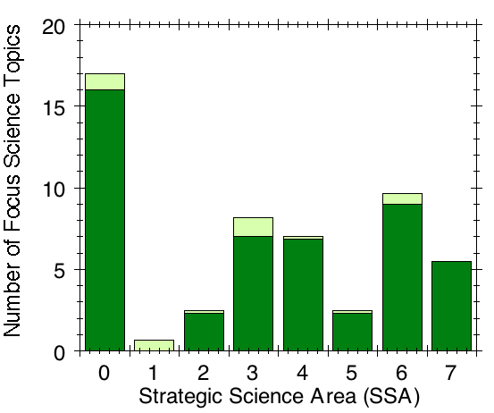
LWS Focus Science Topics Related to Each Strategic Science Area (2004 - upcoming 2017)
Solar Outputs /Geospace Inputs
4 FSTs in ROSES-17
53 FSTs Total
2017 LWS Institute
Solicited 2017
2004-2016
2016 LWS Institute
Scintillations
(FSTs)
Ionizing Radiation
2015 LWS Institute
SEPs
TEC
Note: Some FSTs fall under multiple SSAs. Counted as fractional FSTs that sum to 1.0
Sun/ Climate
Satellite Drag
GICs

Slide 16
ROSES – 16 Selections
ROSES 2016 LWS FSTs developed incorporating inputs from previous Steering Committee reports and informed by SWAP science priorities.
Proposals were due November 2016.
A total of 63 Step-2 proposals were received by NSPIRES.
Three FST Teams were selected composed of a total of 20 proposals.
Kickoff Workshop planned
All new FST teams will meet and develop comprehensive work plans for team member activities.
Goal is to have teams produce a clear set of targets and plan of action at the outset of the FST.

Slide 17
ROSES-16: New FST Teams
FST1
Advances towards a near real time description of the Solar atmosphere & inner heliosphere
FST2
Characterization of the Earth’s radiation environ-ment
FST3
Studies of the global electrodynamics of ionospheric disturbances
LWS Team
DeForest (SRI),
Schuck (GSFC),
Leake (GSFC),
Sokolov (UMich),
Gibson (NCAR),
Warren (NRL),
Jackson (UCSD), Gopalswamy (GSFC)
LWS Team
Denton (SSI)
Tenishev (UMich)
Tobiska (SET)
Ukhorskiy (JHU APL)
Glocer (GSFC)
Elkington (LASP, CU)
LWS Team:
Verkhoglyadova (JPL)
LU (NCAR)
Fang (CU)
Raeder (UNH)
Sazykin (UT Dallas)
Crowley (ASTRA)

Slide 18
2017 ROSES – LWS TR Solicitation
ROSES 2017 LWS Step-1 and Step-2 submissions delayed until after the ROSES 2016 selections.
Delay in part due to delay in announcement of NASA budget.
Revised ROSES 2017 LWS Amendment to be announced shortly. Four chosen FST topics not altered. Changes:
Location of the “Relevance Discussion” & it’s evaluation
Clarification of the data usage for LWS FST studies.
Target dates
Step-1 12/05/17 (Received 136 Step-1 proposals)
Step-2 02/06/18
Currently reviewing Step-1 proposals for relevance. PI will be notified once review is complete

Slide 19
2017 ROSES – LWS TR Solicitation
ROSES 2017 LWS Step-1 Submissions
Step-1 Proposals have been submitted
136 Step-1 Proposals were submitted
~ 18 to 22 to be funded
~ 13% to ~ 16% average success rate
(1) Understanding the Onset of Major Solar Eruptions
(34 Proposals submitted, 4-5 to be funded > 5/32 ~ 15% Success Rate)
(2) Toward a Systems Approach to Energetic Particle Acceleration and
Transport on the Sun and in the Heliosphere
(39 Proposals submitted, 5-6 to be funded > 6/39 ~ 15% Success Rate)
(3) Ion Circulation and Effects on the Magnetosphere and Magnetosphere
– Ionosphere Coupling
(20 Proposals submitted, 4-5 to be funded > 5/20 ~ 20% Success Rate)
(4) Understanding Physical Processes in the Magnetosphere--Ionosphere / Thermosphere / Mesosphere System during Extreme Events
(43 Proposals submitted, 5-6 to be funded ~ 14% Success Rate)

Slide 20
2018 ROSES: Draft LWS FSTs / Dates
ROSES 2018 Draft FSTs
Mid-latitude and Equatorial Dynamics of the Ionosphere-Thermosphere System
Origins, Acceleration and Evolution of the Solar Wind
Understanding the Response of Magnetospheric Plasma Populations to Solar Wind Structures
Understanding Global-scale Solar Processes and their Implications for the Solar Interior
Step-1 and Step-2 Due Dates
Target dates
Step-1 ~ May/June 2018 -After ROSES 2017 Selection
Step-2 ~ Late Summer 2018

Slide 21
LWS Town Hall Agenda Wed, Dec 13, 0630-0845 pm
Item | Time | Agenda Item | Presenter
1 | 0630 | Welcome | Peg Luce/Elsayed Talaat
2 | 0635 | LWS Status | Jeff Morrill
3 | 0645 | GDC Status | Jared Leisner
4 | 0655 | LWS Activities | Lika Guhathakurta
5 | 0710 | Science Centers, SWAP, LWS | Janet Kozyra
6 | 0725 | Why LPAG | Jeff Morrill
7 | 0735 | Future LPAG Activities | Eftyhia Zesta/Mark Linton
8 | 0750 | FST: Interplanetary Structures & Radiation Belts | Mei-Ching Fok
9 | 0805 | FST: RAISE | Stan Solomon
10 | 0820 | Open Discussion | All
11 | 0845 | ADJOURN

Slide 22
National Aeronautics and Space Administration
SMD Monthly Status Review
Subtitle?
Steven W. Clarke
Heliophysics Division
Geospace Dynamics Constellation
Status and Update
1 February 2017
Jared Leisner • NASA Headquarters
December 2017

Slide 23
GDC Process and Notional Timeline
GDC timeline, as anticipated in NASA FY18 budget
2017, est. GDC STDT delivers final report to HQ
2018 GDC AO release
2024 GDC Launch Readiness Date
GDC timeline, as now enacted/anticipated
Q4 2017 RFI for input to STDT
Q1 2018 STDT formed
Q4 2018 STDT delivers final report to HPAC, disbands
Q4 2018 HPAC delivers recommendation report to HQ
Subsequent timeline depends on the HPAC report

Slide 24
Request for Information
On October 17th, RFI released for input to the GDC STDT or to HQ
Submissions were invited on a range of topics that will be considered by the STDT or by HQ
Emphasis was placed on new science, instruments, or spacecraft technologies that have been developed since the Decadal Survey’s publication
On November 30th, the submission period closed
Around 60 responsive submissions were received
Nearly all submissions were, at least in part, intended for the STDT; submissions solely with programmatic information will be retained by HQ
The responses covered the range of topics solicited within the RFI, and also topics not explicitly solicited but that may be useful to the STDT

Slide 25
Science and Technology Definition Team
The STDT was chartered as a task group reporting to HPAC
The STDT will produce a final report that goes to HPAC, and HPAC will deliver that report and their own recommendation report to HQ
The STDT will consist of two Co-Chairs, HPAC reps, and other members; the group will possess expertise and experience that covers, non-exhaustively, instrumentation, flight missions, non-standard mission architectures, modeling, data analysis, and ground-based observations
The STDT will produce GDC reference missions that start with, but are not limited to, the Decadal Survey reference mission
“The specific goal of the STDT is to define a compelling and executable mission concept for GDC, which is prioritized by the National Academies’ 2013 Decadal Survey for Heliophysics. The STDT will conduct a mission concept study and define design reference mission(s) for GDC, including an assessment of the science rationale for the mission and the provision of science parameters, investigation approaches, key mission parameters, and any other scientific studies needed.” [GDC STDT TOR]

Slide 26
LWS Town Hall Agenda Wed, Dec 13, 0630-0845 pm
Item | Time | Agenda Item | Presenter
1 | 0630 | Welcome | Peg Luce/Elsayed Talaat
2 | 0635 | LWS Status | Jeff Morrill
3 | 0645 | GDC Status | Jared Leisner
4 | 0655 | LWS Activities | Lika Guhathakurta
5 | 0710 | Science Centers, SWAP, LWS | Janet Kozyra
6 | 0725 | Why LPAG | Jeff Morrill
7 | 0735 | Future LPAG Activities | Eftyhia Zesta/Mark Linton
8 | 0750 | FST: Interplanetary Structures & Radiation Belts | Mei-Ching Fok
9 | 0805 | FST: RAISE | Stan Solomon
10 | 0820 | Open Discussion | All
11 | 0845 | ADJOURN

Slide 27
LWS Town Hall – LWS Activities
Add Lika’s Slides

Slide 28
LWS Town Hall Agenda Wed, Dec 13, 0630-0845 pm
Item | Time | Agenda Item | Presenter
1 | 0630 | Welcome | Peg Luce/Elsayed Talaat
2 | 0635 | LWS Status | Jeff Morrill
3 | 0645 | GDC Status | Jared Leisner
4 | 0655 | LWS Activities | Lika Guhathakurta
5 | 0710 | Science Centers, SWAP, LWS | Janet Kozyra
6 | 0725 | Why LPAG | Jeff Morrill
7 | 0735 | Future LPAG Activities | Eftyhia Zesta/Mark Linton
8 | 0750 | FST: Interplanetary Structures & Radiation Belts | Mei-Ching Fok
9 | 0805 | FST: RAISE | Stan Solomon
10 | 0820 | Open Discussion | All
11 | 0845 | ADJOURN

Slide 29
How it all fits together
Mutually beneficial synergies between:
LWS
National Space Weather Program (SWORM) and Action Plan (SWAP)
Science Centers (HSCs): DRIVE and R2O-O2R
Multi-agency partnerships
International collaborations
Multi-agency
HSCs
LWS
SWAP
Int’l

Slide 30
LWS moving into the future
Focus on research into the full range of space weather conditions and the physics that drives them.
Research areas defined and re-scoped as discoveries, new information and new technologies emerge.
Encourage targeted research that not only addresses practical problems but also produces new and fundamental understanding.
LWS is aligning existing areas of research excellence with National priorities in extreme space weather prediction to “accelerate efforts in support of the SWAP and national preparedness. This effort is supported with mandatory funding ($5M/year so far) for:
Benchmark maturation, implementation of FY2016 plans, and continuation of planning efforts between the agencies
Can also augment LWS R&A elements that address space weather
Space climate is another important aspect, which will
Drive the types of space weather experienced in the decades ahead.
Next-generation technologies will likely have new and/or unknown vulnerabilities to space weather while being essential to national security, economic vitality and the everyday functioning of society.

Slide 31
LWS Strategic Science Areas (SSA) versus SWAP Benchmarks
Aligning existing areas of research excellence with National priorities in extreme space weather prediction to “accelerate efforts in support of the Administration’s multi-agency Space Weather Action plan” aimed at national preparedness.
SWAP: Solar radio bursts
SWAP: GICs
SWAP: Ionizing Radiation
SWAP: Upper Atmosphere
Expansion
SWAP: Ionospheric Disturbances
Notes:
SSA-0, Physics-based forecating of solar electromagnetic, energetic particle and plasma outputs
Enable forecast capabilities across temporal scales (years to centuries) for the variability of solar magnetism, focused on processes that drive formation, interaction, and emergence of magnetic flux systems within the solar interior and their implications for the space environment and responses of Earth’s atmosphere.
SSA-1, Physics-based Geomagnetic Forecasting Capability
Enable1-3 day (long lead-time) and 15-30 min (short lead-time) predictions of pending extreme fluctuations in geomagnetic field
SSA-2, Physics-based Satellite Drag Forecasting Capability
Enable specification of the global neutral density in the thermosphere and its variations over time
SSA-3, Physics-based Solar Energetic Particle Forecasting Capability
Probabilistic prediction of the intensity of SEP events, and increased time periods for all-clear forecasting capability with higher confidence level
SSA-4, Physics-based TEC Forecasting Capability
Enable specification of the global ion density in the topside ionosphere and plasmasphere and its variations over time under varying geomagnetic conditions
SSA-5, Physics-based Scintillation Forecasting Capability
Enable prediction of scintillation occurrence utilizing limited sources of available data and ascertain how radio signals are degraded by ionospheric irregularities
SSA-6, Physics-based Radiation Environment Forecasting Capability
Enable predictive capability for the radiation environment and its effective dose as well as dose rates based on GCR, SEP, cutoff rigidity, atmosphere density, and gamma-ray/X-ray inputs

Slide 32
LWS Science looking forward
Core LWS Science activities continue:
ROSES – 201X LWS Strategic Capabilities (with NSF)
Partnerships:
Joint NASA-NSF: Heliophysics DRIVE Science Centers (solicitation early 2018)
Joint NASA-NSF: Computational Aspects of Space Weather (TBD)
Joint NOAA-NASA-NSF: O2R 1-year Pilot. (Solicitation soon)
Possible future Joint NASA-NSF collaboration on Parker Solar Probe + Solar Orbiter+ Daniel K. Inouye Solar Telescope (DKIST) and other ground-based solar observatories
Seeking to enable Space Weather-oriented opportunities:
R2O & O2R tools, SBIR’s, Space Weather-oriented tech development
Notes:
LWS is aligning existing areas of research excellence with National priorities in extreme space weather prediction to “accelerate efforts in support of the Administration’s multi-agency Space Weather Action plan” aimed at national preparedness. Alongside this effort, research into the full range of space weather conditions, based on the program elements described above, continues to be a high priority, with research areas defined and re-scoped as discoveries, new information and new technologies emerge. Understanding and predicting conditions on the Sun as they evolve over time (space climate) is another important aspect of the LWS program into the future. This longer-term solar evolution is important because it will drive the types of space weather experienced in the decades ahead by astronauts, space tourists, space industries, and other space assets which provide critical infrastructures for society. All of these no doubt will be supported by rapidly developing next-generation technologies having potentially new and/or unknown vulnerabilities to space weather. These ubiquitous and interdependent infrastructures continue to make essential contributions to national security, economic vitality and the everyday functioning of society. The aim of the LWS program is to encourage targeted research that not only addresses practical problems such as these but also produces new and fundamental understanding.

Slide 33
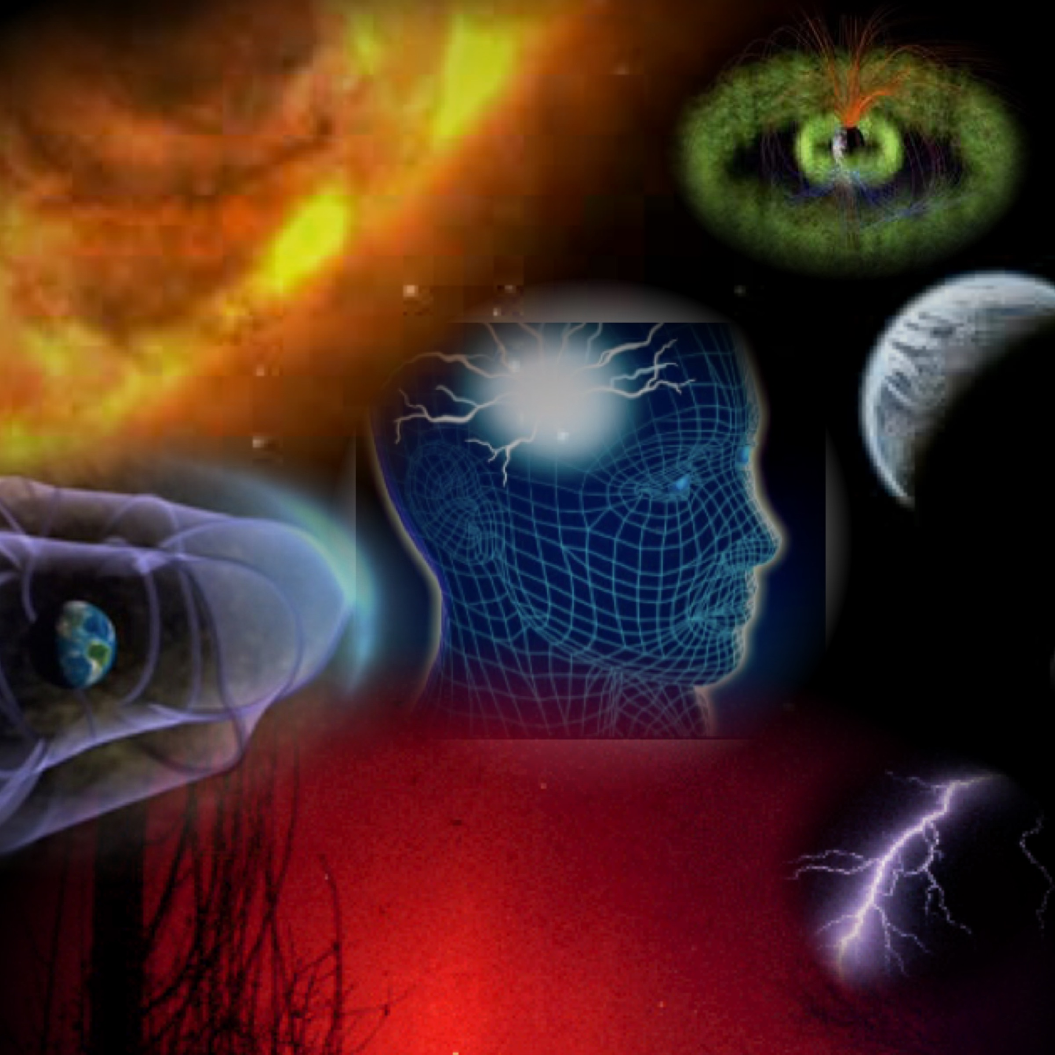
"NASA and NSF together should create science centers to tackle the key science problems of solar and space physics that require multidisciplinary teams of theorists, observers, modelers, and computer scientists.”
- 2013 Solar and Space Physics Decadal Survey
Implemented as a component of the Grand Challenges Research program. However, elements in the centers relevant to SWAP, may be supplemented with space weather funds.
Relationship between LWS and HPD Centers
The R2O-O2R centers called for by SWORM are a separate program element not led by NASA.
A solicitation for a tri-agency 1-year O2R pilot will appear soon.
Moving forward on the most compelling science questions in Heliophysics

Slide 34
Expected NASA Drive Center Funding in Grand Challenges Research (GCR) program
2017
2018
2019
2020
$2M
$4M
$6M
$8M
**First DRIVE Center solicitation has shifted to early 2018. Funding profile may be adjusted from that shown here.
Out-year funds are expected to be flat at $8M/yr
NRC Decadal Survey recommends center budgets of $2-3M/yr over 4-6 years. Renewals?
Concept is to have multiple DRIVE centers in existence at any given time
May augment with space weather funding if there is a strong R2O center component
Modest NSF contribution still TBD with delayed start.

Slide 35
Anticipated Timeline for DRIVE Center Program Implementation & Solicitation
Gathering Inputs
CSSP HSC Report, 2017
RFIs deadline 9/5/17 – THANK YOU to those who submitted RFIs
Solicitation
Internal NASA approval process
Ammendment to ROSES-18
Full Proposals Due
Dec 2017
Dec 2017
Feb 2018
March 2018
May 2018
Develop Program
NASA HPD creates draft program
Discussions with NSF
LWS Town Hall
Step 1 proposals due

Slide 36
SWOT Analysis
Information guiding DRIVE Center planning
35 RFIs: 7 proprietary & confidential, 16 discuss specific center ideas, 4 suggest strong R2O/O2R components. Will not discuss specific RFIs
RFIs
NRC,
CSSP
NRC Decadal Survey [2013]; NRC Science of Team Science [2015]; CSSP Report on DRIVE Center Implementation [2017]; NSF Portfolio Review [2016]
Centers for Chemical Innovation (CCI) – now 15 centers
Phase I = $1.8M over 3 yrs; Phase II = $4M/yr, 5 yrs
Materials Research Science & Eng Ctrs (MRSEC)– now 23
$2.2-4M/yr for up to 6 yrs
Science & Technology Centers (STC)– now 12
$4M/yr for 5 years with a possible renewal for 5 yrs
Physics Frontier Centers (PFC) – now 11
$1-5M/yr for 5 years with potentially one renewal
NSF
Centers
* In 2005, 200 centers, $350 M/yr (7% NSF budget)
NASA
Center
The NASA Astrobiology Institute (NAI) – Virtual institute managed at AMES has 12 teams, 600 researchers, 100 institutions
Each team funded at $1M/yr for 5 yrs, can recompete

Slide 37
Issues raised about DRIVE Center Implementation
Pre-Center Phase?
Increased compu-tational demand
O2R-R2O component?
Cost & Lifetime?
Proposal Evaluation?
Consider O2R-R2O compo-nent? Shared funding with LWS space weather ele-ment or other agencies?
What should be # of co-existing Centers? Budget & center lifetime? Program funding profile needed?
Use 2-Phase center model (example CCI)? Minimize cost & duplication between Centers with shared resourc-es model (ex: MRSEC)?
How to address the increased computational demands generated by multiple centers?
Adopt reverse site-visit model (ex: CCI, MRSEC, PFC) or site-visit model (ex: STC) for proposal review? What are program-specific review criteria?
The Human Element
Dominantly face-to-face or virtual? How to support deep knowledge integration & efficient communication?
Post Award Evaluation
Post-award reviews? Metrics for success?
Notes:
Centers for Chemical Innovation (CCI) – now 15 centers
Phase I = $1.8M over 3 yrs; Phase II = $4M/yr, 5 yrs
Materials Research Science & Eng Ctrs (MRSEC)– now 23
$2.2-4M/yr for up to 6 yrs
Science & Technology Centers (STC)– now 12
$4M/yr for 5 years with a possible renewal for 5 yrs
Physics Frontier Centers (PFC) – now 11
$1-5M/yr for 5 years with potentially one renewal

Slide 38
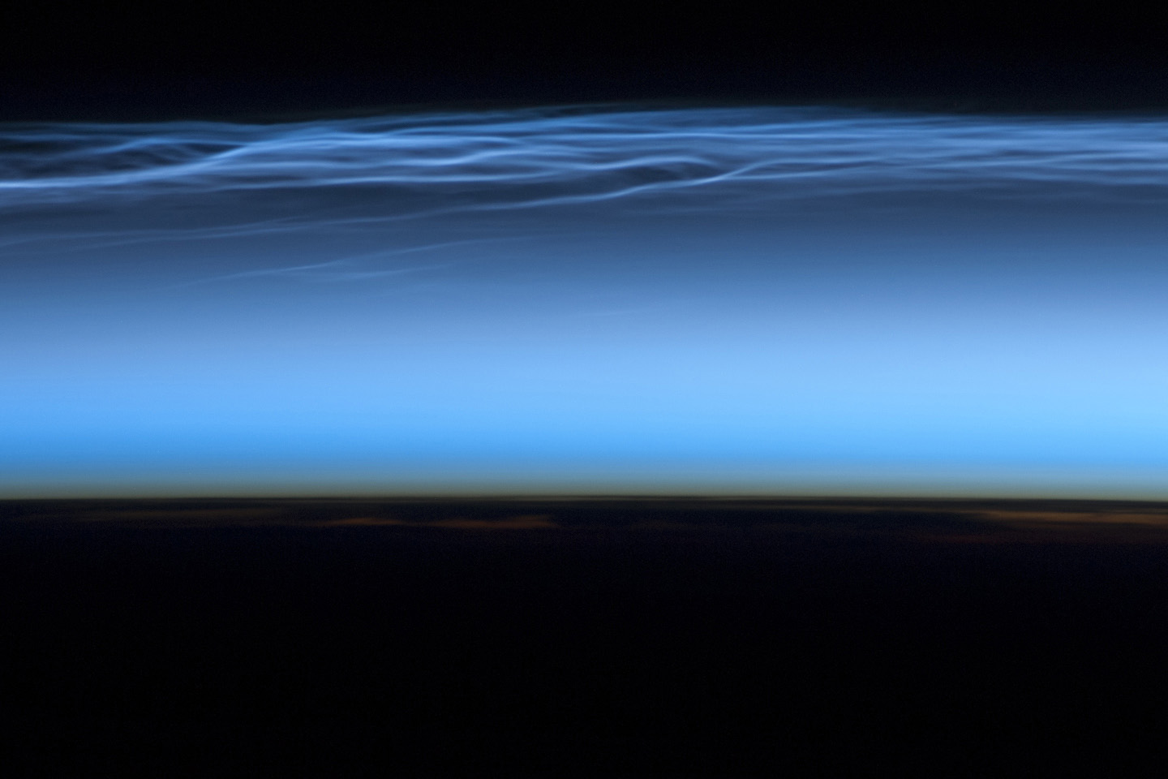
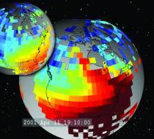
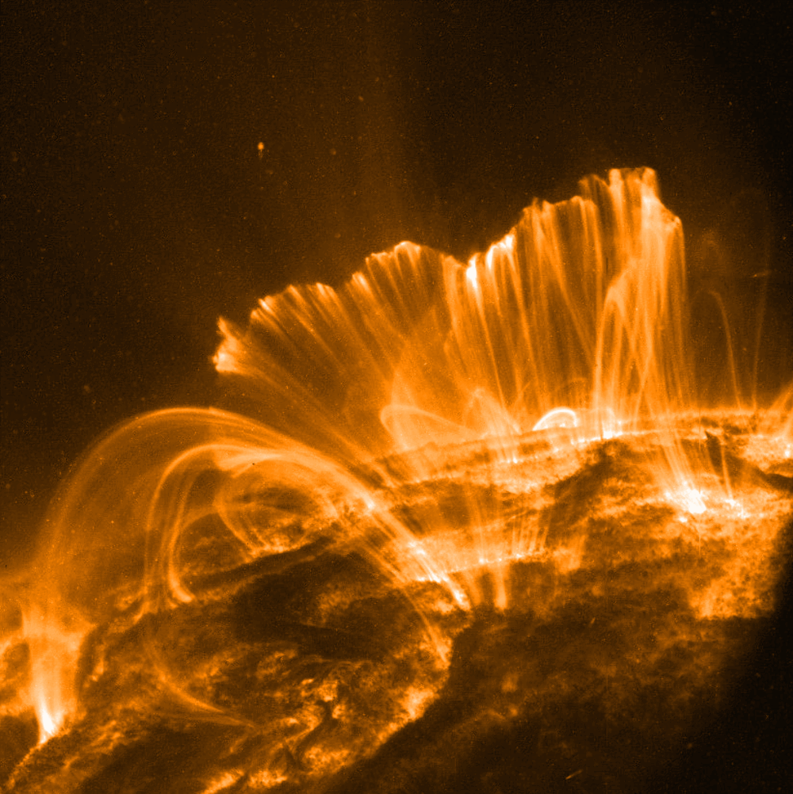
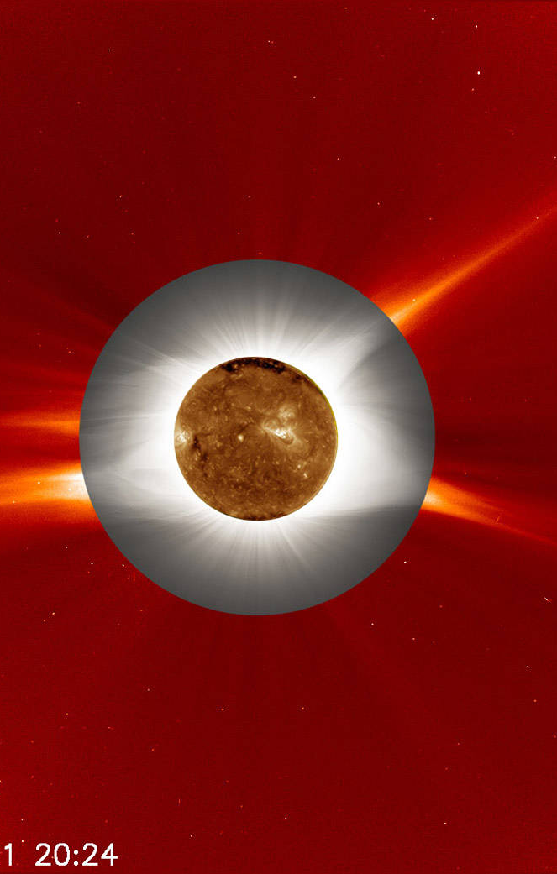
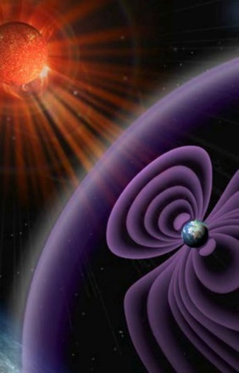
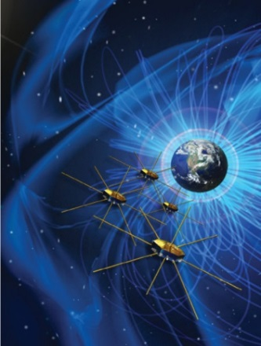
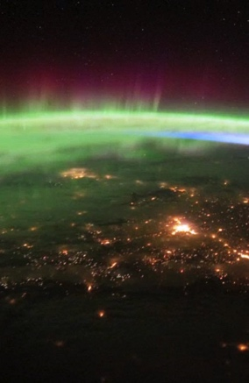
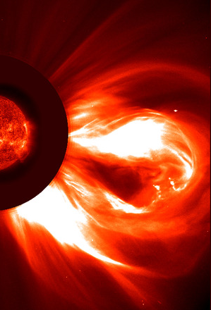
NASA-NSF Partnership for Collaborative Space Weather Modeling (2013-2018)
LWS Strategic Capabilities
Assimilative global IT electrodynamics
Schunk (USU)
What’s next? Future plans being discussed by LPAG and with NSF
Flux emer-gence & transport
Mansour (Ames)
Global Coronal Model
Fisher (UC Berkeley)
Modeling of flares, CMEs, & IP impacts
Antiochos (GSFC)
Real-time space weather fore-casting
Odstrcil (GSFC)
Energetic particle acceleration modules
Schwandron (UNH)
Kinetic effects in global MHD models
Bhattachar-jee (Princeton)
Thermo-sphere Ionosphere storm forecasts
Mannucci (JPL)

Slide 39
LWS Synergies
NSF-NASA “Computational Aspects of Space Weather”
3 -Year Grants (FY18-20)
~ $2M/YR from LWS Science
Final language under review. Cooperation on: CCMC, LWS Stra-tegic Capabilities, and Science Centers
Joint R2O modeling.
Approved 18 May
Tri-agency (NASA/NSF/NOAA) O2R pilot in development
NSF-NASA MOU
NOAA-NASA MOU
Targeted Modeling Research and Development
Fundament-al
Research
CCMC
SWPC
(& 557th Weather Wing)
Operational Models
LWS
Focus Science Teams
LWS
Strategic Capabilities
Most recently Europe (L5), Japan (NGSPM), Korea (SW model, rocket), India (L1, SW modeling)
RFI closed 9/5
35 responses. Solicitation in early FY18
DRIVE
Science Centers
International
Contributions/Partnerships
Notes:
CCMC
Leverage current capability to:
Bring-in the best space weather modeling & data products
Define and implement internationally recognized metrics for evaluation
Leverage expertise, access to information
Enables:
Agile responses to new requirements
Rapid implementation & evaluation of newly emerging techniques
An access portal to simulation results and observations

Slide 40
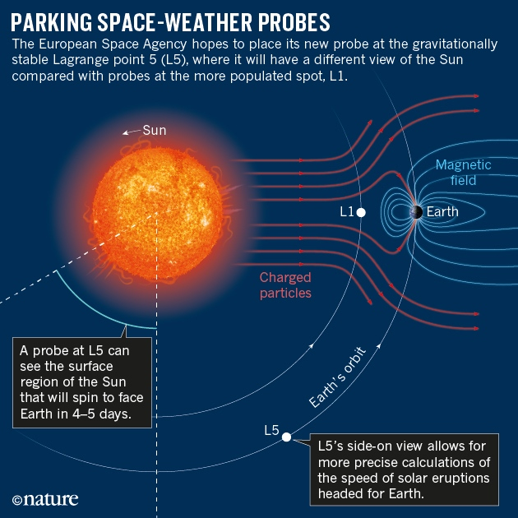
LWS & International Collaborations
L5 Mission - Europe
Next Generation Solar Physics Mission (NGSPM)
Agreement among NASA, JAXA and ESA for the study of a possible multi-lateral solar physics mission concept.
Aditya - L1 First Indian mission to study the Sun
launch during 2019 – 2020 timeframe
6 experiments
observations of Sun's Photosphere (soft and hard X-ray), Chromosphere (UV) and corona (Visible and NIR). In addition, particle payloads will study the particle flux emanating from the Sun and reaching the L1 orbit, and the magnetometer payload will measure the variation in magnetic field strength at the halo orbit around L1.

Slide 41
LWS Town Hall Agenda Wed, Dec 13, 0630-0845 pm
Item | Time | Agenda Item | Presenter
1 | 0630 | Welcome | Peg Luce/Elsayed Talaat
2 | 0635 | LWS Status | Jeff Morrill
3 | 0645 | GDC Status | Jared Leisner
4 | 0655 | LWS Activities | Lika Guhathakurta
5 | 0710 | Science Centers, SWAP, LWS | Janet Kozyra
6 | 0725 | Why LPAG | Jeff Morrill
7 | 0735 | Future LPAG Activities | Eftyhia Zesta/Mark Linton
8 | 0750 | FST: Interplanetary Structures & Radiation Belts | Mei-Ching Fok
9 | 0805 | FST: RAISE | Stan Solomon
10 | 0820 | Open Discussion | All
11 | 0845 | ADJOURN

Slide 42
LPAG - LWS Program Analysis Group
FACA Committee vs Program Analysis Group.
Several SMD committees were required to be reformed as FACA (Federal Advisory Committee Act) committees.
HPAC (Heliophysics Advisory Committee)
Senior Review
STDTs (e.g GDC)
Public meeting announcements 30 days in advance
Requires members become Special Government Employees.
Ethics training
Financial disclosure forms
After numerous discussions with Lawyers and SMD Staff, LWS Steering Committee activities were considered to be closer to Program Analysis Groups used by other Divisions in SMD.
LWS Program Analysis Group was developed.

Slide 43
New LWS Community Input Structure
LWS Program Analysis Group (LPAG).
Interdisciplinary forum for soliciting & coordinating community input in support of LWS objectives.
Widely used by other Divisions in SMD and current format is nearly identical to other SMD PAGs.
Two LPAG Co-Chairs and an LPAG Executive Committee (EC) – organize meetings, collect & summarize community input, prepare reports to HPD Director & LWS staff.
The full LPAG consists of all members of the community who participate in the open meetings.
A list of candidates for LPAG membership provided to Co-Chairs. Selections made by Co-Chairs w/ support of LWS staff.
Membership for 3 years with ~ 1/3 rotation each year. Membership includes NSF, NOAA, DoD as ex officio members.
Terms of Reference (TOR) define LPAG activities which are very similar to LWS Steering Committee. TOR on LWS website.

Slide 44
LWS Town Hall Agenda Wed, Dec 13, 0630-0845 pm
Item | Time | Agenda Item | Presenter
1 | 0630 | Welcome | Peg Luce/Elsayed Talaat
2 | 0635 | LWS Status | Jeff Morrill
3 | 0645 | GDC Status | Jared Leisner
4 | 0655 | LWS Activities | Lika Guhathakurta
5 | 0710 | Science Centers, SWAP, LWS | Janet Kozyra
6 | 0725 | Why LPAG | Jeff Morrill
7 | 0735 | Future LPAG Activities | Eftyhia Zesta/Mark Linton
8 | 0750 | FST: Interplanetary Structures & Radiation Belts | Mei-Ching Fok
9 | 0805 | FST: RAISE | Stan Solomon
10 | 0820 | Open Discussion | All
11 | 0845 | ADJOURN

Slide 45
Living with a Star
Program Analysis Group (LPAG)
Co-Chairs:
Eftyhia Zesta (NASA Goddard Space Flight Center, GSFC)
Mark Linton (Naval Research Laboratory, NRL)
Members: TBD
Liaison Members: TBD
LWS Program Ex Officio:
Elsayed Talaat, LWS Chief Scientist (NASA Headquarters, HQ)
Jeff Morrill, LWS Program Scientist (NASA HQ)
Janet Kozyra, LWS Science Lead (NASA HQ)
Shing Fung, LWS Website Manager (NASA GSFC)

Slide 46
Development of TR&T Science Topics
Procedure for soliciting and obtaining community input for science topics, and for then developing these science topics:
Early 2018:
First LPAG meeting.
Call for community input to TR&T science topics (6 weeks).
Online town hall to discuss call for community input.
Spring 2018:
Draft science topics at second LPAG meeting.
Release draft science topics for community input.
Summer 2018
6 week community comment period for draft TR&T science topics.
Conference town halls for community comment on draft topics.
Finalize science topics at third LPAG meeting.

Slide 47
LWS Strategic Science Areas:
LWS TR&T science topics target the following Strategic Science Areas (SSA’s):
Physics–Based Understanding to Enable Forecasting of
SSA-0: Solar electromagnetic, energetic particle, and plasma outputs driving the solar system environment and inputs to Earth’s atmosphere
SSA-1: Geomagnetic Variability
SSA-2: Satellite Drag
SSA-3: Solar Energetic Particles
SSA-4: Total Electron Content (TEC)
SSA-5: Ionospheric Scintillation
SSA-6: Radiation Environment

Slide 48
Solicitation of community input
to TR&T science topics:
Early 2018:
Announce call for community input to science topics through Space Physics and Aeronomy newsletter, Solar News, and other newsletters and e-mail lists every 2 weeks for a 6 week input period.
Summarize and discuss call for input in online town hall, develop flyer for distribution.
Release the suggested science topics online as they are submitted, without submitter identifying information. Include a comment box. Archive input and discussion.

Slide 49
Draft science topics at second LPAG meeting:
Spring 2018:
At its second meeting, following the 6 week input period, the LPAG develops draft science topics based on the community input received and based on the established LWS TR&T Strategic Science Areas.
2016: 57 topics submitted online.
In future years, in addition to the process outlined above, seek science topic input via:
➢ Final write-up of LWS institutes.
➢ Town hall and science discussion sessions at conferences.
➢ Final write-up of LWS science teams.

Slide 50
Solicit community comment on draft TR&T science topics:
Summer 2018:
Release (online) these draft science topics to the community for a comment period of at least 6 weeks.
During this comment period, present these draft science topics via town halls at SPD, CEDAR/GEM & SHINE, and via SPA Newsletter and Solar News.
Finalize science topics at third LPAG meeting:
Summer 2018: At its third meeting, following this comment period, the LPAG finalizes the TR&T science topics and compiles the LPAG annual report, incorporating community feedback on the previously released draft science topics.
2016 annual report: 15 science topics

Slide 51
Other LPAG Activities for 2018:
Metrics for Evaluating Progress Towards Achieving
LWS-TR&T Goals
The LPAG plans to develop metrics for NASA’s evaluation of scientific progress in SSA-oriented research.
Strategic Capabilities for ROSES 2018
The LPAG plans to discuss Strategic Capabilities for ROSES 2018.

Slide 52
2003 LWS Science Definition Team (SDT) Report: Strategic Capabilities
Section 4.5 Strategic Capabilities:
“A primary goal of the LWS Program should be the development of first-principles-based predictive and specification models for the coupled Sun-Earth system…
The development of such models for all the components of the Sun-to-Earth system and the larger efforts that combine the components into a global system view would clearly be of enormous benefit to LWS science….
To begin the process of developing and integrating components of the Sun-Earth chain, the SDT has identified these components and their integration as strategic capabilities that are critical for the TR&T program. “

Slide 53
LWS Town Hall Agenda Wed, Dec 13, 0630-0845 pm
Item | Time | Agenda Item | Presenter
1 | 0630 | Welcome | Peg Luce/Elsayed Talaat
2 | 0635 | LWS Status | Jeff Morrill
3 | 0645 | GDC Status | Jared Leisner
4 | 0655 | LWS Activities | Lika Guhathakurta
5 | 0710 | Science Centers, SWAP, LWS | Janet Kozyra
6 | 0725 | Why LPAG | Jeff Morrill
7 | 0735 | Future LPAG Activities | Eftyhia Zesta/Mark Linton
8 | 0750 | FST: Interplanetary Structures & Radiation Belts | Mei-Ching Fok
9 | 0805 | FST: RAISE | Stan Solomon
10 | 0820 | Open Discussion | All
11 | 0845 | ADJOURN

Slide 54
LWS Town Hall – FST # 1
Add FST # 1 Slides

Slide 55
LWS Town Hall Agenda Wed, Dec 13, 0630-0845 pm
Item | Time | Agenda Item | Presenter
1 | 0630 | Welcome | Peg Luce/Elsayed Talaat
2 | 0635 | LWS Status | Jeff Morrill
3 | 0645 | GDC Status | Jared Leisner
4 | 0655 | LWS Activities | Lika Guhathakurta
5 | 0710 | Science Centers, SWAP, LWS | Janet Kozyra
6 | 0725 | Why LPAG | Jeff Morrill
7 | 0735 | Future LPAG Activities | Eftyhia Zesta/Mark Linton
8 | 0745 | FST: Interplanetary Structures & Radiation Belts | Mei-Ching Fok
9 | 0805 | FST: RAISE | Stan Solomon
10 | 0820 | Open Discussion | All
11 | 0845 | ADJOURN

Slide 56
LWS Town Hall – FST # 2
Add FST # 2 Slides

Slide 57
LWS Town Hall Agenda Wed, Dec 13, 0630-0845 pm
Item | Time | Agenda Item | Presenter
1 | 0630 | Welcome | Peg Luce/Elsayed Talaat
2 | 0635 | LWS Status | Jeff Morrill
3 | 0645 | GDC Status | Jared Leisner
4 | 0655 | LWS Activities | Lika Guhathakurta
5 | 0710 | Science Centers, SWAP, LWS | Janet Kozyra
6 | 0725 | Why LPAG | Jeff Morrill
7 | 0735 | Future LPAG Activities | Eftyhia Zesta/Mark Linton
8 | 0750 | FST: Interplanetary Structures & Radiation Belts | Mei-Ching Fok
9 | 0805 | FST: RAISE | Stan Solomon
10 | 0820 | Open Discussion | All
11 | 0845 | ADJOURN

Slide 58
Thank you.

Slide 59
LWS Town Hall Welcome
Welcome to the LWS Town Hall
The Heliophyics Division is strongly committed to the further success of the LWS Program through the Flight Programs, Focus Science Topics, Strategic Capabilities, and other aspects of LWS.
Despite delays caused by restructuring of the various committees we look forward to progress now that many of these challenges have been overcome. This includes changes to the LWS Steering Committee and the GDC STDT.
We are excited by opportunities to contribute through LWS to accelerate efforts in support of the SWAP and national preparedness.
Thank you for attending and we look forward to your inputs and participation.

Slide 60
LWS Town Hall Welcome
Elsayed’s Welcome Talking Points

